Slide 1
Finance & Auxiliary Services Town Hall
8/26/25
Scott Bitner, VP Finance & Auxiliary Services
Deputy CFO

Slide 2
Agenda
Real Estate Planning & Space Management (25)
Employee Recognition Awards (10)
Division Highlighted for Quarter – Central Administrative Support Services (25)
HCM Update (15)
Upcoming Events (5)
Q&A (10)
Notes:
Based o

Slide 3
Guest Organization Highlighted Real Estate Planning & Space Management (REPSM)
Luke Mowbray

Slide 4
Real Estate, Planning, and
Space Management
Luke Mowbray
Director
Lisa Crawley
Executive Assistant
Robert Grooms
Real Estate Project Manager
Maddison Wells
Facilities Planner II
*Vacant
CapitaI Projects Planner

Slide 5
About the Office
The Office of Real Estate, Planning, and Space Management (REPSM) is committed to providing capital budgeting, real estate, space management, and long-range planning service to the UMB community. Responsibilities Include:
Campus Master Planning
Real Estate Transactions
Leases
Acquisitions
Sales/ Dispositions
Partnerships
Assorted studies/ reports
City and State Property Entitlements
State Capital Budget Requests
Capital Facilities Programming
Space Needs Assessments
Space Utilization Studies
Campus Space Inventory
Move Management
Architectural Test Fitting
Historic Preservation

Slide 6
Quick Facts
UMB’s space inventory includes ~14,800 rooms
UMB currently holds 30 leases as both landlord and tenant
UMB’s owns 54 buildings measuring ~6.3M SQFT, with a replacement value of ~$3.6B
UMB’s campus measures 63 acres

Slide 7
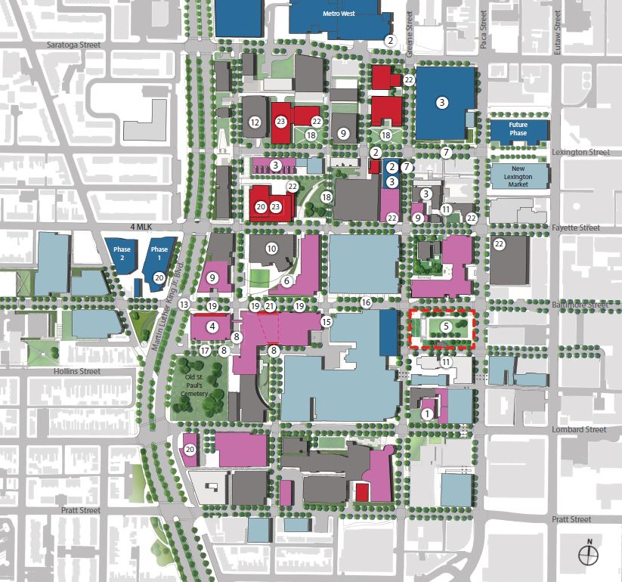
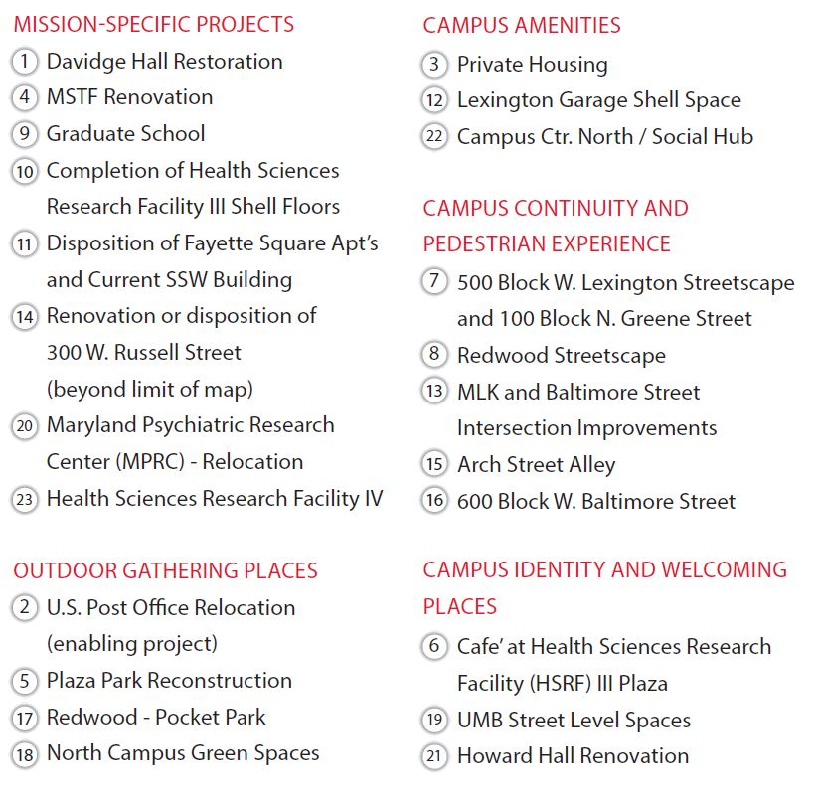
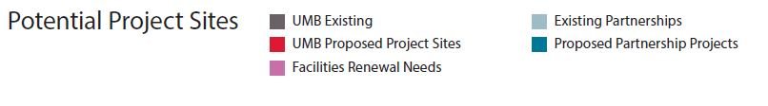
UMB FACILITIES MASTER PLAN | 2022 UPDATE – PLANNING OUTCOMES
The Proposed Plan Update

Slide 8
Capital Projects
Can include: New construction, major renovations, infrastructure improvements, and facilities maintenance
Project Costs:
Exceed $100,000 and have a useful life expectancy of at least 10 years.
Can include land acquisition, design, construction, and movable or fixed furniture and equipment
Must demonstrate a need for a specific type of space or compelling deferred maintenance need identified in the institution’s facilities master plan (FMP)

Slide 9
Sources of Capital
The State’s Capital Improvement Program (CIP)
Large projects such as the New School of Social Work
GO Bonds, MD Consolidated Capital Bond Loan Program (MCCBL), PAYGO, NBF (campus funds)
Projects must be in the campus Facilities Master Plan
DBM MUST approve Part 1 & 2 Facilities Programs prior to spending
Capital Facilities Renewal Program (CFR)
Academic Revenue Bonds and PAYGO
USM allots a prorated share from single fund based upon a campus’ total replacement value and their annual spending on DM (UMB FY ‘24 Allocation = $4.912M)
System Funded Construction Program (SFCP)
Auxiliary operations (parking, student housing, etc.)
Campus funded projects from $1M and up

Slide 10
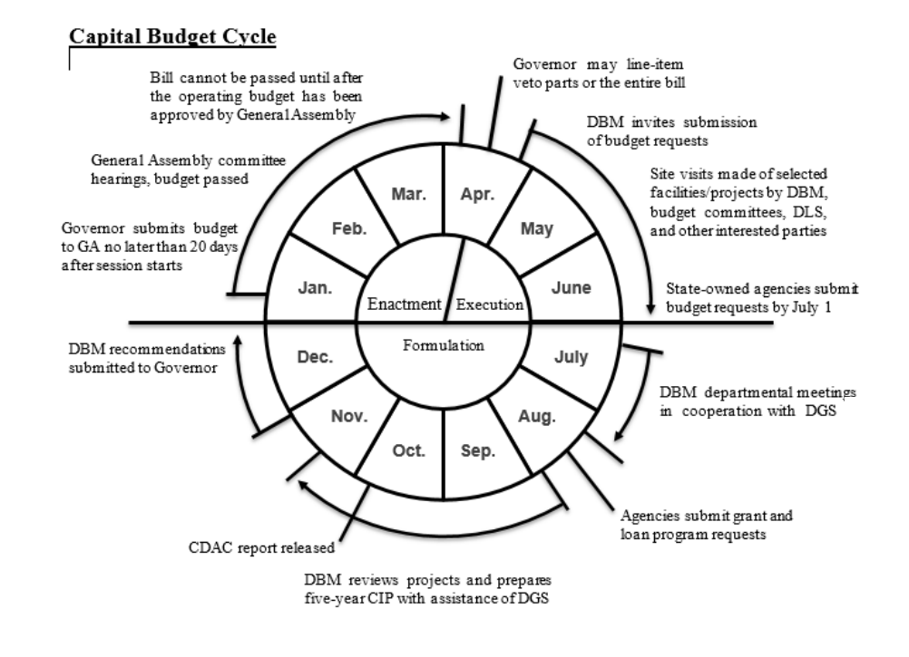

Slide 11
Currently Funded CIP Projects
New School of Social Work: $125.262M
Entirely Bond Funded
Central Electric Substation and Electrical Infrastructure: $75.09M
Bonds and State General Funds: $71.57M; UMB Funding: $3M
Dental Ambulatory Surgery Center: $10.08M
Bonds: $3.2M; School Funding: $6.88M

Slide 12
Unfunded CIP Requests
Maryland Psychiatric Research Center (MPRC): $TBD
Part 1 Facilties Program being developed
Plaza Park Renovations: $23.53M
Part 1 & 2 Facilities Programs Submitted

Slide 13
Recent Notable Real Estate Transactions
Sale of Fayette Square
Swap agreement for the current Lodge and Former Ronald McDonald House
MOU allowing for the demolition of 613 West Lexington Street
Lease of Space in 4 MLK
Expiration of leases in BioPark 1
Lease for Institute for Health Computing
Leases for temporary Strategic Operation Center (SOC)

Slide 14
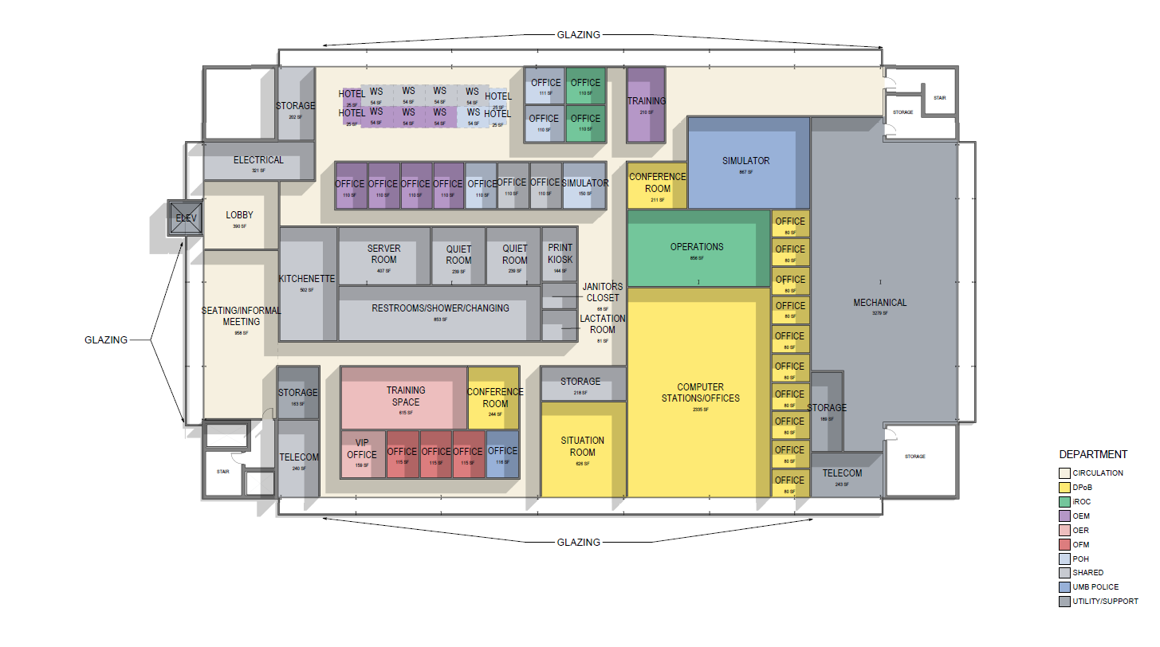
Downtown Partnership of Baltimore (DPOB)
Strategic Operations Center (SOC)
*CONCEPT FLOORPLAN FOR 10th FLOOR OF LEXINGTON GARAGE

Slide 15
Campus Vibrancy
North Campus Master Developer RFP
Sidewalk replacement along the 500 block of West Lexington Street
Post Office Negotiations
Campus Environment Committee

Slide 16
Background: UMB Master Developer RFP
WHY:
Campus feedback during the 2022 Facilities Master Plan and current Campus Vibrancy Project activities are strongly supportive of the redevelopment of underutilized parcels and an increase in neighborhood housing and amenities.
An RFP issued December 2023 for a smaller assemblage of properties received limited responses. Potential respondents indicated a larger scale was needed to create interest.
Neighborhood housing complexes are routinely between 90-95% occupancy but developers are slow to invest based upon perceived risks.
INTENT:
Engage a Master Developer to organize the redevelopment of up to 5 unimproved UMB owned sites and the Pascault Row housing complex for redevelopment.
Developer to be responsible for the planning, design, and construction along with the assembly/ management of the development team and financing.
Notes:
Luke Slide- Unedited

Slide 17
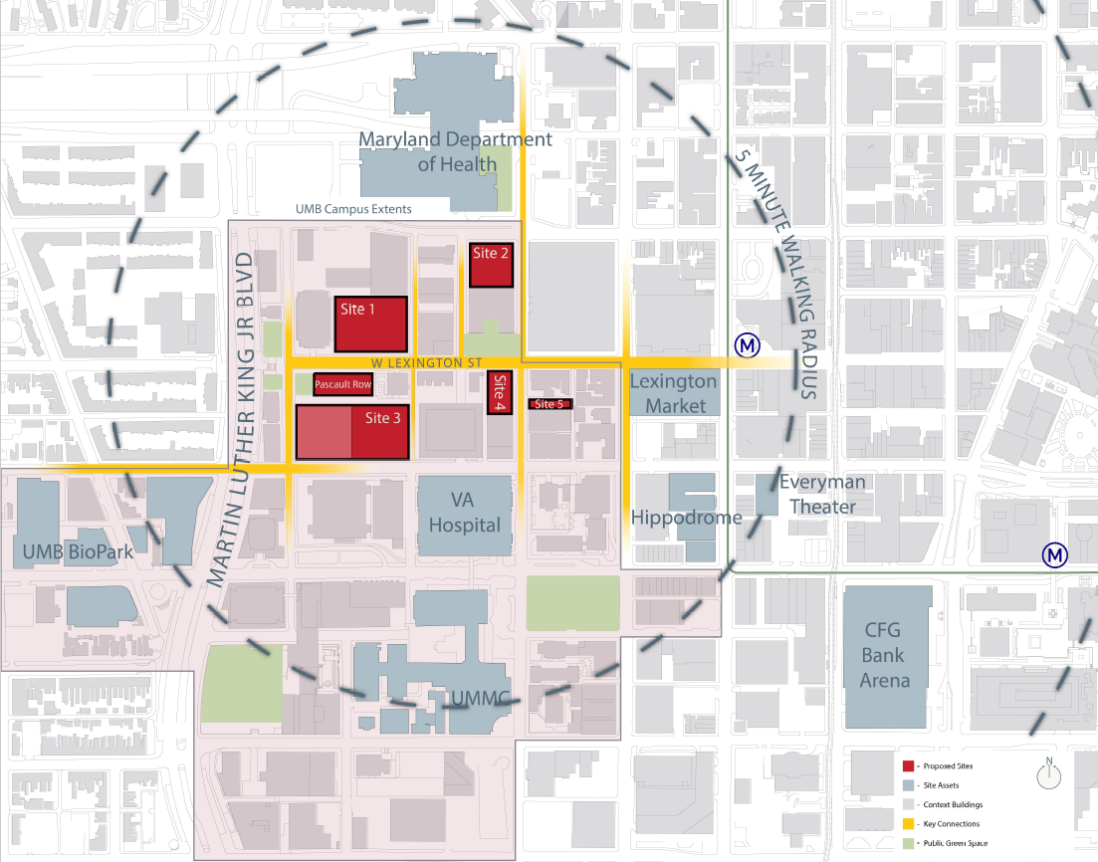
North Campus Redevelopment Sites in RFP
Notes:
Luke Slide

Slide 18
North Campus Development Progress
Issued RFP (Nov 2024) for the redevelopment of:
Five UMB-owned infill sites and the Pascault Row student housing complex
Received six competitive responses
Shortlisted and interviewed four firms in March 2025:
Selected top-ranked respondent in May 2025
Entered exclusive negotiations with for Lexington Street Corridor redevelopment
Pre-development phase officially launched in June 2025
Notes:
Jordann Slide

Slide 19
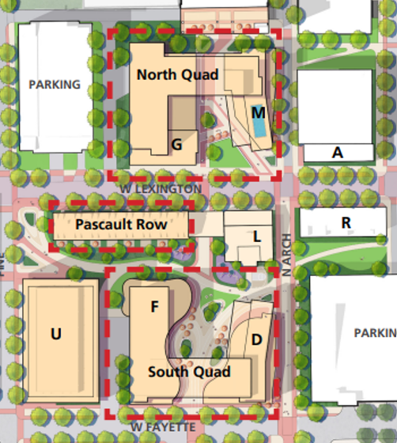
North Campus Development Progress
Ground lease of campus land to enable the construction of 2 new apartment buildings on the north campus
New apartment buildings to include ~1,150 beds and ground floor retail
Long term lease of Pascault Row followed by substantial renovations
Improvements to sidewalks and public infrastructure
DETAILS STILL UNDER NEGOTIATION
19

Slide 20
North Campus Development Next Steps
Continue term sheet negotiations
Begin due diligence and background studies
Draft ground lease/ master developer agreements
Seek BOR approval for ground lease/ sale of subject properties
Begin public infrastructure work and entitlements/ design for apartment construction
Target Construction Period October ‘26 to July ‘28
Opening for Fall ‘28 Semester

Slide 21
Questions?

Slide 22
Employee Recognition
Period Ending June 2025

Slide 23
Service Excellence (period ending June 30, 2025) Committee: Theresa Spindle, Elizabeth Main, Elisa Medina & Priti Wakefield
Awardee:
Richard Elliott
Notes:
Comments shared about Richard by Service Dimension:
Knowledge - Rich's area of expertise lies in the hundreds of Consultant Agreements and Purchase Orders he processes day in and day out for the UMB community. This specialized knowledge enables Rich to perform at a high level of Customer Service Excellence that is appreciated by all departments and stakeholders.
Process Improvement - Rich processes more Purchase Orders than any other procurement professional within SSAS, and offers suggestions on making the Purchase Order process even more efficient.
Attitude - Rich displays a confident and humble attitude and represents SSAS, A&F and UMB in a positive light.
Communication – Rich communicates effectively and diligently with end-users, stakeholders and vendors and conveys a willingness to collaborate in order to achieve the greatest outcome for everyone involved.
Ownership/Accountability - When Rich makes an error, he accepts full accountability and works with the vendor and or end-users to solve the issue in a productive and cohesive manner. He always rises to the occasion with any emergency or rush procurements.

Slide 24
Core Value Award (period ending June 30, 2025)
Awardee:
Shelby Ronco – Respect & Integrity
Notes:
Shelby Ronco is the warm and welcoming face at the University Cashier window. Known for
her friendly demeanor and exceptional customer service, Shelby creates a positive
experience for every customer across the campus community.
As operations have shifted, Shelby has embraced change and taken on increased
responsibilities of the General Working Fund check distribution with ease and
professionalism. Her adaptability, teamwork, and positive presence make her a valuable
asset to the student population, campus departments, and UMB as a whole.
She consistently treats everyone with dignity and respect, creating a positive experience
where all feel valued and supported. Shelby maintains professionalism even in challenging
situations and has shown impressive personal and professional growth. Shelby exemplifies
the values of respect, integrity, adaptability, and teamwork, making her a standout
candidate for this award.

Slide 25
Employee Recognition Schedule
Core Value (Any one or multiple)
Eligibility Period: 10/31/24 – 9/30/25
Deadline For Nominations: 10/15/25
Recognition @ Nov 2025 Town Hall
Service Excellence
Eligibility Period: 10/31/24 – 9/30/25
Deadline For Nominations: 10/15/25
Recognition @ Nov 2025 Town Hall
Changes to Program
Expanding eligibility period to prior 12 months
Nominations can carry forward to following period
Group nominations can be put forward

Slide 26
Nomination Forms
Forms are on the Finance and Auxiliary Service Website https://www.umaryland.edu/finance/
Core Value Employee Recognition Nomination Form
Service Excellence Employee Recognition Nomination Form
Send completed forms with documentation to:
fas-employeerecognition@umaryland.edu

Slide 27
Division Highlighted for Quarter Central Administration Support Services- CASS John Yurich Director - Central Administration Support Services August 26, 2025

Slide 28
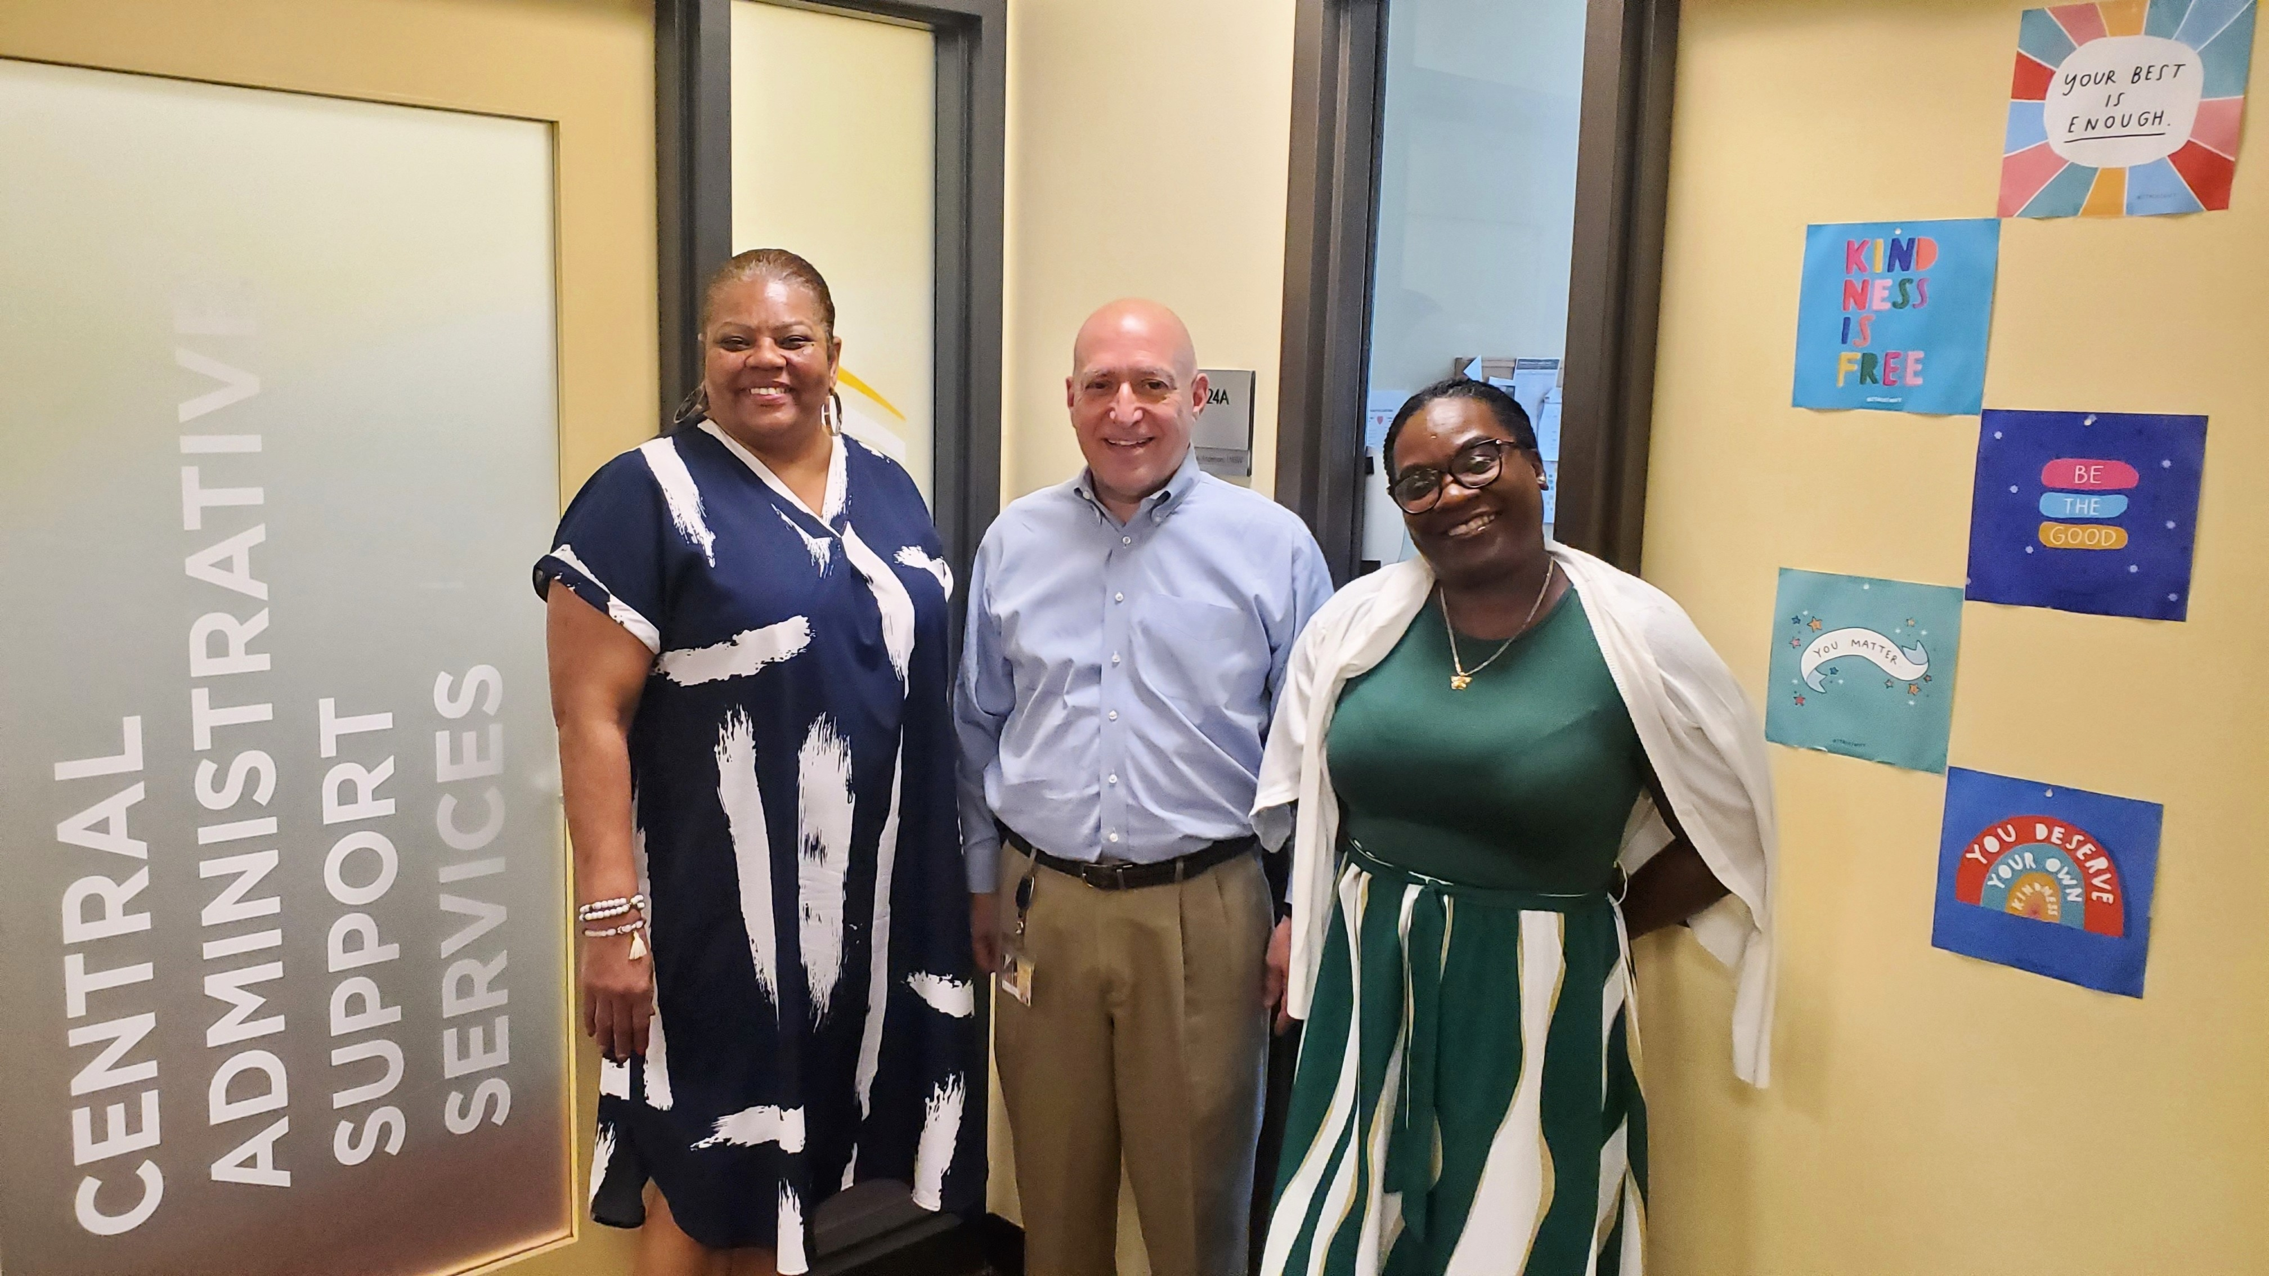
Welcome Central Administration Support Services - CASS
Lexington Building 2nd Floor Suite 2123

Slide 29
Mission Statement
We are committed to ensuring that we provide excellent customer service and communication to all of our customers as we support your department's Human Resources, Payroll and Purchasing/ Administrative requests. We strive to accomplish this as we follow the University’s Core Values and Strategic Plan.

Slide 30
Central Administration Support Services
John Yurich
Director
Central Administration Support Services
Office of Requests and Payment Support
Shelvia McGee-Chavis
Customer Support
Administrative Supervisor
Central Administration Support Services
Office of Human Resources and Payroll Services
Tanisha Burt
Director Human Resources
Central Administration Support Services
Office of Requests and Payment Support
Ashley Simon
Administrative Supervisor
Kareen Allen
Budget Analyst
Jason Ward
Human Resources Generalist
Operations & Maintenance
Environmental Services
Open Position
Currently Recruiting
Human Resources Generalist
Public Safety
Team One
Monarkie McColl
Business Operations Manager
Human Resources Services and Payroll
Team Two
Chantel Todd
Business Operations Manager
Human Resources Services and Payroll
Janell Hooks
Budget Analyst
Cherita James
Payroll Accountant
Rae Horst
Business Operations
Specialist
Melissa Flanagan
Business Operations Specialist

Slide 31
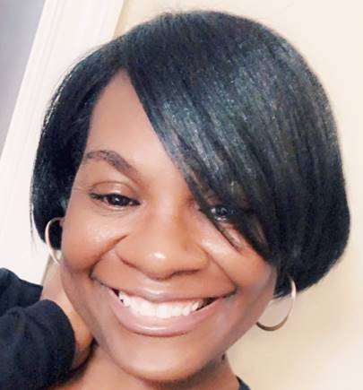

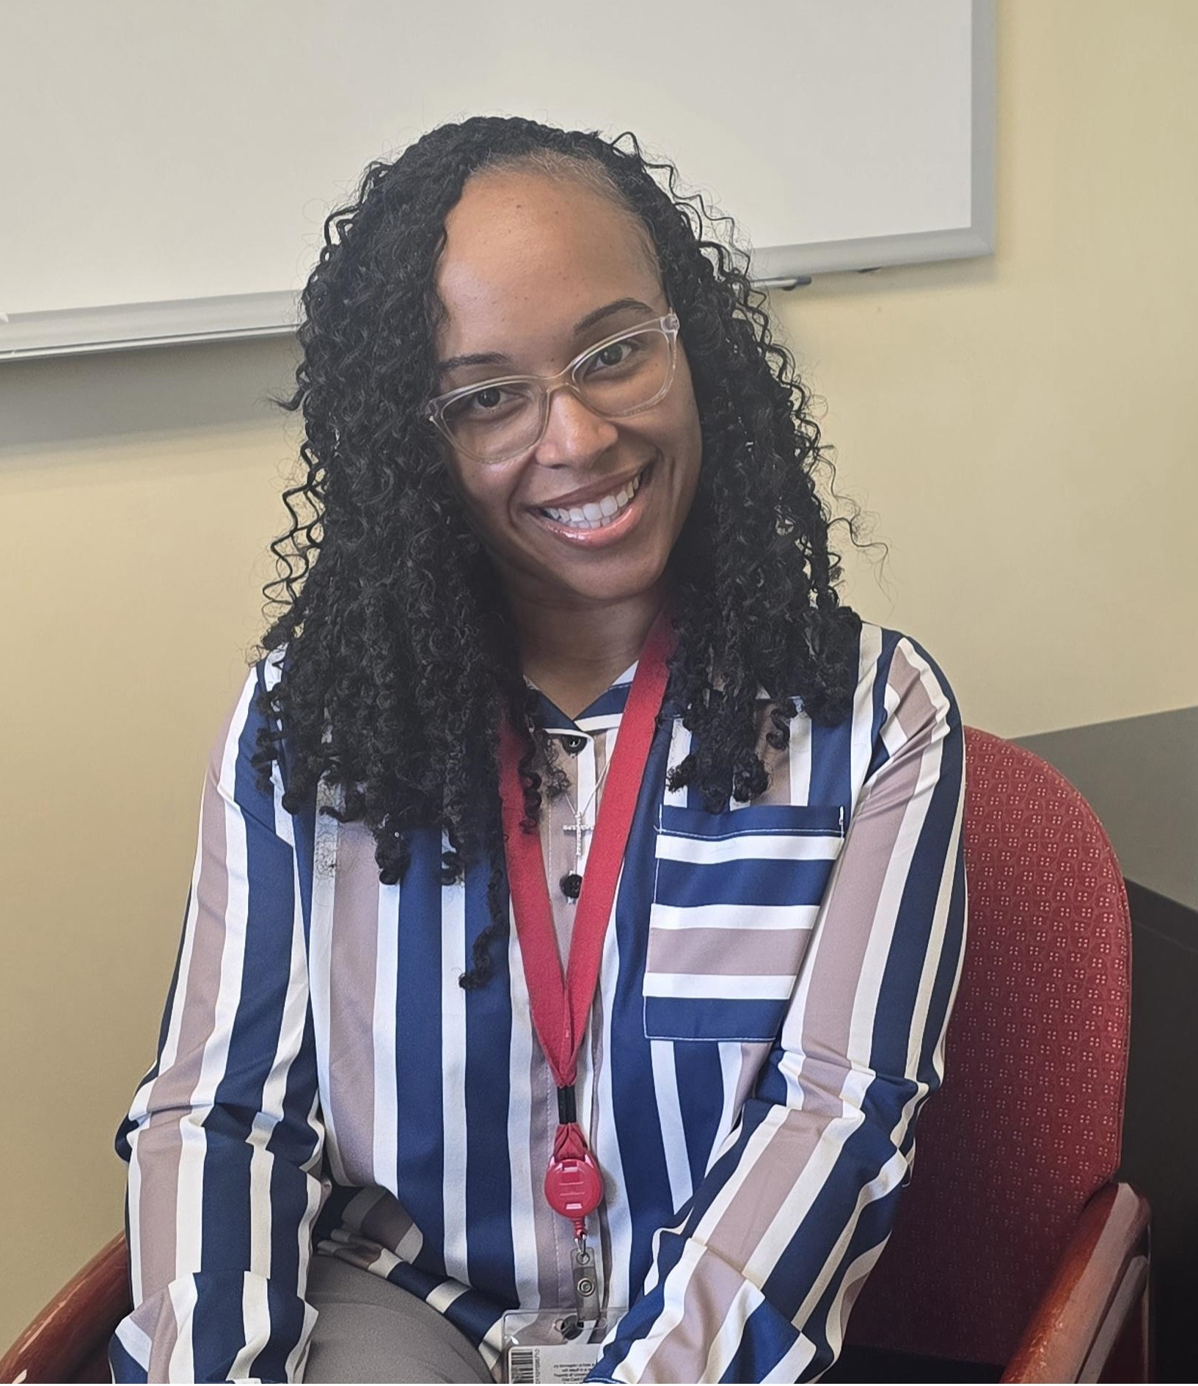

CASS Office of Human Resources and Payroll Services
HR-Payroll Team
Tanisha Burt
Director Human Resources
Monarkie McColl
Business Operations Manager Human Resources and Payroll
Chantel Todd
Business Operations Manager Human Resources and Payroll
Jason Ward
Human Resources Generalist
Operations & Maintenance
Environmental Services

Slide 32
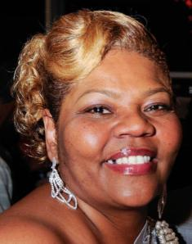
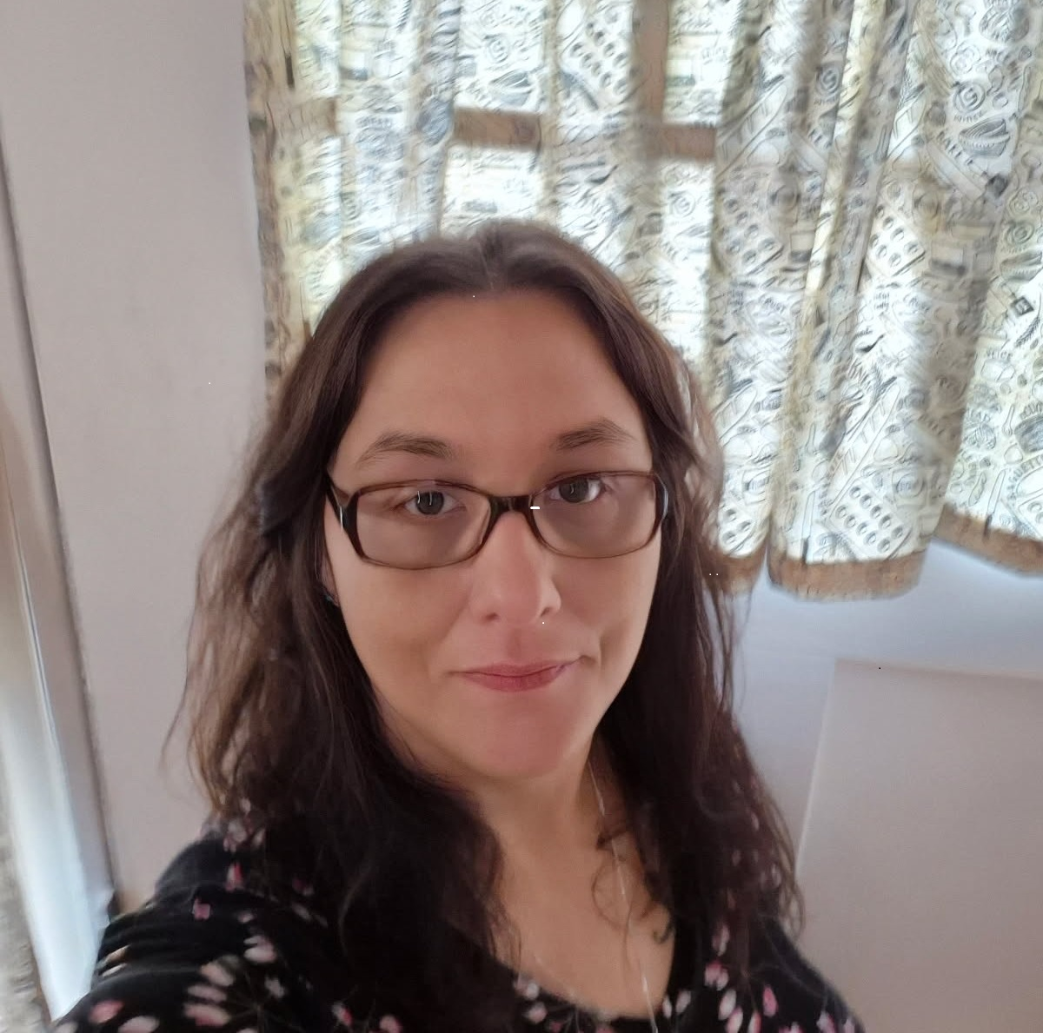

CASS Office of Human Resources and Payroll Services
HR-Payroll Team
Cherita James
Payroll Accountant
Rae Horst
Business Operations Specialist
Payroll
Melissa Flanagan
Business Operations Specialist
Payroll

Slide 33
CASS Office of Human Resources and Payroll Services
Recruitment of staff – completion of administrative processes required for new or replacement staff and processing of all paperwork.
Process employee action forms. (Example- Salary/Job Changes)
Coordinate all Employee Labor Relations actions with HR ELR.
Coordinate the on boarding process for new employees with HR and meet with employees on day two to assist in all areas as needed.
Coordinate parking for all employees. (Tanisha Burt- Parking Liasion)
Serve as the HR Partners representative for departments supported by CASS.
Serve as the Payroll Representative for departments supported by CASS.
Time and Leave (T/L) audit and approval in the system – timesheets must be approved by the employee’s supervisor before our review.
Completion of payroll forms for employee changes (e.g. payroll adjustments, etc.)

Slide 34
CASS Office of Human Resources and Payroll Services
First Stop for all Human Resources and Payroll Questions & Requests !
When in doubt……. Reach Out………. To CASS……
Office of Human Resources and Payroll Services…… ☺ ☺ ☺

Slide 35
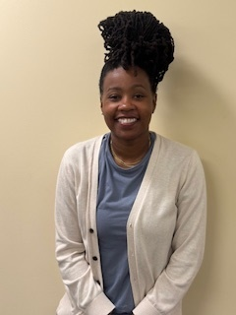
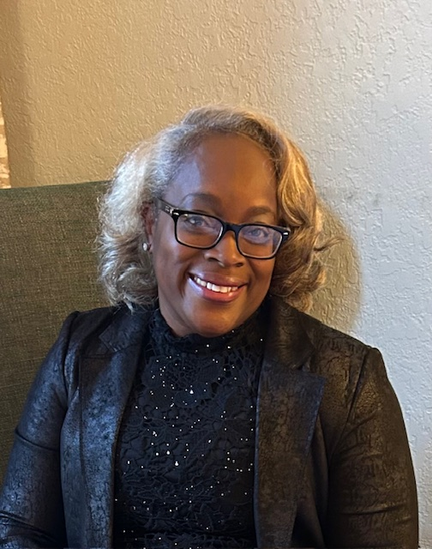

CASS Office of Requests and Payment Support
Requests and Payment Support Team
Ashley Simon
Administrative Supervisor
Kareen Allen
Budget Analyst
Janell Hooks
Budget Analyst
Shelvia McGee-Chavis
Customer Support
Administrative Supervisor

Slide 36
CASS Office of Requests and Payment Support
Financial Administration
Process vendor invoices with Accounts Payable by obtaining appropriate approval and submit in Quantum.
Complete journal entries in Quantum.
Process non-departmental billing.
Process working fund requests.
Perform account reconciliations.
Purchasing Administration
Initiate purchase requisitions.
Initiate change order requests for contracts.
Provide procurement card (Pro Card) support for departments.
Travel Administration
Concur Department Travel Admin for each department.
Provide the travel administration backup role to departments. Travel is initiated and approved within each department.

Slide 37
How well do you know CASS ?
Notes:
Kevin will take over slides

Slide 38
How many employees does CASS provide HR/Payroll support to?
350
700
1,104

Slide 39
For the 35 Departments and Offices in Administration and Finance and on the Administrative side of UMB that CASS provides service to we currently provide HR/Payroll Services to……….
C. 1,104 Employees

Slide 40
On average how many P Card purchases does CASS Make each month?
1
132
27

Slide 41
For the 35 Departments and Offices in Administration and Finance and on the Administrative side of UMB that CASS provides service to –
we average approximately…….
B. 132 Small One Time Purchases- Totaling at times over $68,000

Slide 42
How many years of combined UMB experience/service do the 12 CASS Team Members have?
10 ☹
50
149

Slide 43
Years of combined UMB experience/service the 12 CASS Team Members have…….
B. 149

Slide 44
Which CASS Team Member has the most years of UMB Service?
Cherita James
Kareen Allen
Tanisha Burt

Slide 45


CASS Team Member with the most years of UMB Service……..
A. Cherita James…… 38 Years of UMB Service!!!

Slide 46
Who is the newest UMB/CASS Team Member?
Chantel Todd
Jason Ward
Shelvia (Chevie) McGee-Chavis

Slide 47

Who is the newest UMB/CASS Team Member…..
Jason Ward…
1 year 9 months at UMB … 6 months with CASS

Slide 48
Which CASS Team Member retired from UMB and enjoyed (missed ☺) working for CASS/UMB so much that they came back as a C1 Employee?
Ashley Simon
Kareen Allen
Shelvia (Chevie) McGee-Chavis

Slide 49

CASS Team Member retired from UMB and enjoyed (missed ☺) working for CASS/UMB so much that they came back as a C1 Employee………
B. Shelvia (Chevie) McGee-Chavis

Slide 50
Last Question…………

Slide 51
Who should you go to first with all Human Resources and Payroll Questions and Requests? When in doubt……. Reach Out………. To…………. ☺ ☺ ☺
Stranger you meet in front of The Lexington Building ☹
Scott Bitner (Please do not go to Scott…. ☺……)
CASS Office of Human Resources and Payroll Services

Slide 52
Who should you go to first with all Human Resources and Payroll Questions and Requests? When in doubt……. Reach Out………. To…………. ☺ ☺ ☺
C. CASS Office of Human Resources and Payroll Services

Slide 53
Contact Information-
CASS Office of Human Resources and Payroll Services
DL-AF CASS HR-Payroll <Dl-AFCASSHR-Payroll@umaryland.edu>
CASS Office of Requests and Payment Support
CASS@umaryland.edu
Submit a CASS Service Request
Veoci- CASS Request System
To find all of this information and more regarding how we can assist you…
Please visit the CASS Website-
Central Administration Support Services - Central Administration Support Services (CASS)

Slide 54
Please visit the CASS Website- Central Administration Support Services - Central Administration Support Services (CASS) Staff Directory Services Provided Departments Supported HR/Payroll Representative and more…….
To find all of this information and more regarding how we can assist you…

Slide 55
Quantum HCM Project Updates
F&A Town Hall
August 26, 2025

Slide 56





Recap: August 12th User Fair
“It’s great that the LDX Tool is connected to Quantum One and not just an ‘informational worksheet’.”
“I feel more at ease now that I’ve heard how Compensation will work in
Quantum One!
42% of survey respondents said they first heard about Quantum One via campus communications
97% of survey respondents found the information helpful.
500+
14 Booths
14+ System Demos
“Guides as to how the system will change were most helpful!”
Attendees included:
Mobile Employees
Line Managers
HR Partners
Payroll Reps
A Deans
Deans/VPs
94% of survey respondents said they were almost ready/ready for Go-Live!
Most helpful information shared:
Absence/Time Cards
Demos/System Exposure
Payroll Processes
Training
Notes:
Speaker: Chiradeep
More than half of the 500+ attendees at the User Fair were not project participants like Change Champions, SMEs, or Trainers, which meant the awareness of the project was reaching new audiences, thus increasing the broadness of awareness that the new system is coming!
More LD-specific quotes:
“Excited that I don’t have to wait 2 weeks for the system to update with labor schedule changes!”
“Love that the % calculates in real time on the distribution lines”
“ Excited there are no more combo codes!”
“ Love that the LDX Tool shows breakdown of salary based on distributions.”
“I can do everything in one place!”

Slide 57
Topics of Interest on Campus
Top Topics of Interest:
Training → More information on training availability
System Access & Freeze → System freeze time and transition
Absence Management → Balances, requests, and visibility
Payroll & HR Processes → Integration in new system
Notes:
Speaker: Chiradeep
Absence & Leave Management → Strong interest in balances, PTO requests, and visibility
Training & Knowledge Sessions → Clear demand for more hands-on training info
Payroll & HR Processes → Concerns about integration and accuracy
System Access & Freeze → Questions about availability and transitions
Reporting & Data → Need clarity on future reporting tools
Other/General → Opportunity for broad communications

Slide 58




Quantum One Training
Will training be provided? When and how will we learn the system?
Early learning modules are available now on Percipio via the Quantum One Early Learning Channel.
Formal training sessions + self-paced training planned before Go-Live. Registration for instructor-led sessions will be done in Percipio and will be available by the first of September.
Training will be curated into a learning journey and assigned to users in Percipio based on roles determined by departments.
Access channel here: Quantum One Early Learning Channel
Notes:
Speaker: Chiradeep
Link to Early Learning Channel: https://share.percipio.com/cd/vBQeKsqqX

Slide 59

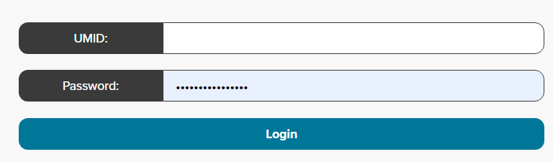
System Access & Freezes
Where will the application [Quantum One] be located for user access?
Quantum One will be accessed through the myUMB Portal.
Single sign-on for a streamlined experience
Is there a list of transactions that we cannot do in Quantum Financials during the down period?
Quantum Financials will be down during the cutover period – Saturday, October 18th – Sunday, October 26th. Items such as Purchase Requisitions, PCard Expense Reports, or Debit Memos will not be able to be completed. However, SPAC, OOTC, and SSAS will have access to completed critical, time sensitive items during this time.
Notes:
Speaker: Chiradeep
Q: Will the financial freeze affect processing setups?
A: No - we just ask that only critical, time sensitive actions be performed.
Q: Is there a list of transactions that we cannot do in QF during down period?
A: No - we just ask that only critical, time sensitive actions be performed.

Slide 60


Absence Requests and Tracking
How do we figure out who’s off in our department?
Team members and Line Managers can see their team’s schedule in Quantum One. There is an early learning module on this topic in Percipio available now. Further training will be available before Go-Live.
As a Line Manager, will I get a notification to approve time cards/absence requests?
Timecards and absence requests will be submitted through Quantum One, and Line Managers will receive notifications from the system. There is an early learning module on this topic in Percipio available now. Further training will be available before Go-Live.
Notes:
Speaker: Chiradeep
Q: What if we don’t make the time off adjustments in time?
A: Absence adjustments will be required to be made after go-live in Quantum One. If the adjustments are not made in time, additional work and a delay in accurate leave balances will occur. There is an early learning module on this topic in Percipio available now, and further training will be available in Percipio before go-live.
Q: As a manager approving time cards, will I get a notifications or reminders?
A: Timesheets will only be used by hourly employees. Time cards and absence requests will be submitted through Quantum One, and Line Managers will receive notifications upon employee submission. There is an early learning module on this topic in Percipio available now, and further training will be available in Percipio before go-live.

Slide 61



Payroll & HR Processes
What reports will be used to report salary & fringe with the PCD report going away?
The PCD report has been rebuilt to be used in Quantum One.
Will award setup be impacted and will there be any payroll impacts?
Award and Project setup will not change. There will not be any payroll impacts.
How will this mesh with UMDs payroll process?
Payroll will still be processed bi-weekly; integrations with CPB are being rebuilt for Quantum One.
Notes:
Speaker: Chiradeep
Q: What reports will be used to report salary & fringe with PCD report going away?
A: The PCD report has been rebuilt to be used in Quantum One.
Q: Setup awards- translations to payroll?
A: Award and Project setup will not change.
Q: Will this affect payroll and time reporting? What should be entered and approved during that time?
A: Timesheets for PPD 26-07 will be entered in HRMS by 10/15, Timesheets (for hourly employees) or absences (for everyone) for PPD 26-08 will need to be entered in Quantum One between 10/27 - 10/29.
Q: How this will mesh with UMDs payroll process
A: Payroll will still be processed bi-weekly; integrations with CPB are being rebuilt for the new application.
Q: How will payroll data roll into ERS? Can we expect the data to be accurate?
A:

Slide 62

Payroll & HR Processes
Will this affect payroll and time reporting? What should be entered and approved during that time?
Timesheets for PPD 26-07 will be entered in HRMS by 10/15.
Timesheets (for non-exempt/hourly employees only) or absences (for everyone) for PPD 26-08 will need to be entered in Quantum One between 10/27 - 10/29.
How will payroll data roll into ERS? Can we expect the data to be accurate?
Payroll data will flow into ERS from Quantum One. The data will be accurate and there will be audit reports to validate it.
Notes:
Speaker: Chiradeep
Notes from Glenda - If this is only related to go-live time, then the information provided is accurate. Maybe we can add that there will be no impact on payroll and time reporting, as there will be no break in either area. Employees will submit timecards for pay period 26-07 in PeopleSoft, and that payroll will be completed in PeopleSoft. Then, timesheets for pay period 26-08 will be entered into the new system, and payroll will also be run there.

Slide 63
Upcoming Events
9/11 – UMB Faculty Convocation
10/14 – A&F Chili Cookoff
10/30 – Campuswide Budget Town Hall

Slide 64
Questions ?

