Slide 1
Finance & Auxiliary Services Town Hall
5/28/25
Scott Bitner, VP Finance & Auxiliary Services
Deputy CFO

Slide 2
Agenda
International Operations (20)
Employee Recognition Awards (10)
Division Highlighted for Quarter – Budget & Financial Analysis (30)
Financial Update (10)
Upcoming Events (5)
Q&A (15)
Notes:
Based o

Slide 3
Guest Organization Highlighted
International Operations
Anna Schowengerdt

Slide 4
Introduction to International Operations
  Welcome
  UMB’s global engagement in a nutshell
  Background to IO
  Overview of each function’s support to our customers
  Q & A
Notes:
ANNA/DANIELLE

Slide 5

Did you know?
UMB’s Global Engagement Data
Awards with International aspects FY 23 – FY 25 (Quantum/Kuali data)
~146 Awards
  Top Schools – SOM and SOD
Awards with International aspects since Fy23 - $126,094,338.98
With ~50% of the awards amount paid (Up to May 2025)
International Travelers
Average number of trips by UMB students, employees, and non-employees per year: (based on Concur data)
  2023 – 829
  2024 – 685
  2025 – 218 * as of 5/20/2025
International Students
850 UMB International Students and scholars
Notes:
ANNA

Slide 6
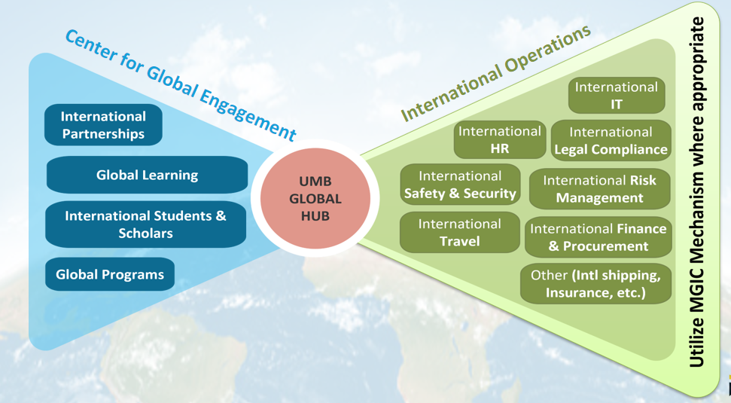
What We Do
Notes:
Danielle

Slide 7
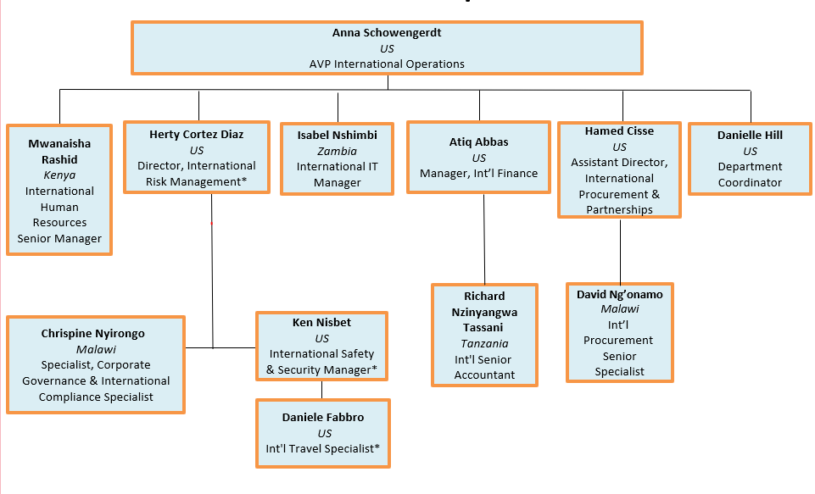
Who Are We?
Notes:
Danielle

Slide 8
Support from International Operations
Procurement
Purchasing Goods and Services from international providers
FY25 Data
  127 Procurement Actions and this involves: Service Contract, Grant Agreements, and POs
  Assisted 6 out of the 7 Schools within UMB (Ex. CGE, School of Nursing, School of Social Work, School of Medicine, IVH, etc.)
  Established a BPA in Cost Rica savings ($50 to $470 daily)
  Structure multi-year contract to respect yearly appropriation
Payment of international consultant/vendors/Honoria/Travel Advance
FY25 Data
  Service all 7 schools and divisions – totaling $1,131,508.00
  Frequent Used Account Code:
    3726 - Studies and Consultant
    4799 - Other grants
    3752 - Other Contractual
  Number of Transactions – 215
  Transaction in Over 23 Countries
    Top Locations – Costa Rica, Nigeria, UK, Canada, Mozambique
Finance
Notes:
Procurement – Hamed / David
Finance – Atiq / Richard

Slide 9
Support from International Operations
Risk Management
Assist with legal compliance / Manage risk
Engaged over 10 law and auditing firms to support the understanding of legal systems and infrastructure for UMB's business in foreign countries
IT support
International Data Protection/IT advice/Cybersecurity
Each year, IO has seen a ~40% increase in the number of ticket request since 2022
Human Resources
Long-term national staff personnel / international HR support / EOR
Currently – EOR Staff – 6 EOR Organization - 2
Division Admin
Support the department – Help manage projects, manage website, P-card, international Insurance
FY2025 – 17K Website viewers
Notes:
ALL

Slide 10
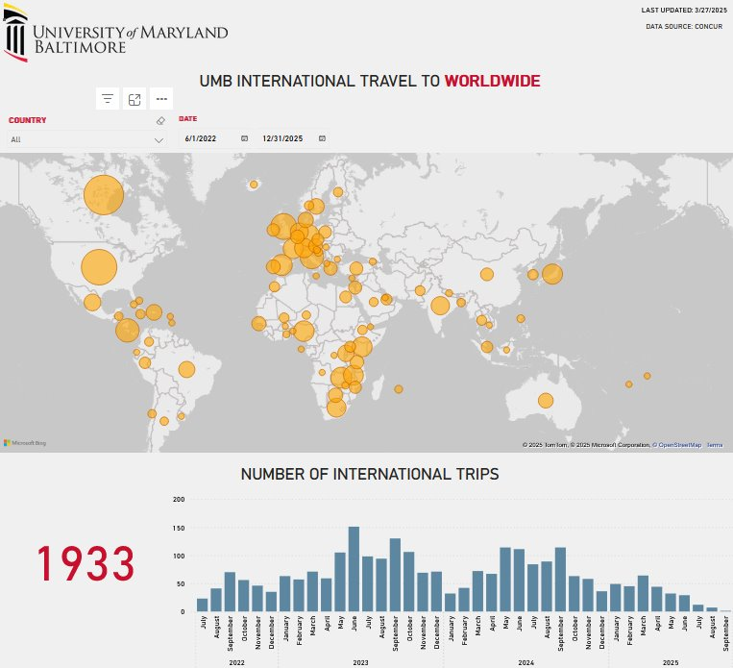
Where does UMB travel worldwide?
Support from International Operations
Travel Safety and Security
Support faculty/students/staff on travel readiness and safety
Ex: Student travel briefings, travel alerts, guidance, critical incident management
IO uses travel data to monitor global safety and security, and to provide enhanced operational support for priority destinations.
Data Shows: UMB Travel since June 2022
Notes:
Ken / Dan

Slide 11

Thank You
Faculty/Student/Staff Resources
Help Desk – Globalhub@umaryland.edu
or call 410-706-4582
Global Hub Website – access policies, procedures, forms, travel alerts, etc.
Notes:
Anna will provide any last words, and Danielle will close out the presentation and open for Q/A

Slide 12
Employee Recognition
Period Ending March 2025

Slide 13
Service Excellence (period ending March 31, 2025)
Committee: Theresa Spindle, Elizabeth Main, Elisa Medina & Priti Wakefield
Nominees:
Jena Antos
Joshua Hitch
Krissy Long
Notes:
We are happy to recognize an employee for this quarter’s Service Excellence Award winner for Finance and Auxiliary Services. This award is given to an employee who exemplifies service excellence across one or more of the 5 service dimensions: Knowledge, Process Improvement, Attitude, Communication, and Ownership/Accountability.
Please join me in honoring the winner of the Finance & Auxiliary Services Service Excellence Award for the October – March 2025 period - Krissy Long With her dedication, accountability, and commitment to excellence, Krissy embodies the very best of Service Excellence. Congratulations, Krissy!

Slide 14
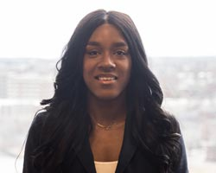
Service Excellence
Awardee
Krissy
Long
Notes:
Read from phone picture

Slide 15
Core Value Award (period ending March 31, 2025)
Nominees:
Willa Fan – Innovation & Discovery

Slide 16
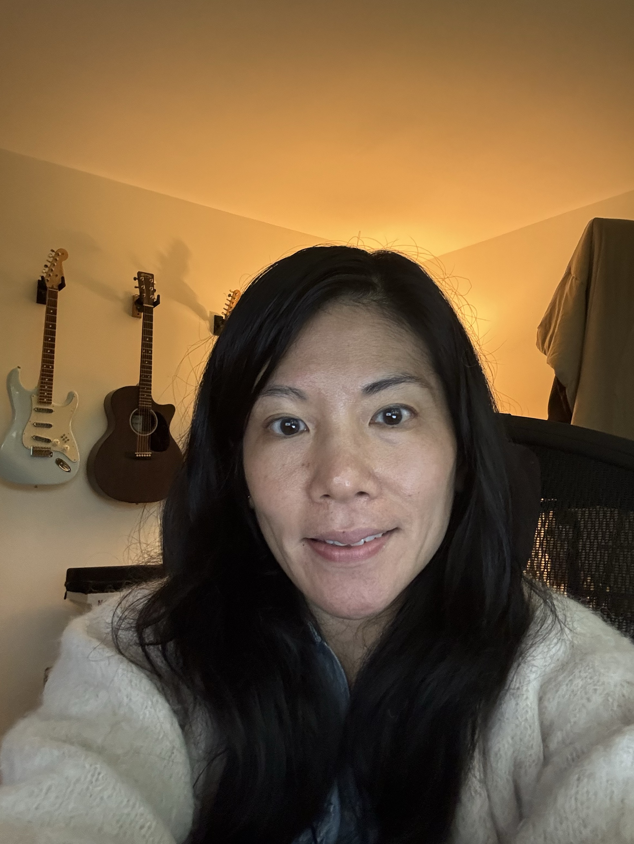
Core Value Awardee
Willa Fan
Notes:
The Innovation and Discovery Core Value is one that Business Applications lives every day. One of the best parts of working in Business Applications is constantly reexamining and improving business processes with new technology. Willa Fan embraces this and works tirelessly to bring as many efficient and effective enhancements to users as possible. She works to improve backend processes, such as working with CITS, SPAC, and SSAS to improve the process of closing POs on closed awards; automating parts of the process and saving SPAC and SSAS time. She works to improve user experiences, such as soliciting and implementing reporting improvements for the Requisition Status Report, the AiM Requisition Report, the PO Notification Report, and the PCard Transactions Report. She works to improve upfront validation, such as when she identified and improved expense workflow rules to automatically reject certain reports and save considerable amount of negative downstream impacts; saving users time and avoiding frustration. Most recently, she partnered with SSAS, CFAS, OOTC, and BFA to significantly improve how utility expenses are itemized, requisitioned, and invoiced. These improvements give decision makers significantly more granular details into utility expenses while also saving time on requisition and invoice creation.
These are just some of the examples of Willa collaborating with different groups to reexamine business processes, identify areas to improve, and leveraging new technologies to make those improvements.

Slide 17
Employee Recognition Schedule
  Core Value (Any one or multiple)
    Eligibility Period: 4/1/25 – 6/30/25
    Deadline For Nominations: 07/15/25
    Recognition @ Aug 2025 Town Hall
  Service Excellence
    Eligibility Period: 4/1/25 – 6/30/25
    Deadline For Nominations: 07/15/25
    Recognition @ Aug 2025 Town Hall

Slide 18
Nomination Forms
Forms are on the Finance and Auxiliary Service Website https://www.umaryland.edu/finance/
  Core Value Employee Recognition Nomination Form
  Service Excellence Employee Recognition Nomination Form
Send completed forms with documentation to:
fas-employeerecognition@umaryland.edu

Slide 19
Division Highlighted for Quarter
Budget & Financial Analysis
Kevin Donegan,
Assistant Vice President, Budget & Financial Analysis
May 28, 2025

Slide 20
                Mission Statement
    Budget & Financial Analysis aims to build a team of specialized financial experts to deliver accurate and timely information for effective decision-making aligned to our university’s strategic plan.

Slide 21
Kevin Donegan
Assistant Vice President
Budget Analysis
Tracy Ngo
Director
Project & Cap Acct.
Alice Maxwell
Asst. Director
Priya Srivastava
Financial Analyst
Financial Analysis
Andrew Flerlage
Director
Anuja Prasad
Accountant Senior
Stacy Dubon
Accountant Senior
Tamara Borisevich
Financial Analyst
Angela Roberts
Snr. Financial Analyst
Tolulope Sogbade Accountant

Slide 22
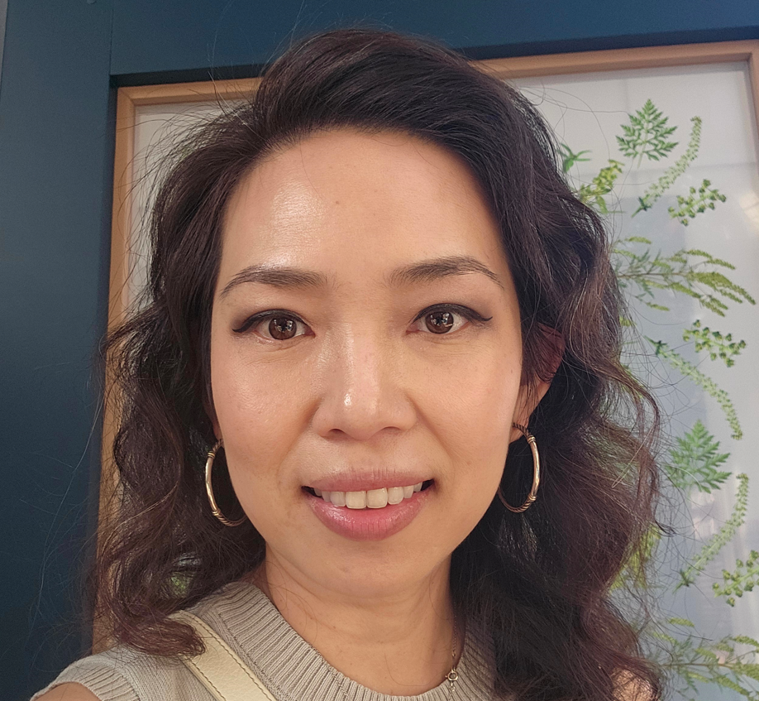
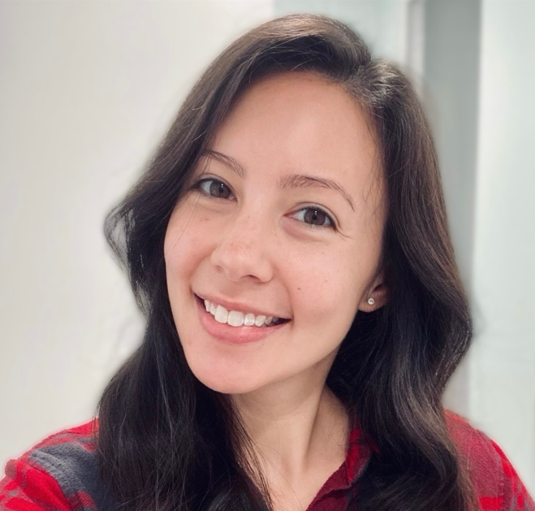
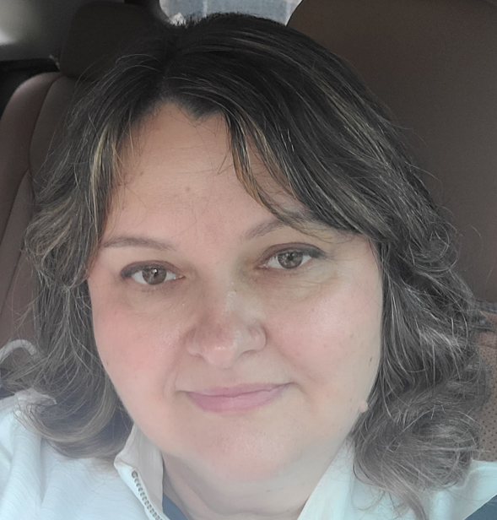
Budget Analysis Team
Tracy Ngo
Director
Angela Roberts
Snr. Financial & Budget Analyst
Tamara Borisevich
Financial & Budget Analyst

Slide 23
Budget Analysis
  Team Goals
  Work closely with UMB Schools & Units to create, monitor, and maintain annual budgets. Ensure that financial resources are allocated efficiently and aligned with the university’s strategic goals.
  Main Tasks
  Liaise, and report to University Maryland System (USM) and other state agencies on UMB’s behalf.
  Collate, monitor and verify all annual changes to UMB’s Annual Budgets.
  Calculate and communicate changes in budget allocations to all campus stakeholders.
  Coordinate and report on Quarterly Forecasts to campus leadership.
  Administer Quantum Planning & Budgeting System (QPB).
  Coordinate and report on Tuition & Fee forecasts and budgets.

Slide 24
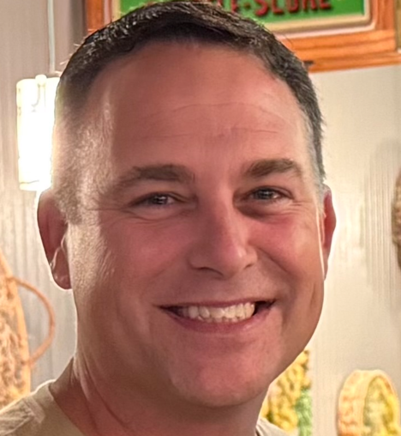
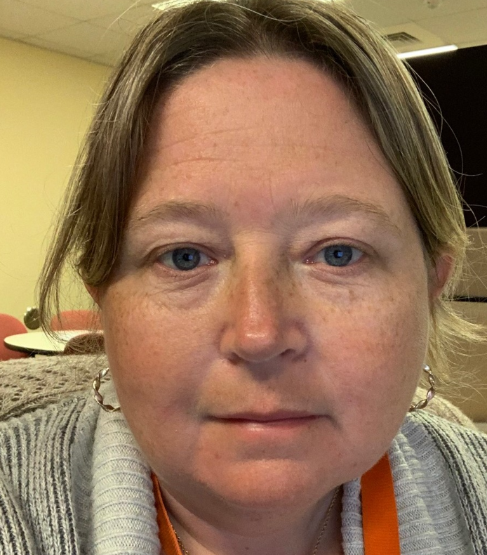
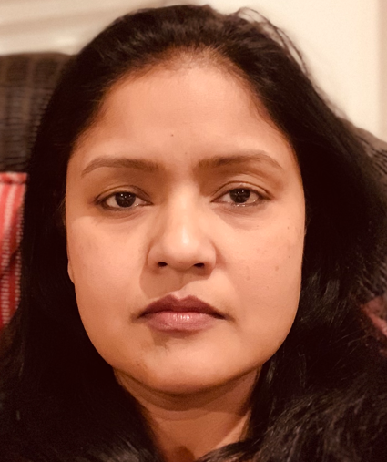
Financial Analysis Team
Andy Flerlage
Director
Stacy Dubon
Accountant Senior
Anuja Prasad
Accountant Senior

Slide 25
Prepare, Review and Deploy Annual Request Budget
Prepare, Review and Deploy Annual Request Budget
Financial Analysis
  Team Goals
  Analyze financial data, prepare reports, and provide insights for decision-making. Evaluate financial performance and assess opportunities to contribute to strategic planning.
  Main Tasks
  Serves as a liaison between BFA and all central admin areas (except Parking, Provost Office & ORD)
  Monthly reporting incorporating employee changes, PO & encumbrance reviews.
  Prepare, Review and Deploy Annual Request Budget, Monitor and Manage Annual Working Budget.
  Regular Customer Meetings
    Review current financial position
    Review planned changes
    Update and report Year End Forecasts
    Offer financial insights and advice to help guide unit level decision-making.

Slide 26
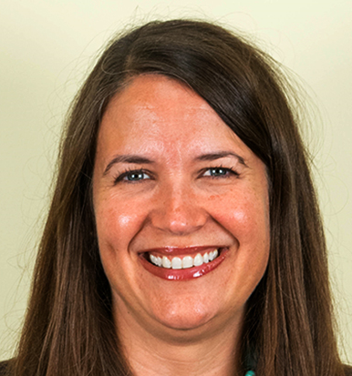
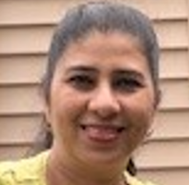
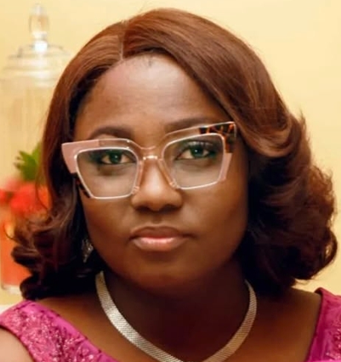
Project & Capital Accounting Team
Alice Maxwell
Assistant Director
Priya Srivastava
Financial & Budget Analyst
Tolu Sogbade
Accountant

Slide 27
Project and Capital Analysis
  Team Goals
  Collaborate with project managers and departments to create detailed budgets for specific capital initiatives. Ensure that project costs are accurately estimated, tracked, and aligned with available resources.
  Main Tasks
  Liaise, and report to University Maryland System (USM) and other state agencies on UMB’s behalf.
  Support Capital Projects Service Center with financial information (200+ capital projects)
  Monthly Customer Meetings
    Review monthly reports incorporating project activity and year-end forecasts.
    Review planned changes
    Update and report Year End Forecasts
    Offer financial insights and advice to help guide unit level decision-making.

Slide 28
How well do you know the Budget Office ?
Notes:
Kevin will take over slides

Slide 29
Financial Planning Processes

Slide 30
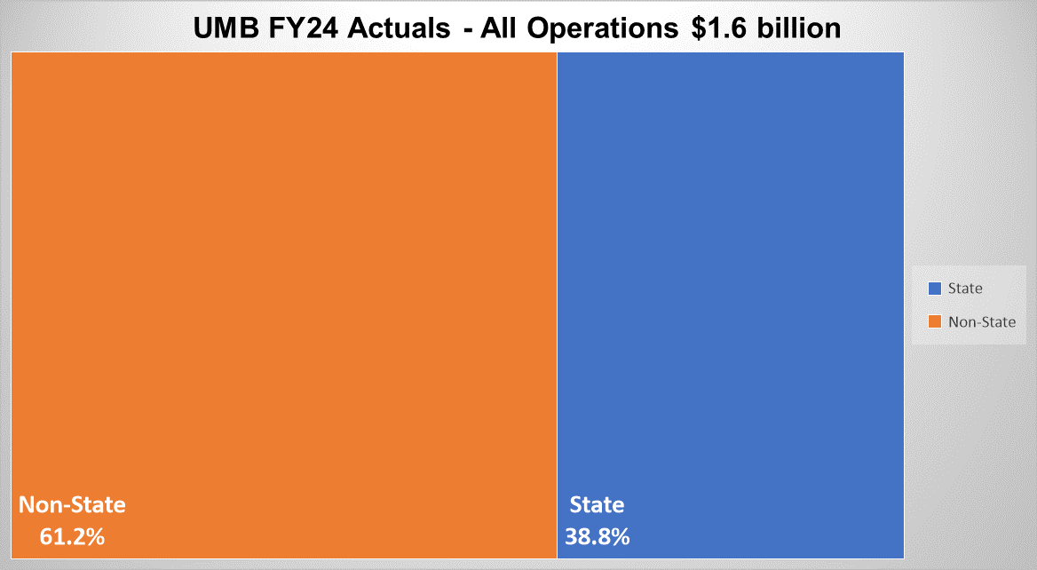

Slide 31
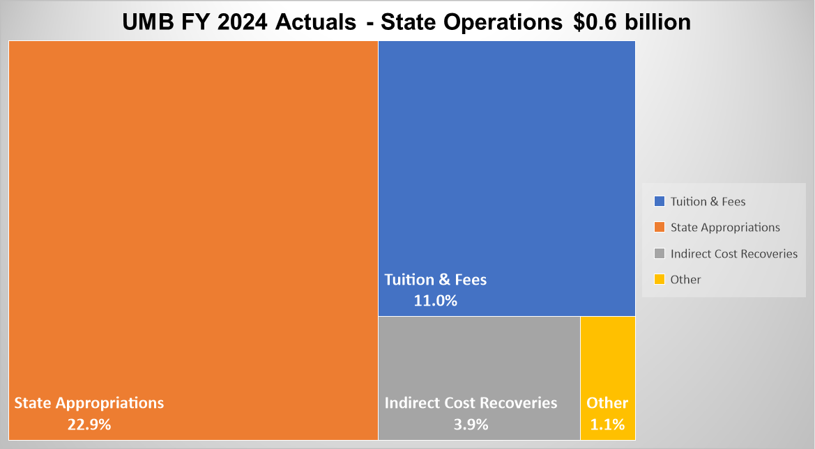

Slide 32
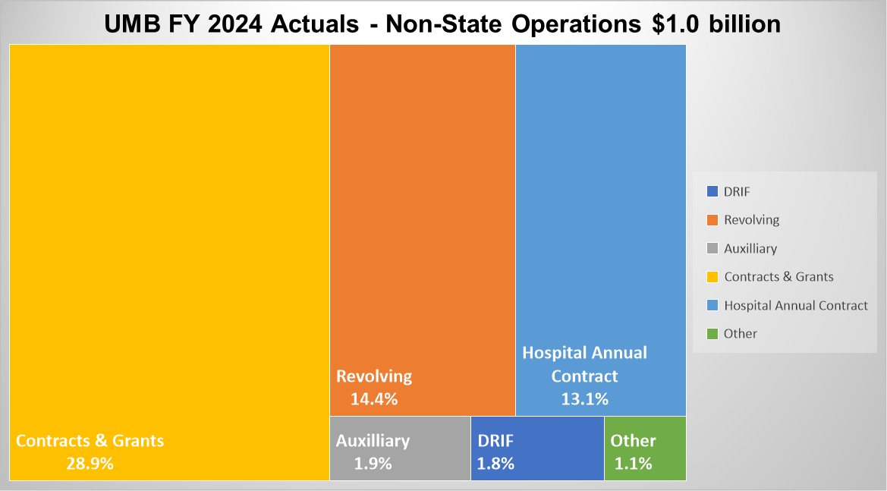
* DRIF - Designated Research Initiative Funds

Slide 33
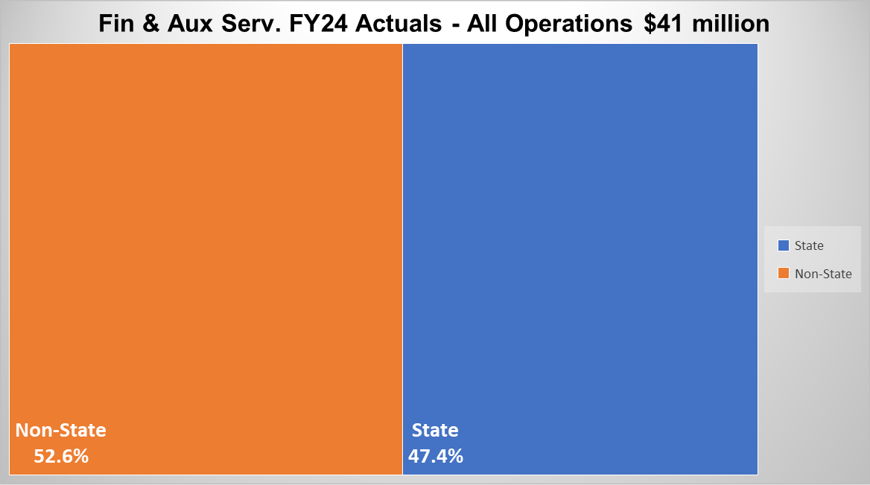

Slide 34
Annual Budget Timeline

Slide 35
Contact List
  Budget Analysis
  DL-AFBFA-Budget@umaryland.edu
  Tracy Ngo / Angela Roberts / Tamara Borisevich
  Financial Analysis
  DL-AFBFA-FinancialAnalysis@umaryland.edu
  Andy Flerlage / Stacy Dubon / Anuja Prasad
  Project & Capital Accounting
  DL-AFBFAProjectCapitalAccounting@umaryland.edu
  Alice Maxwell / Priya Srivastava / Tolulope Sogbade

Slide 36
List of Abbreviations
  BOR - Board of Regents
  DBM - Department of Budget Management (Maryland Governor’s Office)
  DRIF - Designated Research Initiative Funds
  FMWG - Funding Model Work Group (Strategic Finance Planning Group - UMB)
  IDC - Indirect Cost Recovery
  UMB - University of Maryland, Baltimore
  USM - University System of Maryland

Slide 37
Questions ?

Slide 38
Financial Update
UMB received state cuts of 7% for FY26
F&AS implemented majority of our cuts in FY25
The individual impacted due to layoff has been notified
There are no other planned layoffs in F&AS at this time.
However, State still has a $3B deficit to address by FY30
  We expect we may receive an additional cut in FY26
  Reasonable to assume we will be cut in FY27 as well

Slide 39
Financial Update
Continued outside interest on lowering the maximum F&A rates
Trump administration pressure on research
  UMB has seen 26 grants totaling $41M de-obligated ($13M impacting FY25)
  New awards have stalled but picking up some
Forecasting a drop in IDC Recovery base on known reductions
  FY25 – decline of $5M but DRIF allocation declined $10.3M
  FY26 – additional decline of $8.6M with DRIF dropping another $7.5M
Reviewing how IDC Recovery is distributed
  As of now the DRIF allocation is absorbing all the hit which is unfair
    Declined from $23.9M DRIF allocation in FY25 Budget to FY26 Fcst of $6.0M
  Plus, we need to be more strategic and reinvesting in research to broaden our sponsor base
Notes:
Bottom line – not out of woods yet. Combination of additional state reductions and declining IDC will result in further budget reductions in FY26 and FY27

Slide 40
Proposals (Count) by Sponsor Types
Mar YTD 2021 - 2025
SOM – FY’24 1,465; FY’25 1,545 (5.5% increase)
Notes:
Proposal counts Year-to-Date as of the end of March increased by 5%, or 90 counts, compared to the previous year.
NIH submissions rose by 17%, or 93 counts. Federal non-NIH submissions decreased by approximately 20%, or 27 counts. State submissions increased by 3%, or 5 counts, while Private submissions increased by 2% or 19 counts.
The School of Medicine experienced an overall increase of 5.5%, or 80 counts.
Row Labels % Amt
Corporation 0.0% 0
Federal Non-NIH -19.9% -27
Foundation/Association 3.7% 13
Hospital -5.4% -3
NIH 17.3% 93
Other Government 166.7% 5
State 3.3% 5
University 1.1% 4
Grand Total 4.7% 90

Slide 41
Proposals (in $) by Sponsor Types
Mar YTD 2021 - 2025
SOM: FY24 $1,386m v. FY25 $1,756m (27% increase)
Notes:
Proposal dollars increased by 23% ($384m) compared to last year, with a significant contribution from NIH. NIH proposals rose by 35% ($390m), Federal Non-NIH grew by 19% ($14m), while Private sponsors decreased by 1.3% ($5m) and State sponsors dropped by 12% ($14m).
The School of Medicine increased 27% or $370m.
Sponsor % Amt
Corporation -41.7% (63)
Federal Non-NIH 18.6% 14
Foundation/Association 66.5% 41
Hospital 87.5% 11
NIH 35.2% 390
Other Government 2.1% 0
State -11.7% (14)
University 4.3% 6
Grand Total 23.0% 384

Slide 42
Grants & Contracts Awards (in $) by Sponsor Types
Mar YTD 2021 - 2025
SOM – FY’24 $367M; FY’25 $357M (3% decrease)
Notes:
As of March, awards experienced a modest increase of 0.2%, amounting to $1 million, compared to the same period last year.
NIH awards rose by 4% ($6m), and state awards increased by 2.7% ($3m). Federal Non-NIH awards decreased by 4% ($2m), and private awards declined by 4% ($6m).
The School of Medicine’s awards decreased 2.8% ($10m).
Sponsor % Amt
State 2.7% 3
Federal Non-NIH -3.9% (2)
Foundation/Association -9.9% (4)
University 7.3% 2
Corporation -5.5% (3)
Hospital -12.5% (1)
NIH 4.1% 6
Other Government 62.9% 1
Grand Total 0.2% 1
---------------------------------------------------------------​
Examples:
Federal Non-NIH Sponsors
Centers for Disease Control and Prevention
Department of Defense (DOD)
Department of Health/Human Services
US Department of Education
Other Government Sponsors
Indiana Division of Mental Health and Addiction
Higher Education Commission of Pakistan
Tennessee Dept of Mental Health & Substance Abuse Services
Utah Department of Human Services
​
University
Johns Hopkins University
Boston College
Columbia University
Cornell University
Emory University
George Washington
Hospital
Children’s Hospital of Boston
Mayo Clinic Jacksonville
St. Jude Children’s Research Hospital
Corporation
Leidos, Inc
Medtronic Life
Technologies Corporation
McCormick & Company, Inc
Foundation
American Cancer Society American Heart Association
Bill and Melinda Gates Foundation
Cancer Research Foundation
State
Maryland Department of Health & Mental Hygiene
Maryalnd State Dept of Education

Slide 43
Grants & Contracts Awards (in $)
FY 2025 – 2026
FEB - APR
* Total FY25 $72m v. FY24 $100m (28% decrease)
** FY25 data does not cover the entire month of April (report generated on April 28th).

Slide 44
Salary Actions
1% COLA will be effective 7/1/25 (non-exempt, exempt, & faculty)
AFSCME employees will receive
  2.5% Merit effective 7/1/25
  1% > 5 years service effective 7/1/25
  $700 effective 1/1/26

Slide 45
Upcoming Events
6/2 – Maryland Food Bank (9:00 - 11:30); email Scott if interested
6/5 – A&F Town Hall @ SON Auditorium
6/11 – A&F BBQ @ Westminster Hall
6/18 – BARCS supplies donation event on campus – will include guest Officer Summers and Poe (10-11 but location TBD)
7/14 – Maryland Food Bank (9:00 – 11:30); email Scott if interested
7/31 – Campuswide Budget Townhall @ SON Auditorium
8/6 – A&F Ice Cream Social @ SMC

Slide 46
Q&A
Notes:
Based o

