Slide 1
Improving Accessibility with Blackboard ALLY
Understanding Reports, Fixing Common Issues, and Avoiding Quick‑Fix Pitfalls

Slide 2
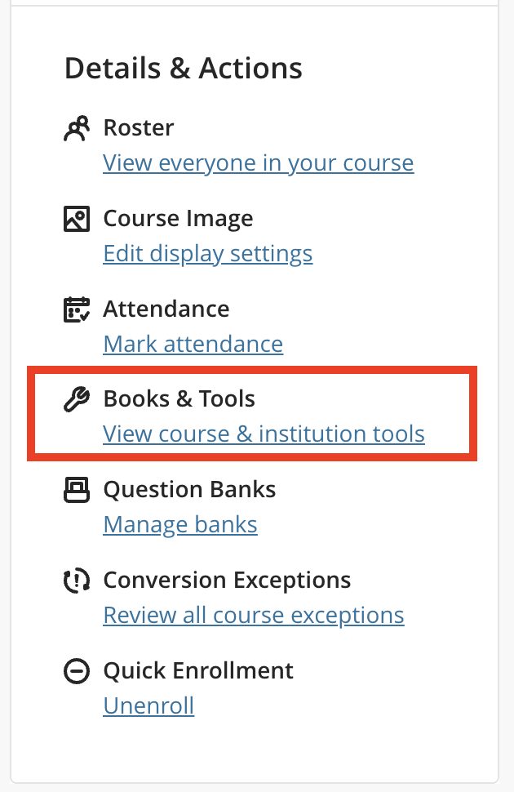
How to Use the ALLY Report
Open the Accessibility Report in your Blackboard course to see an overview of issues.
Use Ally’s step‑by‑step guidance to walk through each fix — it explains what the issue is, why it matters, and how to correct it.
Start with items marked as “Easy to Fix” to make quick progress.

Slide 3
Content With the Easiest Issues to Fix
Image descriptions: Add alt text directly through Ally’s interface; use the AI‑powered description generator as a starting point.
Links without descriptive text: Avoid “click here” or raw URLs —use meaningful link labels.
Headings and structure: Many issues resolve simply by updating the original document and re‑uploading.

Slide 4
Biggest Accessibility Issues
PDFs: Scanned or untagged PDFs are the most common barrier
PowerPoints: A commonly flagged issue is PowerPoint presentations (especially with image descriptions, reading order, and tables without headers)

Slide 5
Quirks of the Ally Report
Malformed HTML: Ally may flag HTML blocks, especially with lists. This is an issue with the current content editor.
Links without discernible text: Embedded videos or images used as links can trigger this (add a descriptive label or caption).
False positives: Occasionally Ally flags items that are technically accessible but formatted in unusual ways.
Hidden content: Ally may scan old or unavailable files still stored in the course.

Slide 6
Shortcuts That Won’t Improve Accessibility
Don’t mark images as “decorative” unless they truly convey no instructional meaning.
Don’t rely solely on ALLY's score as a measure of compliance; use it as a guide, not a finish line.
Don’t ignore structural issues (headings, tables, reading order) in favor of quick fixes.

Slide 7
Blackboard Ally: Key Takeaways
Use the Ally Report to identify issues and follow the built‑in guidance steps for fixing them.
Start with easy wins like adding image descriptions and replacing scanned or inaccessible PDFs.
Watch for common issues such as untagged PDFs and links that lack meaningful descriptive text.
Be aware of quirks like malformed HTML or videos/images that trigger “link without discernible text” warnings.
Focus on meaningful improvements rather than quick score‑boosting shortcuts (e.g., marking meaningful images as decorative).

