Slide 1
PDF Accessibility
FCTL Spring Cleaning Sessions 2026
Notes:
Presentation - PDFs.pptx

Slide 2
Topics
Remediation Tools
Accessibility Checklist (what to look for)
  Document properties
  Machine-readable (OCR)
  Tags
  Logical reading order
  Alt text
  Color & contrast
Using Adobe Acrobat’s accessibility checker

Slide 3
Tools
Equidox
  Online platform
  UMB has limited license
  2 people at a time can be logged into platform
Adobe Acrobat Pro
  Downloadable software
  Requires license (free 7-day trial available)
  CITS Adobe licensing

Slide 4
Alternatives to PDF remediation
Avoid using a PDF altogether
  HTML/CSS (e.g. web pages, Blackboard pages)
  ePub (if available)
  Native creation formats (e.g. Word, PowerPoint, Excel)
Recreate the original document
  E.g. instructor-made handouts, worksheets
  Easier to make a document accessible in Word and convert to an accessible PDF than it is to do all the remediation in the PDF

Slide 5
Accessibility Checklist
Document properties
Machine-readable
Tagged correctly
  Headings, paragraphs, lists, tables, figures, links, form fields, etc.
Logical reading order
Alt text
Color & contrast

Slide 6
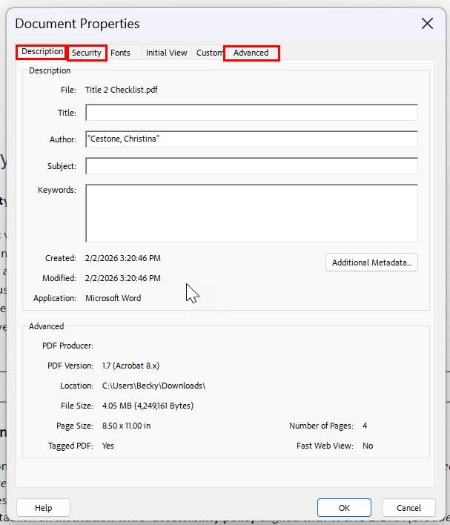
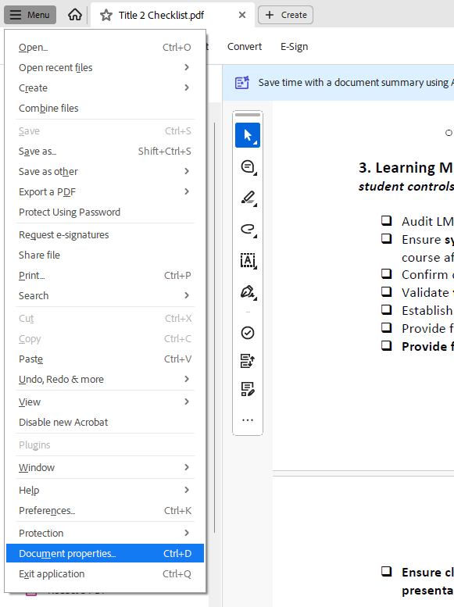
Document properties
Document Title
  Descriptive file name
  Initial view set to show Document Title
  Menu > Document Properties > Description
Security settings
  Content Copying for Accessibility is allowed
  Menu > Document Properties > Security > Security Method
Primary language assigned
  Menu > Document Properties > Advanced > Language

Slide 7
Machine-readable
Can you highlight specific words?
Digital document (best option)
  Designed with a word processing program from the start
  Already machine-readable, but may require additional remediation
Optical Character Recognition (OCR)
  Tries to recognize text on a scanned image to make it machine-readable
  Works best with clear, high-resolution scans
  Errors may need to be corrected
  Usually requires more extensive remediation
Scanned image of document
  Not accessible.

Slide 8
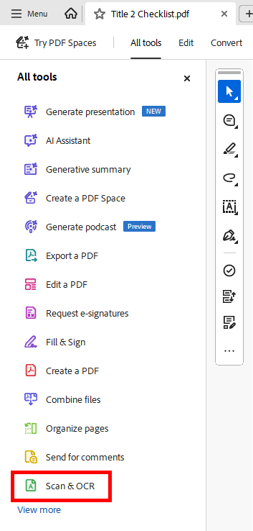
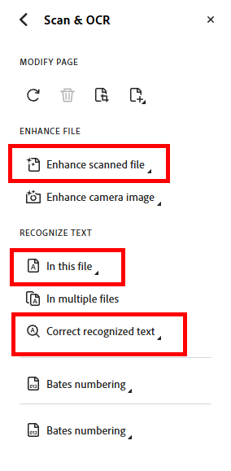
Machine-readable: How to OCR
  Enhance scanned file
    All tools > Scan & OCR > Enhance Scanned File
    Adjusts brightness/contrasts to make text recognition easier
  Recognize Text
    All tools > Scan & OCR > Recognize Text (in this file)
  Make necessary corrections if needed
    All tools > Scan & OCR > Correct Recognized Text
Notes:
If you do need to OCR a document, you can open the All tools side panel by selecting All tools from the top navigation menu. Here we have an image of the All tools panel, which shows a list of 14 tools with a “View more” link at the bottom to display additional tools. Select Scan & OCR from that list and that will open a set of options. There’s an Enhance File section, which is where you can select Enhance scanned file or enhance camera image, and what that does is adjust brightness and contrast to make text recognition easier. Then, in the Recognize Text section, you can select “In this file” to run OCR on the document you have open. There’s also an option in this section to “Correct Recognize text”, which identifies any places Adobe wasn’t sure about when it was recognizing text, and lets you make corrections.

Slide 9
Tags: Overview
Convey document’s formatting and structure to a screen reader
37 possible tags in various categories:
  Container elements
  Heading & paragraph elements
  Label & list elements
  Special text elements
  Inline-level elements
  Special inline-level elements

Slide 10
Three Useful Panels
  Accessibility tags
    Shows all the tags in the document and how they are structured
    Menu > View > Show/Hide > Side panels > Accessibility tags
  Reading Order
    Shows the order in which all tags will be read by a screen reader
    Menu > View > Show/Hide > Side panels > Order
  Content
    Shows all the elements identified in the document, tagged or not
    Menu > View > Show/Hide > Side panels > Content
Tip: Selecting these adds shortcut icons to right sidebar

Slide 11
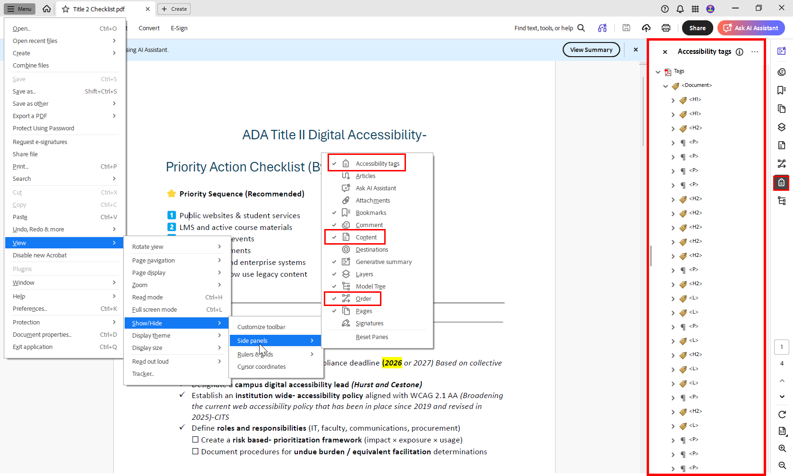
Accessibility Tags panel
This image is a screenshot of Adobe Acrobat with a PDF document open. The interface is shown in a standard desktop layout, with the application menus at the top, the document content in the center of the screen, and the right‑hand sidebar expanded to display accessibility panels.
The document visible in the center of the screen is titled “ADA Title II Digital Accessibility – Priority Action Checklist.” The page shows a large heading at the top, followed by a subheading and a list of bullet points and checkboxes. The document content provides visual context but is not the main subject of the image.
At the top of the application window, the Menu dropdown list is open. Within this menu, View is selected, which shows another submenu in which Show/Hide is selected, which displays a final submenu where Side panels is selected. Here there is a list of side panels that can be toggled to display or to be hidden. Accessibility tags, Order, and Content should be checked. Checking these items will display tool icons for them in the far right sidebar.
The Accessibility Tags panel is currently open on the right‑hand side of the screen and its tool icon is highlighted in the far right sidebar. At the top of the panel is the label “Accessibility Tags.” Below the label is a hierarchical tree view representing the document’s tag structure. The tree begins with a top‑level Document tag and expands downward into nested elements. These elements include heading tags, such as H1 and H2, and paragraph tags labeled P. Each tag appears with an expandable arrow, illustrating how the document is organized logically for assistive technologies such as screen readers.
Notes:
Okay, so, in this screenshot I have a PDF document open in Adobe Acrobat Pro. I’ve opened the menu in the upper left hand corner of the application and selected View, which opens a submenu of options. In that submenu I selected Show/Hide, which opens another submenu. In that submenu I selected side panels, which shows a list of side panels I can toggle to visible or hidden. The visible ones have checkmarks beside them. Again, the three I especially want to have visible are Accessibility tags, Order, and Content.
On the right hand side of the screen, I have the Accessibility Tags panel open, and just to the right of that panel, you can see its tool icon is highlighted in the far right sidebar. It looks like a little tag. At the top of the panel is the label “Accessibility Tags.” Below the label is a hierarchical tree view that represents the document’s tag structure. In this case, the tree begins with a top‑level Document tag, and that tag expands downward into nested elements. These elements include heading tags, such as H1 and H2, paragraph tags labeled P, and some list tags. Each of those tag appears with an expandable arrow, and if you expand those arrows, you can see the raw elements that are included within that tag, like words, symbols, shapes, or objects.

Slide 12
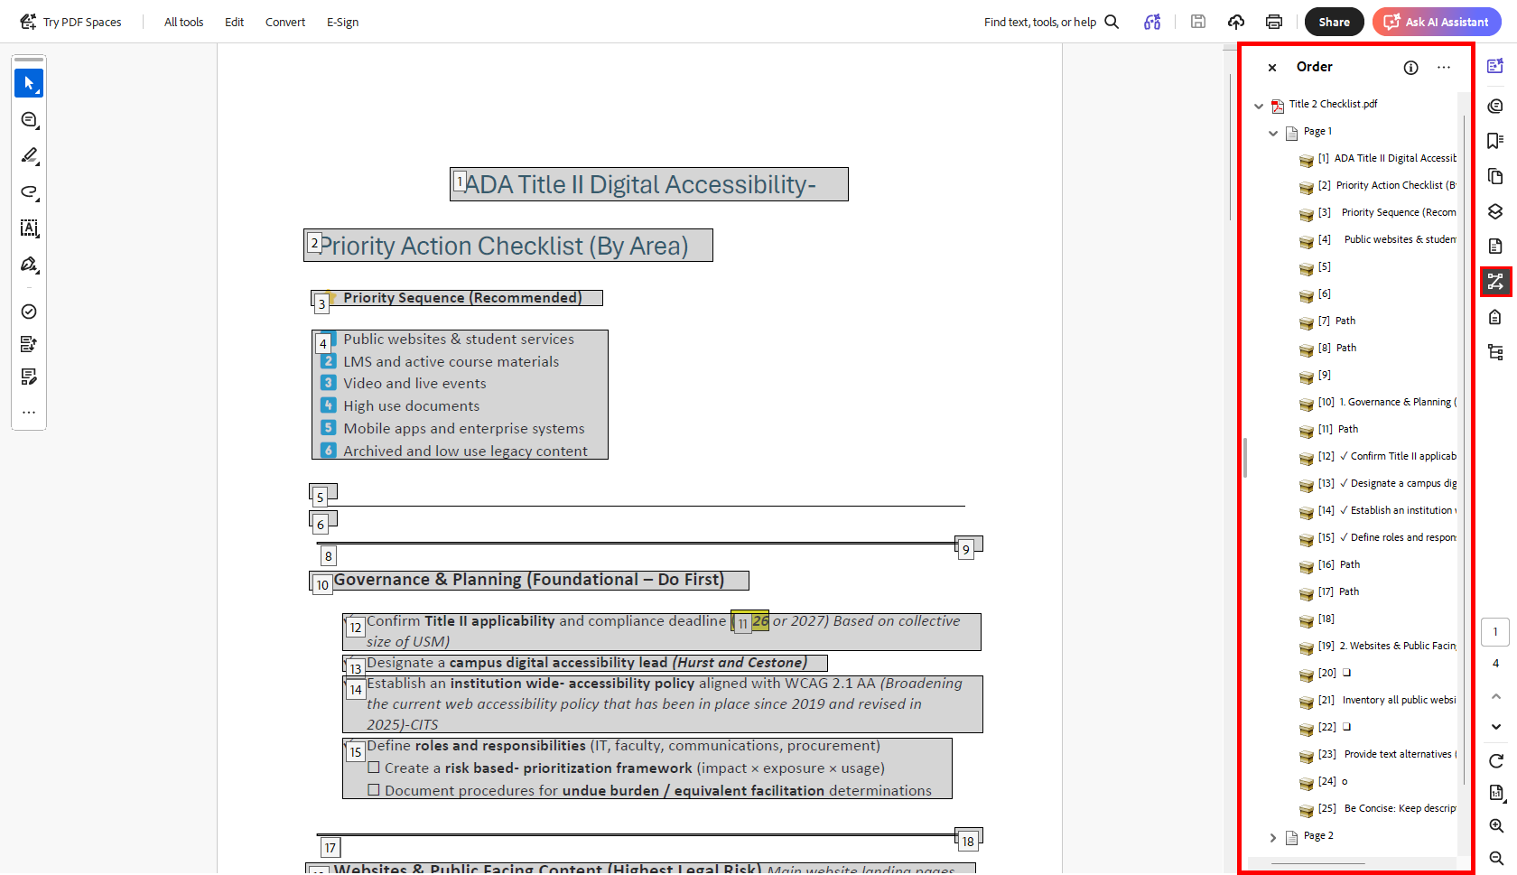
Reading Order
In this image, the Order panel is currently open on the right‑hand side of the screen and its tool icon is highlighted in the far right sidebar.
The panel is titled “Order.” Inside the panel is a hierarchical list representing the reading order of the document’s tagged elements. The list is organized by page and then broken into individual numbered content elements.
Within this Order panel:
The current page is labeled “Page 1.”
Under Page 1, a list of numbered elements appears, starting with 1. This Page 1 has 25 total elements. And if we were open up the page 2 list below that, we’d see that the count restarts at 1 for each page.
You’ll notice, too, that each numbered item in the right side panel corresponds directly to a numbered and outlined region on the document page in the central viewing area.

Slide 13
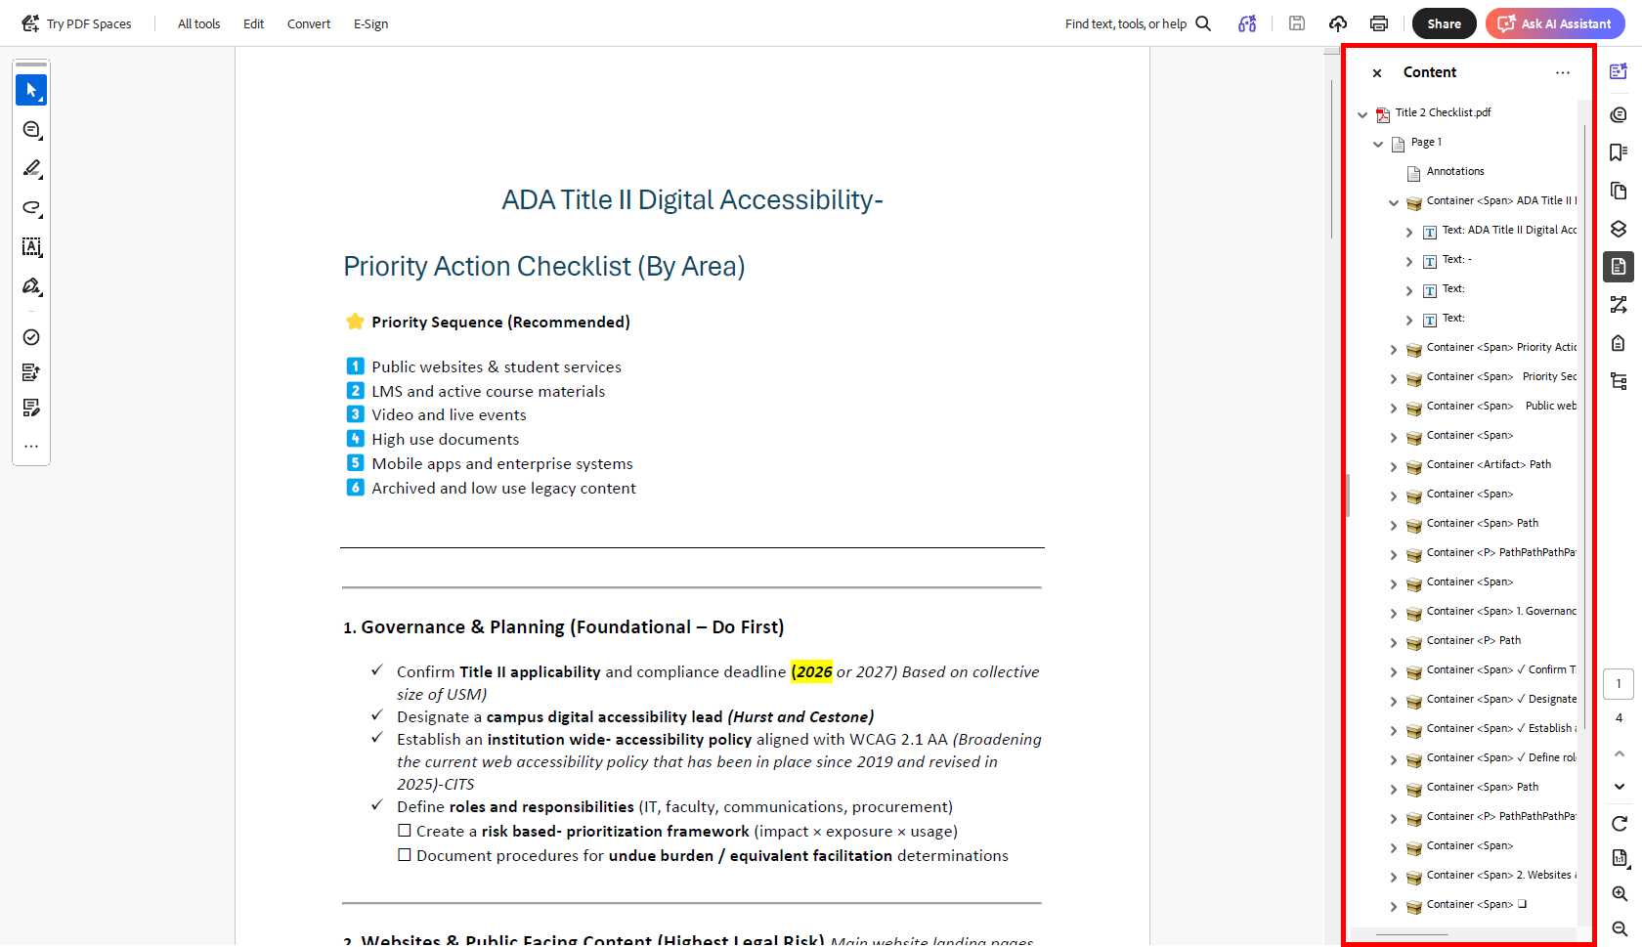
Content panel
This screenshot shows the Content panel open on the right hand side. At the top level of the Content panel is the document itself, named using its file name – Title 2 Checklist.pdf. Nested within this top level item are a serires of expandable sections. The first section is Page 1, and this section is expanded to show a collection of items, mostly expandable containers.
Each container is named using a combination of “container”, the tag type, and the text within the container… The name of the first container, which corresponds with the document title at the top of the document, is “Container span ADA Title II Digital Accessibility”
This container is expanded to show the individual elements nested within it… this container has 4 different text “items” nested within it… the first is the text ADA Title II Digital Accessibility, the second is the dash immediately after that title, and then two blank text items, which are the blank lines making up the white space between the title and the next heading.
Notes:
This next screenshot shows the Content panel open on the right hand side. At the top level of the Content panel, the document is listed under its file name, followed by expandable sections. Right now, the Page 1 section is expanded to show a series of items, mostly containers… the first container is named with a combination of the tag and the text within the container… so at the moment, the name is “Container span ADA Title II Digital Accessibility”… and this container is expanded to show the individual elements nested within it… this container has 4 different text “items” nested within it… the first is the text ADA Title II Digital Accessibility, the second is the dash immediately after that title, and it looks like we have two blank text items, which I’m guessing are two soft returns, or blank lines, making up the white space between the title and the next heading.

Slide 14

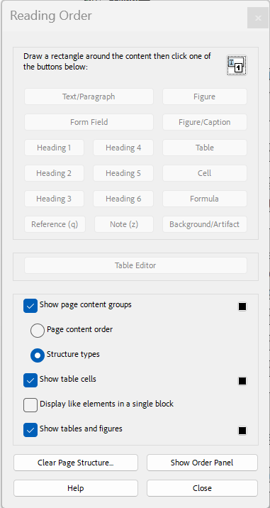
The Reading Order Tool
  Selector and tag buttons: Draw a rectangle around “elements” on the page to select them and assign common tags easily.
  Table Editor: Allows you to see/edit the nested tags within a table (row tags, header cells, data cells, etc.)
  Page content order: Shows numbers on each tagged element to indicate current reading order. Numbers restart at “1” on each page.
  Structure types: Shows the tag type of each tagged element. May need to use “Tag Panel” to see nested tags in tables, lists, links, etc.
  Clear Page Structure: Clears all the tags on the current page only.
Notes:
Okay, so in addition to the three panels we just looked at, the reading order tool will be a really useful tool for you as you work with tags and reading order. You can access the reading order tool from the floating toolbar. Mine is usually located on the left-hand side of my screen, it’s got an arrow icon, a comment icon, and further down on the toolbar there’s an icon that looks like two boxes with two small arrows beside them. This is the reading order tool. Click on this icon and it will open the reading order window. The top section of this window has a selector tool, with a text description beside it that says: “Draw a rectangle around the content then click on of the buttons below”. So, you can click the icon here, drag a rectangle around, say, a paragraph, or an image, or a heading…. And then below the icon there’s a bunch of buttons that let you apply a tag to your selection. These buttons include the text/paragraph tag, a form field tag, a figure tag, a figure/caption tag, tags for heading levels 1 through 6, a table tag, a cell tag, a formula tag, a reference tag, a note tag, and a background/artifact tag.
So, as an example, if you used the selector tool to select a paragraph of text on your page, you would click the “text/paragraph” button in this upper box and it would tag your selection as a paragraph. Underneath the top box with the selector tool and tag buttons is a table editor button. If you select a table on your page, you can click this button to open the table editor and see the table structure in more detail… meaning, the rows, and cells that make up the table. And you can do some editing of the table structure in the table editor. The box below this has different display options… When the “Show page content groups” checkbox is selected, you have the choice to show either the reading order of the elements on the page, or the structure types (or tags) of the elements on the page. I toggle between these two views often.
There’s an option to display like elements in a single block, which I don’t currently have checked… that means if you have two paragraph tags in a row, for instance, it will display them as a single paragraph element instead of two separate ones. Then the last display option, which I have checked, is to show tables and figures.
Finally, at the bottom of this window is a clear page structure button, which lets you clear all the tags from the current page only… a show order panel button, which will open up the reading order side panel we looked at earlier, a help button, and a close button.

Slide 15
Tags: Three Starting Places
Review and edit existing tags within the PDF
Use auto-tagging tool
  All tools > Prepare for accessibility > Autotag document
  Feature can be helpful but requires checking/fixing
Clear tags and tag manually
  All tags: From the “Accessibility tags” panel, select top-level “Tags” and delete
  Tags on an individual page: From the “Reading Order” window, select “Clear Page Structure”
Tip: When remediating, save often. “Undo” is unreliable.
Notes:
Okay, now that we know the various panels and tools that are available to use when we’re working with tags, let’s get back to the process of tagging. Depending on the document you’re working with, there’s three different approaches you can choose from. The first scenario is, you have a PDF that already has tags in it. Best case scenario, this was a digital document that was created accessible before being converted into a PDF, and the tags are really clean and accurate. In this case, you could simply review the existing tags and make any minor corrections as needed.
Scenario 2 is where you have a PDF that doesn’t have any tags in it. Maybe a scanned document, for instance. This is where you can use the auto-tagging tool, which you can access from that All Tools menu, in the Prepare for accessibility tool. Best case scenario here is that Adobe does a good job identifying and tagging content. It will still require review and probably some fixing, but it gives you a really solid start. Actually, let’s call that Scenario 2a, where you didn’t have any tags to start with. There’s a Scenario 2b, where maybe your document did have tags, but they’re a mess. There are times where it is actually quicker and easier to clear out existing tags and run the auto-tagging tool, then it is to try and correct a bunch of messy and incorrect tags.
Scenario 3 is similar… you’ve got a document with a bunch of messy tags, but this time, let’s say you clear them out and run the auto-tagging tool, but the auto-tagging tool doesn’t do a great job either, and the tags would require a whole lot of clean up. Sometimes, in this type of situation, the easiest option is to clear out all the tags and to tag the content manually using the Reading Order tool we just looked at and/or the Accessibility Tags side panel we looked at before that.
The tricky thing about choosing a starting place is that it’s not always clear until you play around a little bit, which approach is actually going to be the least amount of work. If approach one looks rough, maybe you try approach 2 and see what the auto tags look like. Then maybe you realize, actually the existing tags looked better, I’ll stick with approach one. Or maybe you realize, you know, it’s a simple document, I could manually tag this in half the time it would take to correct these existing tags, and you that route.
One last tip here, is that remediating tags and reading order doesn’t always have a reliable “undo” option. I’ve lost hours of work before when I changed a tag and it did all sorts of weird things to my document, and I had no way of undoing it to try again. So save often when you’re remediating PDFs.

Slide 16
Tags: Artifact
<Artifact> is used to identify decorative images, non-essential content
Elements designated as artifacts will not appear in the Accessibility Tags panel and will not be read by screen readers
Will only appear in the Content panel

Slide 17
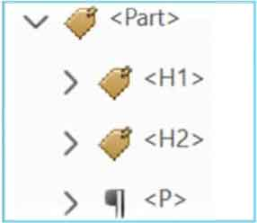
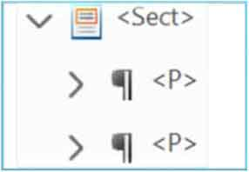
Tags: Container elements
The only required container is the <Document> tag (first item in tags tree, containing all others).
Tag | Description
<Part> | Large major section of a document (e.g., a report chapter). Can be used to group smaller units of content together.
<Div> | Division element is a generic block-level element or group of block-level elements.
<Art> | Article element is a self-contained body of text considered to be a single narrative.
<Sect> | Small section within a larger part (e.g., pull quote, sidebar, boxed text).
Notes:
I’m going to go through the rest of the tags by category, starting with the container elements. Container elements essentially allow you to group other elements. These aren’t required but can be helpful.
The table on the right shows 4 different container tags. The part tag is used to identify a large major section of a document, like a report chapter, and then smaller units can be grouped together within that part tag. The div tag identifies a generic block-level element or group of block-level elements… as opposed to in-line elements. The Art tag identifies article elements, which are self contained bodies of text considered to be a single narrative. And the sect tag is for smaller sections within a larger part, such as a pull quote, or a sidebar, or boxed text.
From what I understand, Part and section are the more commonly used container tags, but sometimes I’ll open a document that has a bunch of these other two tags, often unnecessarily.
On the left side of the slide, there’s a screenshot of what a Part container tag might look like in the Accessibility tags panel. There’s a part tag at the top of tree, and nested within that part tag are an h1 heading tag, then an h2 heading tag, and then a paragraph tag. The image below that shows an example of a section container. It starts with the sect tag, and nested within that are two separate paragraph tags.

Slide 18
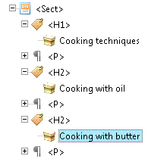
Tags: Heading & paragraph elements
Tag | Description
<H> | Not recommended.
<H1> | Heading level 1. Best used for title/highest section level of document.
<H2> | Main-level headings after title.
<H3> - <H6> | (Sub)heading levels 3, 4, 5, 6.
<P> | Paragraph
Notes:
Start with H1 (title).
Use subsequent heading levels in logical order to indicate hierarchy.
Use paragraph tag for each separate paragraph.

Slide 19
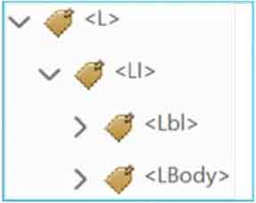
Tags: Label & list elements
Tag | Description
<L> | List element, indicates a list. Must contain list items.
<LI> | List element item, indicates a member of the list. Must have a list body element, might have a label element.
<Lbl> | Label element would be a bullet, number, etc. that precedes the item content.
<LBody> | The content of the list item.
Notes:
<L> (starts list)
<LI> (starts a list item)
<LB> (the bullet/number)
<Lbody> (the item content)
<LI> (starts 2nd list item)
<Lbl> (the bullet/number)
<LBody> (the item content)

Slide 20
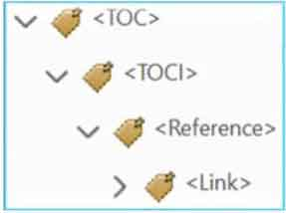
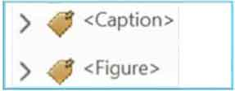
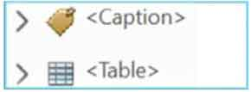
Tags: Special text elements
Tag | Description
<BlockQuote> | For one or more paragraphs of text attributed to someone other than the author of the immediate surrounding text.
<Caption> | A brief portion of text that describes a table or a figure.
<Index> | A sequence of entries that point out the occurrence of specific text in the main body of the document.
<TOC> | Contains a structured list of items and labels identifying those items; has its own discrete hierarchy.
Notes:
Identify text that isn’t used as a generic paragraph.

Slide 21

Tags: Inline-level elements
Tag | Description
<BibEntry> | Describes where some cited information may be found.
<Quote> | For an inline portion of text attributed to someone other than the author of the text surrounding it; different from a block quote, which is a whole paragraph or multiple paragraphs.
<Span> | Any inline segment of text; commonly used to delimit text that is associated with a set of styling properties.
Notes:
Identifies a span of text that has specific formatting or behavior

Slide 22
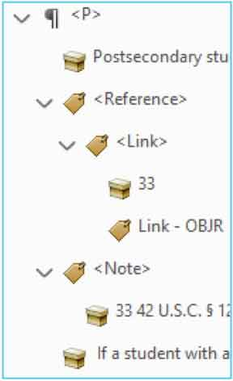
Tags: Special inline-level elements
Tag | Description
<Code> | For programming text embedded within a document.
<Figure> | A graphic or graphic representation.
<Form> | Interactive form-fillable elements (checkboxes, fillable text, signatures).
<Formula> | For a mathematical formula.
<Link> | A hyperlink container. Must have children: link text & Link – OBJR tag.
<Note> | Explanatory text or documentation, such as a footnote or endnote.
Notes:
Identifies a span of text that has specific formatting or behavior

Slide 23
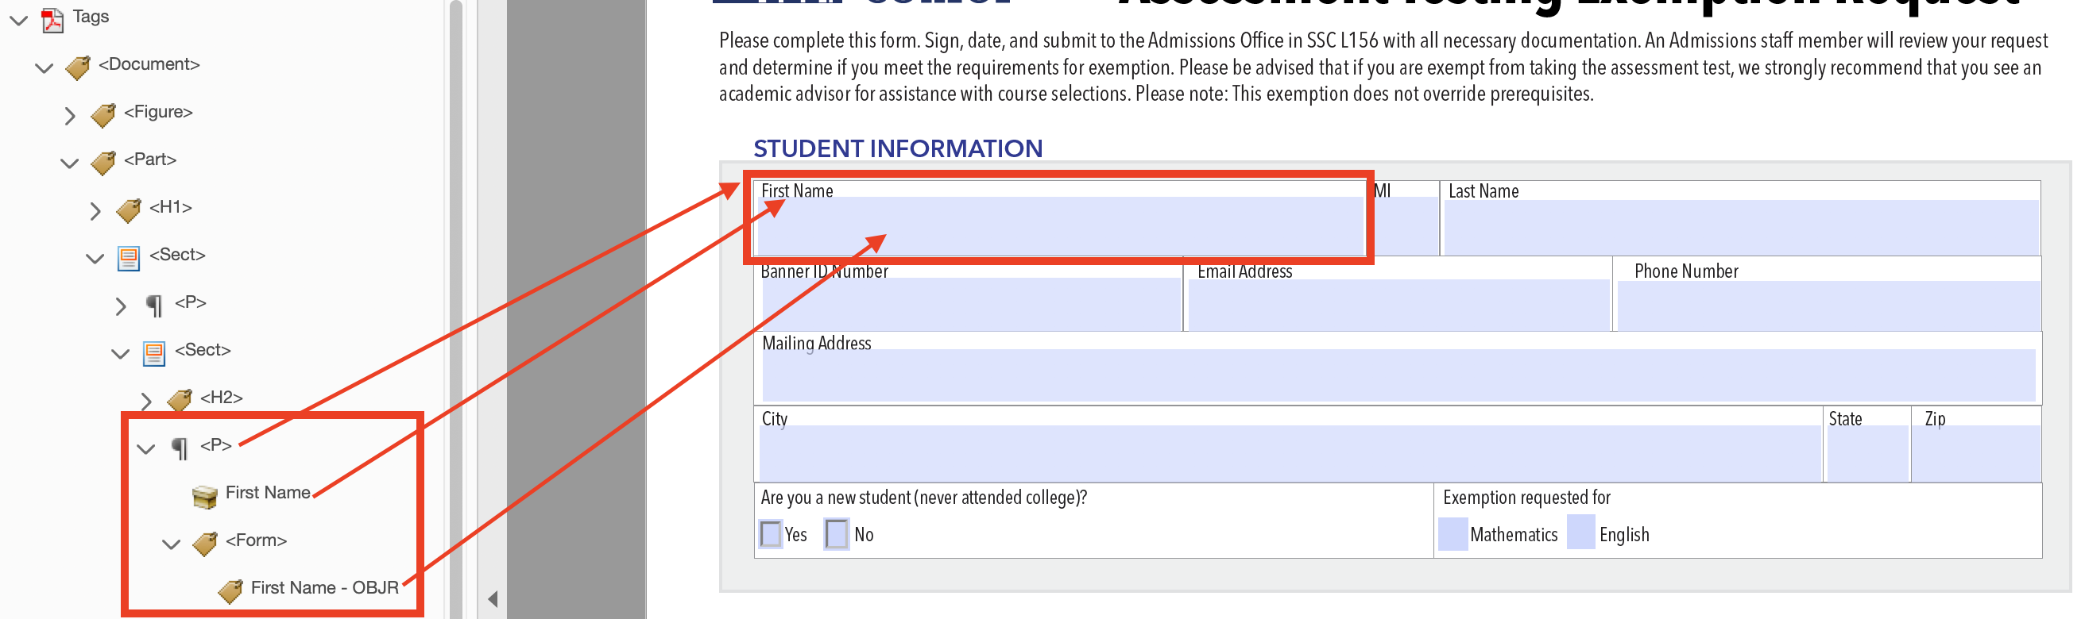
Tags: Forms
CSCU Digital Accessibility: PDFs with Fillable Forms
https://accessibility.ct.edu/training/creating-accessible-content/pdfs-fillable-forms/

Slide 24
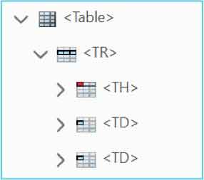
Tags: Tables
Tag | Description
<Table> | Main tag that houses all table tag components.
<TR> | Main tag that houses all tags/cells within a specific row.
<TH> | Heading cells within a table row tag.
<TD> | Data cells within table row tag.
CSUSM: How to properly tag a table in Adobe Acrobat
https://www.csusm.edu/iits/services/accessibility/documents/pdf/how_to_properly_tag_a_table_in_adobe_acrobat.pdf

Slide 25
Reading Order
Use the Order side panel to make sure the tags follow the visual/logical reading order of the document.
Drag items up or down in the Order side panel to reorder.

Slide 26

Reading Order
In this image, the Order panel is currently open on the right‑hand side of the screen and its tool icon is highlighted in the far right sidebar.
The panel is titled “Order.” Inside the panel is a hierarchical list representing the reading order of the document’s tagged elements. The list is organized by page and then broken into individual numbered content elements.
Within this Order panel:
The current page is labeled “Page 1.”
Under Page 1, a list of numbered elements appears, starting with 1. This Page 1 has 25 total elements. And if we were open up the page 2 list below that, we’d see that the count restarts at 1 for each page.
You’ll notice, too, that each numbered item in the right side panel corresponds directly to a numbered and outlined region on the document page in the central viewing area.

Slide 27
Alt text: Overview
All images/visual objects that convey meaning are tagged as Figures.
  If not, they should be tagged as Artifacts.
All “Figures” have alternative text that describes its purpose/function.

Slide 28
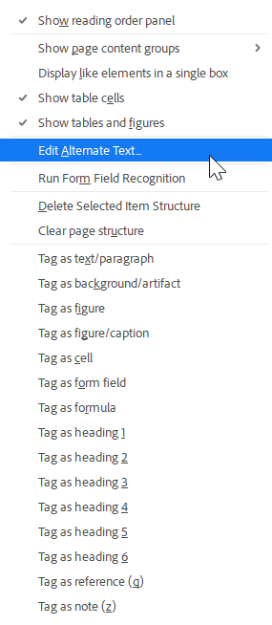
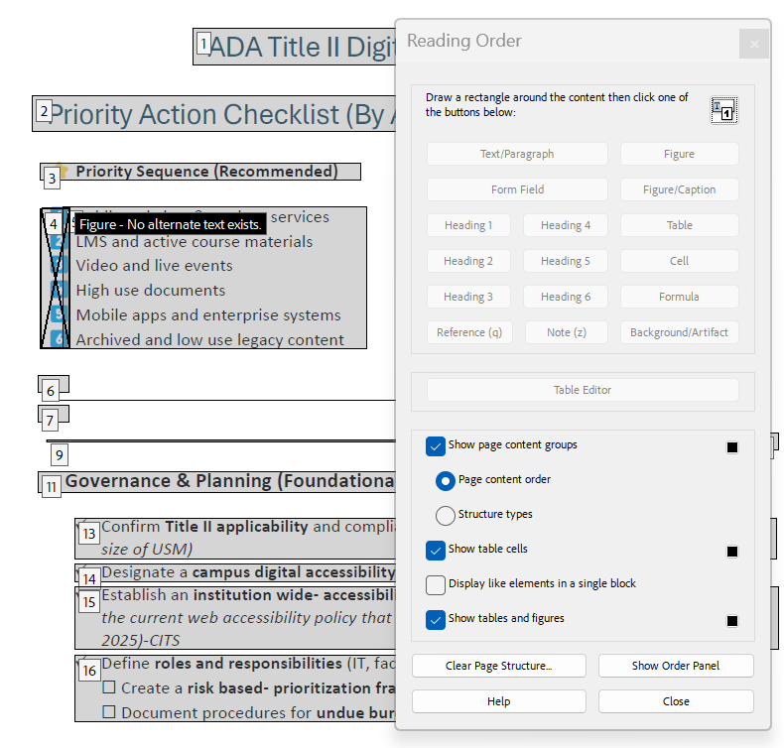
Alt text: How to Add
With the Reading Order tool open, select the Figure in the document.
Right click on the figure when it is selected.
Select “Edit Alternative text” from the menu.

Slide 29
Alt text: What to write
How to write alt text
  Content and function - why is the image included?
  Avoid redundancy
  Keep it brief – 125 characters OR link to a longer description.

Slide 30
Alt text: Working with AI
Download the image
Go to Microsoft Copilot
Click the + icon in the prompt box and upload your image.
Input the following prompt: “Can you describe this image for a screen reader? Please format as a long description.”
Modify as needed.

Slide 31
Color & Contrast
Text has sufficient contrast (including text in images)
Color alone is not used to convey meaning
If manual check required: WCAG Color Contrast Checker
  Use the color picker to select the foreground text color and the background color.
  Provices compliance results for small text, large text, and UI components.

Slide 32
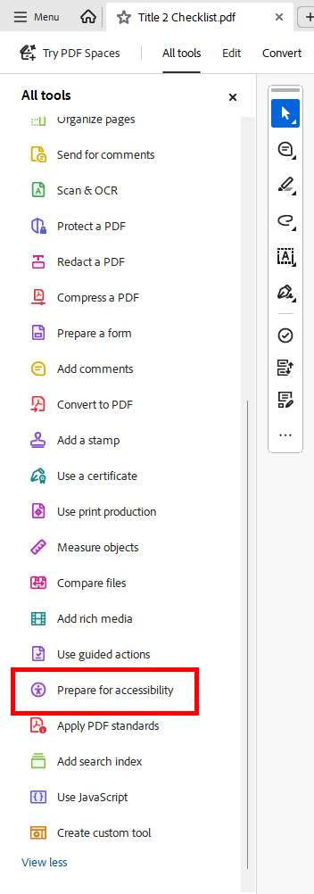
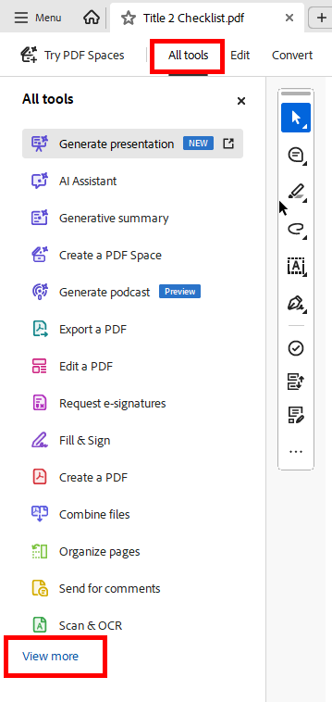
Using the Accessibility Checker
All Tools (View more) > Prepare for Accessibility > Check for Accessibility
Categories
  Document
  Page Content
  Forms
  Alternate Text
  Tables
  Lists
  Headings

Slide 33
Accessibility Checker: Statuses
Passed
Skipped by User (not checked)
Needs Manual Check (e.g. logical reading order)
Failed

Slide 34
Accessibility Checker: Action Choices
Fix: Either fixes the item automatically or displays a dialog box prompting you to fix the item manually.
Skip Rule: Skips future checks and changes status to Skipped
Explain: Provides more details about the issue.
Check Again: Use after manually modifying item(s).
Show Report: Report with links to repair tips.
Options: Opens dialog box where you select which checks are performed.

Slide 35
Equidox interface
Import documents > open document > click into document
“Zones” are the items/blocks that get tagged
  When you select a zone, its properties will appear in the left panel
    Properties
      Name
      Type
      Language
      Order
    “Type” properties
      Text: tag, indentation, merge, break lines
      Heading: Level, merge, break lines, use as template

Slide 36
Resources
General Services Administration. Create Accessible PDFs.
Michigan State University. Word vs. PDF.
University of Wisconsin-Green Bay. Digital Accessibility Tip: When to Use Optical Character Recognition (OCR) on PDFs.
Adobe. Fix text issues in scanned PDFs.
General Services Administration. Common PDF Tags and Their Usage.
NYSED. How to Create or Fix Adobe PDF Link Tags.
WebAIM. Alternative Text.
Accessible Web. WCAG Color Contrast Checker.
CSCU. PDFs with Fillable Forms.
California State University San Marcos. How to Properly Tag a Table in Adobe Acrobat.
Illinois State University. Accessibility.

