Slide 1

Microsoft PowerPoint
Digital Accessibility Workshop

Slide 2
Use High-Contrast Colors and Readable Fonts
Importance of High Contrast
  High-contrast colors improve text visibility for all users including those with low vision and color blindness.
Readable Fonts Enhance Clarity
  Using sans-serif fonts like Arial or Calibri reduce cognitive load and improves comprehension.
PowerPoint Accessibility Tips
  Use built-in themes with strong contrast and ensure body text is at least 18pt font for readability.
High Contrast vs. Low Contrast
Sans-serif vs. Serif
24pt font vs. 12pt font

Slide 3
Use Unique, Descriptive Slide Titles
Purpose: Each slide should have a unique, meaningful title that clearly describes the slide’s content.
Why This Is Important for Accessibility
Screen reader users navigate and scan presentations by slide titles
Repeated or missing titles make it difficult to understand what each slide is about
Unique titles function like headings in a document, improving orientation and comprehension
Notes:
This especially supports:
Blind or low-vision users
Neurodivergent learners
Students reviewing slides asynchronously

Slide 4
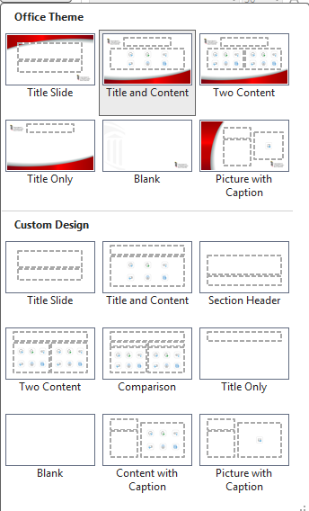
Creating Descriptive
Slide Titles
Common Accessibility Issues
Slides with no title
Repeated titles
Slides with no meaning: Slide 1, Slide 2
Repeated titles like: Example, Example, Chart, Chart
How to Create Accessible Slide Titles
Use a layout with a Title placeholder (Layout → Title and Content)
Write unique, descriptive titles, such as:
  “Steps to Create Accessible Tables”
  “Common Alt Text Mistakes”
Notes:
This especially supports:
Blind or low-vision users
Neurodivergent learners
Students reviewing slides asynchronously

Slide 5
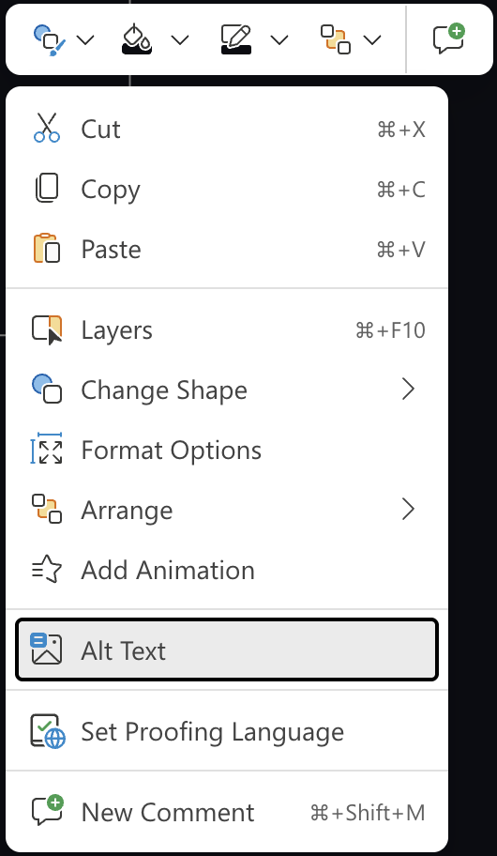
Add Alt Text for Images, Charts, and Graphics
Purpose of Alt Text: Alt text describes visuals
for screen reader users, ensuring accessibility
to all learners
Guidelines: Write concise, descriptive text focusing on the key message without using phrases like 'picture of...’
  If an image does not convey meaning, or if the information can be found elsewhere on the slide, mark the image as decorative
Adding Alt Text in PowerPoint
  Add alt text by right-clicking images and selecting 'Alt Text'
Notes:
Test

Slide 6


Handling Complex Visuals
Slide titles can be hidden off screen too.
  Hide description off-slide in the margins to provide summaries for complex visuals that need more detailed explanations.​
  Be sure to add this to the reading order!
  This won’t show for those looking at your visual, but it will be read aloud by screen readers.

Slide 7
Ensure Logical Reading Order for Slide Elements
Importance of Logical Order
  Logical reading order ensures screen readers present slide content clearly and coherently for all users.
Impact of Incorrect Order
  Out-of-order elements confuse assistive technology users, reducing comprehension and usability.
Using PowerPoint Reading Order Pane
  The Reading Order Pane helps verify and adjust reading order of slide elements easily.
Best Practices for Order
  Arrange title first, followed by body text, images, and other elements in a logical flow.

Slide 8
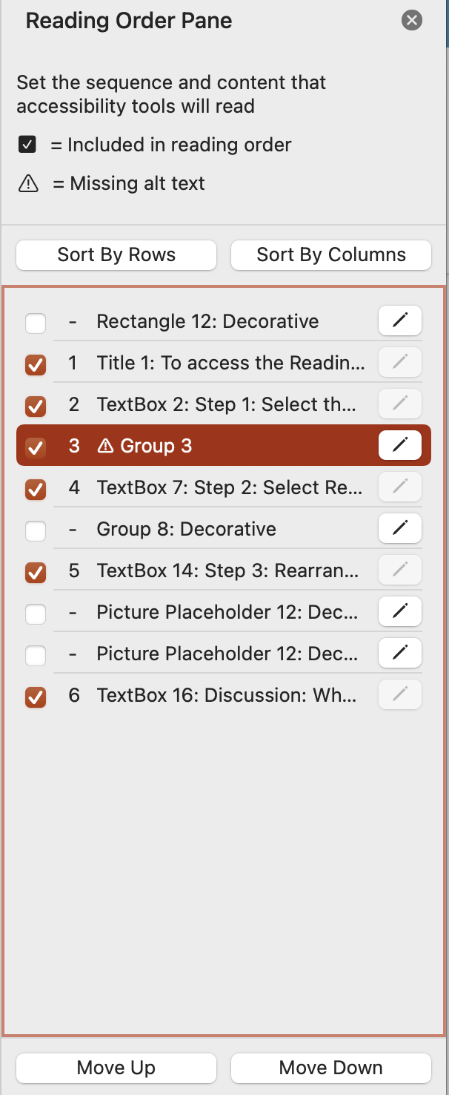
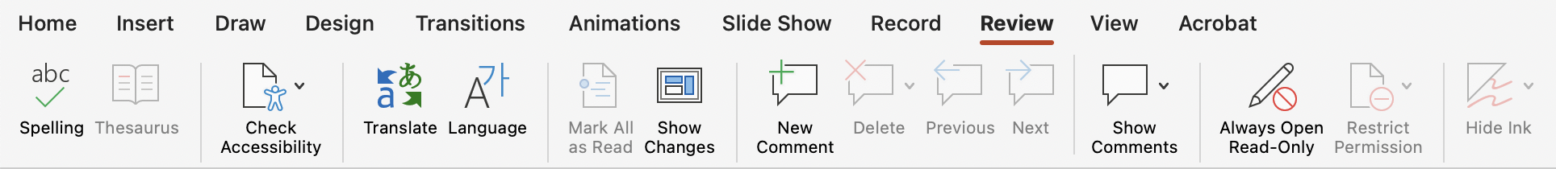
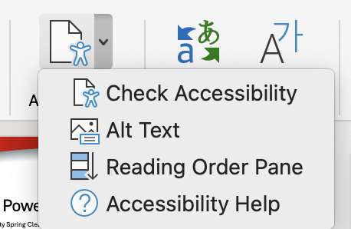
To access the Reading Order Pane:
Step 1: Select the Review tab, and click the arrow next to Check Accessibility
Step 2: Select Reading Order Pane from the dropdown menu
Step 3: Rearrange the items into a correct logical order for screen readers.
You can add/edit alt text by clicking the pencil icon next to images.
Uncheck items that are decorative or do not need to be read aloud for comprehension
Notes:
Notes go here

Slide 9
Accessible Tables in PowerPoint
Purpose: Accessible tables are structured so screen readers can understand and communicate relationships between data (rows, columns, and headers)
Principles to keep in mind:
Keep tables simple: Avoid merged or split cells
Avoid using tables for layout: Use tables only for data, not visual alignment
Accessible Table
Day | Time | Location
Monday | 1:00–3:00 PM | In-person
Wednesday | 1:00–3:00 PM | Zoom
Friday | 9:00–11:00 AM | Hybrid
In-accessible Table
Office Hours by day, time, and location
Monday | 1–3 PM | In‑person
Wednesday |  | Zoom
Friday | 9–11 AM | In‑ person | Zoom
Notes:
Why This Matters
Screen reader users rely on proper table structure to navigate data meaningfully
Tables created visually (or copied from Excel/Word incorrectly) can be read as confusing blocks of text
Proper tables support users with visual, cognitive, and learning disabilities

Slide 10
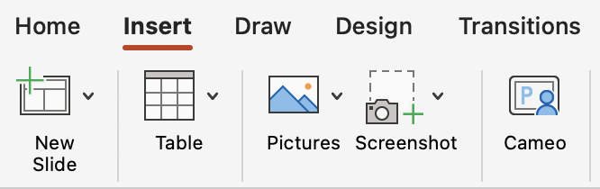
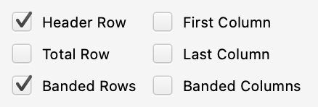
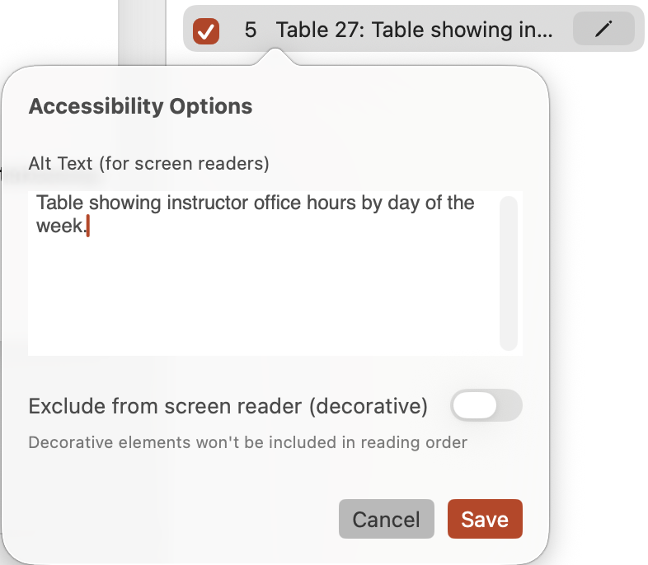
How to Create Accessible Tables in PowerPoint
Use Insert → Table (do not draw tables manually or use text boxes)
Designate a header row: Click in the table → Table Design → check Header Row
Add Alt Text to the table:
  Click pencil icon next to the table in Reading Order → Edit Alt Text
  Describe what the table shows and its key takeaway
Notes:
Why This Matters
Screen reader users rely on proper table structure to navigate data meaningfully
Tables created visually (or copied from Excel/Word incorrectly) can be read as confusing blocks of text
Proper tables support users with visual, cognitive, and learning disabilities

Slide 11
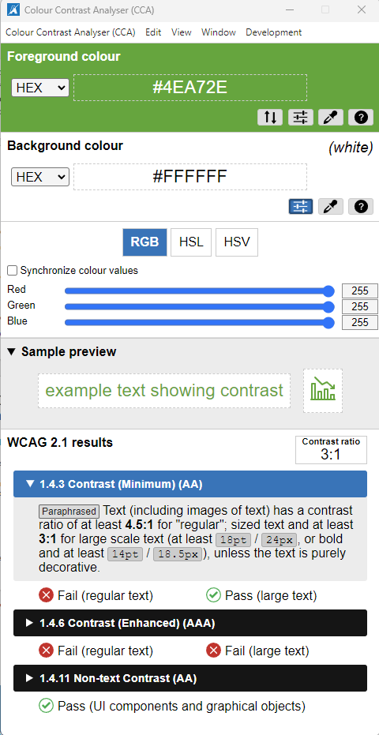
Color Contrast and Preset Table Styles
Use 18pt+ font sizes to avoid color contrast issues
Accessible Table
Day | Time | Location
Monday | 1:00–3:00 PM | In-person
Wednesday | 1:00–3:00 PM | Zoom
Friday | 9:00–11:00 AM | Hybrid
In-accessible Table
Day | Time | Location
Monday | 1:00–3:00 PM | In-person
Wednesday | 1:00–3:00 PM | Zoom
Friday | 9:00–11:00 AM | Hybrid

Slide 12

Provide Captions or Transcripts for
Embedded Media
Importance of Captions​
  Captions display spoken dialogue and sounds to support deaf or hard of hearing users in understanding video content.​
Role of Transcripts​
  Transcripts provide a text version of audio or video content, making information accessible and searchable.​
Accessibility Benefits​
  Providing captions and transcripts ensures compliance and benefits users in noisy environments or those preferring reading.​
[cc] closed captions...

Slide 13
Run the Accessibility Checker Before Sharing​
Purpose of Accessibility Checker​
  The Accessibility Checker identifies potential issues and provides recommendations to improve presentation accessibility.​
Common Accessibility Issues​
  It checks for missing alt text, low color contrast, and incorrect reading order in slides.​
Using the Accessibility Checker​
  Navigate to Review tab, then select Check Accessibility to run and view issue details and fixes.​
Benefits of Running Checker​
  Ensures inclusive design and prevents barriers for users with disabilities before
  sharing presentations.​

Slide 14
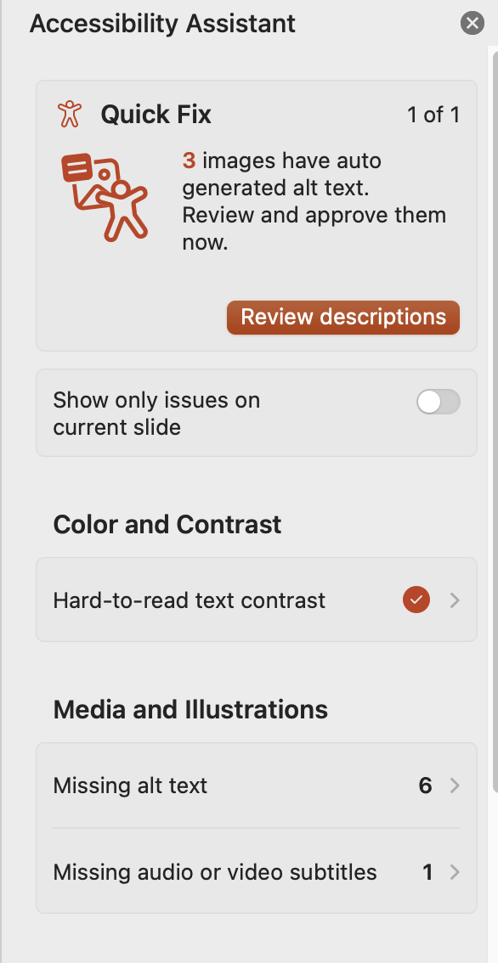
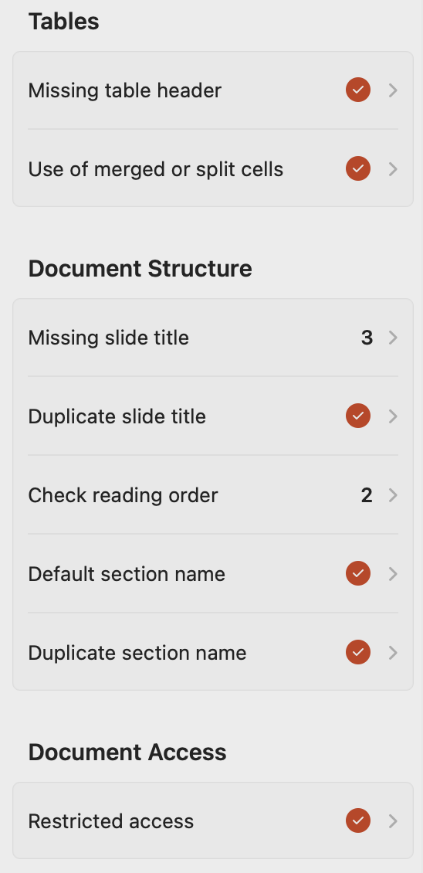
Accessibility Checker
Will show you the following information:
Notes:
Notes go here

Slide 15
Save/Export your Presentation Correctly
On a PC:
Use File > Export > Create PDF/XPS
In the options, select "Document structure tags for accessibility"
Check the option to Optimize for electronic distribution
This ensures screen readers and assistive tech can interpret it properly; embeds tags for navigation, links, and structure, making it accessible
On a Mac:
Use the File > Export menu
Select PDF as the format
Check the option for Best for electronic distribution and accessibility
This action preserves tags and structure for screen readers and easy online sharing

Slide 16
Summary of PowerPoint Accessibility Best Practices
Good Visual Style: Use high-contrast colors and large, readable fonts to improve visibility for all viewers.​
Alt Text for Images​: Add descriptive alt text to images and graphics to assist screen reader users.​
Logical Reading Order​: Ensure a clear and logical sequence for reading slide elements to maintain clarity.​ Include a unique, descriptive slide title as your first element.
Follow proper rules and formatting: Tables, outlines, lists, and bullets should all be created using the built-in tools, never drawn or made with symbols.
Captions and Transcripts​: Provide accurate captions or transcripts for all embedded media to support deaf or hard of hearing users.​
Accessibility Checker​: Run the Accessibility Checker to find and fix potential accessibility issues before sharing.​
Save your Presentation Correctly: Follow the proper steps to preserve the alt text,
heading tags, and reading order you worked hard to create.
Notes:
Notes go here

