Slide 2
Office of the Controller Job Aid
Responsible Unit | Payroll | 04/09/24
Title | Glacier Processing

Slide 3
Glacier Guide for Foreign Nationals
Foreign National employees and/or individuals who expect to receive payments from the University of Maryland, Baltimore (UMB) must complete a Glacier record.
You will receive an email from support@online-tax.net (see below example):
Please note: If you have any questions on any GLACIER pages, click on the ‘Online Support’ or ‘Contact GLACIER support’ icon on the bottom right, you will get immediate support from GLACIER.

Slide 4
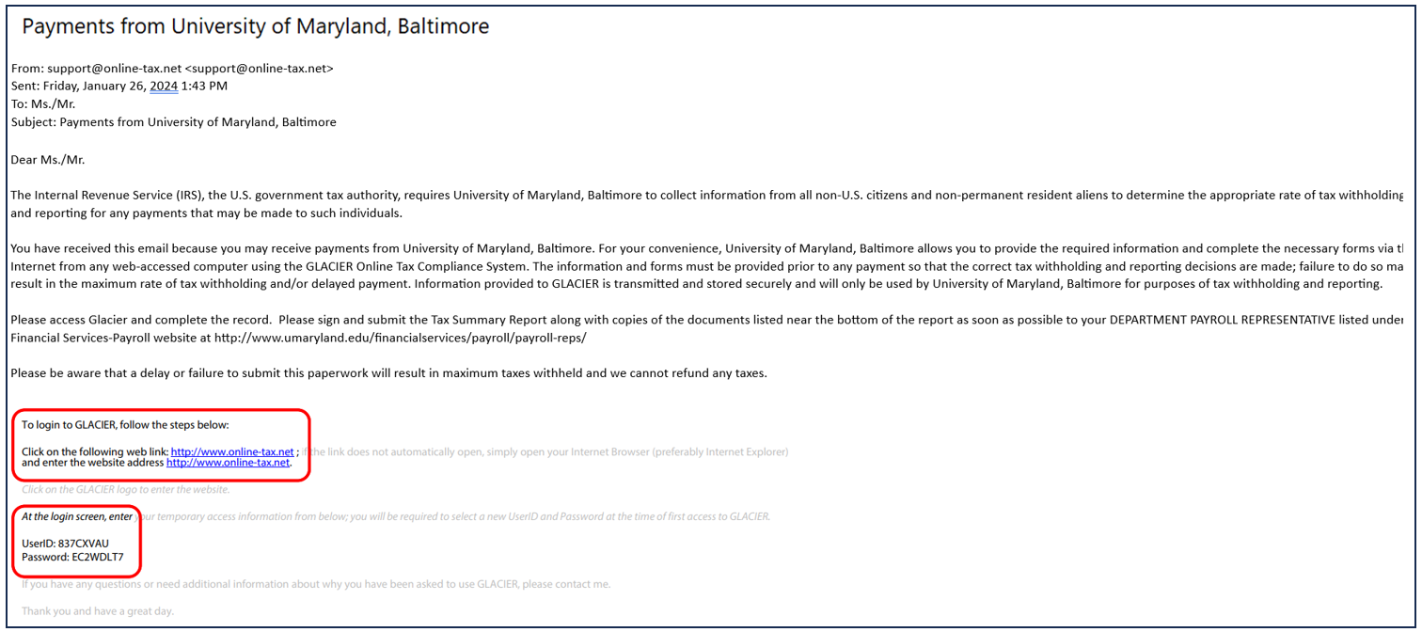

Slide 5
PART 1: GLACIER LOGIN

Slide 6
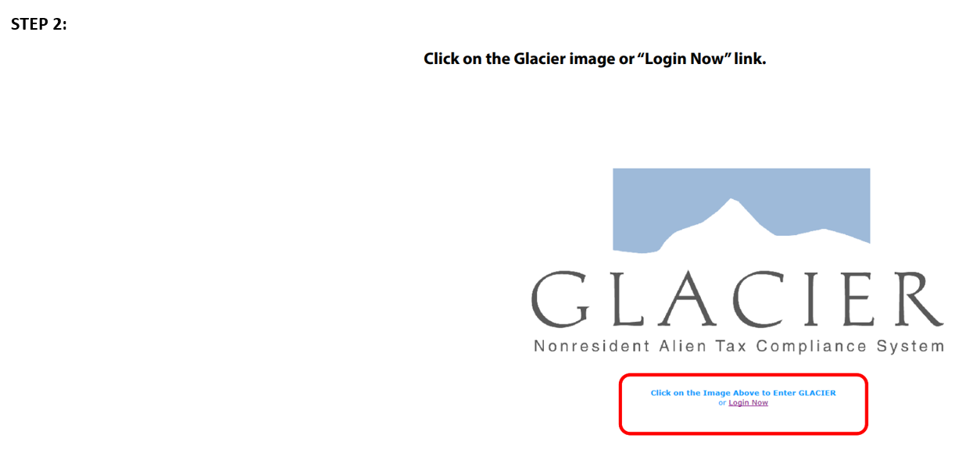
STEP 1: Click on the GLACIER web link from the email.

Slide 7
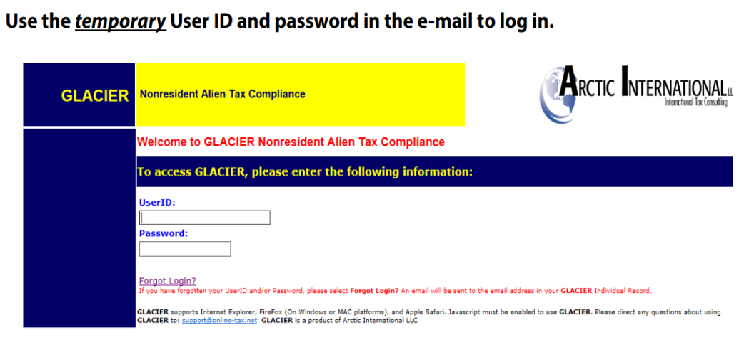
Step 3:

Slide 8
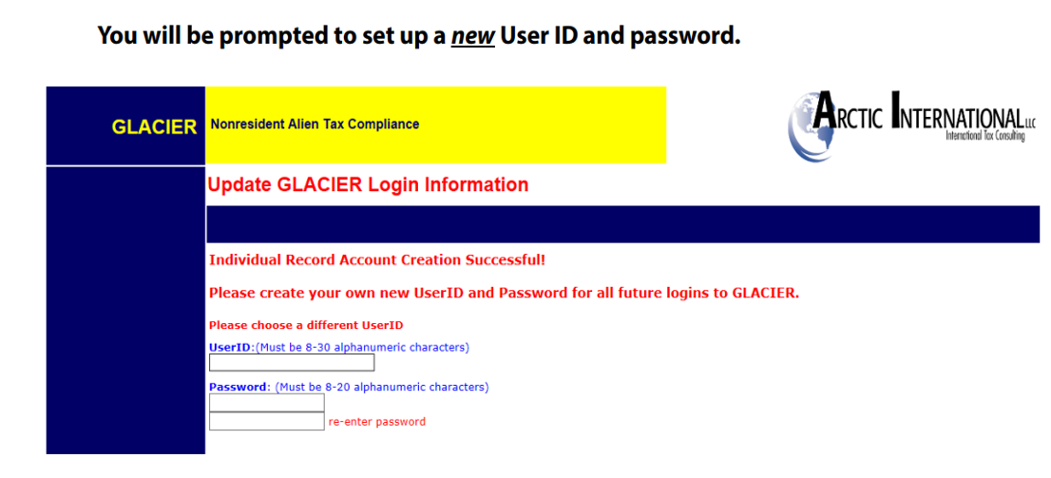
Step 4:

Slide 9
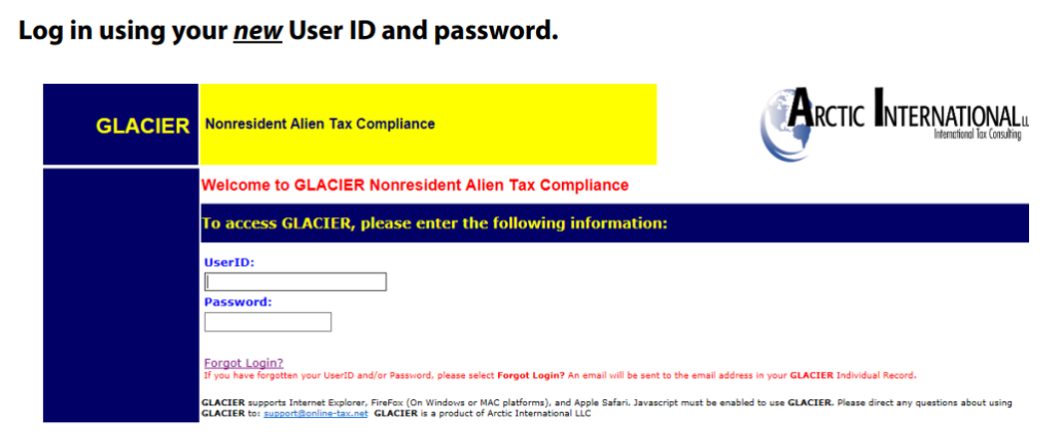
Step 5:

Slide 10
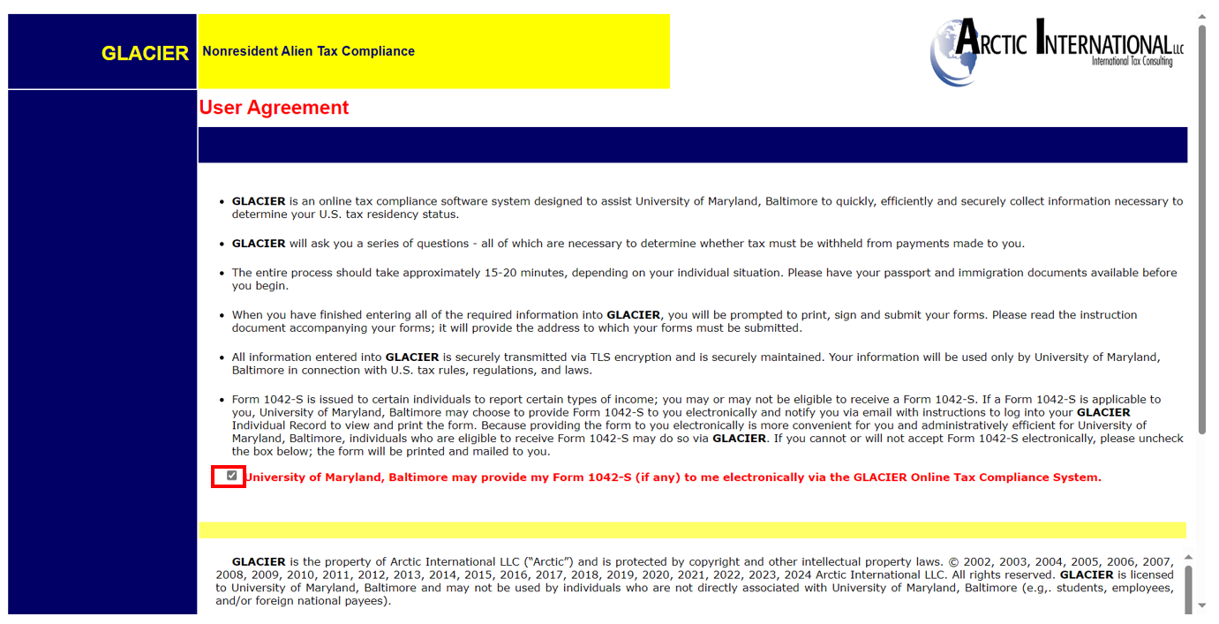
Step 6: Read the following User Agreement, click on the ‘Check Box’ (circled in red) and click ‘I Accept’ at the bottom of the page.
‘Check Box’ and click ‘I Accept’ at the bottom of the page.

Slide 11
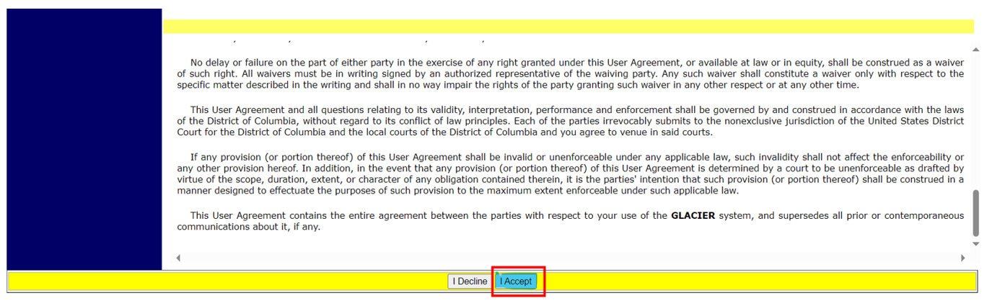
Cont’d- Step 6: Read the following User Agreement, click on the ‘Check Box’ (circled in red) and click ‘I Accept’ at the bottom of the page.
‘Check Box’ and click ‘I Accept’ at the bottom of the page.

Slide 12
PART II: CREATE YOUR GLACIER RECORD

Slide 13
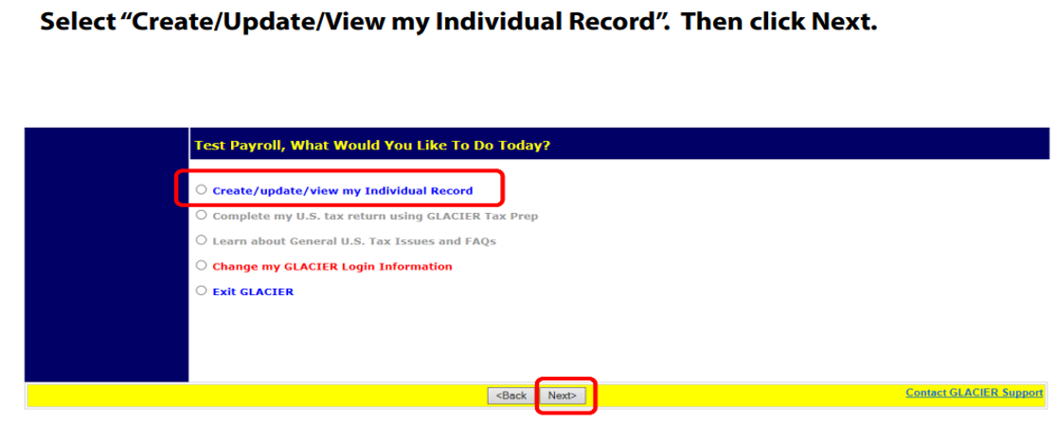
Step 1:

Slide 14
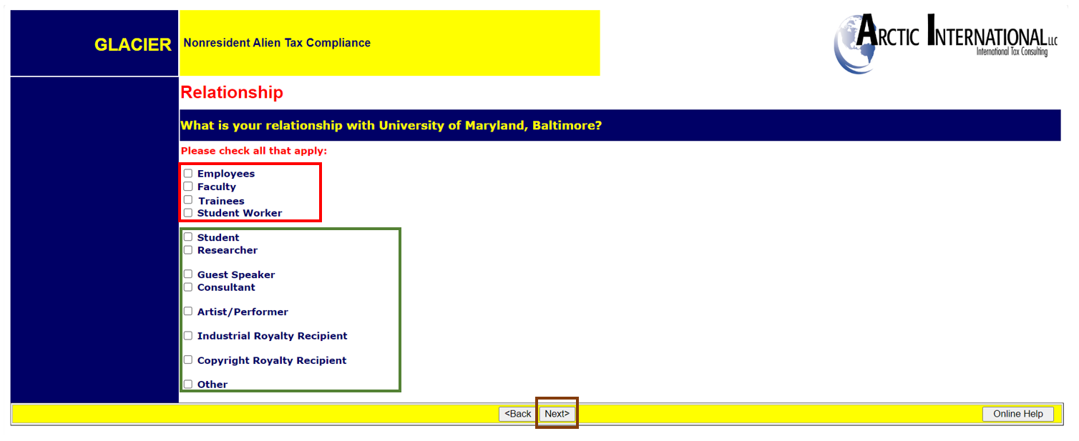
Step 2: Choose your relationship with UMB. If you are an employee, please only select from boxes circled in red. If you are a non-employee, select from boxes circled in green.
Click Next.

Slide 15
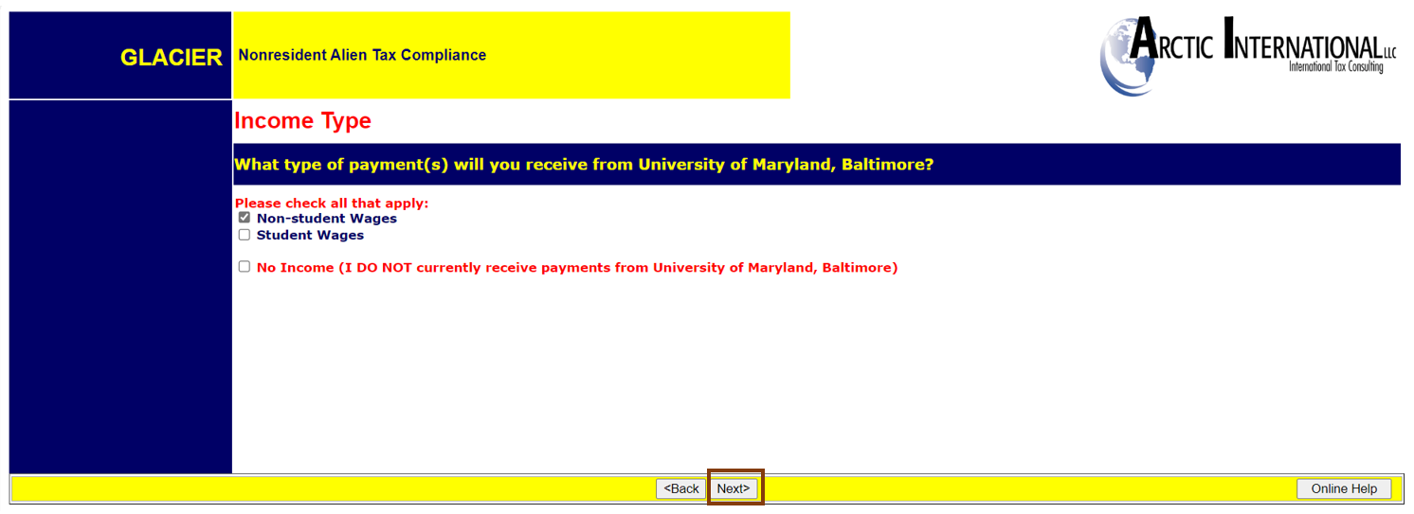
Step 3: Choose the type of payments that you will receive.
Click Next.

Slide 16
STEP 4: Enter your Personal Information:
First, Middle, and Last Name
Email Address
Social Security Number (SSN)/Individual Taxpayer Identification Number (ITIN)
Foreign Taxpayer Identification Number
Employee ID (UMB)
Click Next.

Slide 17
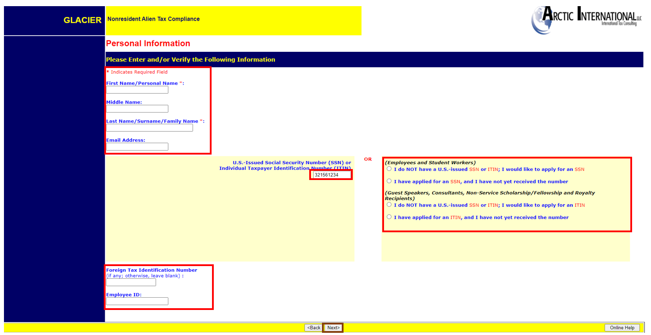
Step 4:

Slide 18
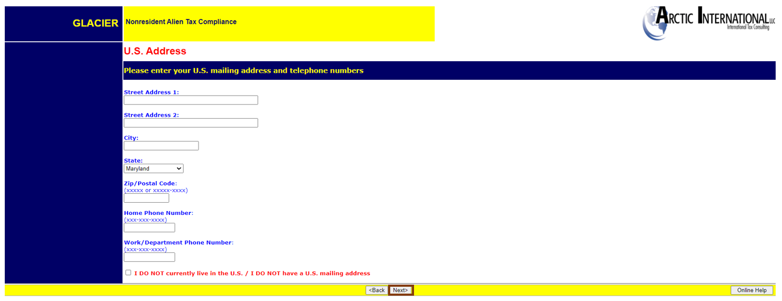
Step 5: Enter the US Address you currently live.
If you do not have a US Address, check the box “I DO NOT currently live in the US/I DO NOT have a US mailing address. (This is not normal for an employee)
Then Click NEXT.

Slide 19
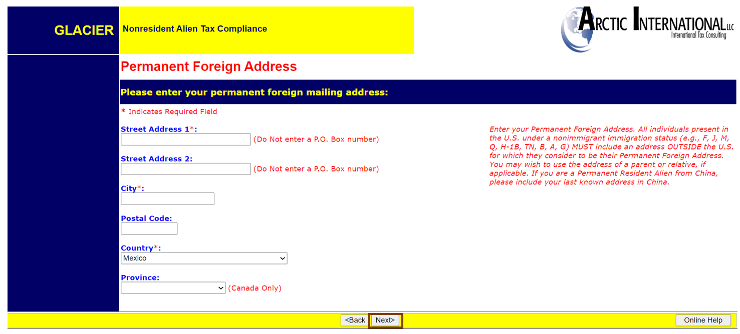
Step 6: Enter your permanent foreign address.
Then Click NEXT.

Slide 20
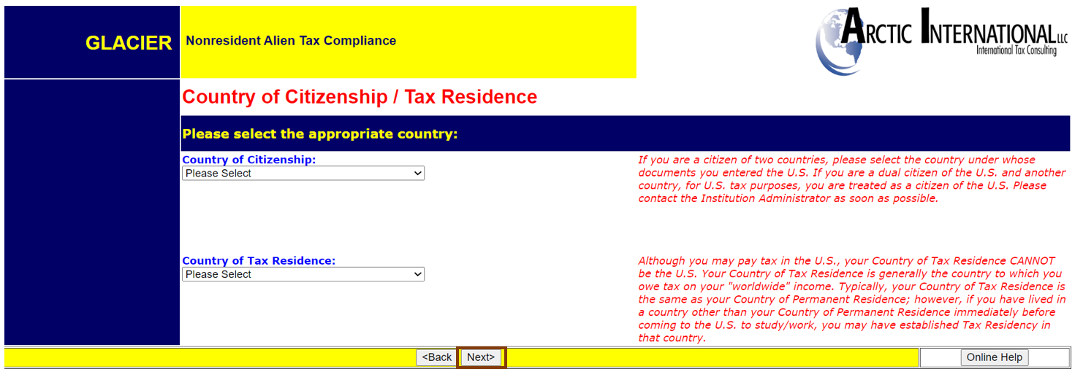
Step 7: Enter your County of Citizenship/Tax Residency from the dropdowns. Please do not select the United States. If your Country of Citizenship and Tax Residence are not the same, your account will be placed on ‘Hold’ and you will receive further instructions.
Then Click NEXT.

Slide 21
PART III: ENTER INFORMATION ON IMMIGRATION AND DATE OF ENTRY TO THE US

Slide 22
Step 1: If you are on an F-1, J-1 or H1-B, select the institution that sponsored your immigration status. This can be found on your I-20 (Certificate of Eligibility for Nonimmigrant Student Status issued by F-1 Sponsors), DS-2019 (Certificate of Eligibility issued by J-1 sponsors) or Form I-797 (H1-B). Then select your immigration status from the dropdown.
Then Click NEXT.

Slide 23
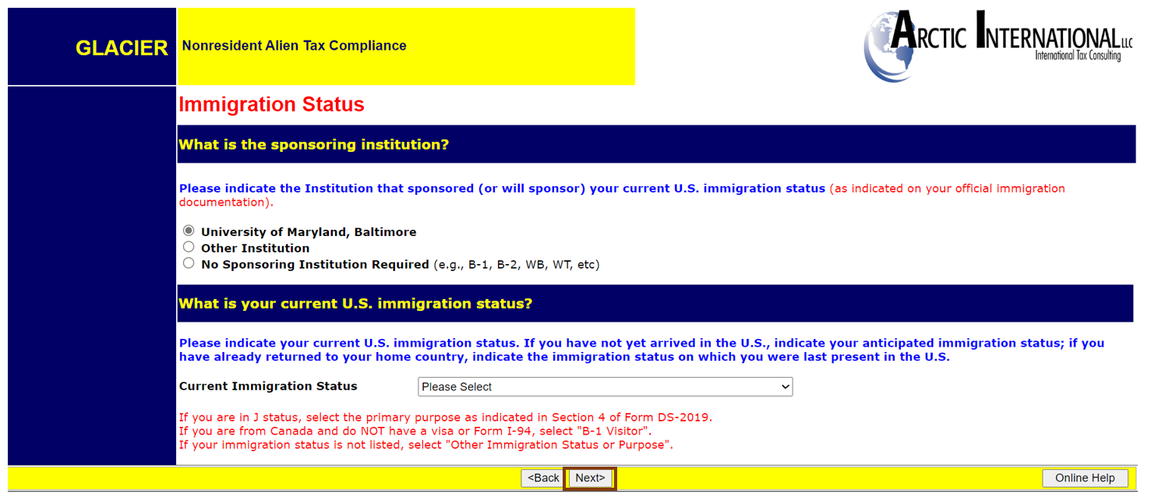
Cont’d- Step 1:

Slide 24
Step 2:
Original Date of Entry: Enter the arrival date from your current visa.
Date Permission To Stay: Enter the expiration date from your current immigration status.
Departure Date: Enter the approximate date you will permanently leave the US (not including vacations).
Then Click NEXT.

Slide 25
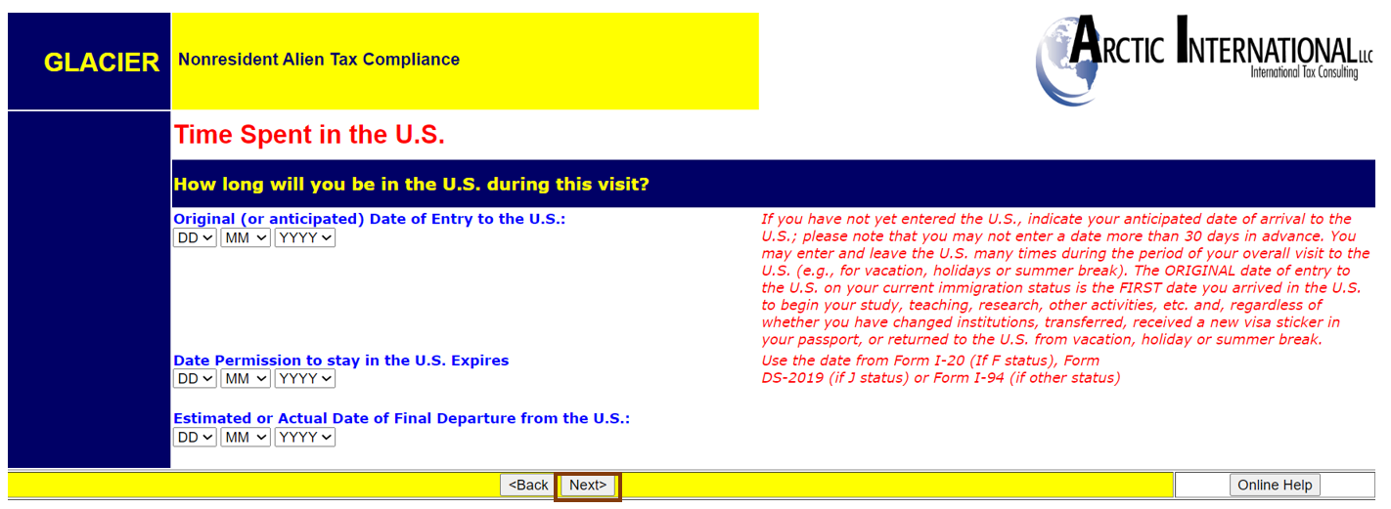
Cont’d- Step 2:

Slide 26
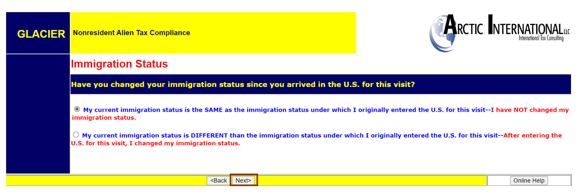
Step 3: If your immigration status has not changed since you entered the US, select the first option.
If your immigration status has changed since you entered the US, select the second option.
Then click NEXT.
:

Slide 27
Step 4: Glacier calculates Number of Days Present in the US based on the information provided.
If this is your first time been to the US, select the first option.
If you have previously visited the US, select the second option- enter the visits below.
Then click NEXT.
:

Slide 28
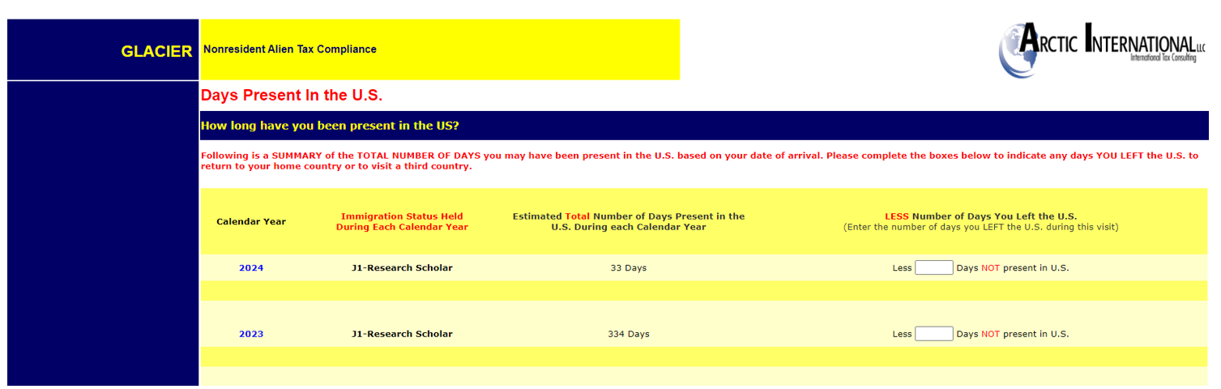
Cont’d- Step 4:

Slide 29
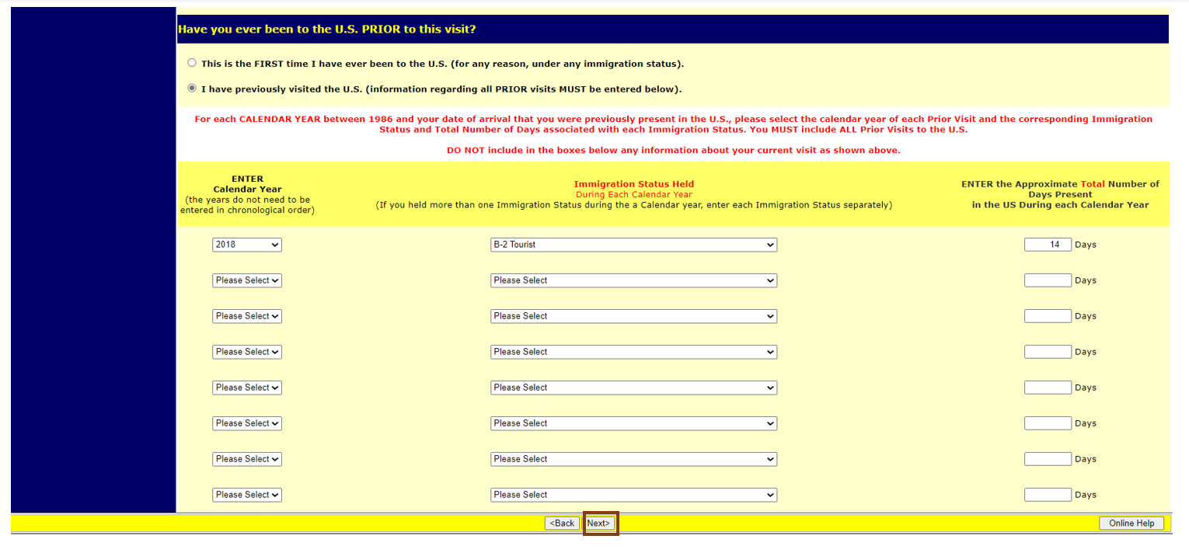
Cont’d- Step 4:

Slide 30
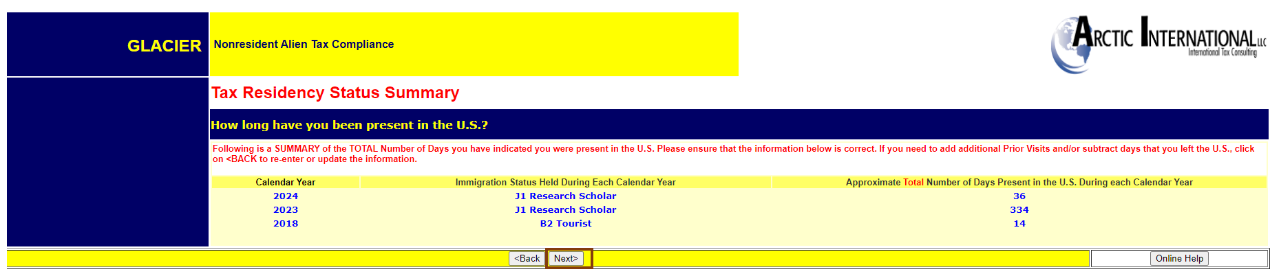
Step 5: Review the Tax Residency Status Summary
Then Click NEXT.

Slide 31
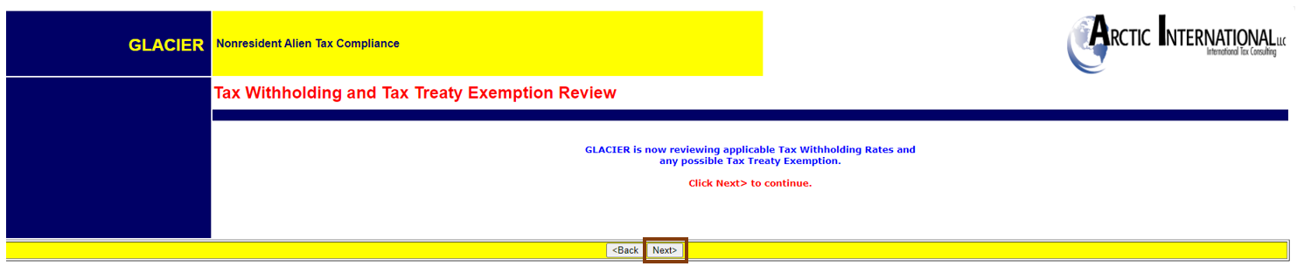
Step 6: Tax Withholding and Tax Treaty Exemption Review.
Then Click NEXT.

Slide 32
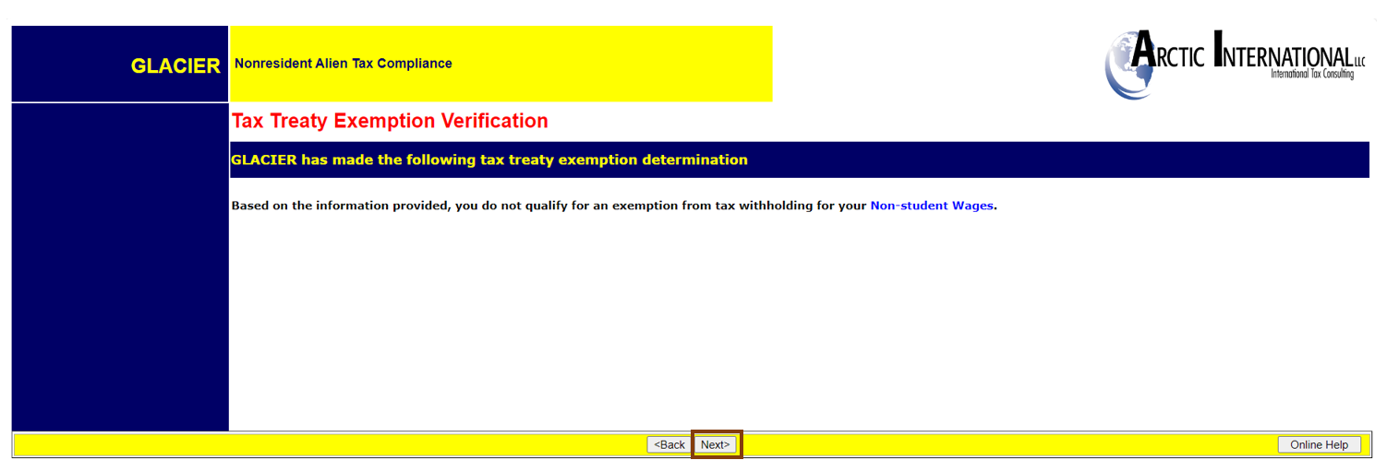
Step 7: Tax Treaty Exemption Verification Review.
Then Click NEXT.

Slide 33
Step 8: Tax Summary Report is available. Based on the information provided, GLACIER has made the determination.
Nonresident Alien for US Tax Purposes. Employee must file a ‘NRA’ W4 and MW507 forms.
No Tax Treaty exemptions
FICA Tax Exempt
Forms required to be completed-
Tax Summary Report
Tax forms W-4 (Federal) and MW507 (State)– Forms must be retrieved from link Employee - Tax Form Table - Payroll Services (umaryland.edu)
Attach required document copies-
I-94/I-o4W
Visa sticker page
Form DS-2019
Then click NEXT.
:

Slide 34
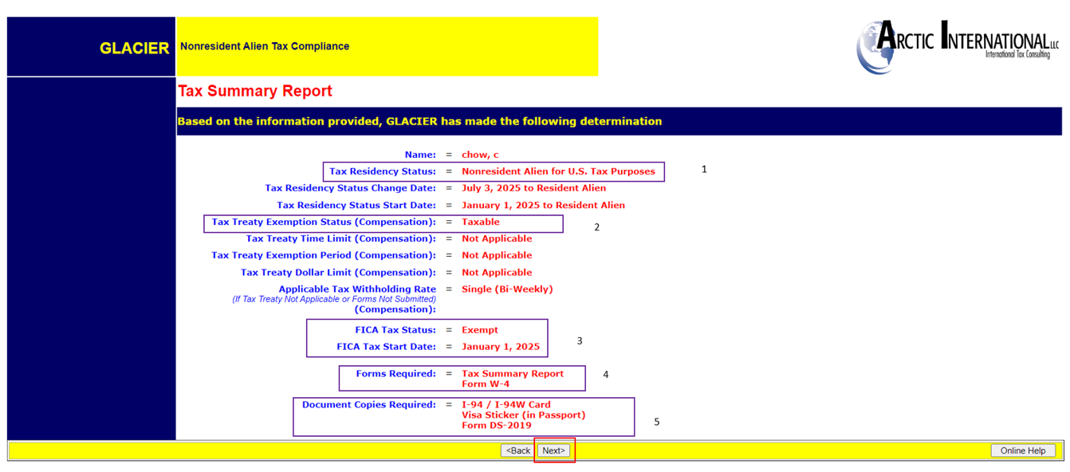
Cont’d Step 8:

Slide 35
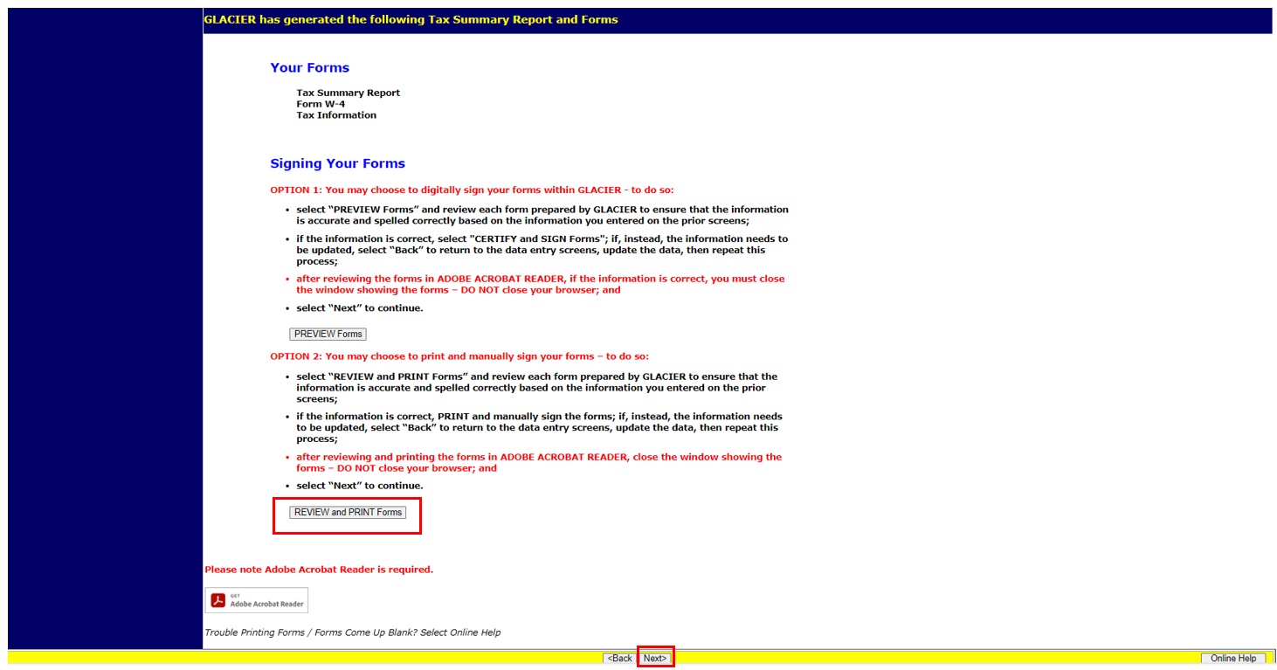
Step 9: Click ‘Review and PRINT Forms’
Then Click NEXT.

Slide 36
Step 10: Print the Tax Summary Report.
This date should be the same as the Immigration Document, i.e. DS-2019 for J1, I-20 for F1, etc.
Tax Residency has been determined as NonResident Alien For US Tax Purposes (NRA).
No Tax Treaty available
FICA tax Exempt- submit the GLACIER packet to your department payroll representative at your earliest convenience. FICA tax will not be turned off until GLACIER packet has been processed by The Office Of The Controller- Payroll Services (OOTC-PS).
Complete the Required Forms
Form W4- You must complete the following 2 Tax forms (forms must be typed with wet signature). The forms must be retrieved from our webpage at: Employee - Tax Form Table - Payroll Services (umaryland.edu)
W-4 (Federal) and
MW507 (State)
Attach the required Document Copies
Sign and Date the Tax Summary Report in black ink
:

Slide 37
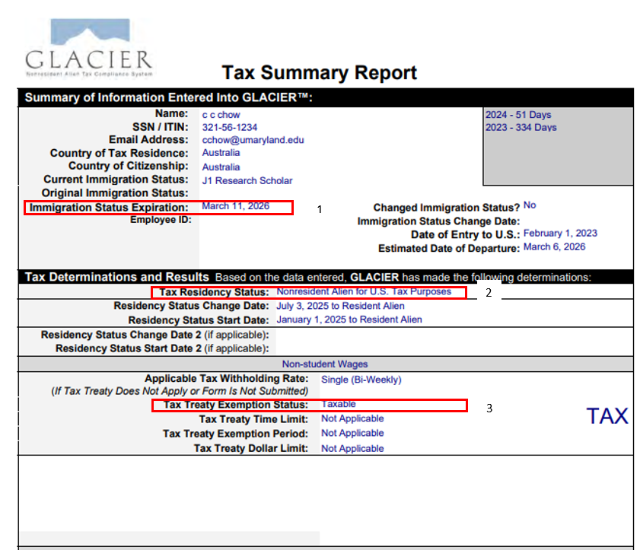
Cont’d- Step 10:

Slide 38
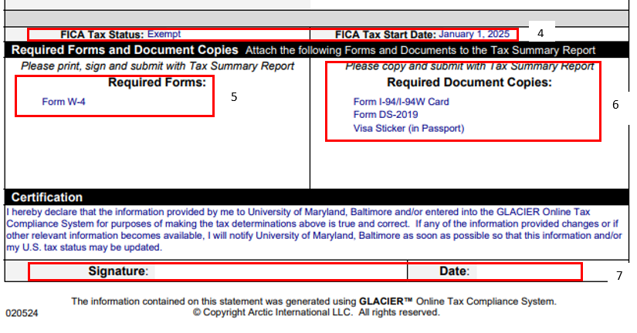
Cont’d- Step 10:

Slide 39
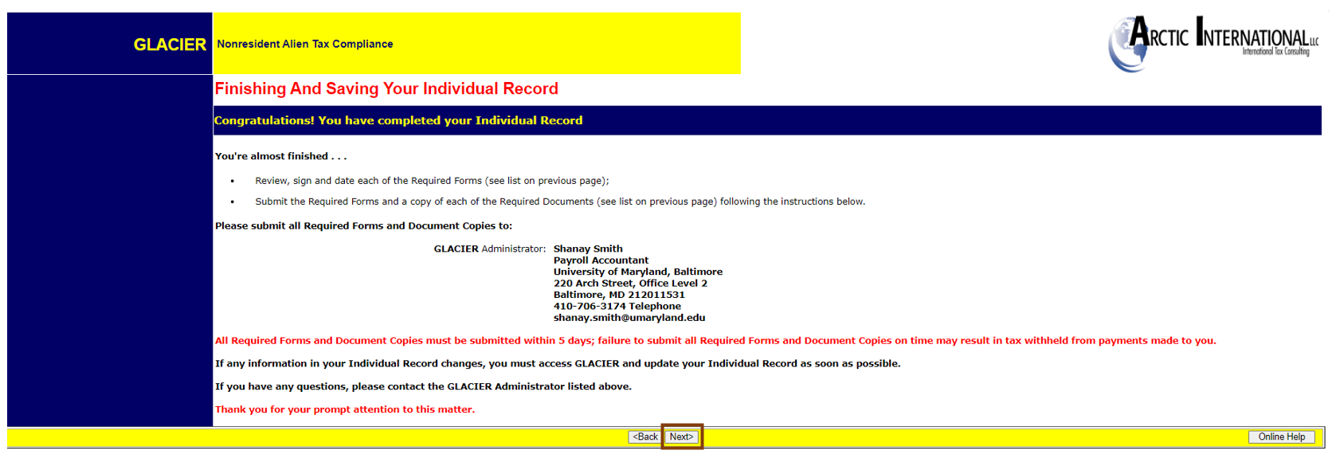
Step 11: Submit the GLACIER packet to your department payroll representative for review and submission.
Then Click NEXT.

Slide 40
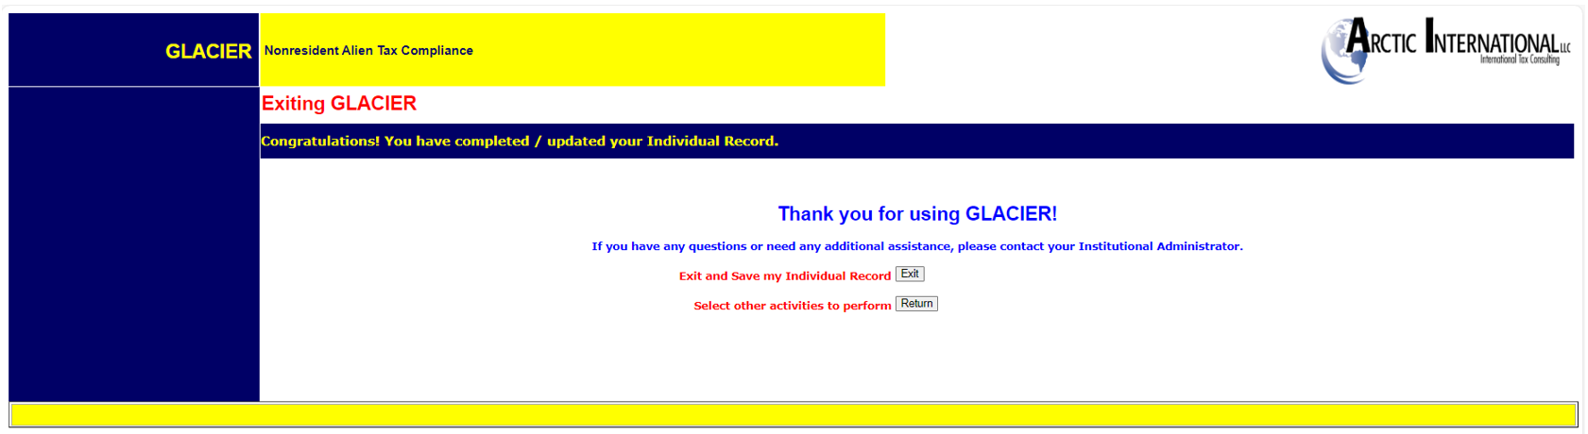
Step 12: Click ‘Exit’ to Exit and Save your Individual Record OR
Click ‘Return’ to Select other activities to perform.

Slide 41
Employees must update their GLACIER record if they have any changes on Visa type, Status, or estimated departure date. This is important because it may affect their tax treaty benefits and/or FICA taxes. Employees should also validate their paychecks. See below example 1 and 2.
Employees who was granted a green card or permanent residency must update their GLACIER record. Print and Submit the updated change. See below example on Status change to US Permanent Residence.

Slide 42
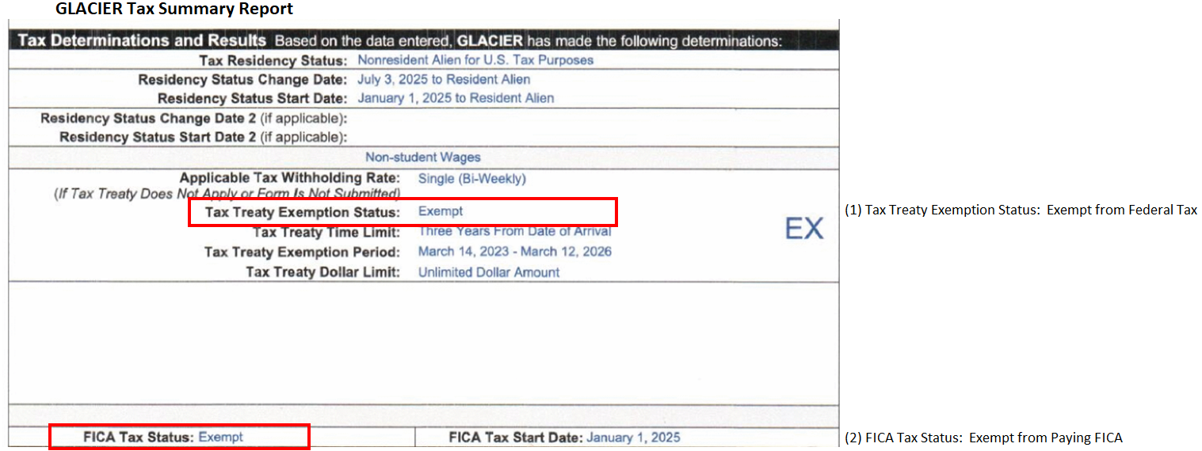
EXAMPLE 1: GLACIER Tax Summary Report Decision
-- Eligible for Tax Treaty and Exempt from FICA Tax

Slide 43
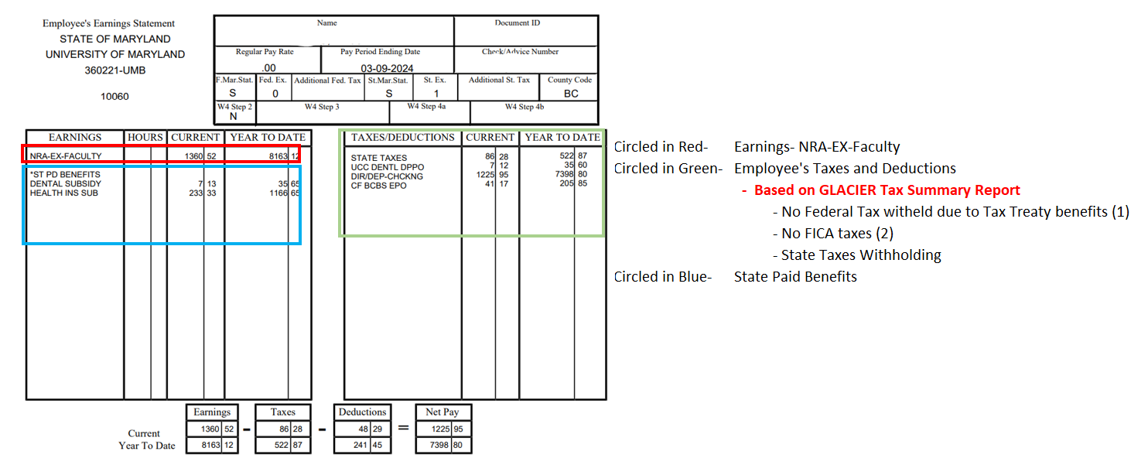
EXAMPLE 1: Validate Paycheck based on GLACIER Tax Summary Report Decision
-- Eligible for Tax Treaty and Exempt from FICA Tax

Slide 44
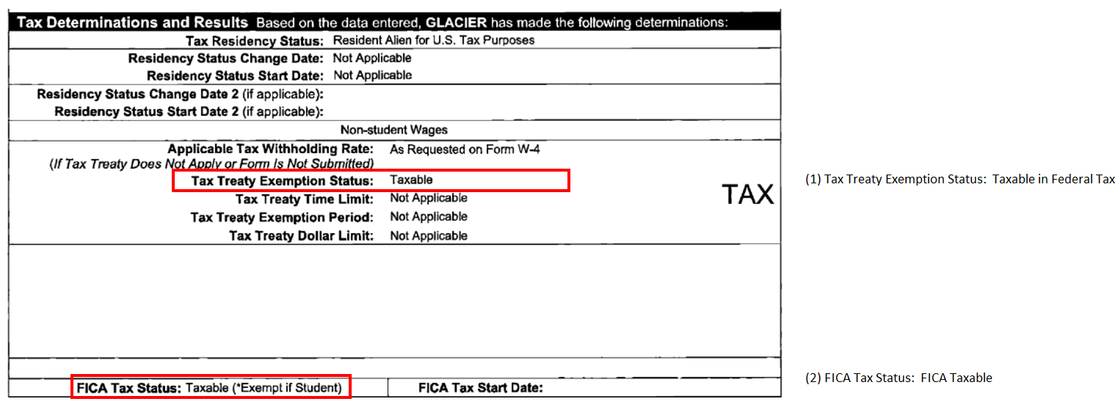
EXAMPLE 2: GLACIER Tax Summary Report Decision
-- Not Eligible for Tax Treaty and Subject to FICA Tax

Slide 45
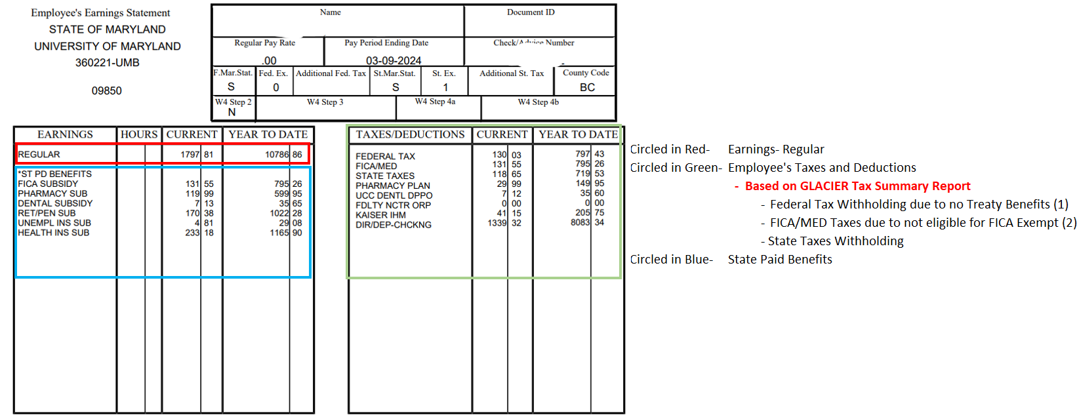
EXAMPLE 2: Validate Paycheck based on GLACIER Tax Summary Report Decision
-- Not Eligible for Tax Treaty and Subject to FICA Tax

Slide 46
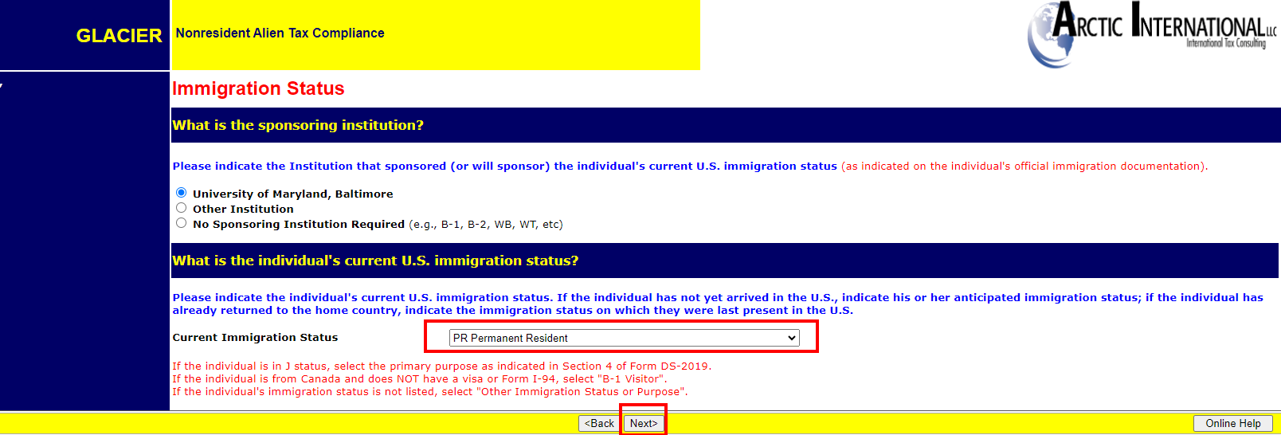
Update Immigration Status to US Permanent Resident

Slide 47
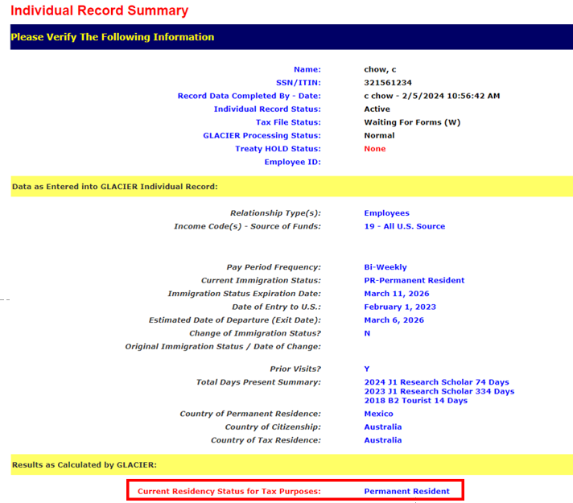
Updated status to Permanent Resident
Print out the GLACIER Record Summary and Complete
A Permanent Resident Certificate and send them
To your Payroll Representative to be submitted
To the OOTC-PS office.
The Permanent Resident Certificate can be found at:
Payroll Forms - Payroll Services (umaryland.edu)

Slide 48
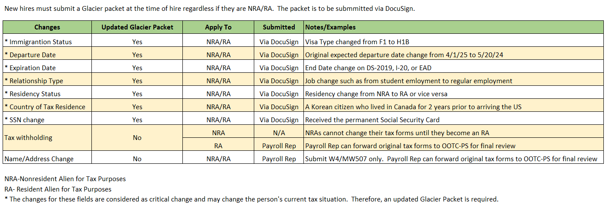
When to update/submit an updated Glacier Packet

Slide 49
THE END
Contact DL-BF NRA Help if you have any questions.

