Slide 1
Asset Management
Capital and Non-Capital
Presenters:
Alexandra Zouras-Wieneke, Deputy Controller (OOTC)
Jennifer Thompson, Director (MAS)
September 26, 2023

Slide 2
Agenda
Introductions
Procedural Overview
Capital Assets
Non-Capital Assets
Employee Reimbursements
Compliance
Important Reminders

Slide 3
Introductions

Slide 4
Introductions
General Accounting
Ajibola Akintola, Director
Roshaun Nelson, Accounting Supervisor
Nicole King, Accountant
Briana Griffin, Accounting Associate
Financial Reporting
Bryan Mack, Financial Reporting Manager

Slide 5
Capital Assets

Slide 6
Capital Assets
Capital Asset Management Procedures
Definitions and Terms:
Real Property – Buildings and building improvements, land improvements, infrastructure, and construction in progress
Personal Property – Equipment, library books, and software
Capital Asset Equipment – is all equipment not permanently affixed to the buildings, have a useful life of greater than one year, and a unit cost of $5,000 or greater.

Slide 7
Capital Assets
Equipment added to the Fixed Asset System must meet all definition criteria
  
Not Permanently Affixed to Buildings
Useful Life over 1 year
Unit Cost $5,000 or greater

Slide 8
Capital Assets
Qualifying Assets are uploaded monthly into the Fixed Asset System by General Accounting based on the object code used when purchasing
Purchase Invoices are reviewed to confirm the asset meets criteria
Costs to develop equipment and place the asset into working order are added to the unit cost, e.g., add-on equipment components, software, installation costs, shipping costs, etc.
Unit Costs + Additional Costs = Total Equipment Costs
The total equipment costs is what is added to the fixed asset system.
Tag numbers are assigned during the system upload process and General Accounting generates the tag certification form that is provided to department personnel when equipment is tagged.
Backlog in tagging!

Slide 9
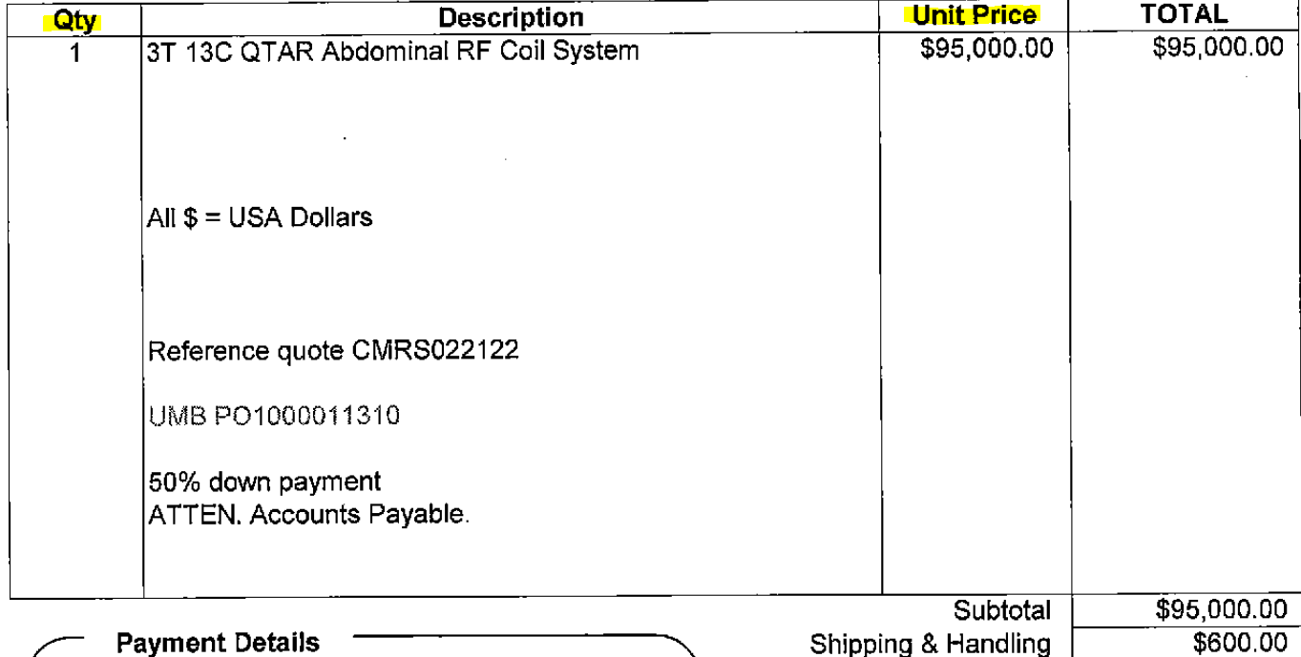
Capital Assets
Invoice Example where the unit cost exceeds $5,000.
This qualifies as a capital asset purchase, use correct capital asset obj code.

Slide 10
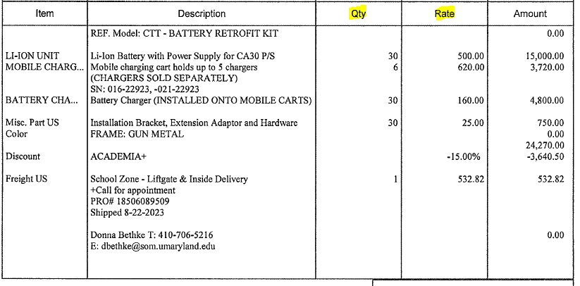
Capital Assets
Invoice Example where the unit cost is under $5,000 but the total equipment purchase is over $5,000.
This does NOT qualify as a capital asset purchase, use the correct non-capital asset/supply object code.

Slide 11
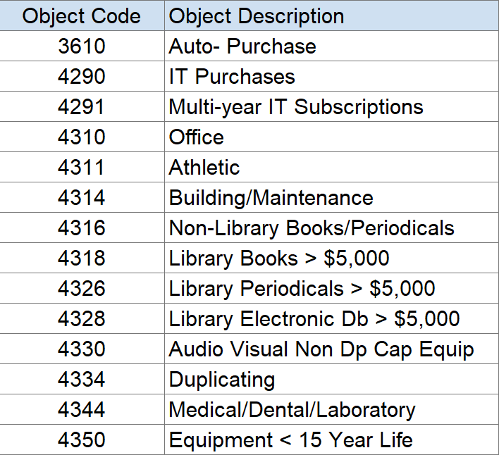
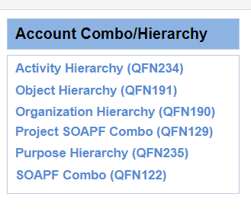
Capital Assets
Correct capital asset object codes to use when the purchase qualifies as a capital asset:

Slide 12
Capital Assets
Physical Count of Capital Asset Inventory
Biennial (every 2 years) physical count of all capital assets assigned, conducted by department/division
Resuming count process September/October 2023
Inventory Reports now available in Quantum Financials for users to run and begin counting
Great time to catchup on tagging equipment, please contact GeneralAccounting@umaryland.edu to arrange pickup or delivery of tags
General Accounting will send out instructions for the inventory count submission process to all Department Administrative Deans and Financial management personnel
General Accounting will perform independent verification after inventory counts are submitted

Slide 13
Capital Assets
Transferring Capital Assets to UMB from another university or accepting donated Capital Assets, these assets must be accounted for and recorded in the Fixed Asset System, please notify General Accounting GeneralAccounting@umaryland.edu
Transferring Capital Assets purchased with sponsored funds to another university, the department must follow the Office of Research & Development (ORD) Transfer Policy
Changes to Assets
Location changes or department transfers
Capital Equipment Transfer Form and send it to GeneralAccounting@umaryland.edu
Asset disposals
UMB Surplus Property Form, docusign form, is routed to facilities and then to General Accounting to retire the asset in the system

Slide 14

Questions
This Photo by Unknown Author is licensed under CC BY

Slide 15
Non-Capital Assets

Slide 16
Non-Capital Assets
Non-Capital Asset Procedures
Definitions and Terms
Non-Capital Asset (NCA) – Equipment or other physical assets with the acquisition cost of $1,000 or more but less than $5,000 per unit and have a useful life greater than one year
Designated Non-Capital Asset (DNCA) – a subset of NCA’s that require additional stewardship and documentation. DNCA’s are sensitive items that are easily converted to personal use and susceptible to theft
Employee Equipment Acknowledgment System – used to generate and store the EEA Form for employees to acknowledge DNCA’s assigned to them and their responsibilities for the equipment

Slide 17
Non-Capital Assets
Operational Units are required to
Identify an NCA Custodian who oversees the assignment, tagging, disposing, and recordkeeping of NCAs
Properly segregate duties (authorization, purchasing, custody, and recordkeeping)
Record NCA purchases appropriately (3953 obj)
Tag assets (tags available from Genera Accounting)
Assign DNCA’s to employees using the EEAF and the EEAF sys
Retain appropriate NCA/DNCA documentation and records

Slide 18
Non-Capital Assets
Designated Non-Capital Assets (DNCA)
Laptops
Tablets
Audio/Visual
NCAs located in a residence
Optional – Operational Units may choose to classify additional items as DNCA’s
Mobile phones
Desktop Computers
Equipment costing less than $1,000 located in a residence
All DNCAs must be assigned/recorded into the EEAF system within 30 days of purchase by the NCA Custodian

Slide 19
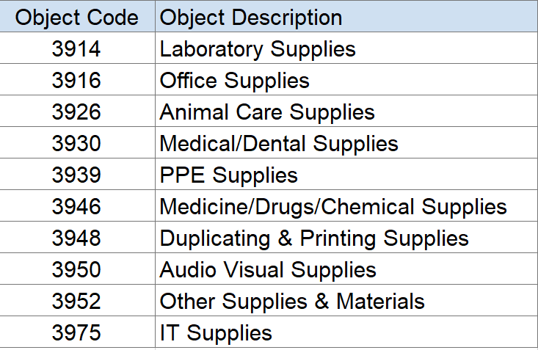
Non-Capital Assets
Correct object code to use when the purchase qualifies as a non-capital asset = 3953 Non-Capital Assets
If your purchase does not qualify as a non-capital asset, use an appropriate supply object code:

Slide 20
Non-Capital Assets
NCA Disposals
Follow the Disposal of Surplus Property Policy
Be mindful that disposing computer equipment has additional processes and must comply with
Disposal of Media Containing Data Policy
Using the IT Disposal System if disposing items containing data
For items not containing data, complete the Excess Property Declaration Form
DNCA’s disposals must also be recorded in the EEAF system

Slide 21

Questions

Slide 22
Employee Reimbursements

Slide 23
Employee Reimbursements
Employee Reimbursements for certain business expenses are processed through Concur.
Reimbursement for items that are extravagant or excessive may be denied or employee may be required to repay UMB.
Equipment, supplies, and materials for use at an off-campus site must be shipped to UMB and picked up by the employee.
If the appropriate object code is not available in concur, the reimbursement must be submitted via a NONPO payment request
Per the telework policy, employees are responsible for the cost of operating their remote worksite including personal equipment, furniture, and internet service (section F-1).
Equipment provided by UMB for remote worksites are the property of UMB and must be returned

Slide 24
Questions
This Photo by Unknown Author is licensed under CC BY

Slide 25
Compliance

Slide 26
Compliance
Audit Findings
Donated capital assets not recorded in inventory
Disposal procedures not followed
Media Containing Data / Assets taken with departing PIs
Failure to follow Non-Capital Asset Policy
Purchases not recorded in EEAF or details inaccurate
Assets not assigned or not accepted
EEAF system not being used at all ☹
Key Reminder
Pcard point of purchase and/or centralized IT office receiving offer opportunities to ensure compliance (record tag number!)
Management Advisory Services
Routine Pcard reviews evaluate NCA policy compliance
Follow-up to ensure audit recommendations are addressed

Slide 27
Questions

Slide 28
Important Reminders

Slide 29

Important Reminders
Follow Policies and Procedures
Submit asset changes using proper forms
Use correct asset object codes
Contact GA to pick up asset tags or to arrange for tagging
Assign and Record DNCAs in EEAF System
Ensure emp business reimb. are appropriate

Slide 30

Questions

Slide 31
Links
Capital Asset Management - https://www.umaryland.edu/media/umb/af/fs/policies/CapitalAssetManagement.pdf
Capital Equipment Transfer Form - https://www.umaryland.edu/media/umb/af/fs/forms/CapitalEquipmentTransfer.pdf
ORD Transfer Policy - https://www.umaryland.edu/spa/policies-and-procedures/equipment-management/equipment-transfer-policy/
Surplus Property Form - https://powerforms.docusign.net/f155b440-75da-44e7-a952-7948da405f3f?env=na3&acct=f779d0ec-0798-4308-920b-6ee2bfff1782
Non-Capital Asset - https://www.umaryland.edu/policies-and-procedures/library/financial-affairs/procedures/controller/non-capital-assets.php
NCA Disposals - https://www.umaryland.edu/policies-and-procedures/library/financial-affairs/policies/viii-120a.php

Slide 32
Links
NCA OOTC Webpage - https://www.umaryland.edu/controller/general-accounting/non-capital-assets/
EEAF System - webauth.umaryland.edu/idp/profile/SAML2/Redirect/SSO?execution=e1s1
Employee Reimbursements - https://www.umaryland.edu/controller/disbursements/employee-reimbursements/
Telework Policy - https://www.umaryland.edu/policies-and-procedures/library/human-resources/policies/vii-611a.php

