Slide 1
Cash Receipts and Deposit Workshop
Presenters
Alexandra Zouras-Wieneke, Deputy Controller (OOTC)
Jordan Nixon, Assistant Controller/Bursar (OOTC)
Rama Camara Spasic, Director (SPAC)
Jennifer Thompson, Director (MAS)
September 19, 2023

Slide 2
Agenda
Introductions
Cash Handling Procedures Definitions & Concepts
Cash Handling Procedural Overview
Collections Process - Billing & Revenue
SPAC Billing & Revenue
Compliance
Important Reminders

Slide 3
Introductions

Slide 4
Introductions
General Accounting Team
Ajibola Akintola, Director
Roshaun Nelson, Accountant Supervisor
Nicole King, Accountant
Briana Griffin, Accounting Associate

Slide 5
Procedural Definitions & Concepts

Slide 6
Procedural
Definitions & Concepts
Link to procedures - Handling Cash and Depositing UMB Funds
Cash receipts - are cash and checks received by an operating unit through the mail or in-person
Inherently risky process – controls are necessary!
Why are checks received by unit versus other available collections avenues (e.g., lockbox)?
Operational units are encouraged to use alternate collections avenues

Slide 7
Procedural
Definitions & Concepts
UMB Funds - All funds administered by UMB, regardless of fund source. UMB funds include State appropriated general funds, tuition, fees, and other income, as well as auxiliary funds, revolving/discretionary funds, Designated Research Initiative Funds, gifts, contract or grant revenues, and other restricted funds.
UMB funds are the property of the State of Maryland
State regulations apply to the management, safekeeping, and use of UMB funds
UMB Funds must be deposited into the State Treasury the first working day after the funds are received
preference is to deposit funds on the day received

Slide 8
Procedural Overview

Slide 9
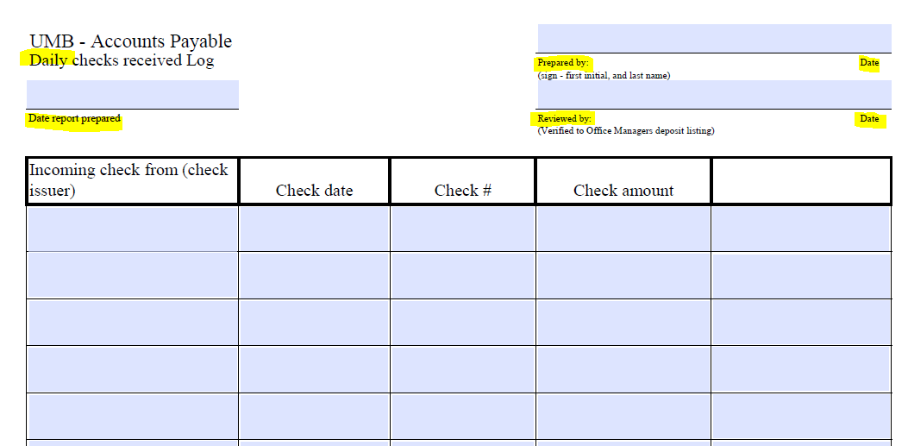
Procedural Overview
Receiving Cash/Checks
Funds must be recorded on a log immediately upon receiving and restrictively endorse checks/money orders.

Slide 10
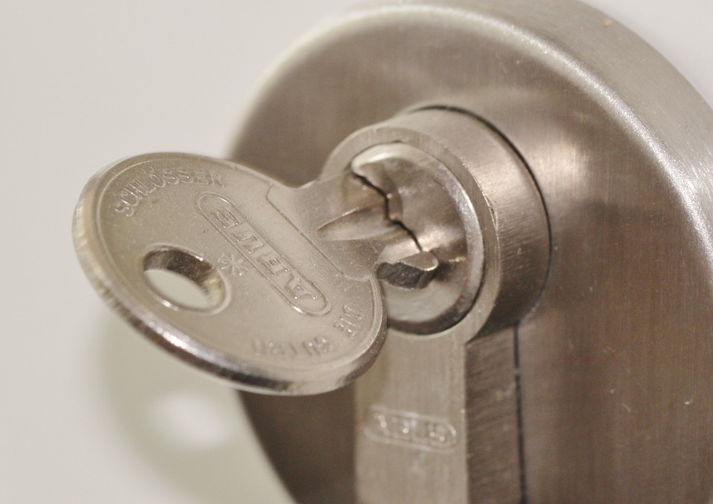


Procedural Overview
Securing Cash/Checks
Cash/Checks must be kept in secure location

Access
Restricted

Locked

Safe
Cabinet

Slide 11
Procedural Overview
Depositing Cash/Checks
Prepare online deposit summary form
Located on Student Financial Services - University Cashier website
Complete online deposit form, print form, and take form, funds, and documentation required per deposit type to the Cashier’s Office for processing
Follow deposit instructions so that revenue is applied correctly
Cashier will provide a receipt which confirms deposit was taken to/received by the cashier – Important for the deposit verification
Funds must be deposited the 1st working day after funds are received
Deposits accepted at Cashier's Office during business hours
Operational Units must not leave deposits at the cashier window unattended

Slide 12
Procedural Overview
Deposit Verifications
Deposits must be verified by Operational Units
Performed within 2 business days after funds are taken to cashier’s office
Performed by an independent person
Verify cashier receipt against the initial recordation log
Document the verification by initialing and dating the log/receipt Example on next slide
Legislative Audit Finding!

Slide 13
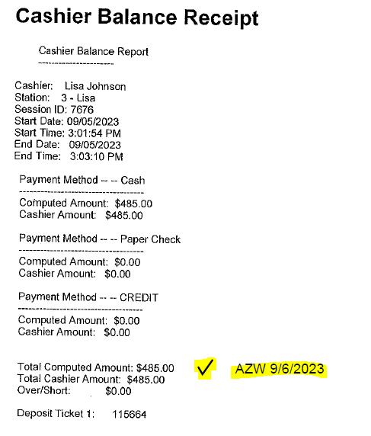
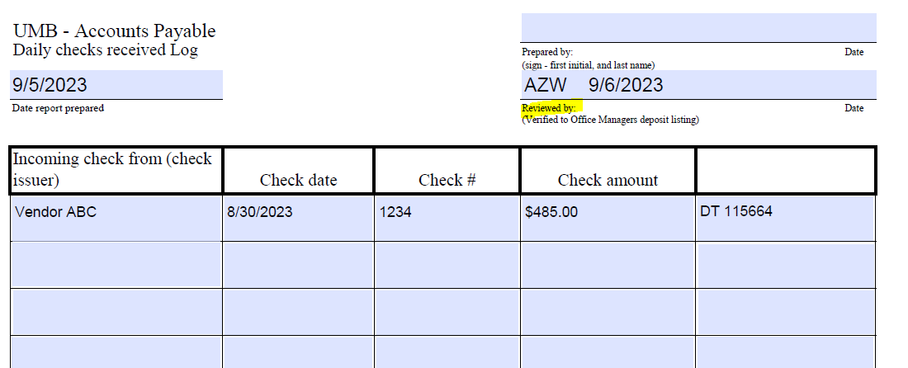
Deposit Verification Example

Slide 14
Procedural Overview
Reconciliations
Deposit Transactions must be reconciled monthly
Compare the deposit logs against the general ledger activity to confirm deposits were properly recorded (Trans Union Report, Misc. Receipt transaction type)
Document the reconciliation by signing and dating rec docs
The reconciliation must be reviewed by Dept. Head or Designee and documented (sign/date)
Discrepancies must be investigated/resolved, report unresolved differences to unit supervisor and Management Advisory Services

Slide 15
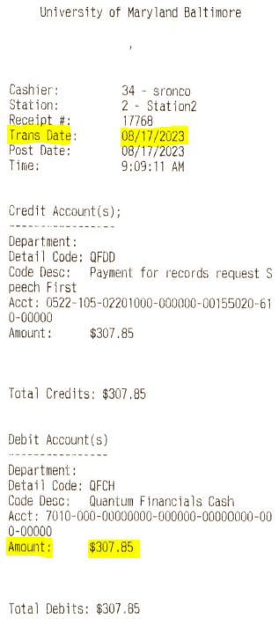
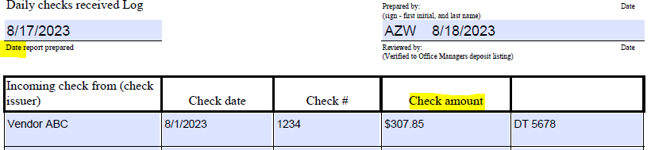
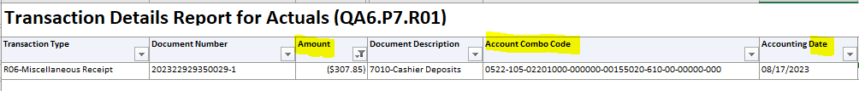
Deposit Verification and Reconciliation Example
Cashier Receipt
Deposit verification - compare the initial log with the cashier receipt
Initial Recordation Log
Reconciliation – confirming the deposit posted in the financial system

AZW 8/18/23

Slide 16

Questions
This Photo by Unknown Author is licensed under CC BY

Slide 17
Collections Billing and Revenue

Slide 18
Collections Billing & Revenue
Operational Units who bill external customers for goods and services must do so through the appropriate billing system:
Non-Sponsored – Customer Billing System
Sponsored – Sponsored Billing System
Using a billing system makes it easier for SPAC and General Accounting to identify and post the revenue
Unidentified revenue remains unclaimed, not applied to unit
Operational Units will not receive revenue until the bill is paid (except for Foundation bills)

Slide 19
Collections Billing & Revenue
Non-Sponsored – Customer Billing System (CBS)
Operational Unit is responsible for
Initiating the bill in the CBS
Sending out the initial invoice to the customer
Following up with customers to collect on the bill
General Accounting is responsible for
Add new customers and memo lines upon request using request forms on GA website
Sending out dunning notices (reminder invoices)
Reporting unpaid bills to the State Central Collections Unit (SCCU)

Slide 20
Collections Revenue
Collections revenue (or payments from customers) are received in multiple ways
ACH/Wires
Lockbox (checks)
Online Payments (credit card)
RSTARS Transfers (from other state agencies)
Unclaimed revenue lists are posted on the OOTC website for Operational Units to review to locate a customer payment. To claim funds, contact:
General Accounting (non-sponsor funds) - GeneralAccounting@umaryland.edu
SPAC (sponsor funds) – SPACcollections@umaryland.edu

Slide 21

Questions

Slide 22
SPAC Billing & Collections Overview

Slide 23
SPAC Billing Overview
Only SPAC is authorized to create sponsored invoices for the University
SPAC creates all Cost, LOC (Letter of Credit) and Schedule invoices
Volume and Milestone invoices are created by the department, but they must submit “events” in the OSN “Social” platform in Quantum Financials
Tutorials on how to create events can be found within the UPK system at https://cf.umaryland.edu/upk/quantum/PlayerPackage/data/toc.html
The department must upload a copy of the invoice to the event
Through this process, SPAC will create an internal invoice that will show in QA under “Award Detail”
Additional guidance on creating a Volume and Milestone Invoice can be found at Policies and Procedures - Sponsored Projects Accounting and Compliance (SPAC) (umaryland.edu)

Slide 24
SPAC Collections Overview
Make Checks Payable to:
University of Maryland, Baltimore
Sponsored Projects Payments
Remit to: University of Maryland, Baltimore
PO Box 41428 Baltimore, MD 21203-6428
The site Address: 220 N. Arch Street Baltimore MD 21201 should not be used as the payment address
If a payment by check is received in error by the department, the check should be deposited via cashier’s office.

Slide 25
SPAC Collections Overview
On the Deposit Form
Select the “SPON Invoice Payment” deposit type.
The Deposit Distribution will default to object 7126, SOAPF all zeros. SPAC will apply the payment to the open invoice
Always be sure to include the Maker of the Check on the form.
In the Deposit Description field, please reference the PI, Project ID Invoice Number (if known)
Always bring a copy of the printable deposit summary form, photocopy of the check, along with additional backup such as Award Number and PI to assist SPAC with posting the payment.
For Clinical Trial payment identification purposes, please include additional backup with the project title or protocol number (if known)

Slide 26
SPAC Collections Overview
ACH Forms: forms should be sent to spaccollections@umaryland.edu for completion. This will ensure that all bank/financial information is completed accurately.
Remittance Advice: all payment advices should be sent to spaccollections@umaryland.edu to aid in posting funds accurately to each project.

Slide 27

Questions

Slide 28
Compliance

Slide 29
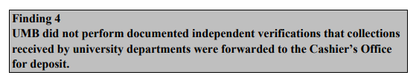
Compliance
Legislative Audit Finding:
Key words: “Documented” and “Independent”
Properly maintained initial recordation log is necessary for deposit verifications
An “independent” verification must be performed by someone without access to cash receipts
A “documented” verification must include signature/initials, date, and be retained!
Follow-Up Timing
Management Advisory Services performs audit follow up reviews in preparation for auditors
USM auditors start assessing the current-status this month!
Legislative Auditors expected back summer/fall 2024

Slide 30
Important Reminders

Slide 31
Important Reminders

1. Record funds on log immediately
2. Deposit funds timely, don’t hold funds
3. Get cashier receipt, don’t leave deposits at window
4. Follow deposit instructions so funds are applied easily
4. Verify and reconcile deposits and document
5. Use AR Billing System to collect revenue

Slide 32

Questions

Slide 33
Links
Cash Handling Procedures - https://www.umaryland.edu/policies-and-procedures/library/financial-affairs/procedures/controller/handling-cash-and-depositing-umb-funds.php -
SFS University Cashier - https://www.umaryland.edu/student-financial-services/university-cashier/ -
Customer Billing - https://www.umaryland.edu/policies-and-procedures/library/financial-affairs/procedures/controller/customer-billing-and-collections.php
Customer Billing Forms - https://www.umaryland.edu/controller/general-accounting/customer-billing-forms/
OOTC Unclaimed Revenue - https://www.umaryland.edu/controller/unclaimed-payments/ -
22

