Slide 3
FY26 CA Rollover
Thursday, May 22, 2024
10am- noon

Slide 4
Agenda
SPAC-Costing and Compliance (SPAC-CC)
FY26 Fringe Benefit Rates
Fiscal Year End Deadlines: Direct Retro and Budget Retro
Salary Cap Updated
Summer FICA Adjustments: Grad Assistants and Students
Updates: CGP and MOV moved to Fringe Pool
Office Of The Controller- Payroll Services (OOTC-PS)
EFP Rollover FY26
PP25-26 and PP26-01 Actuals Distributions & Encumbrances

Slide 5
SPAC- CC

Slide 6
FY26 Pending Fringe Benefit Rates
Final approval has not yet been received
A memo will be sent out to Campus to announce the Implementation of the approved Fringe Benefit Rate Agreement
FY26 rates will be set up in HRMS from 26-01
The memo and rate agreement will be uploaded to our website
https://www.umaryland.edu/cost/about-the-office/fringe-benefit/

Slide 7
FY26 Fringe Benefit Rates – Pending Approval
Final approval has not yet been received
Changes in Federal Cost Accounting Standards office
A memo will be sent out to Campus to announce the Implementation of the approved Fringe Benefit Rate Agreement
FY26 rates will be set up in HRMS from 26-01
The memo and rate agreement will be uploaded to our website
https://www.umaryland.edu/cost/about-the-office/fringe-benefit/

Slide 8
FY26 Fringe Benefit Rates – Pending Approval
 | Apply to Accounts | FY25 | FY26+ (Proposed) | Costs Recorded In Account
Faculty | 1011 – Faculty 9/10 mo. | 28.5% | 29.3% | 2790 – Fringe rate Faculty
 | 1012 – Faculty 12 mo.
Staff | 1013 – Exempt staff | 39.1% | 38.4% | 2791 – Fringe rate Staff
 | 1014 – Non-exempt staff
 | 2194 – Non-exempt GED Program
Legislated Benefit | 2071 – Faculty | 8.2% | 8.2% | 2793 – Fringe rate Legislated Benefit
 | 2072 – Exempt staff (C1)
 | 2073 – Non-exempt staff (C1)
 | 2080 – Summer salaries
 | 2085 – Supplemental Pay
 | 2110 – Overtime
 | 2120 – Shift differential
 | 2130 – On call pay
 | 2140 – Bonus Payments
 | 2074 – College Work study (summer)
 | 2075 – Students (other than CWS) (summer)
 | 2090 – Contractual employee (C2) (Until FY15)
Limited Benefit | 1021 – Post Docs/Fellows | 19.4% | 20.5% | 2792 – Fringe rate Limited Benefit
 | 2090 – Contractual Employee (C2) (FY16+)
Students | 1020 – Graduate Assistants | 0% | 0% | N/A
 | 2074 – College Work study
 | 2075 – Students (other than CWS)
Other | 2196 – Accrued Leave Payout | 0% | 0% | N/A

Slide 9
FY 26 Fringe Rates
The FY26 fringe rates will be applied to the entire first pay period in FY26
PP26-01 (6/29/25 to 7/12/25)
The fringe for PP26-01 will be posted as follows
06/29/25 to 06/30/25 – Posted to FY25
07/01/25 to 07/12/25 – Posted to FY26

Slide 10
FY26 Fringe Rates Summary Chart
Pay Period | Rate Used | Posted in FY
25-26 | FY25 | 2025
26-01 | FY26 | 2025 (06/29/25-06/30/25)* 2026(07/01/25-07/12/25)
26-02 | FY26 | 2026
* On the Payroll Charge Detail (PCD) report, this expense will be listed under Pay Period 25-27

Slide 11
FY26 Retroactive Distributions
The direct retro cut off date for the 25-26 pay period is Friday, 6/27/25 by close of business (COB)
Note that this is different from the usual Tuesday prior to the payday deadline to allow Costing and Compliance enough time to process the anticipated fiscal year end increased volume.
DEADLINE for Budget Retros to be posted in FY25 is Monday, June 30th, by 8PM (they must be fully approved in HRMS)
All Direct Retros received on Tuesday July 1st and forward will be posted to FY26

Slide 12
Direct Retro Cut Off Dates
When Received by Cost Analysis | Pay Period Processed | Pay Period End Date | Pay Period Pay Date | Posted in FY (HRMS and Financials)
Tuesday, 06/17/25 @ 2pm | 25-25 | 06/14/2025 | Friday 06/20/2025 | 2025
Friday, 06/27/2025 @ COB | 25-26 | 06/28/2025 | Thursday 07/03/2025 | 2025
Tuesday, 07/01/25 and beyond | 26-01 | 07/12/2025 | Friday 07/18/2025 | 2026

Slide 13
DR Processing - Reminders
Physician Services Contracts Exception:
No Direct Retros moving payroll to or from a PSC account in FY25 will be processed after the FY25 DR deadline on Friday 6/27/2025
A direct retro and a budget retro cannot be processed in same pay period
Plan accordingly!!!

Slide 14
DR Processing – Reminders Continued
Please remind your PIs to sign your online direct retros after submission:
Verify that they have signed the DR
DRs are not received or processed by SPAC-CC if not approved by PI

Slide 15
DHHS Salary Cap_Cost Sharing for Payroll Expenses
DHHS Salary Cap for 01/01/2025 to 09/30/25 updated in April 2025 and is now $225,700
Budgeting:
For new Proposals, use new salary CAP
For active awards, rebudget if funds are available. No additional budget will be provided
https://grants.nih.gov/grants/guide/notice-files/NOT-OD-25-085.html

Slide 16
Summer Students FICA Exemption
Students and Graduate Assistants are exempt from payroll tax and fringe.
During summer
Subject from: 05/18/25 (PP25-24) at Legislated benefit rate of 8.3% for FY25
Revert to Exempt from: 09/07/2025 (PP26-06)
Students who are exempt in the summer will have manual entry to reverse the posted fringe during this period

Slide 17
Child Care Grant Exp Moved to Fringe Pool
Object Code 2170, Earnings code “CGP”
FY23 to date, moved to Fringe Pool
No credit to employee home org

Slide 18
Moving and Relocation Exp Moved to Fringe Pool
Object Code 2160, FY23 exp and related Fringe moved
Employee Home Org and Original SOAPF credited
Emails will be sent to specific Department Coordinator with detail of SOAPF, EMPIDs and total amount
Direct Retros submitted in PP 25-22 (Pay Date 05/09/2025) and 25-23 (Pay Date 05/23/2025)
Changes are currently available on PCD
Will post to Quantum Financials and Analytics on Friday 05/23/2025
2 EMPIDs pending DR/DR
3 EMPIDs pending SOAPF combo closed

Slide 19
Moving and Relocation Exp Moved to Fringe Pool, Wages Only - Summary

Slide 20
Questions or Comments for Costing and Compliance

Slide 21
OFFICE OF THE CONTROLLER- PAYROLL SERVICES
(OOTC- PS)

Slide 22
EFPS & DISTRIBUTIONS
& THE FY26 ROLLOVER

Slide 23
FY26 EFP Rollover
The process where we take the last EFP used for actuals distribution in FY25 and copy it to FY26
Will occur after 8PM on Tuesday, 7/1/25
After the rollover is done, EFPs for FY25 cannot be changed
Note: If your new hires are not in eUMB in time for you to create a new EFP on 7/1, you will need to do a DR to move out the charges from the PCA

Slide 24
Fix EFP – Salaried EEs
AFY, ASY, and EFY paygroups- “Fix” EFPs will NOT be created
All retro earnings with effective dates prior to 7/1/25 that are paid in PPs 26-02 through 26-26 will be charged to the Department Payroll Clearing Account (PCA)
Departments are required to submit Direct Retros (DRs) to redistribute prior year earnings paid in FY26

Slide 25
Fix EFP – Non-Salaried EEs
NFY, HRL, and SPC paygroups- “Fix” EFPs will be created temporarily
Effective date of the Fix EFP will be either the first day of PP#23 (5/4/25), employee’s hire date, or date transferred to department, whichever is latest
The Fix EFPs are created to allow for timesheet entry that can go back 4 pay periods (PPs #25-26)
The Fix EFPs will be deleted after 4 pay periods in FY26 since timesheets can only go back 4 pay periods (i.e. deleted on Sunday, 9/14/25)

Slide 26
Fix EFP – Non-Salaried EEs
If there are multiple EFPs for an employee in FY25 between 5/4/25 and 6/30/25, the prior year retro earnings paid PP26-02 through 26-04 will only be done based on the last FY25 EFP
Corrections must be done via Direct retro (DR)
Prior year retro earnings paid beginning PP26-05 through 26-26 will be charged to the PCA
Departments are required to submit DRs to redistribute prior year expenses paid in FY26

Slide 27
FY26 EFP Cut Off Date
Tuesday- 7/1/25: All EFPs for FY25 must be approved in eUMB before 8pm
EFPs entered but not approved by the deadline will be deleted
No budget retros for FY25 after 7/1/25, 8pm

Slide 28
PP25-26 (6/15-6/28/25) Distribution
Wednesday-7/2/25: Actuals Distribution process is run for PP25-26 with no encumbrances
Thursday-7/3/25: Validate that payroll expenses were distributed correctly using HRMS Payroll Charges Detail (PCD)
Monday-7/7/25: Validate that payroll expenses were distributed correctly using Quantum Analytics- HRMS Payroll

Slide 29
WHAT TO DO
BEFORE THE FY26 EFP ROLLOVER
From today until 8pm on Tuesday, 7/1/25

Slide 30
Before the FY26 EFP Rollover
Make sure all employees have a FY25 EFP
Run Funding Summary Report and/or
Run query UMB_CA_NO_EFP
Administrative depts tend to forget to set up EFPs for new employees- means more work at budget time!

Slide 31
Before the FY26 EFP Rollover
Review all funding sources that end 6/30/25 or earlier and determine redistributions
Use EFP Query or Funding Summary Report
Complete redistributions by entering & approving new EFP for a Budget Retro
Approve new EFP by 8pm on Tuesday, 6/17/25 for PP25-25
Approve new EFP by 8pm on Tuesday, 7/1/25 for PP25-26 and PP26-01 distribution (6/29/25-7/12/25)

Slide 32
Before the FY26 EFP Rollover
Check ALL Funding End Dates (FED) on EFPs:
No FED ⇒ no change required
FED > 6/30/25 ⇒ no change required
FED < 6/30/25 ⇒ change now so that payroll expenses do not charge PCA
FED = 6/30/25 ⇒ OK to change now; must be changed in FY26 to avoid charging PCA

Slide 33
Before the FY26 EFP Rollover
Funding End Dates on EFPs:
For sponsored projects, the funding end date is required and it can be extended to the lesser of the project end date or 6/30/30 (current FY + 5 years)
For all other funding sources, an end date is not required or recommended but if entered it cannot be greater than the end of the current fiscal year

Slide 34
Before the FY26 EFP Rollover
Check for EFPs that cite PCA:
Run Query UMB_CA_EFP_BY_COMBO_CODE
Enter Department PCA for Combo Code
If EFP is found where PCA is cited, consider changing it

Slide 35
Before the FY26 EFP Rollover
Run Funding Summary Report using an “as of” date of 6/30/25 and select the “PCAs Only” report choice. Only the following will be returned:
Lines marked as ‘DP’ (i.e. No EFP)
Lines with Funding End Dates of 6/30/25 or earlier (i.e. Expiring EFP)

Slide 36
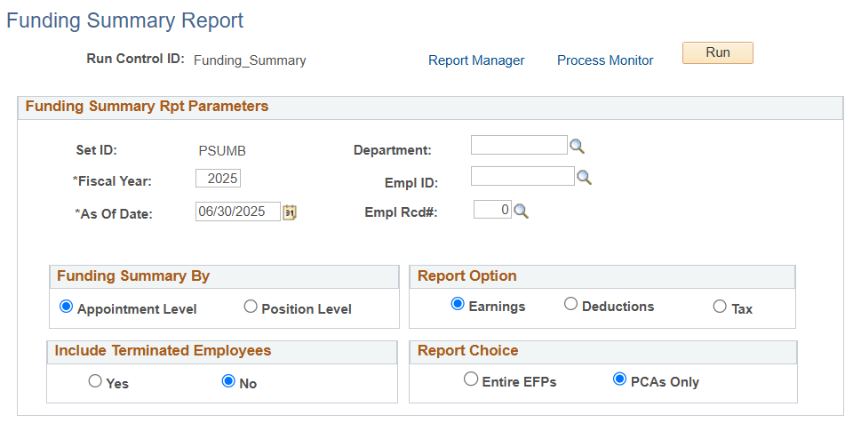
Setting Up Funding Summary Report: Checking EFPs Before 25-26 Distribution (Now- 7/1/25)
Using 6/30/25 will help you insure that charges through the end of the fiscal year are using the correct combo code.
The default setting (“No”) returns EFPs for active employees only. Select “Yes” if you also need to display EFPs for terminated employees.
Use PCAs Only Report Choice to isolate the EFPs that will default to the PCA/Dept level

Slide 37
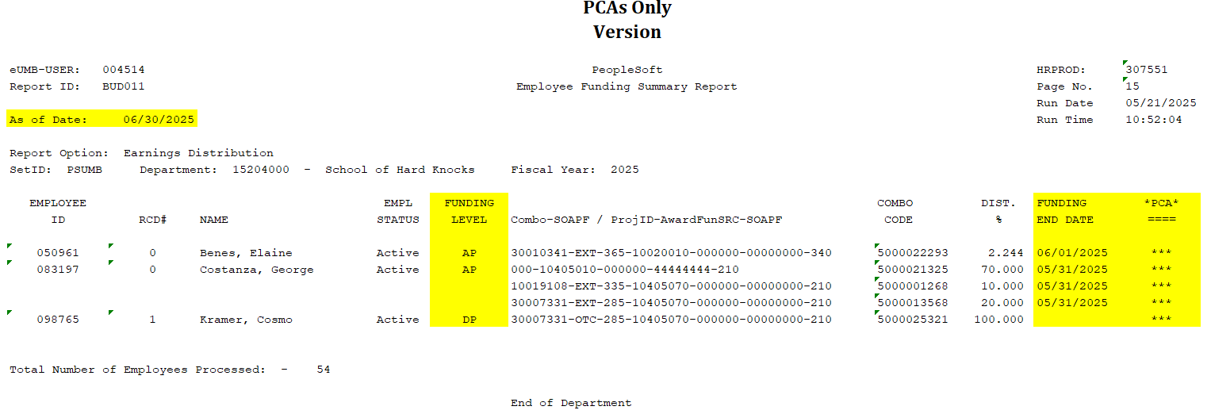
Reviewing Funding Summary Report: Checking EFPs Before 25-26 Distribution (Now- 7/1/25)
Only the portion of the EFP that will be charged to the PCA is displayed- not the full EFP.
Displays problem EFPs in effect as of 6/30/25
AP= Appointment Level Profile (EFP is in eUMB);
DP= Department Level Profile (EFP is NOT in eUMB and payroll-related expenses will be charged to departmental PCA!)

Slide 38
FY26 EFP Rollover
(after 8pm on Tuesday, 7/1/25)

Slide 39
FY26 Rollover
The last FY25 EFP will be used to programmatically:
Create the Initial 7/1/25 EFP
Create the “fix” EFP ONLY for employees in paygroups NFY/HRLY/SPC
No fix EFP for employees in paygroups AFY/ASY/EFY

Slide 40
FY26 Rollover
The “fix” EFP (NFY/HRLY/SPC Only):
Will have a Funding Begin Date of 5/4/25, employee’s hire date, or date transferred to department -- whichever is latest
Used to distribute FY25 payroll expenses associated with pay earnings dates from 5/4/25-6/30/25 paid in PP26-02 through 26-04 (ex. Shift, OVT, hourly employees)
Cannot be created if an employee has no FY25 EFP by 7/1/25
Prior fiscal year retro pay (<7/1/25) will be charged to PCA and the department must submit a DR to move expenses

Slide 41
FY26 Rollover
EFPs will programmatically be created for both active employees and employees who were terminated after 1/1
No action is required on your part for terminated employees

Slide 42
What to do after the Rollover & Before PP26-01
Actuals Distribution
From Wednesday, 7/2/25 through
Tuesday, 7/15/25 at 8PM

Slide 43
Before PP26-01 Actuals Distribution
Make sure all active employees have a valid 7/1/25 EFP
Review 7/1/25 EFP to be sure it is valid (check combo codes, funding end dates, % distributions)
Create a valid 7/1/25 EFP if it is not there
7/2/25 at 6AM – 7/15/25 at 8PM:
Departments review and create additional 7/1/25 EFPs as needed to reflect valid combo codes, funding end dates, % distributions

Slide 44
Checking FY26 EFPs Before 26-01 Distribution
Run Funding Summary Report using an “as of” date of 7/1/25 and select the “PCAs Only” report choice. Only the following will be returned:
Lines marked as ‘DP’ (i.e. No EFP)
Lines with Funding End Dates of 7/1/25 or earlier (i.e. Expiring EFP)

Slide 45
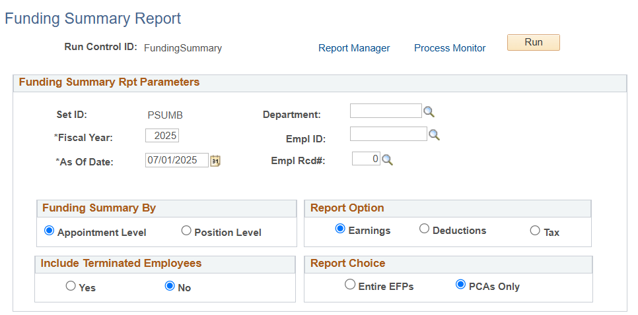
Setting Up Funding Summary Report: (thru 7/15/25 Checking FY26 EFPs Before 26-01 Distribution
This report displays the “problem” EFPs in effect “as of” the last day of PP 26-01.
The default setting (“No”) returns EFPs for active employees only. Select “Yes” if you also need to display EFPs for terminated employees.
Use PCAs Only Report Choice to isolate the EFPs that will default to the PCA/Dept level

Slide 46
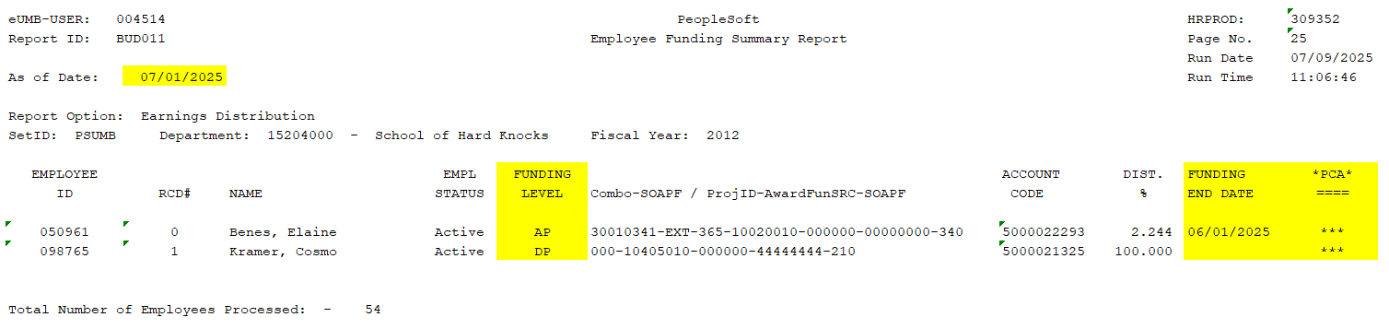
Reviewing Funding Summary Report: (thru 7/15/25) Checking FY26 EFPs Before 26-01 Distribution
Displays EFPs in effect as of 7/1/25
ALERT! Funding sources expiring 6/30/25 and earlier require your quick attention or your PCA will be charged.
ALERT! If Funding Level = DP (Department Level Profile), employee DOES NOT HAVE EFP in eUMB. Payroll-related expenses will be charged to the departmental PCA!

Slide 47
FY26 Redirect EFPs To PCA Process
On Tuesday, 7/15/25 after 8pm

Slide 48
FY26 Redirect EFP Process
If the FY26 EFP has a funding end date of 6/30/25 or earlier, on Tuesday, July 16th after 8pm, the EFP will be changed by the system
A process will run to replace any combo code with an expired funding end date with your department default combo code- AKA your PCA- with funding end date of 7/1/25

Slide 49
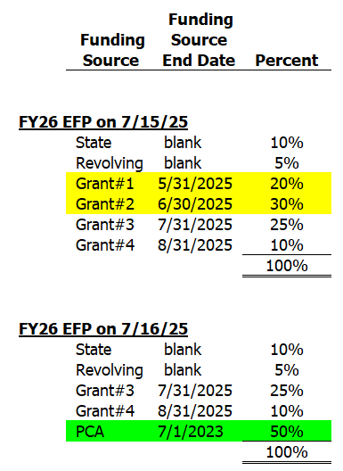
EFP Redirect Example
The initial FY26 EFP created effective 7/1/25 with combo codes expiring before 7/1/25 was not fixed before 7/15/25 at 8pm
A redirect process will run on Tuesday, 7/15/25 to remove combo codes with funding end dates prior to 7/1/25 and add the PCA/Dept Default combo code equal to the percent of combo codes removed.

Slide 50
PP26-01 Actuals Distribution & Encumbrances
On Wednesday, 7/16/25

Slide 51
PP26-01 (6/29-7/12/25) Distribution
Wednesday-7/16: Actuals Distribution process is run for PP26-01 with encumbrances calculated from 7/13/25 forward
Thursday-7/17: Validate that payroll expenses were distributed correctly using PCD in HRMS
Friday-7/18: Validate that payroll expenses were distributed correctly using HRMS Payroll in Quantum Analytics

Slide 52
PP26-01 Actuals Distribution
Two Week period = 6/29/25-7/12/25
Using FY26 Fringe Benefit Rates for entire PP26-01 (6/29/25-7/12/25)
For PCD reporting purposes, we refer to period of 6/29-6/30 as PP25-27 (AKA the payroll accrual) and 7/1-7/12 as PP26-01
For Quantum Analytics- HRMS Payroll reporting purposes, we refer to the entire pay period as 26-01 and use the Fiscal Year field to segregate 6/29/25-6/30/25 from 7/1/25-7/12/25

Slide 53
PP26-01 Actuals Distribution
PP26-01 covers payroll expenses associated with both FY25 and FY26- when the actuals distribution is run:
FY25 payroll expenses (based on pay earnings dates) will be distributed based on the FY25 EFP(s) in effect for 6/29/25-6/30/25
FY26 payroll expenses (based on pay earnings dates) will be distributed based on the 7/1/25 EFP in effect

Slide 54
PP26-01 Actuals Distribution
When a valid EFP is not set up before the 26-01 actuals distribution process is run:
Payroll expenses associated with earnings dates greater than the Funding End Dates on your EFPs will be distributed to your PCA
You will need to do a budget retro
You will have LARGE encumbrance balances on your PCA

Slide 55
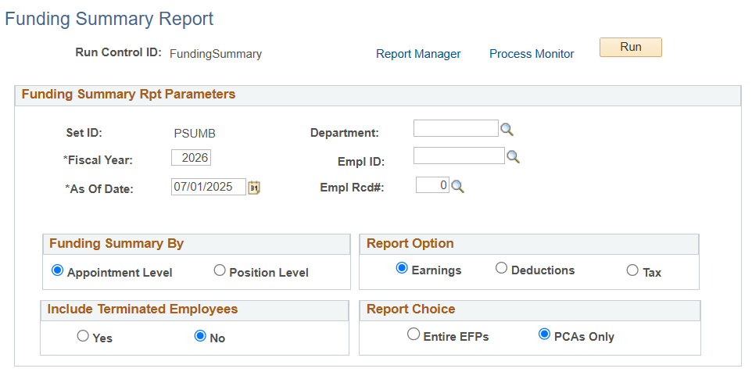
Setting Up Funding Summary Report: (starting 7/16/25) Checking FY26 EFPs Used 26-01 Distribution
This report displays the “problem” EFPs in effect “as of” the last day of PP 26-01.
The default setting (“No”) returns EFPs for active employees only. Select “Yes” if you also need to display EFPs for terminated employees.
Use PCAs Only Report Choice to isolate the EFPs that will default to the PCA/Dept level

Slide 56
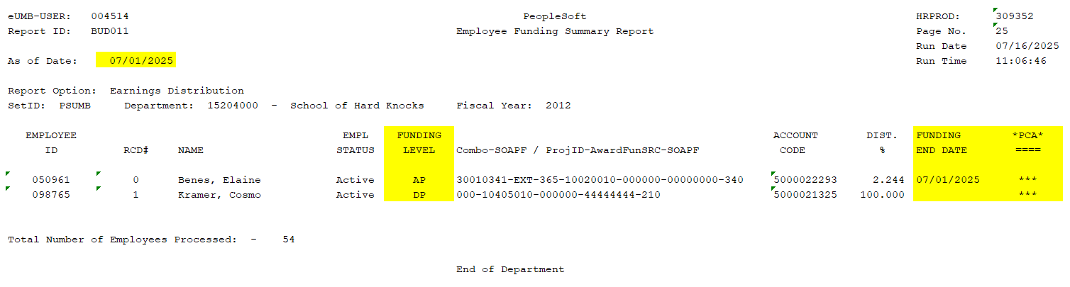
Reviewing Funding Summary Report: (starting 7/16/25) Checking FY26 EFPs Used 26-01 Distribution
Example where no changes were made to FY26 EFPs
Displays problem EFPs in effect as of PP26-01
ALERT! Funding sources expiring 7/01/25 were changed by the redirect process to charge your PCA

Slide 57
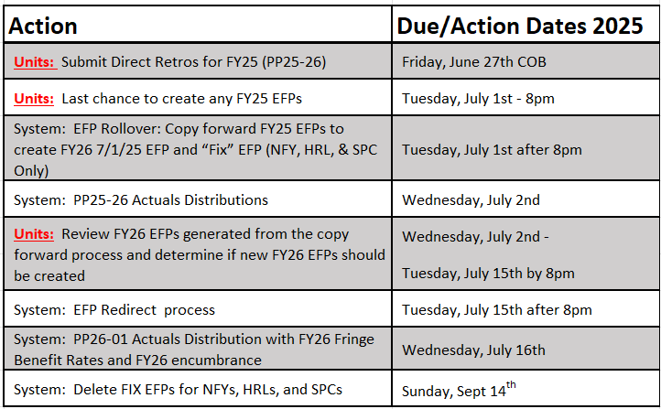
Key Dates Summary

Slide 58
Tools for Checking EFPs
Use Funding Summary Report
Main Menu>Set Up HRMS> Product Related> Commitment Accounting> Reports> Funding Summary USA
Use queries (recommend using pivot tables with download to Excel)
Main Menu> Reporting Tools> Query> Query Viewer
UMB_CA_EFP_BY_EMPL_ID (one employee)
UMB_CA_EFP_BY_EMPL_ID_CURR_SAL (current salary)
UMB_CA_EFP_BY_DEPT_ID (all employees)
UMB_CA_EFP_BY_DEPT_ID_CURR_SAL (current salary)
UMB_CA_NO_EFP (for missing EFPs)
UMB_CA_EFP_BY_PROJ_ID (check PCA)
UMB_CA_EFP_BY_PROJ_ID_CURR_SAL (current salary)
UMB_CA_EFP_BY_COMBO_CODE (alternative to proj ID)
UMB_CA_EFP_BY_COMBOCD_CURR_SAL (current salary)

Slide 59
PP26-01 Reminders
Since we use the real service dates on the PA form, the earnings will be distributed to the appropriate fiscal year according to those dates
Write the appropriate fiscal year on the top of the PA form
If a Combo Code is not indicated on the PA form:
Pay earnings prior to 7/1/25 will be distributed based on FY25 EFP(s)
Pay earnings after or equal to 7/1/25 will be distributed based on FY26 EFP

Slide 60
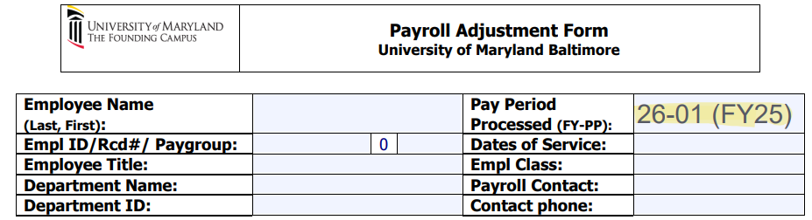
PP26-01 Payroll Adjustment Form

Slide 61
PP26-01 Reminders
The bi-weekly salary rate calculation is to divide the annual salary by the pay period factor.
Since FY26 is a non-leap year, the bi-weekly salary calculation will be calculated based on factor 26.07142857
365 days divided by 14 days per pay period = 26.07142857
Refer to FY Salary Calculation Charts- 14ths and 10ths

Slide 62
PP26-01 Reminders
Salary Pay is calculated on 14ths –
New Hires:
New faculty/exempt employees- Hire effective Monday, 6/30/25 will receive 13/14ths pay
New faculty/exempt employees- Hire effective Sunday, 6/29/25 will receive a full bi-weekly pay 14/14th
Non Exempt employees- Hire effective 6/30/25, pay is based on hours work

Slide 63
PP26-01 Reminders
Salary Pay is calculated on 14ths –
Terminations:
Effective Sunday, 6/29/25 (last day Saturday, 6/28/25), employee will not receive a paycheck
Effective Monday, 6/30/25 (last day Sunday, 6/29/25), employee will receive 1/14th pay, departments will send us a PAF to remove 1/14th pay
Effective Tuesday, 7/1/25 (last day Monday, 6/30/25), employee will receive 2/14ths pay

Slide 64
PP26-01 Reminders
Calculation charts have been updated and published on OOTC- Payroll Services website at Calendars - Payroll Services (umaryland.edu)
Payroll Calendar (only FY25)
Pay Date Schedule
CA Calendar
FY Salary Calculation Chart – 10ths
FY Salary Calculation Chart – 14ths

Slide 65
Payroll Calendar
Payroll Adjustment Forms (PAFs) due early due to holidays:
PP25-24 (5/18-5/31/25): PAFs are due on 5/22/25, payroll processing begins Tuesday, 5/27/25
PP25-25 (6/1-6/14/25): PAFs are due on 6/6/25, payroll processing begins Tuesday, 6/10/25
PP25-26 (6/15-6/18/25): PAFs are due on 6/18/25, payroll processing begins Tuesday, 6/24/25
PP26-01 (6/29-7/12/25): PAFs are due on 7/2/25, payroll processing begins Tuesday, 7/8/25

Slide 66
Questions or Comments

