Slide 1
Leadership as a Learning Outcome
Gregory A. Brightbill, MBA, Med
Associate Director, Student Leadership and Involvement
Intercultural Leadership and Engagement

Slide 2
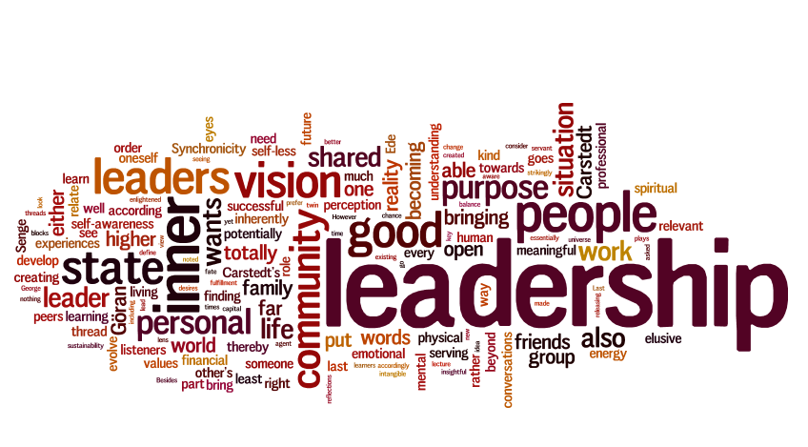
Notes:
“never have so many labored so long to produce so little.”
Bennis W and Nanus B (1985) Leaders: The Strategies for Taking Charge. New York: Harper and
Row. p. 4

Slide 3
What is “Leadership?”
Notes:
Global Engagement & Learning
Interprofessional Education
Cultural Competency
Community Engagement
Ethics & Integrity
Leadership

Slide 4
Examples of Leadership Models
“Great Man” Theory
(Spencer, 1874)
Lewin’s Leadership Styles
(Lewin, Lippitt, & White, 1939)
Transactional Leadership
(Webber 1947; Bass 1981)
Transformational Leadership (Downton 1973; Burns, 2004)
Situational Leadership
(Hersey & Blanchard, 1969)
Servant Leadership (Greenleaf, 1970)
Notes:
Spencer, H. The Study of Sociology. Appleton, 1874.​
Downton, J. V. (1973). Rebel leadership: Commitment and charisma in the revolutionary process. Free Press.
Burns, James Macgregor (2004). Transformational Leadership. ISBN 9780802141187.
Dansereau, Fred, Jr., George B. Graen, and William J. Haga. “A Vertical Dyad Linkage Approach to Leadership within Formal Organizations: A Longitudinal Investigation of the Role Making Process.” Organizational Behavior and Human Performance 13 (1975): 46–78.
Weber, M. (1947). The Theory of Social and Economic Organizations. New York: Free Press.
Bass, B. M., & Stogdill, R. (1981). Handbook of leadership. Theory, research, and managerial.
Hersey, P., & Blanchard, K. (1969). Life cycle theory of leadership. Training and Development Journal, 23, 26-35.
Lewin, K.; Lippitt, R.; White, R.K. (1939). Patterns of aggressive behavior in experimentally created social climates. Journal of Social Psychology 10: 271–301.
Greenleaf

Slide 5
What is “Leadership?”
INFLUENCE
The ability “to influence others to voluntarily commit themselves to achievement of a goal or objective” (Kearns, 2019, p. 256)
Notes:
Kearns, K. (2019). The Leadership Portfolio Program at The University of Pittsburgh: Teaching leadership to graduate students1. Teaching Public Administration, 37(3), 255–273. https://doi.org/10.1177/0144739419851143

Slide 6
What is “Leadership?”
SITUATIONAL
Described as contextual complexity, reliant on both the abilities of the leader and the requirements of the setting.
Notes:
Kearns, K. (2019). The Leadership Portfolio Program at The University of Pittsburgh: Teaching leadership to graduate students1. Teaching Public Administration, 37(3), 255–273. https://doi.org/10.1177/0144739419851143

Slide 7
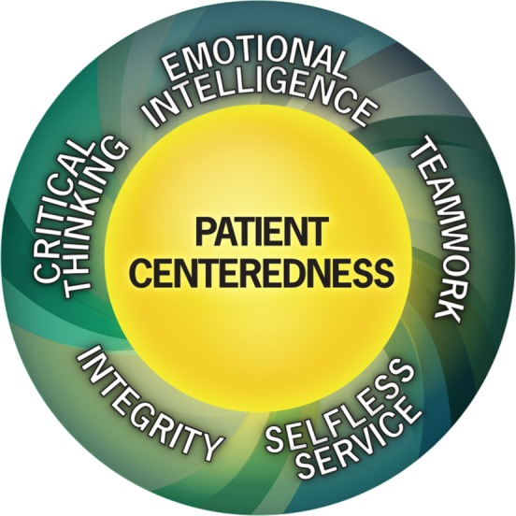
Duke Healthcare Leadership Model (Hargett et al., 2017)
Notes:
UMB Mission: “serve the public good of Maryland and society at-large“
Hargett, C. W., Doty, J. P., Hauck, J. N., Webb, A. M., Cook, S. H., Tsipis, N. E., Neumann, J. A., Andolsek, K. M., & Taylor, D. C. (2017). Developing a model for effective leadership in healthcare: a concept mapping approach. Journal of healthcare leadership, 9, 69–78. https://doi.org/10.2147/JHL.S141664

Slide 8
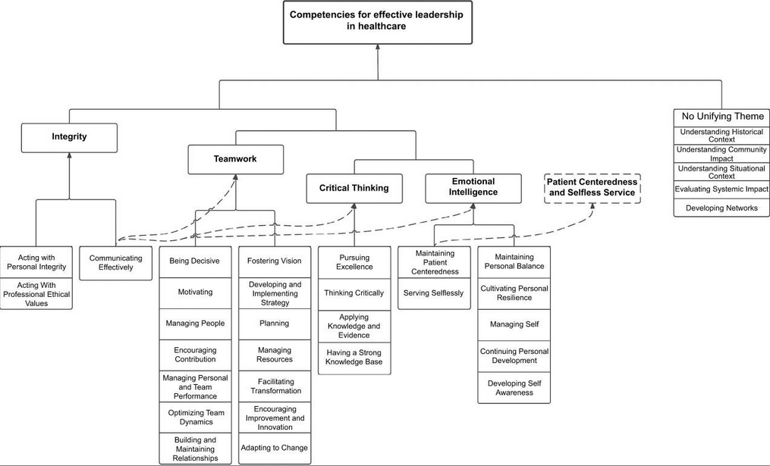
(Hargett et al., 2017, table 3 )
Notes:
Hargett, C. W., Doty, J. P., Hauck, J. N., Webb, A. M., Cook, S. H., Tsipis, N. E., Neumann, J. A., Andolsek, K. M., & Taylor, D. C. (2017). Developing a model for effective leadership in healthcare: a concept mapping approach. Journal of healthcare leadership, 9, 69–78. https://doi.org/10.2147/JHL.S141664

Slide 9
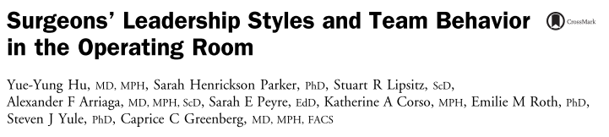
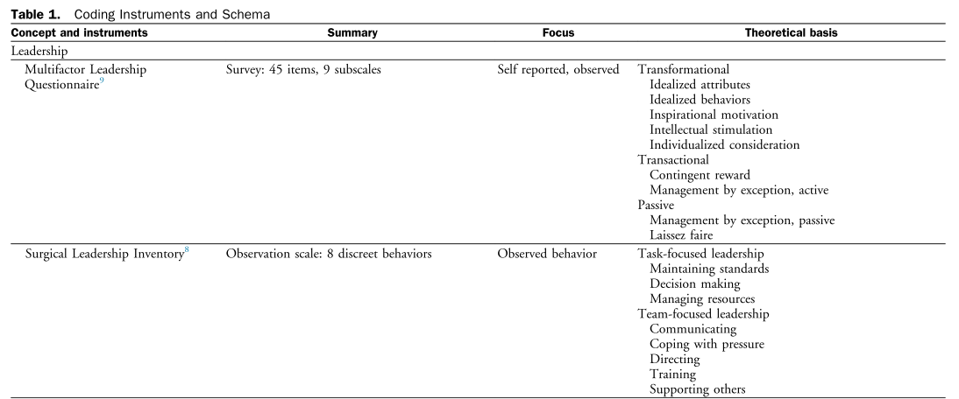
(Hu et al., 2016, p. 43)
Notes:
Hu, Y. Y., Parker, S. H., Lipsitz, S. R., Arriaga, A. F., Peyre, S. E., Corso, K. A., … Greenberg, C. C. (2016). Surgeons’ Leadership Styles and Team Behavior in the Operating Room Abstract presented at the American College of Surgeons 101st Annual Clinical Congress, Scientific Forum, Chicago, IL, October 2015. Journal of the American College of Surgeons, 222(1), 41–51. https://doi.org/10.1016/j.jamcollsurg.2015.09.013

Slide 10
Surgeons' Leadership Inventory (Parker et al., 2013)
Element | Definition | Measurable Actions
Maintaining standards | Supporting safety and quality by adhering to acceptable principles of practice, following codes of good ethics, and enforcing procedures and protocols by consistently demonstrating appropriate behaviors | Practical knowledge Ethical role-modeling Judicial
Making decisions | Seeking out appropriate information and generating alternative possibilities or courses of action, synthesizing the information, choosing a solution to a problem, and letting all relevant personnel know the chosen option. | Critical thinking and problem solving Ability to filter information and input Ability to communicate synthesized information and decisions
Managing resources | Assigning resources (people and equipment) depending on the situation or context; delegating tasks appropriately to team members, and ensuring the team has what it needs to accomplish the task | Situational awareness Team-building and delegation Goal-setting
Directing | Clearly stating expectations regarding accomplishment of task goals; giving clear instructions; using authority where required; demonstrating confidence in both leadership and technical ability | Goal setting “Glass half-full” mentality
Training | Instructing and coaching team members according to goals of the task; modifying own behavior according to team’s educational needs; identifying and maximizing educational opportunities | Mentoring capacity Training ability
Supporting others | Judging the capabilities of team members; helping where appropriate; establishing a rapport with team members and actively encouraging them to speak up | Responsiveness to others’ needs Charismatic personality
Communicating | Giving and receiving information in a timely manner to aid establishment of a shared understanding among team members. Speaking appropriately for the situation. Asking for input from team members | Timely and responsive Ability to voice concerns Active listening
Coping with pressure | Showing flexibility and changing plans if required to cope with changing circumstances to ensure that goals are met; anticipating possible complications and communicating them to staff; adopting a forceful manner if appropriate without undermining the role of other team members | Strong under pressure Foresight Flexibility and adaptability
Notes:
Tying tangible behaviors to measurable outcomes
Hu, Y. Y., Parker, S. H., Lipsitz, S. R., Arriaga, A. F., Peyre, S. E., Corso, K. A., … Greenberg, C. C. (2016). Surgeons’ Leadership Styles and Team Behavior in the Operating Room Abstract presented at the American College of Surgeons 101st Annual Clinical Congress, Scientific Forum, Chicago, IL, October 2015. Journal of the American College of Surgeons, 222(1), 41–51. https://doi.org/10.1016/j.jamcollsurg.2015.09.013

Slide 11
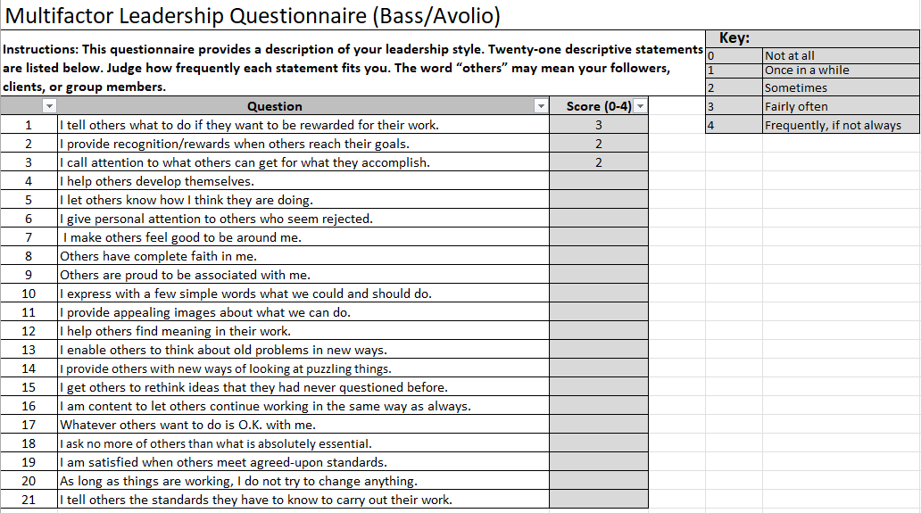
Multifactor Leadership Questionnaire

Slide 12
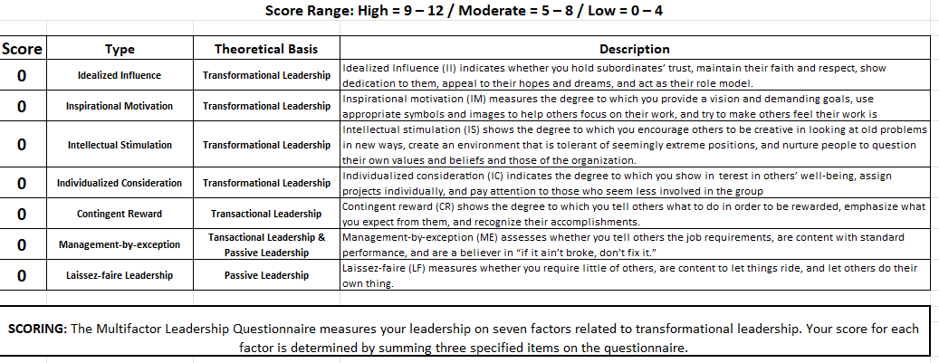

Slide 13
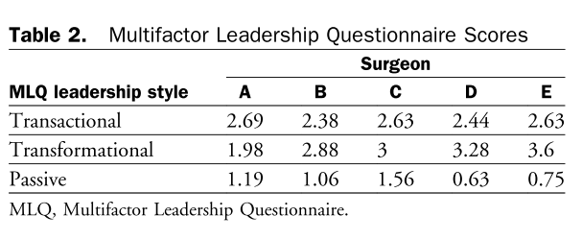
(Hu et al., 2016, p. 45)

Slide 14
How can we deliver this ILO?
Integrating key skills into curriculum
  Ex: Public speaking, critical thinking, problem solving, ethical dilemma role-playing
Identify and cultivate current leaders
  Mirroring, modeling, mentoring
Challenges?
  Diverse views of leadership and scope

Slide 15
References
Bass, B. M., & Stogdill, R. (1981). Handbook of leadership. Theory, research, and managerial.
Bennis W and Nanus B (1985) Leaders: The Strategies for Taking Charge. New York: Harper and
Row. p. 4
Burns, James Macgregor (2004). Transformational Leadership. ISBN 9780802141187.
Dansereau, Fred, Jr., George B. Graen, and William J. Haga. “A Vertical Dyad Linkage Approach to Leadership within Formal Organizations: A Longitudinal Investigation of the Role Making Process.” Organizational Behavior and Human Performance 13 (1975): 46–78.
Downton, J. V. (1973). Rebel leadership: Commitment and charisma in the revolutionary process. Free Press.
Greenleaf, R. K. (1997). The servant as leader. In R. P. Vecchio (Ed.), Leadership: Understanding the dynamics of power and influence in organizations (pp. 429–438). University of Notre Dame Press. (Reprinted from "Servant Leadership," Paulist Press, 1977, pp. 7–17)
Hargett, C. W., Doty, J. P., Hauck, J. N., Webb, A. M., Cook, S. H., Tsipis, N. E., Neumann, J. A., Andolsek, K. M., & Taylor, D. C. (2017). Developing a model for effective leadership in healthcare: a concept mapping approach. Journal of healthcare leadership, 9, 69–78. https://doi.org/10.2147/JHL.S141664
Hersey, P., & Blanchard, K. (1969). Life cycle theory of leadership. Training and Development Journal, 23, 26-35.
Hu, Y. Y., Parker, S. H., Lipsitz, S. R., Arriaga, A. F., Peyre, S. E., Corso, K. A., … Greenberg, C. C. (2016). Surgeons’ Leadership Styles and Team Behavior in the Operating Room Abstract presented at the American College of Surgeons 101st Annual Clinical Congress, Scientific Forum, Chicago, IL, October 2015. Journal of the American College of Surgeons, 222(1), 41–51. https://doi.org/10.1016/j.jamcollsurg.2015.09.013
Kearns, K. (2019). The Leadership Portfolio Program at The University of Pittsburgh: Teaching leadership to graduate students1. Teaching Public Administration, 37(3), 255–273. https://doi.org/10.1177/0144739419851143
Lewin, K.; Lippitt, R.; White, R.K. (1939). Patterns of aggressive behavior in experimentally created social climates. Journal of Social Psychology 10: 271–301.
Spencer, H. The Study of Sociology. Appleton, 1874.​
Weber, M. (1947). The Theory of Social and Economic Organizations. New York: Free Press.

