Slide 1

Ethics & Integrity in Higher Education
Henry Silverman, MD, MA

Slide 2
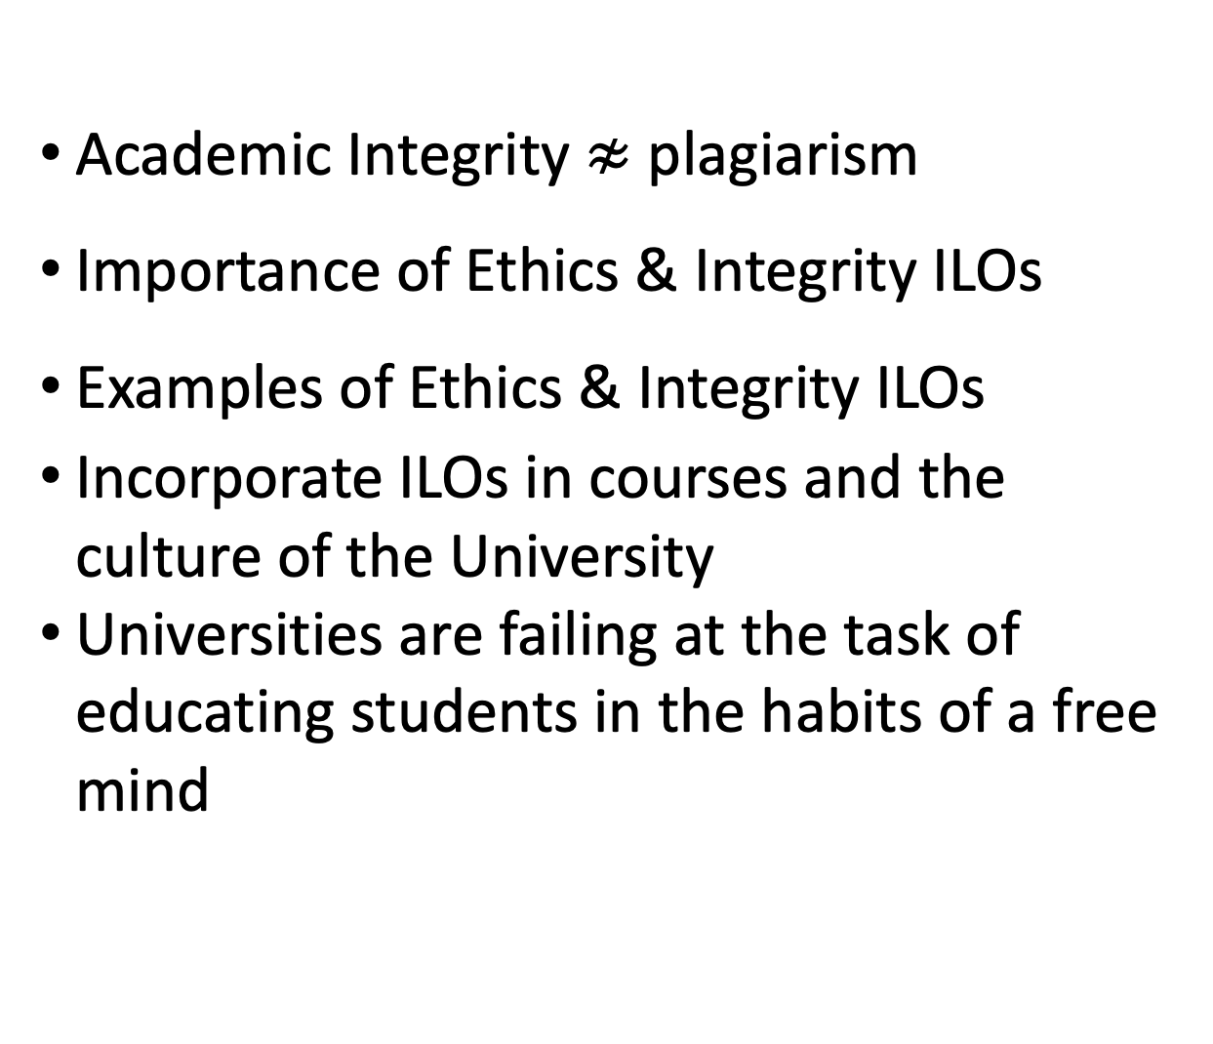
Major Points
Academic Integrity $≉$ plagiarism
Importance of Ethics & Integrity ILOs
Examples of Ethics & Integrity ILOs
Incorporate ILOs in courses and the culture of the University
Universities are failing at the task of educating students in the habits of a free mind

Slide 3
UMB proposed institutional learning outcomes:
  Interprofessional Education
  Community Engagement
  Global Health → Global engagement and education
  Leadership
  Cultural Competency (Diversity, Equity, and Inclusion)
  Ethics and Integrity

Slide 4

Definition
Academic institutions often define academic ethics & integrity as intellectual honesty within academic work that is devoid of plagiarism, fabrication and dishonesty.
Minimalistic view

Slide 5

University of Maryland Baltimore
Core Values
Respect and Integrity: We value each other and hold ourselves accountable for acting ethically and transparently using compassion and empathy.
Well-Being and Sustainability: We care about the welfare of our people, planet, communities, and University.
Equity and Justice: We embrace and are committed to diversity, and we value inclusive and just communities. We oppose racism and oppression in all forms.
Innovation and Discovery: We imagine and explore new and improved ways to accomplish our mission of education, research, clinical care and service.

Slide 6
Importance of Ethics and Integrity – Several Levels
Students
responsible conduct in research
plagiarism, fabrication, and falsification
Institution
Critical to the reputation of the institution as a provider higher education
Ensures that the program is reputable
Professional Careers
economic success
Societal
live a life of civic duty within communities
help to develop awareness of responsibilities and rights within society

Slide 7

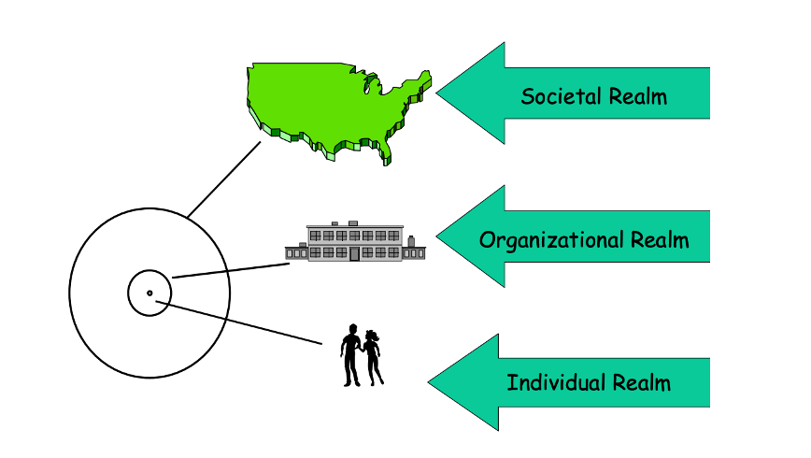
Glaser’s Three Realm of Ethics

Slide 8
Beyond the Institution
Professional Careers
Civic Responsibility

Slide 9
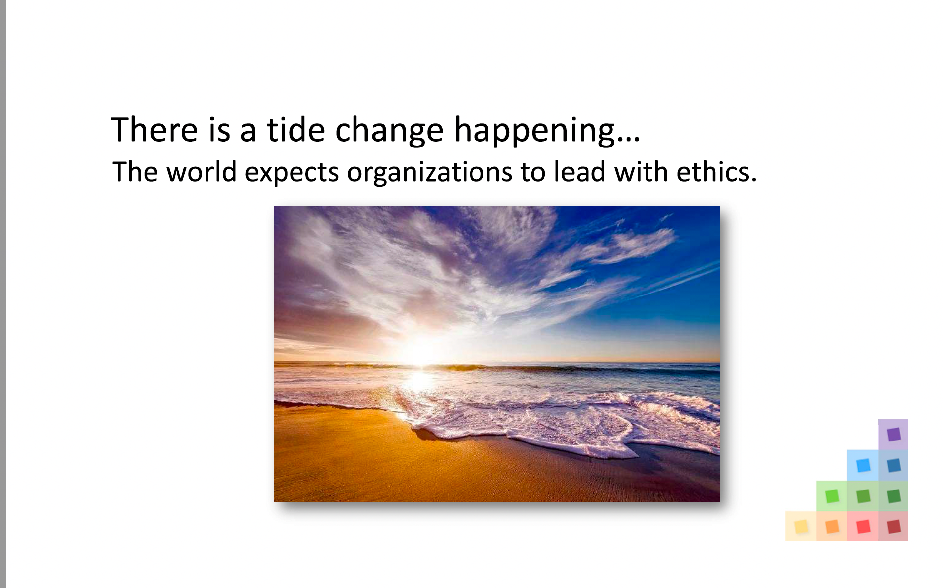

Slide 10
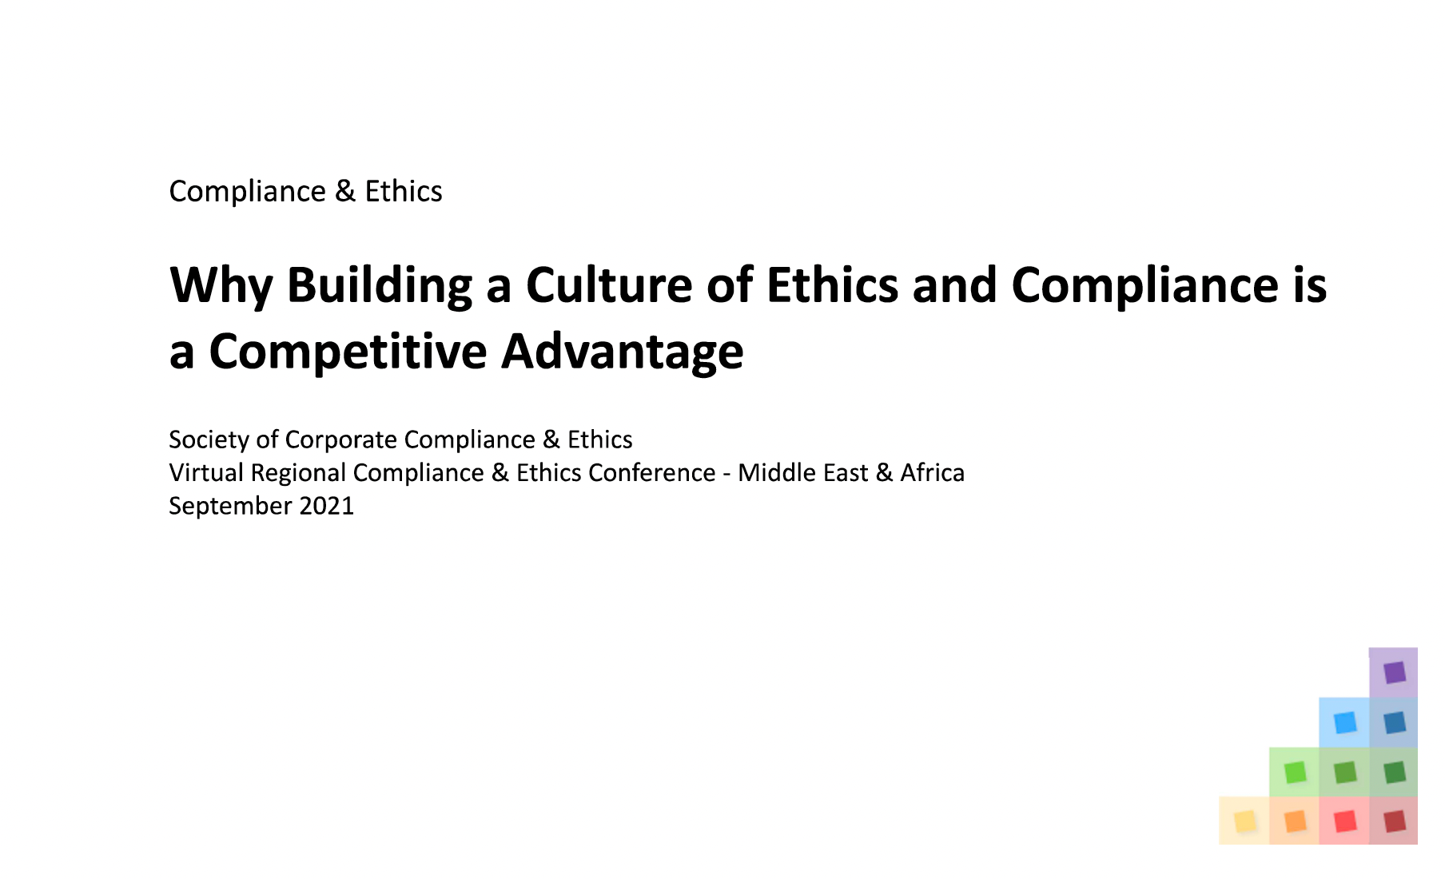

Slide 11
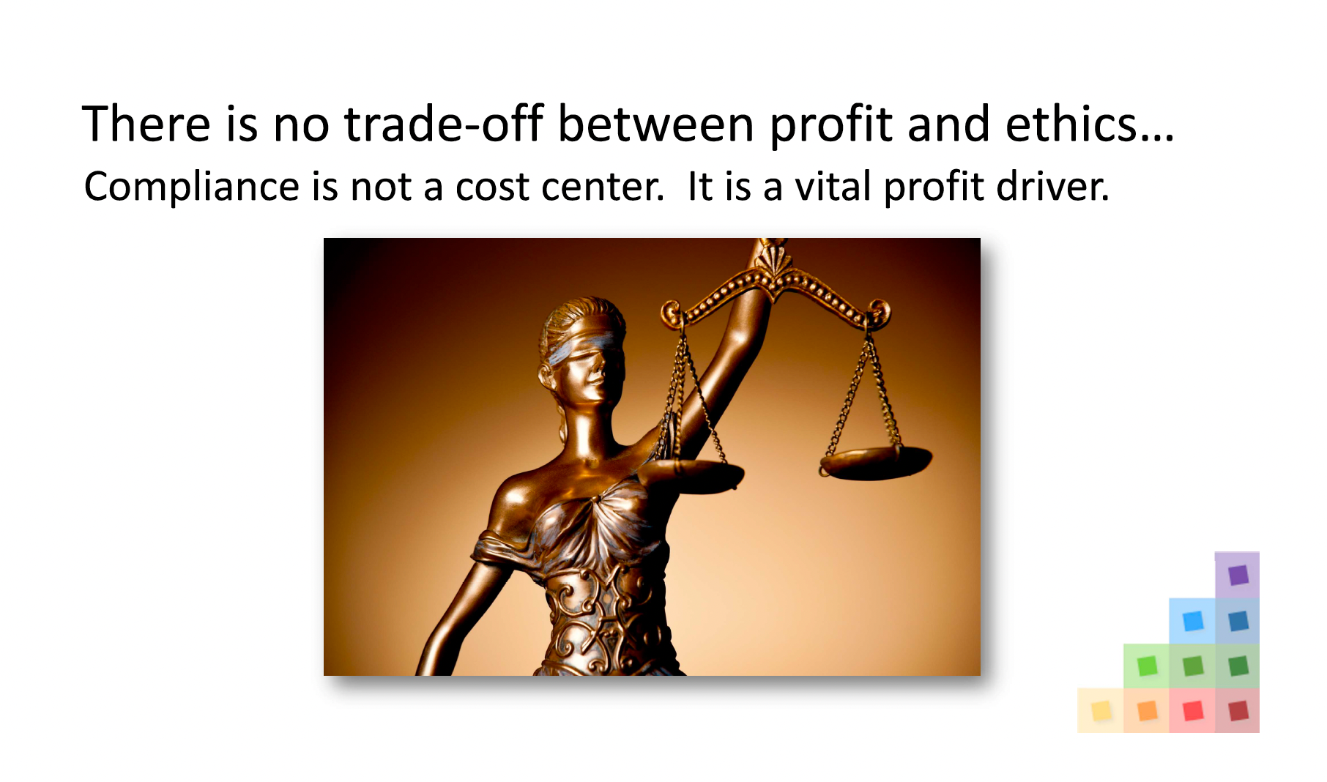

Slide 12
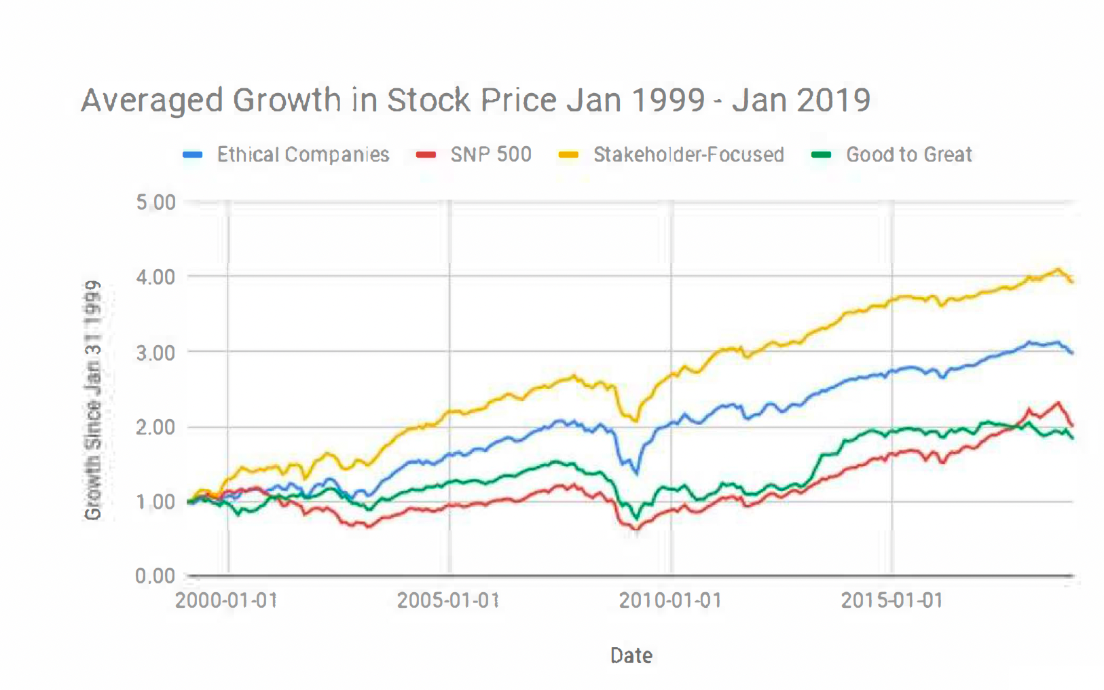

Slide 13


Slide 14
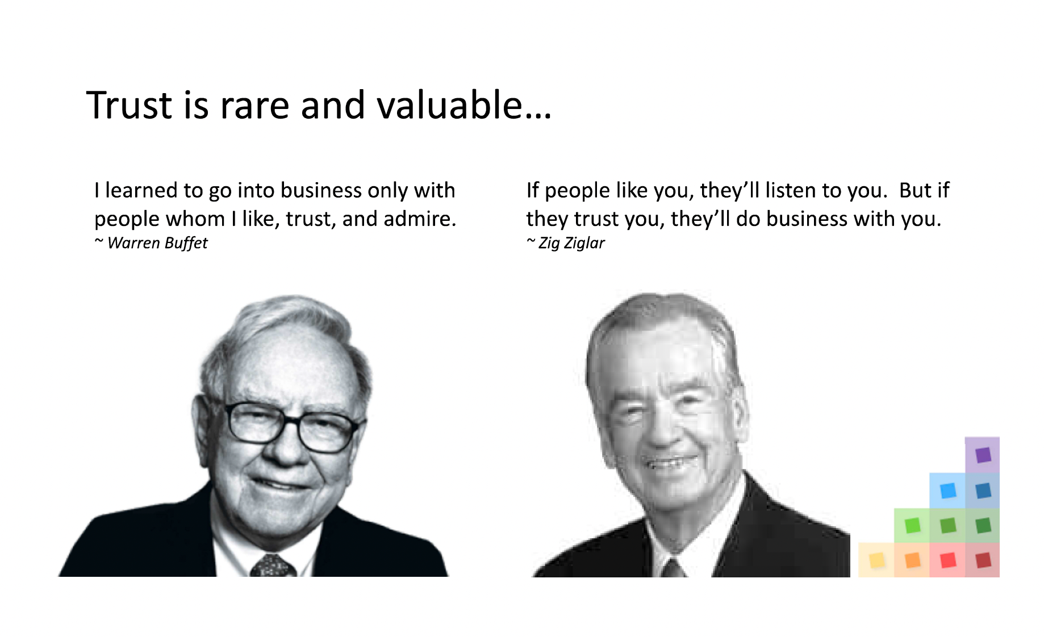
Business success: competence, passion and integrity

Slide 15
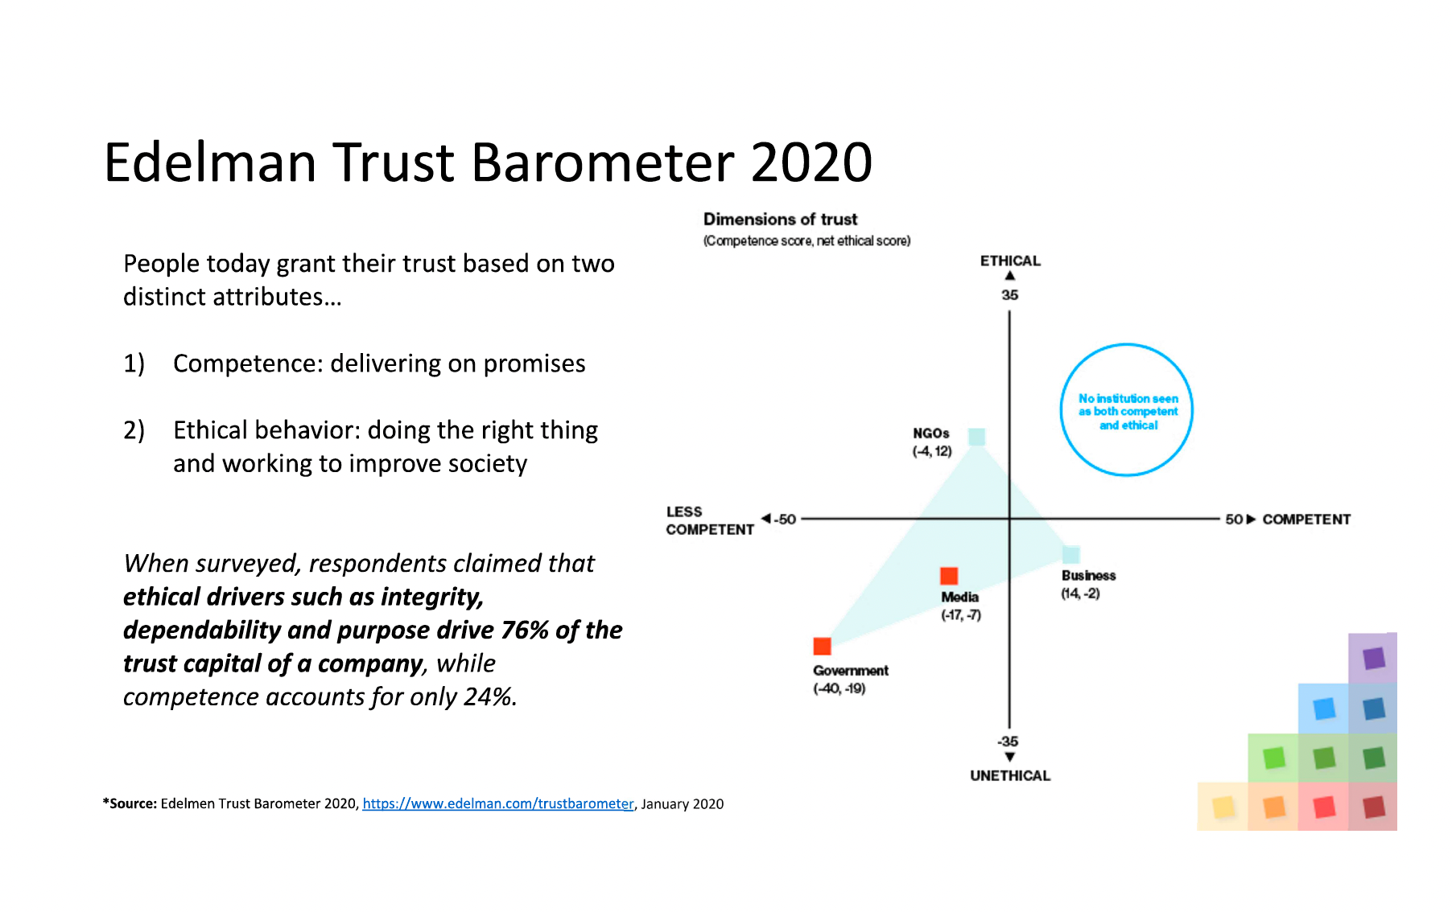

Slide 16
Students want to work for “good” companies
Millennials (1981-1996) will make up 75% of the workforce by 2025 and they are looking for socially responsible employers
64% of Millennials won't take a job if their employee doesn't have strong corporate social responsibility (CSR) values
83% of Millennials would be more loyal to a company that helps them contribute to social & environmental issues¹
88% of Millennials say their job is more fulfilling when they are provided opportunities to make a positive impact on social and environmental issues¹
  Cone Communications Millennial Employee Study, https://engageforgood.com/2016-cone-communications-millennial-employee-engagement-study/
  Deloitte Insights 2020 Global Marketing Trends Report, https://www2.deloitte.com/cn/en/pages/about-deloitte/articles/pr-2020-global-marketing-trends-report.html 2020
  Deloitte Global Millennial Survey 2020, https:/jwww2.deloitte.com/global/en/jnsights/topics/talent/deloitte-millennial-survey.html December 2020

Slide 17
Beyond the Institution
Professional Careers
Civic Responsibility

Slide 18
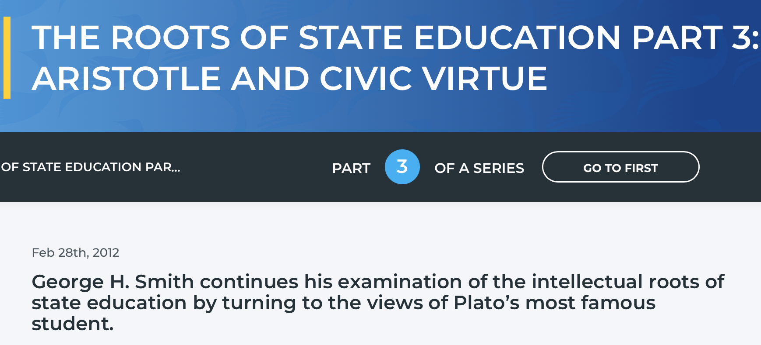

Slide 19
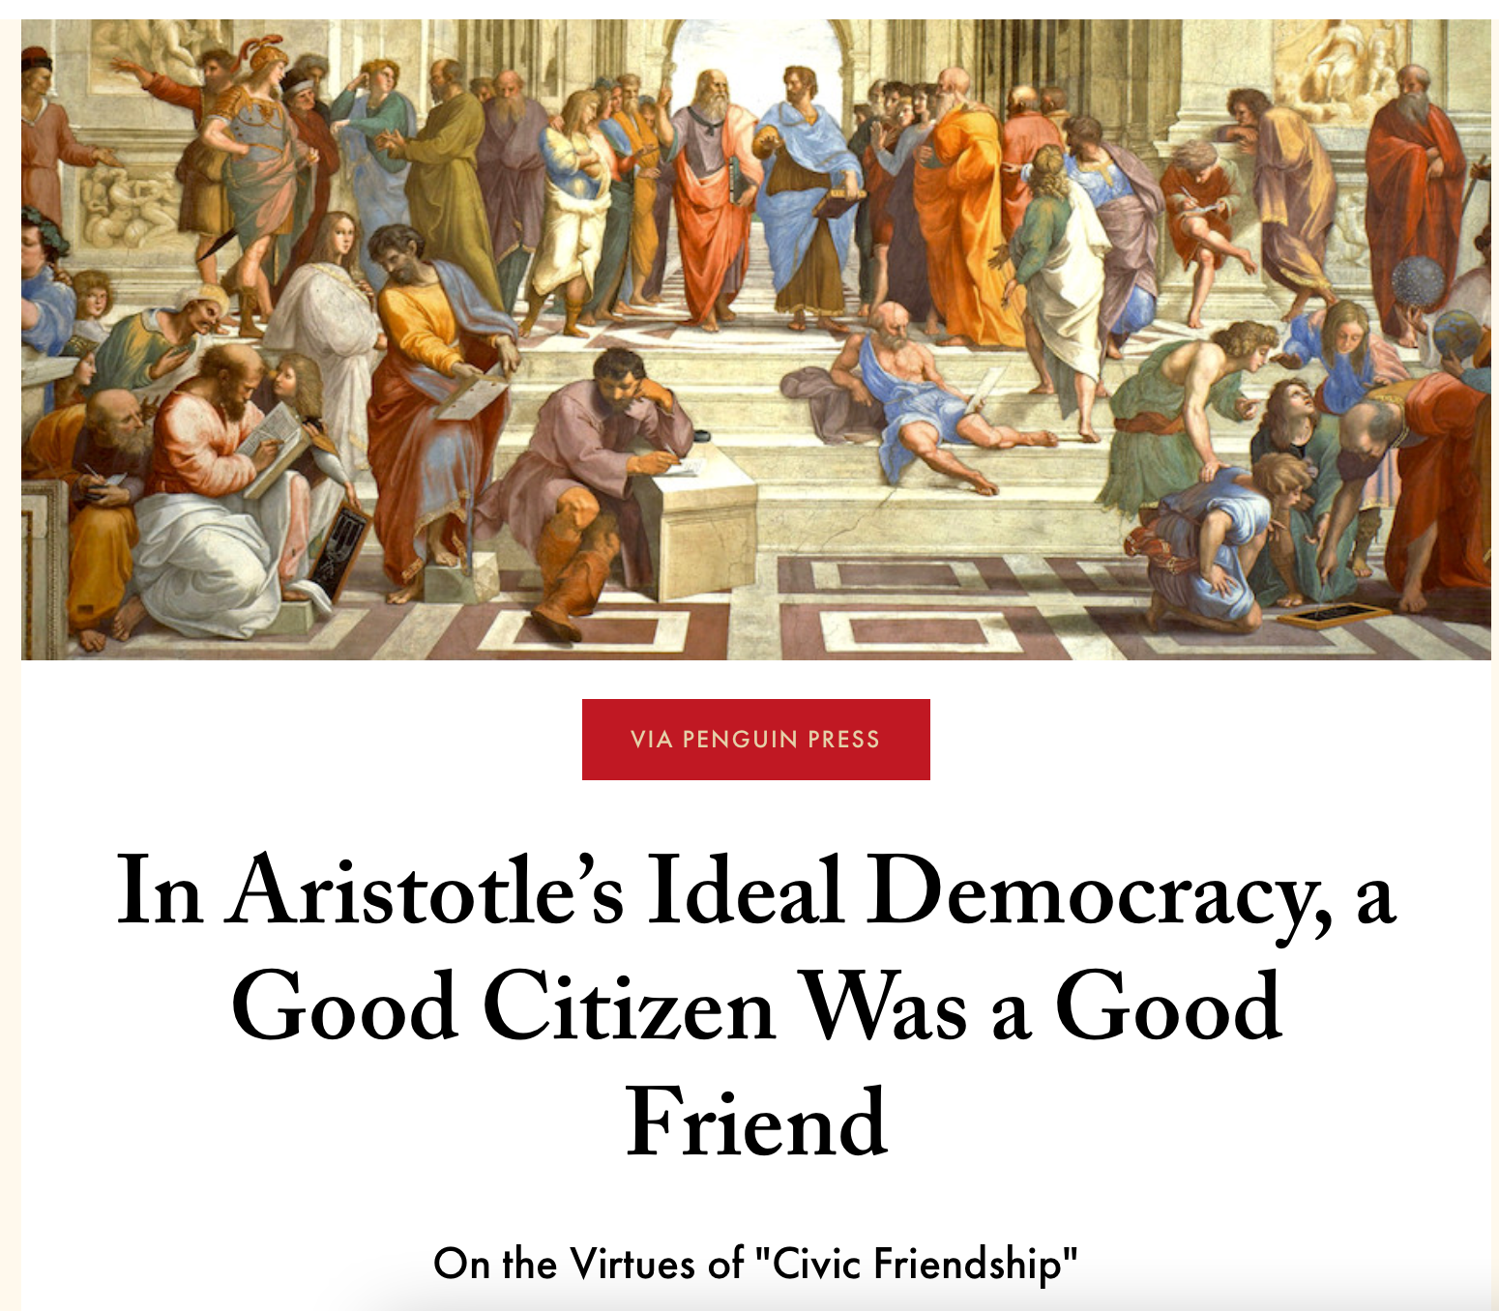

Slide 20


Slide 21
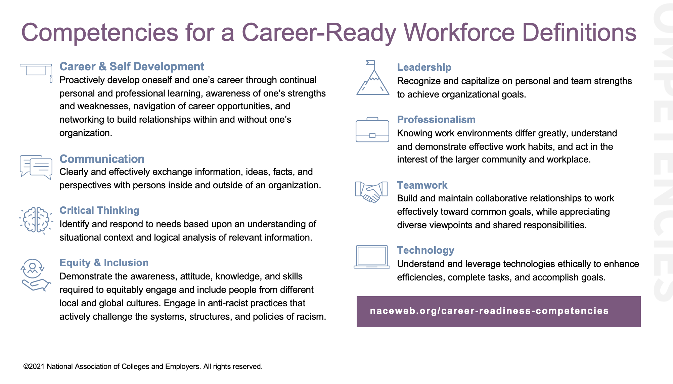

Slide 22
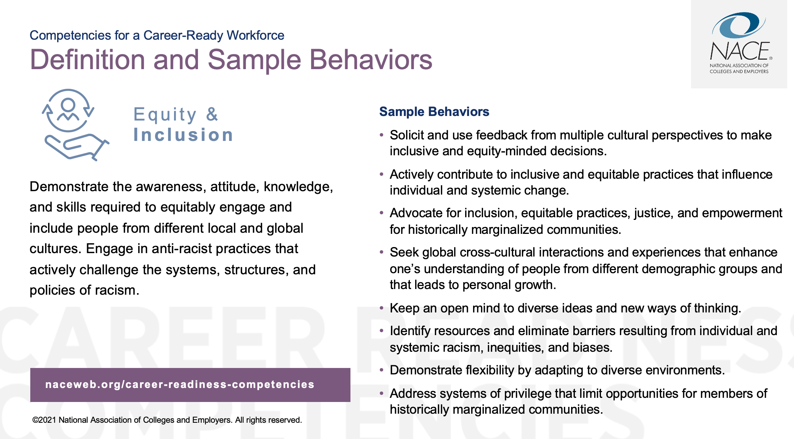

Slide 23
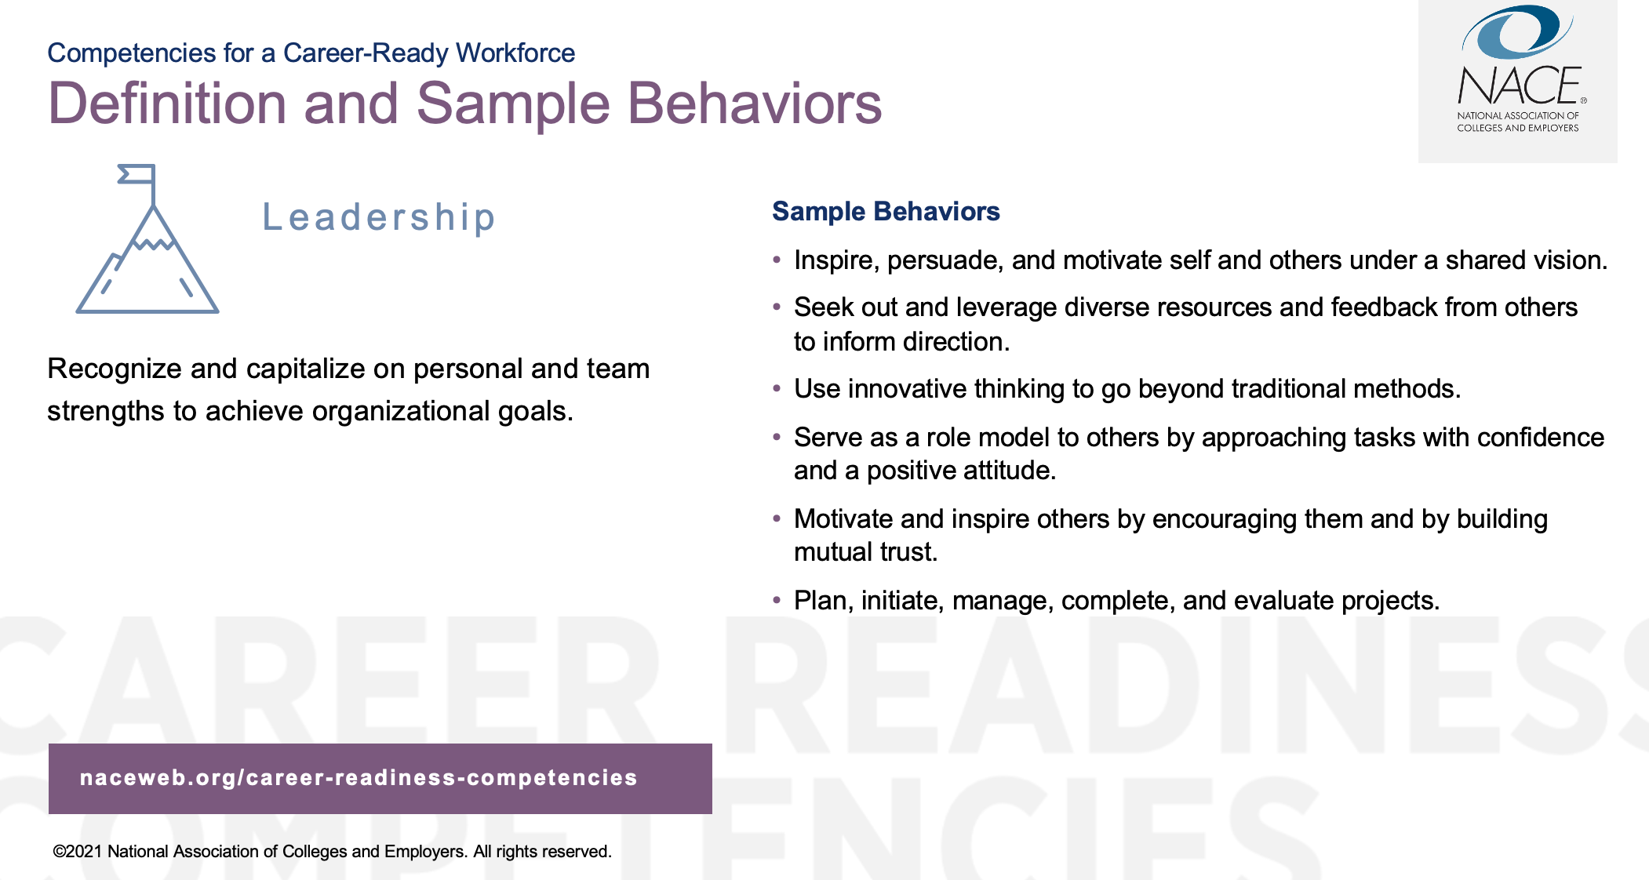

Slide 24
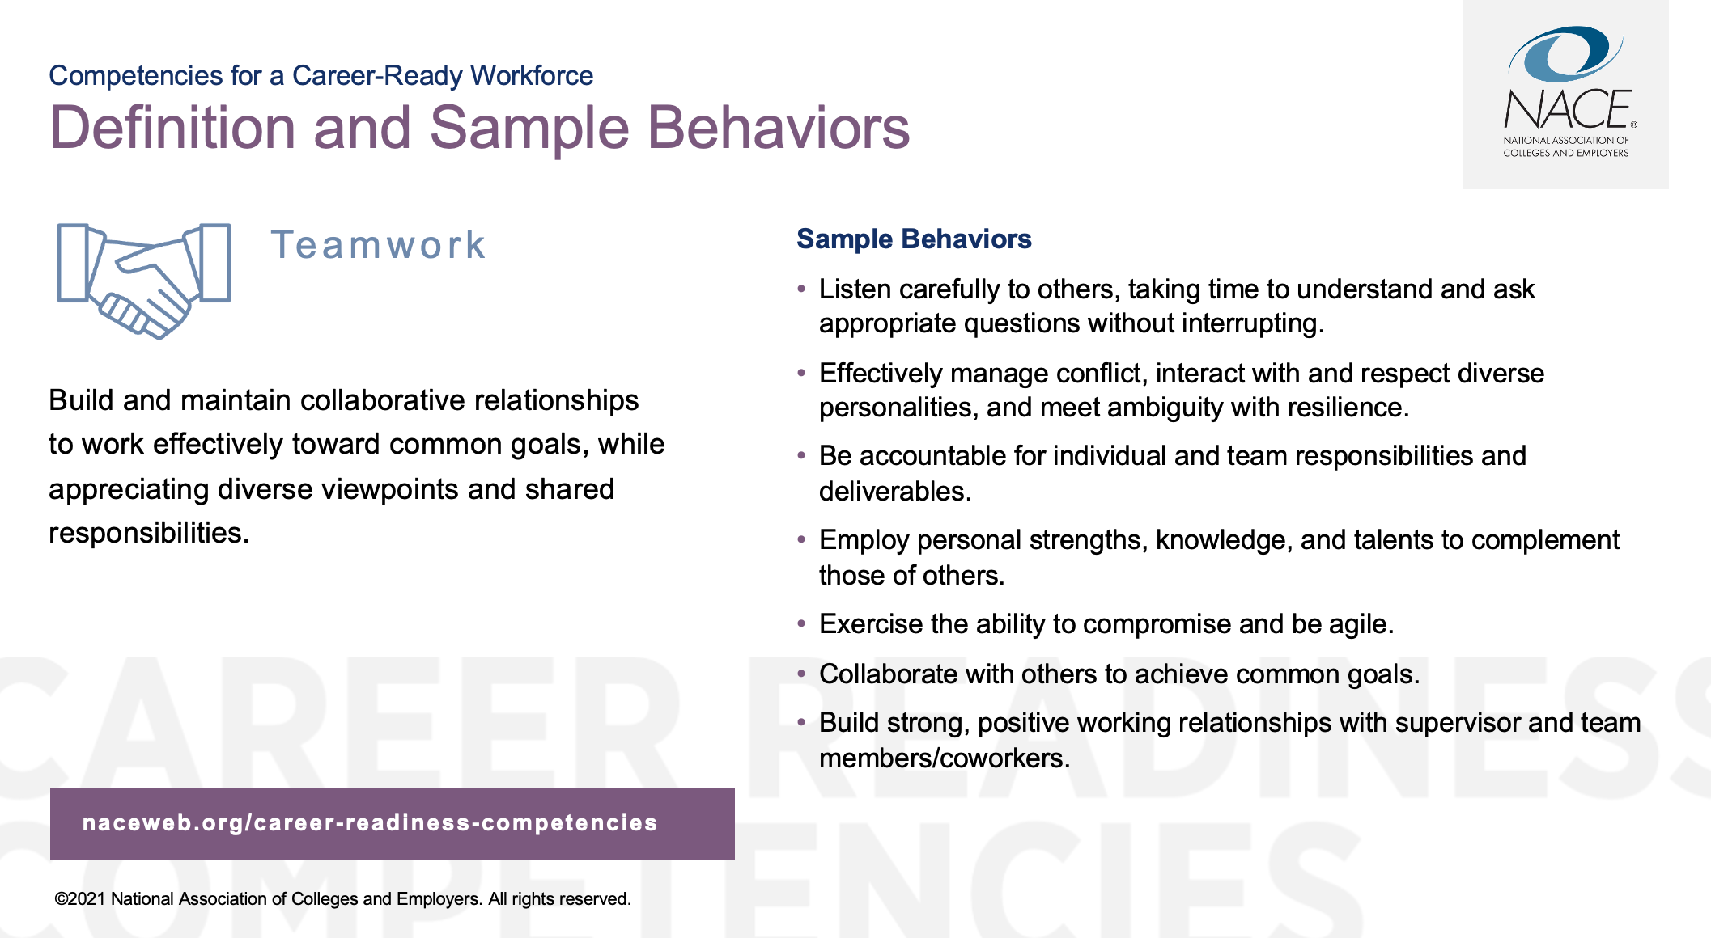

Slide 25
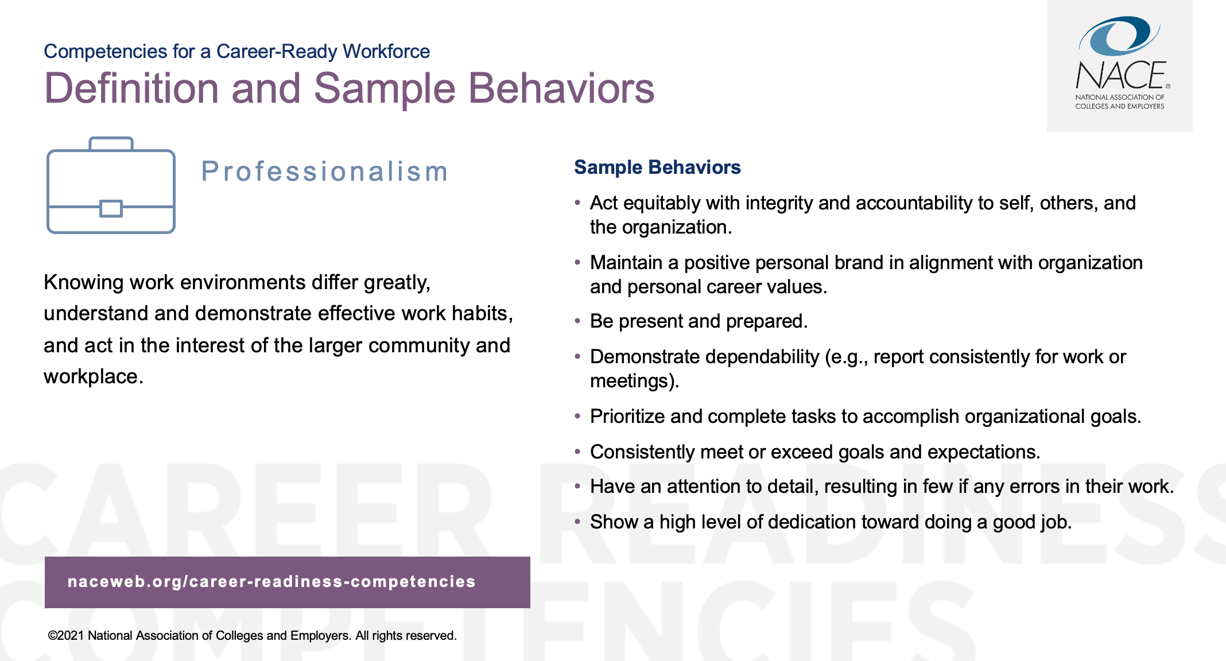

Slide 26
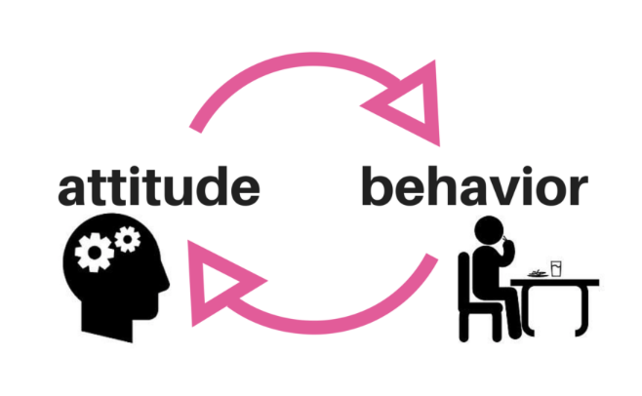
Bloom’s Taxonomy: Cognitive, Psychomotor, Affective

Slide 27

Institutional Learning Outcomes
Institutional Learning Outcomes are measurable expectations that are formed by core commitments from the institutional values of purpose, service, and leadership.

Slide 28
What is an ILO?
The knowledge, skills, abilities, and attitudes that students are expected to develop as a result of their overall experiences with any aspect of the college, including courses, programs, and student services.
Looks at the “whole student”
The ILOs are the most universal educational goals of the Institution and a single course or program cannot and is not expected to meet all of the ILOs
However, each course and program is expected to contribute to at least one ILO and many courses will contribute to multiple ILOs

Slide 29
Institutional Learning outcomes
By the time of graduation, the student will be able to:
Identify ethical dilemmas and apply different theoretical approaches, make informed, principled choices.
Demonstrate critical self-reflection of one's own ethical values and show the capacity to perceive events from others’ perspectives
Demonstrate courage in acting ethically
Exhibits personal accountability and collaborates respectfully with others to accomplish a common goal.
Work collaboratively and respectfully as members and leaders of diverse teams and communities)
Ethics
Leadership
Teamwork

Slide 30
Institutional Learning outcomes
By the time of graduation, the student will be able to:
Demonstrate honesty, trust, and respect in Academic (plagiarism, research ethics) and civil affairs
Appreciate different perspectives and able to operate with civility in a complex world that involves changing social institutions and diverse world views
Integrity
Social Responsibility

Slide 31
HOW WILL ILOs BE MEASURED?
Affective Measures
Attitudes, Beliefs, Opinions, Confidence, Motivation
Knowledge Measures
Content, Cognitive
Skill Measures
Application, Demonstration of Ability, Use of Knowledge/Skill

Slide 32
Bloom’s Taxonomy: Cognitive, Psychomotor, Affective

Slide 33
Institution Core Values
Institutional Learning Objectives
Courses
Courses
Assessment

Slide 34
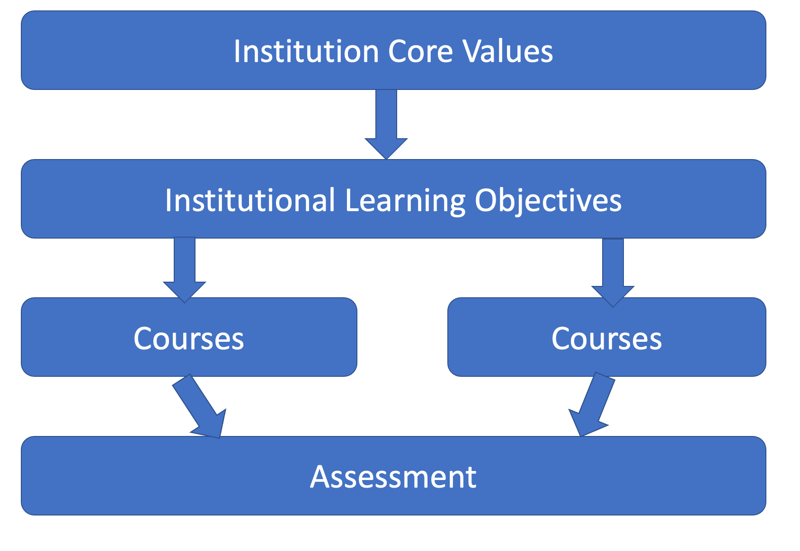
Institution’s Ethical Climate

Slide 35
Are students ethical?
Most students are ethical.
They want to do the “right” thing and make the “right” decision.
However, the institutional climate might not enable students to do the “right” thing.

Slide 36

What Universities Owe Democracy
“…at their best, universities serve as escalators for social mobility, educators for democratic citizenship, stewards of fact and expertise and forums for “purposeful pluralism” — the expression and contest of ideas.
“…our universities are failing at the task of educating students in the habits of a free mind. Instead, they are becoming islands of illiberal ideology and factories of moral certitude, more often at war with the values of liberal democracy than in their service.” Brent Stephens

Slide 37
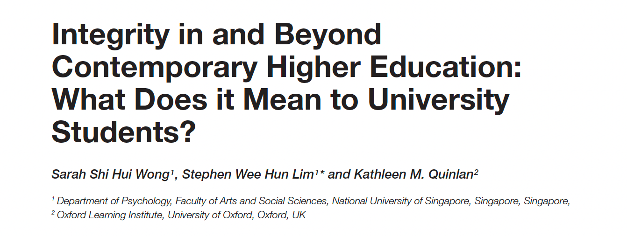
Research has focused on academic integrity in terms of students’ conduct in relation to university rules and procedures, whereas fewer studies examine student integrity more broadly. Of particular interest is whether students in higher education today conceptualize integrity as comprising such broader attributes as personal and social responsibility.

Slide 38
Results
Integrity was predominantly taken as “not plagiarizing”, “not cheating”, and “completing tasks independently”.
The survey also revealed further perceptions from a smaller group of students:
  In an institution context: “being honest with others”, “group work commitments”, “holding true to one’s beliefs”, “being honest with oneself”, “upholding a strong work ethic”.
  In a workplace context, “power and responsibility and its implications”, “professionalism”, and “representing or being loyal to an organization”.

Slide 39
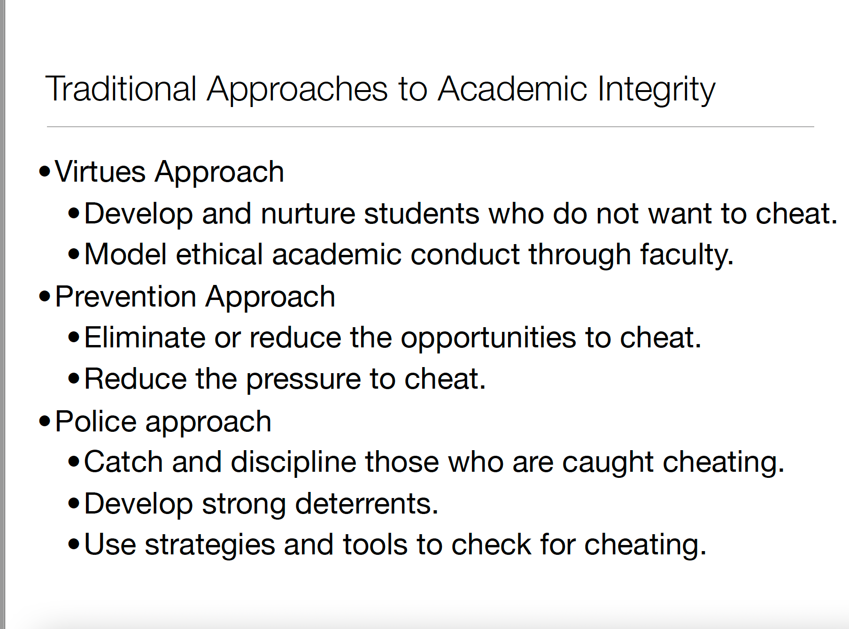

Slide 40
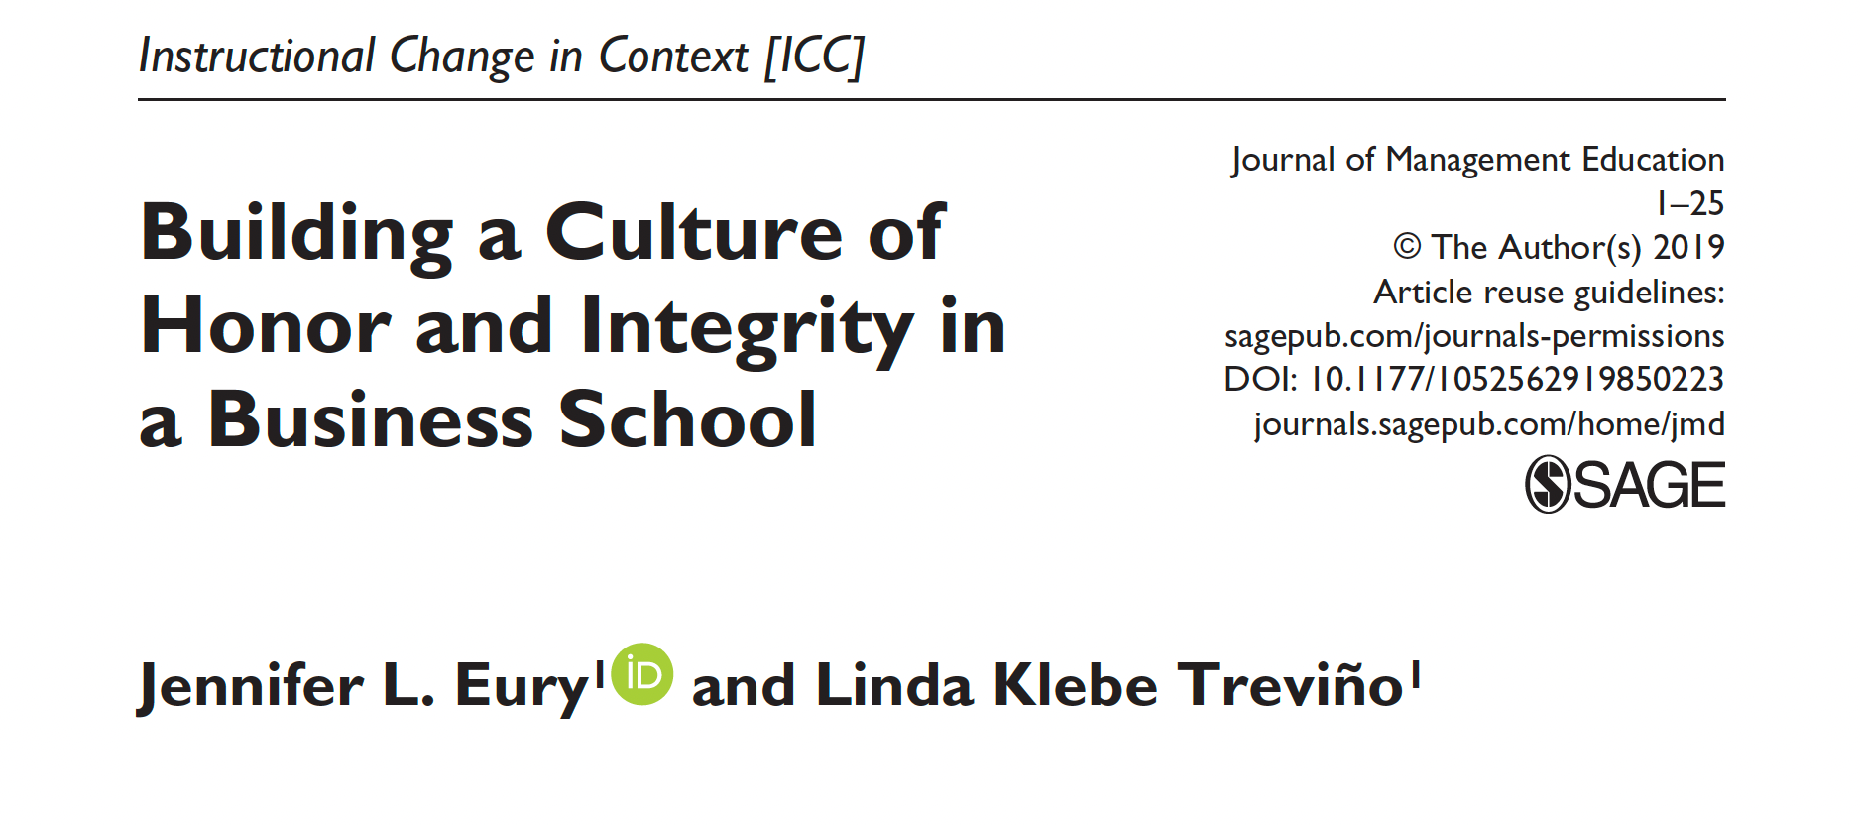

Slide 41
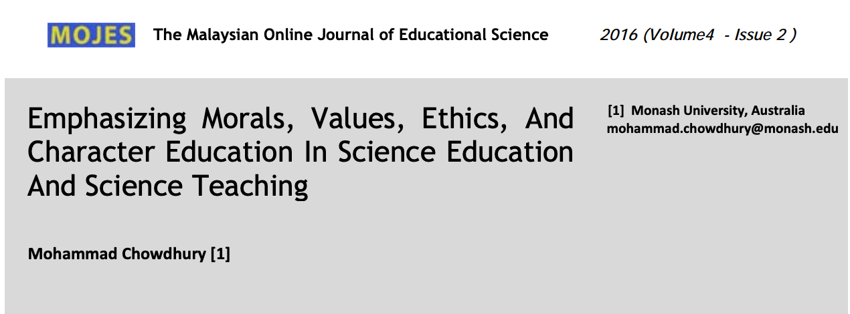

Slide 42
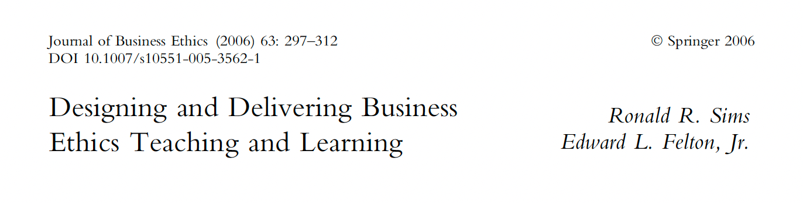
Campus-wide course?

Slide 43
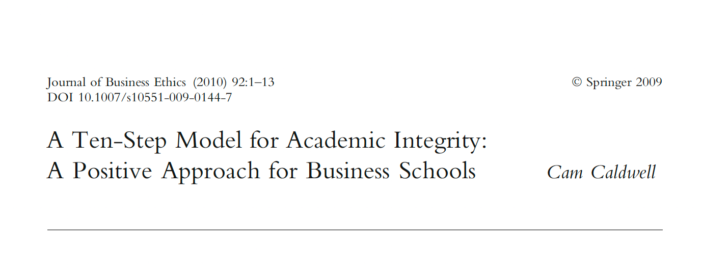

Slide 44
10-Step Model
Articulation of a clear and vision mission
Orientation and training of faculty
Explanation and clarification of policies
Implementation of a just process for addressing violations
Attainment of student ownership
Empowerment of students in education and enforcement
Maintenance of dialogue with stakeholders
Refinement of the ethics curriculum
Monitored enforcement
Evaluation of outcomes and communication of results.

Slide 45
Institution’s Goal
Institution must clearly communicate expectations regarding ethics, integrity, and academic honesty.
Not merely to be the police of academic violations, but rather to create a culture and climate at the school that emphasizes ethics and integrity.
Goal is to prepare students for the real world

Slide 46

Thank you!

Slide 47
References
https://www.unodc.org/e4j/en/integrity-ethics/module-1/additional-teaching-tools.html;
https://www.craftonhills.edu/~/media/Files/SBCCD/CHC/About%20CHC/Research%20and%20Planning/ILO%20Final.pdf

