Slide 1

Interprofessional Institutional Learning Objectives
Bimbola Akintade
Lorraine Doucette
Crystal Edwards

Slide 2
Task Force
We wish to thank the following individuals for providing feedback on the objectives:
Christine King, EdD – Director for Student Success SON
Fotini V. Anagnostopoulos-King, D.M.D – SOD
Elizabeth Lamos, MD, FACP – SOM
Norman Retener, MD, FACP – SOM
Kathleen Hoke, JD – SOL
Sara Gold, JD – SOL
Toby Guerin, JD – SOL
Amanda Lehning, MSW, PhD - SSW

Slide 3
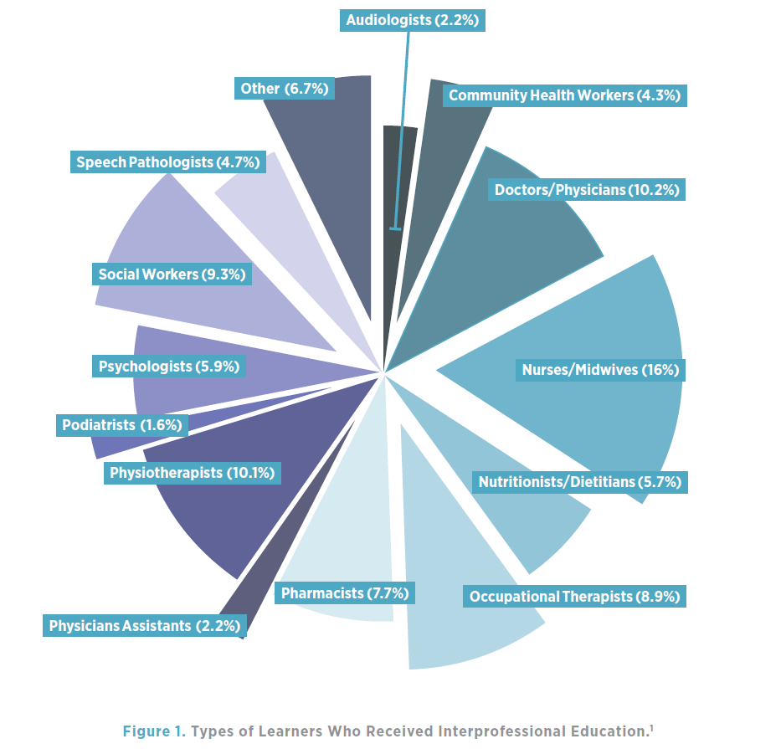

Slide 4
Survey Questions
Does your school participate in IPE initiatives?
What are the barriers you have faced regarding starting an IPE program?
What are the goals and outcomes for IPE for your students?
How do you measure student participation in IPE initiatives at your school?

Slide 5
What is the level of faculty involvement in IPE initiatives at your school ?
How would you describe the resources available for IPE at your school?
What challenges have you or do you currently encounter with providing IPE initiatives for students at your school?
What is your vision for the future of IPE at your school/ the campus?

Slide 6
Objective One
Graduates will have exposure to working and interacting with other healthcare and human services professionals on the UMB campus.
Why is it important?
Survey responses: Develop better tracking of student participation in interprofessional learning initiatives.
How to assess?
Annual programmatic evaluation

Slide 7
Objective Two
Graduates will demonstrate cultural humility in their engagement with diverse healthcare and human services professionals on the UMB campus.
Why is it important?
Survey responses: Expand interprofessional learning opportunities for all students across all levels of education.
How to assess?
Annual programmatic evaluation

Slide 8
Objective Three
Graduates will have opportunities to research, investigate, and integrate skills within and across healthcare and human services disciplines.
Why is it important?
Survey responses: Provide more opportunities for all students across all levels of education to collaborate.
How to assess?
Annual programmatic evaluation

Slide 9
Objective Four
Graduates will have the ability to recognize challenges in the healthcare and human services systems and partner with other professionals to identify solutions.
Why is it important?
Survey responses:
Provide incentives for faculty to develop IPE experiences.
How to assess?
Annual programmatic evaluation

Slide 10
Thank you!

