Slide 1

PCard Refresher Training
Co-hosted by SSAS & MAS
PCard-Admin@umaryland.edu
MAShelp@umaryland.edu
Notes:
Housekeeping Items:
Introductions.
This session will be recorded.
Turn Mic and Camera off.
People in the room Mic.
Feel free to unmute yourself with questions or comments OR type them into the chat.
Begin recording.

Slide 2

Online Presence and Communication
SSAS Webpage
Procurement (general goods and services)
Socially Responsible Procurement
Events & Announcements
Forms (Account Maintenance)
PCard Admin Webpage
Calendar of Important Dates
Annual Newsletter
Percipio : Intro to the UMB PCard Program
Bits & Bytes – More Frequent
Elm – Less Frequent

Slide 3
Socially Responsible Purchases
Supplier Diversity
All Quantum users now have access to the Sweeten application, which makes finding diverse suppliers easy.
Cardholders are expected to seek out minority and women owned businesses where possible as they make purchases.
For more information, please visit:
Procurement MBE
Green Purchases
Maryland’s Department of General Services has specifications for state agencies to follow when purchasing goods and services to prioritize environmentally and socially beneficial procurement practices.
Examples of vendors currently under contract UMB:
Office Supplies, equipment, and furniture
AJ Stationers
Blind Industries and Services of Maryland (BISM)
Maryland Correctional Enterprises (MCE)
Rudolph Supply
Lab Supplies, equipment, and safety products
Fisher Scientific
VWR
For more information, please visit:
Procurement Buy Green

Slide 4

US Bank Navigation
Monthly Statement
Transaction Management
Track Disputes and Credits
View Pending Transactions
Run Transaction Detail Report
Declined Transactions
Cardholder should verify
Monthly / single transaction limit
Validation issue (name, zip, CVV, etc.)
Card status (Is it activated? Has it expired?)
PCPA or US Bank can identify
MCC
Identify & Verify Decline Reason
www.Access.USBank.com
The bank has updated their authentication process when contacting customer service. The following will help guide you through this process.
Tip: Refer to your Application and/or most recent Account Maintenance request.
Organization Short Name: MD
Name: [your name]
Last 4 digits of Card Number: [Printed on your PCard]
Last 4 Social Security Number: [last 4 of your UMB Employee ID]
UMB does not give employee’s SSN to the bank
Email: [must match application]
Phone: [must match application]
Address: [must match application]
Single Purchase Limit: [As requested – if unsure contact PCard-Admin@umaryland.edu]
Credit Limit: [As requested – if unsure contact PCard-Admin@umaryland.edu]

Slide 5
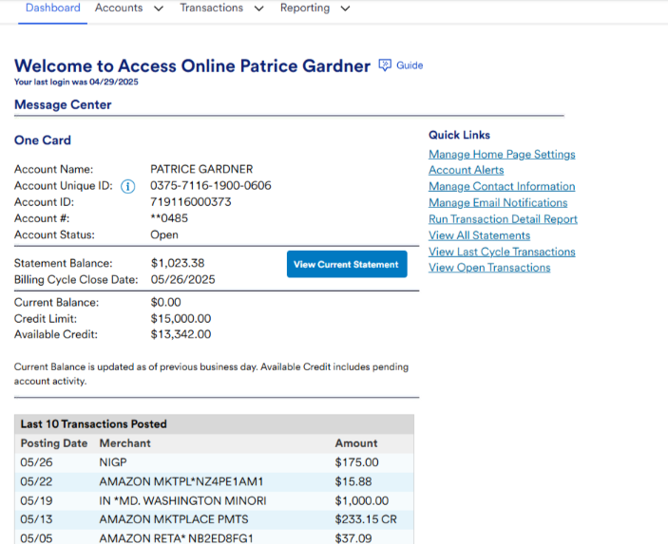



Statement
Statements become available on the 25th or 26th of each month for the previous month.
A full schedule for statement availability can be found on the PCard Program Calendar

Slide 6
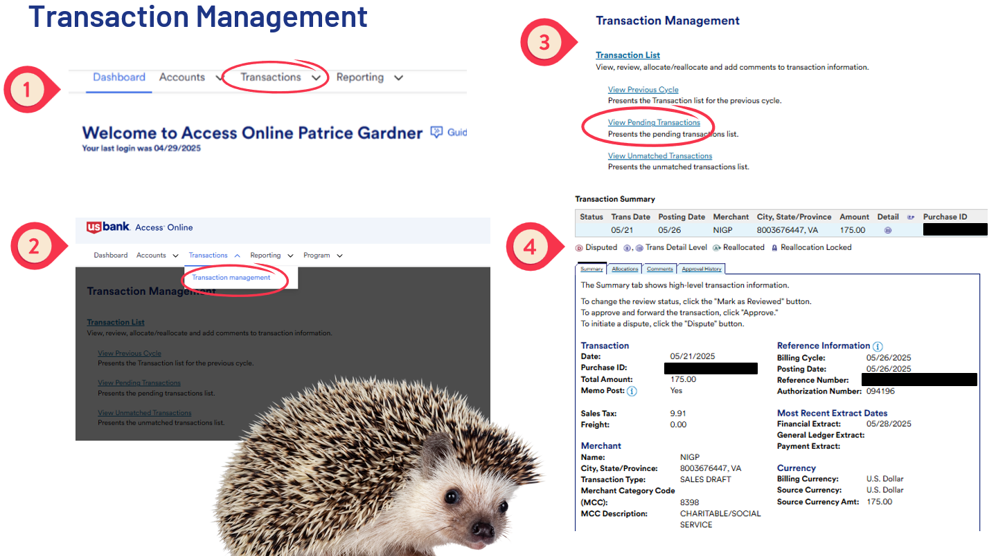

Slide 7
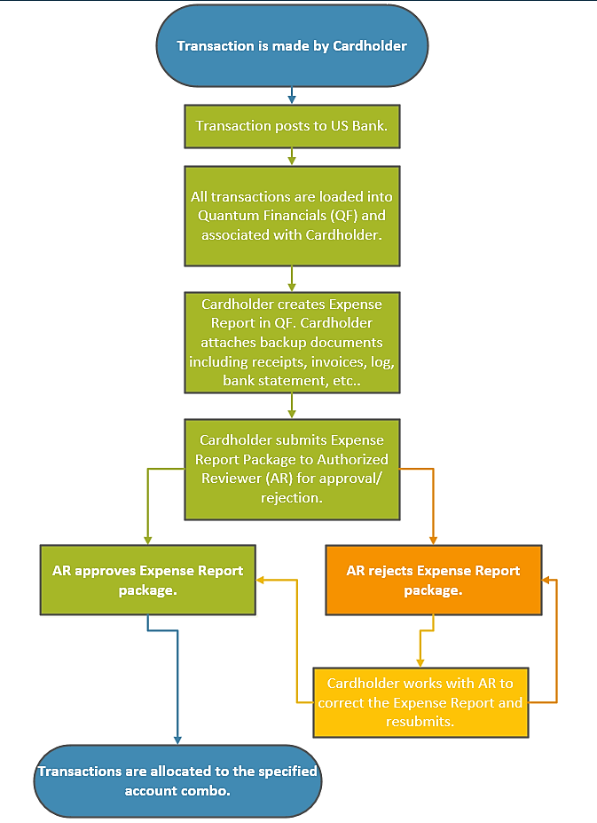
Life Cycle of a PCard Transaction

Slide 8
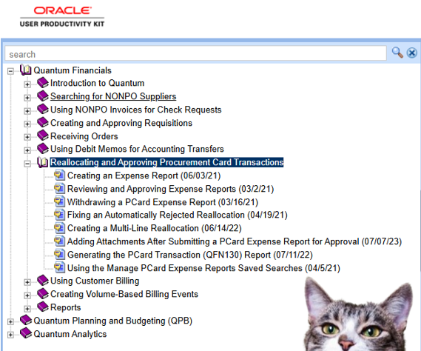
UPK Oracle’s User Productivity Kit
UPK – Quantum
Tell us about an issue you have and let’s see if we can find a UPK that will help. (ex – How to add backup docs after the fact)

Slide 9

QFN130
Transaction Management (Quantum Financials)
Expense Report Status
Saved → Expense Report created but not sent for approval.
Pending Manager Approval → Waiting for approval. (before submitted status)
Submitted → Is approved and allocated to specified account combo.
Rejected by Individual → returns to cardholder for changes
(most common)
Does allow changes or updates to Expense Report.
Approver is seeking documentation, Account Combo/Project ID correction, etc.
Manager Requested More Information → Does NOT return to cardholder
(less common)
Does not allow for changes or updates to Expense Report.
Approver is seeking additional explanation only.

Slide 10

EOY Processes
OOTC End of FY Notification
Recommend connecting with Approver, Delegate, Unit Budget Head for any outstanding or last-minute factors.
Announcements - Office of the Controller
PCard Program Calendar

Slide 11

FAQs
Extended Leave – What should I do?
Increasing limits – Justification
MD State Sales and Use Tax?
Questions so far?

Slide 12
MAS Placeholder
Recording End: MAS will continue the discussion with traditional compliance review topics.

Slide 13
Disputes
Transactions identified as fraudulent during the monthly reconciliation, or improper charges unable to be resolved with vendor, must be disputed with USBank promptly.
Must be reported (800-344-5696) within 60 days of relevant bank statement date.
Failure to adequately track to resolution may carry PCard consequences.
Notify pcard-admin@umaryland.edu of problems.

Slide 14

Disputes
Disputes may be appropriate for:
Fraudulent/unauthorized charges
Overcharge/Duplicate charge
Defective/incorrect/missing merchandise
Cancellation requested but not processed by merchant
Services not as described

Slide 15
Tracking Expected Refunds
All expected refunds must be immediately recorded.
The log then serves as a visual reminder to follow up.
During reconciliation, forward pending transactions to following month's log.
Best Practice: if expected refund does not post by the end of the first full month, seriously consider initiating dispute. If still working with vendor, mark end of dispute window on your calendar and set reminders.
Be particularly cautious when dealing with hotels -
Ensure Credit Card Authorization Form is completed correctly and maintain copy!

Slide 16
Miscellaneous Reminders
Gift Cards are NEVER permitted
Never share card/card number, and ensure full cc# is not visible in documentation
Adhere to Single Purchase Limit ($4,999)
Retain Itemized Final Receipts
Business Purpose for purchase must always be clear from supporting documents
Level of detail varies depending on purchase. Example: Pipettes vs. Nail Polish
Support for catering must be detailed enough to illustrate event allowability
Upload fully approved TAR to support hotel expenses

