Slide 1

PCard Refresher Training
Co-hosted by SSAS & MAS
PCard-Admin@umaryland.edu
MAS-help@umaryland.edu

Slide 2

Online Presence and Communication
SSAS Webpage
Procurement (general goods and services)
Socially Responsible Procurement
Events & Announcements
Forms (Account Maintenance)
PCard Admin Webpage
Calendar of Important Dates
Annual Newsletter
Percipio : Intro to the UMB PCard Program
UMB PCard User’s Guide
Bits & Bytes – More Frequent
Elm – Less Frequent

Slide 3

Socially Responsible Purchases
Supplier Diversity
All Quantum users now have access to the Sweeten application, which makes finding diverse suppliers easy.
Cardholders are expected to seek out minority and women owned businesses where possible as they make purchases.
For more information, please visit:
Procurement MBE
Green Purchases
Maryland’s Department of General Services has specifications for state agencies to follow when purchasing goods and services to prioritize environmentally and socially beneficial procurement practices.
Examples of vendors currently under contract UMB:
Office Supplies, equipment, and furniture
AJ Stationers
Blind Industries and Services of Maryland (BISM)
Maryland Correctional Enterprises (MCE)
Rudolph Supply
Lab Supplies, equipment, and safety products
Fisher Scientific
VWR
For more information, please visit:
Procurement Buy Green

Slide 4
IT Procurement Compliance and Security (IT-PCS) Form
Security and Compliance Reviews
Web Accessibility Assessments
Integration with Central Systems
Fiscal Oversight
Redundancy Checks
This form is required for the purchase of IT services, software solutions, and certain hardware.
For more information, visit:
IT Procurement Compliance and Security Form

Slide 5
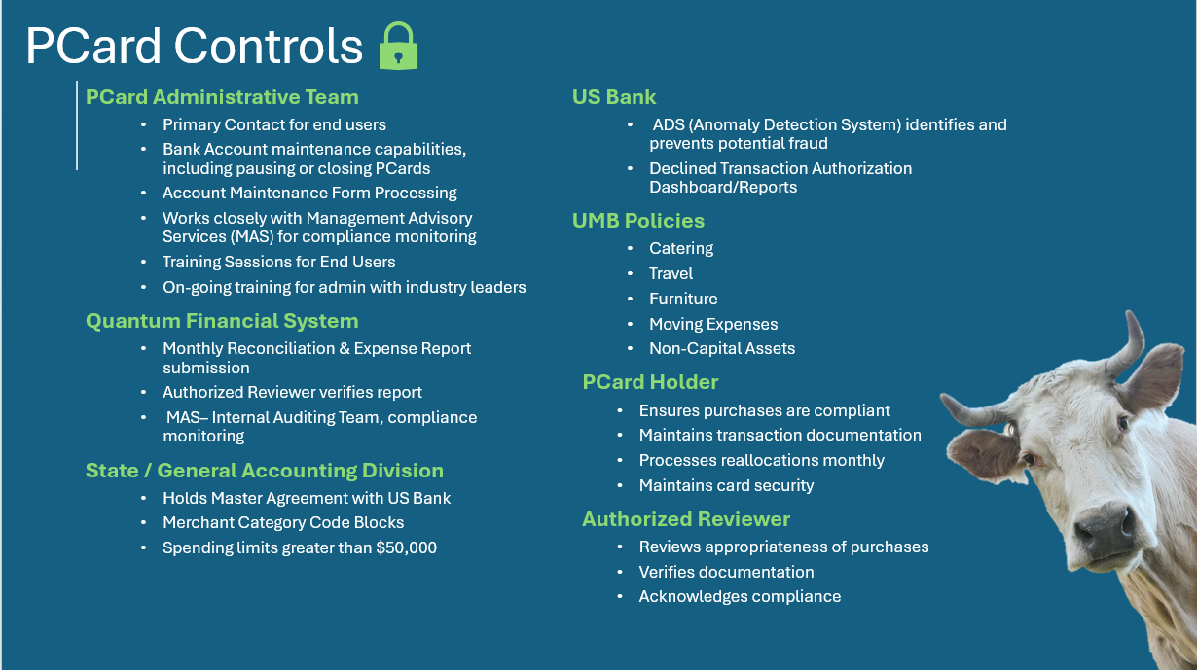

Slide 6
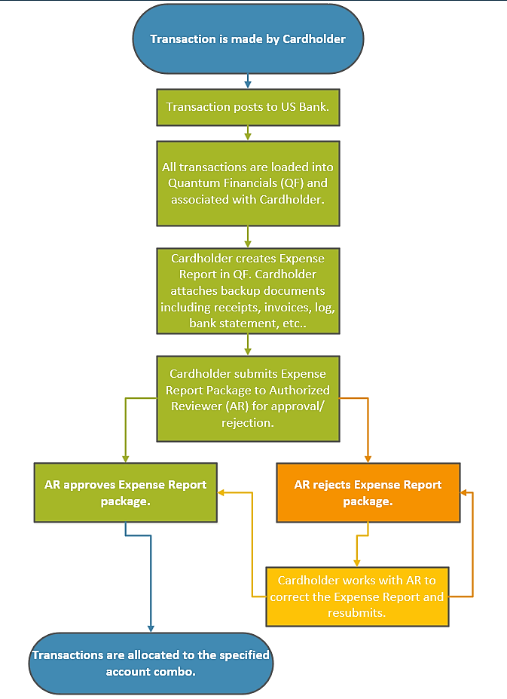
Life Cycle of a PCard Transaction

Slide 7

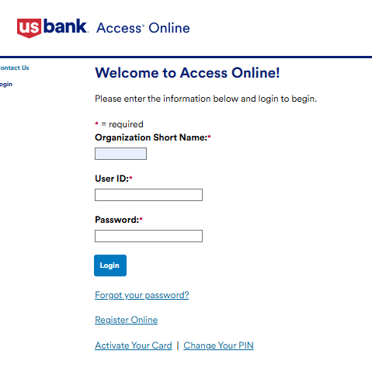
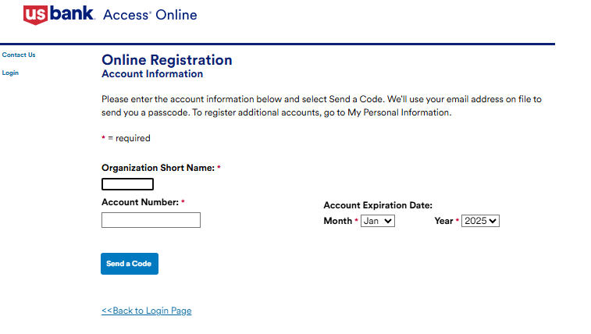
US Bank Registration
Beginning July 2025, paper statements have been replaced by e-statements.
All cardholders are required to have a User Profile in Access Online to obtain statements.
www.access.usbank.com
MD
CREDIT CARD NUMBER
Notes:
- Contact pcard-admin@umaryland.edu for password resets – have 15 minutes set aside to complete this

Slide 8
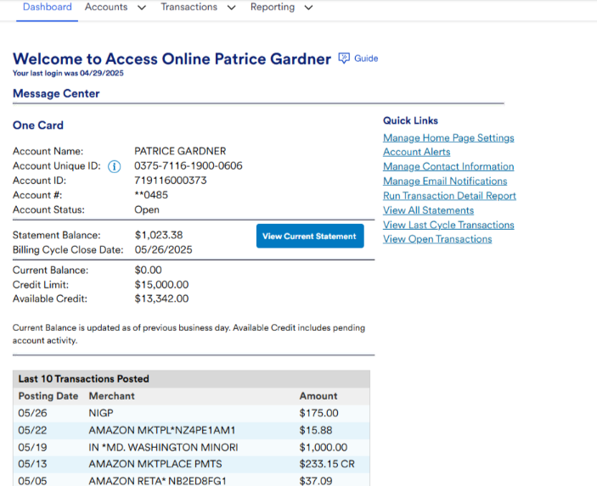



Statement
Statements become available on the 25th or 26th of each month for the previous month.
A full schedule for statement availability can be found on the PCard Program Calendar

Slide 9
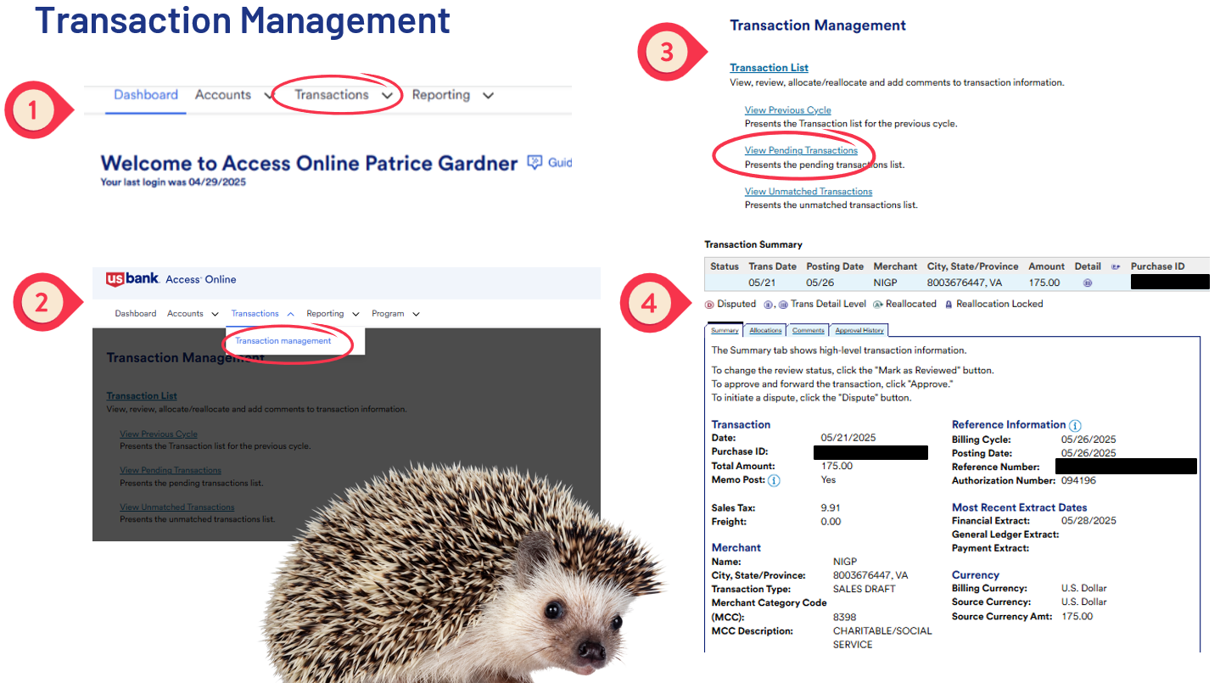

Slide 10


DECLINED TRANSACTIONS
Cardholder should verify
Monthly / single transaction limit
Validation issue (name, zip, CVV, etc.)
Card status (Is it activated? Has it expired?)
PCPA or US Bank can identify
Identify & Verify Decline Reason
MCC
Notes:
Detailed look at transaction Management on next slide

Slide 11

FAQs
Extended Leave – What should I do?
Increasing limits – Justification
MD State Sales and Use Tax?
Questions so far?

Slide 12

Split Purchases
Single Purchase Limit is $4,999
When a purchase >$5k is artificially/intentionally split into smaller payments, this constitutes a split purchase.
Blatant Example:
Cardholder wants to purchase $7,000 piece of equipment and asks vendor to process separate payments to avoid the bank’s dollar cap.

Slide 13
Splits - Multiple Orders
“What Did You Know & When Did You Know It?”
Scenario 1: Numerous same day purchases
When a cardholder spends >$5k with one vendor in one day, it draws audit scrutiny. If the orders were placed around the same time, the purchases will likely be viewed as a split, unless we can document that the second request was received after the first order was already placed.
Auditors evaluate things like sequence numbers on invoices/quotes and time stamps on order confirmations.
It is not relevant if the orders were placed for different PIs/projects!

Slide 14
Splits - Multiple Orders
“What Did You Know & When Did You Know It?”
Scenario 2: Numerous same “project” purchases
When a cardholder spends >$5k for one purpose an auditor may deem that a split even if the charges are spread over time. Auditor stance is to object if a reasonable person could have predicted the total amount would exceed the single purchase limit.
Examples:
Catering for breakfast and lunch at same event
Printing different swag items for same giveaway purpose

Slide 15
Splits - How to Avoid Audit Findings
Ask Permission, Not Forgiveness!
Consider the full scope of upcoming projects.
If need is likely to exceed $5k, contact SSAS proactively for a Purchase Order
Consider the “Spirit of the Policy”
The point is to encourage cost savings via volume purchases
Larger purchases must go to SSAS for multiple quotes or competitive bids
Consult with SSAS about contracts where appropriate
Pattern of spending with single vendor
Pattern of spending on single good/service
Consequences for violations

Slide 16
Miscellaneous Reminders
Gift Cards are NEVER permitted
Never share card/card number, and ensure full cc# is not visible in documentation
Retain Itemized Final Receipts
Upload Transaction Log and Statement
Track Pending Refunds!
Record expected credit on log and forward until refund posts
Dispute if necessary - 60-day window - leverage reminders!
Business Purpose for purchase must always be clear from supporting documents
Level of detail varies depending on purchase. Example: Pipettes vs. Nail Polish
Catering support must be detailed enough to illustrate event allowability
Upload fully approved TAR to support hotel expenses

