Slide 1

Welcome to UMB
UMB IT Resources for New Employees

Slide 2
Agenda
UMID
myUMB Portal
Microsoft Applications
Eduroam Wireless Access
Conferencing Software
CITS

Slide 3

What is the UMID?
Activating your UMID will synchronize passwords; this is a crucial part of the Single Sign-On (SSO) system, which reduces the number of passwords and logins a user must remember and maintain. Once activated, you will login to your email, computer, and all UMID- protected systems with the same UMID & password.
To Activate your UMID:
  First, you will receive your workstation/email ID and temporary password from your supervisor. (The workstation/email ID is a combination of your first and last name BEFORE the @umaryland.edu)
  Next, visit WWW.UMARYLAND.EDU/CITS and select the UMID icon and follow the “Getting Started with your UMID” instructions
  You can access, activate, and update your UMID and password by going directly to the Account Management Site here: HTTPS://DIRECTORY.UMARYLAND.EDU/
Your UMID is a unique username that you will use to create your account on the UMB Account Management Site.

Slide 4
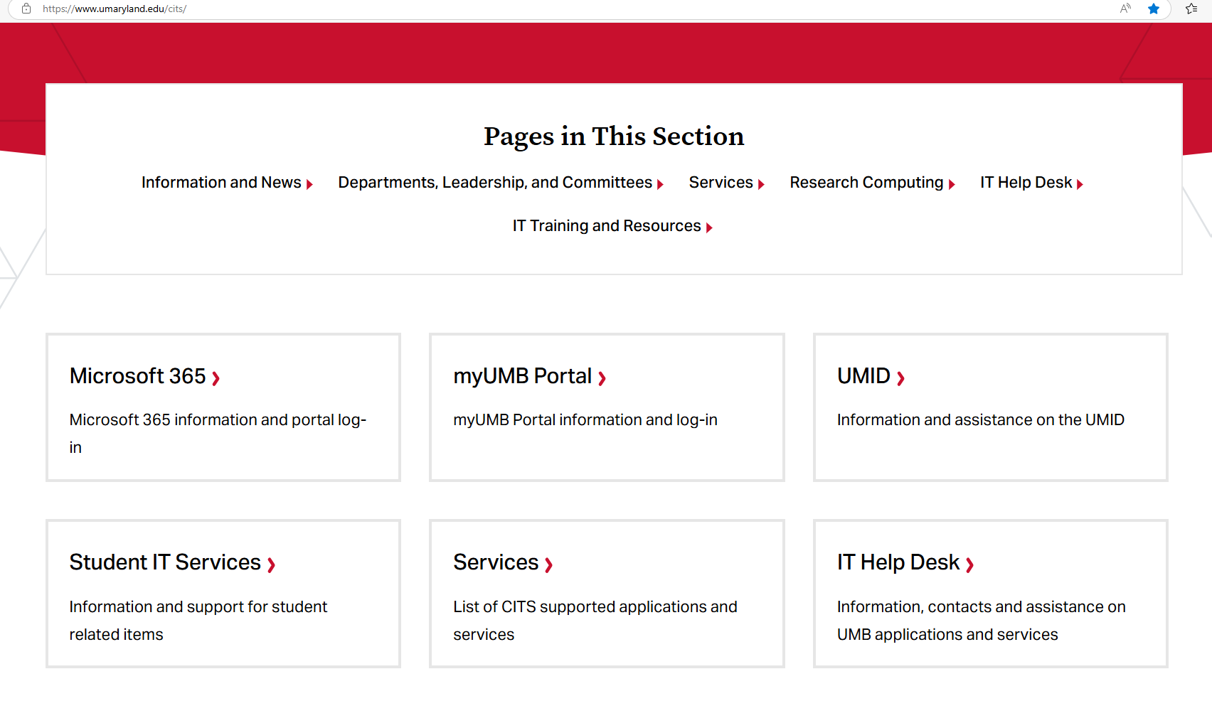
ACTIVATE Your UMID at WWW.UMARYLAND.EDU/CITS
Click Here!

Slide 5
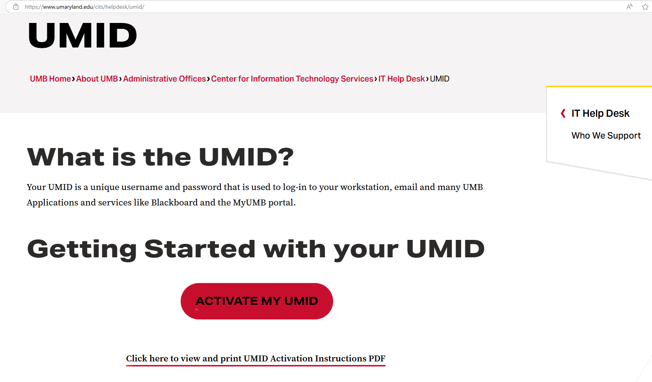

Select “ACTIVATE MY UMID”
Print/Download PDF instructions here!

Slide 6
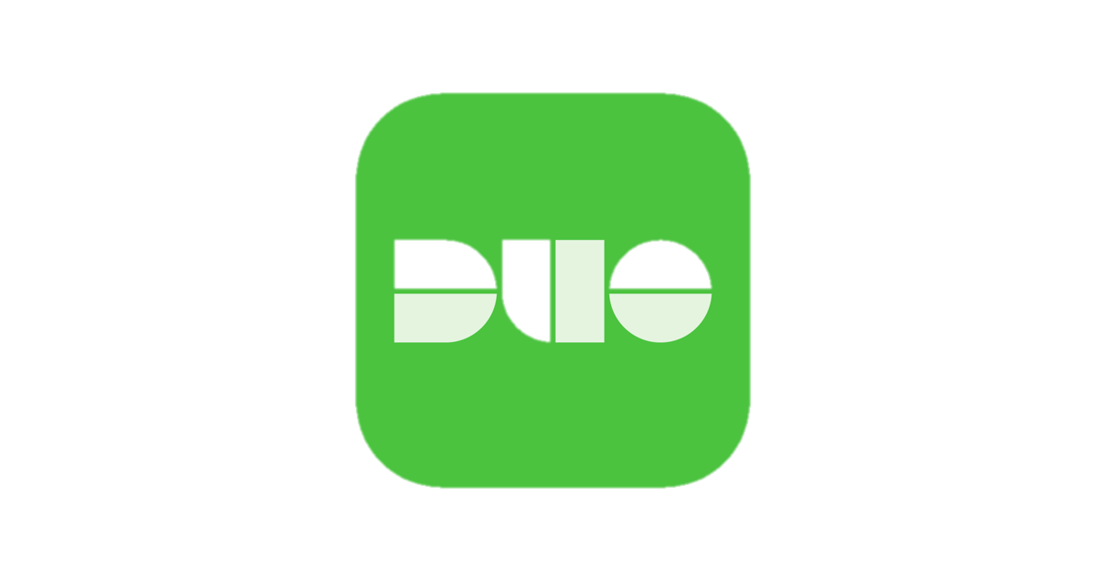
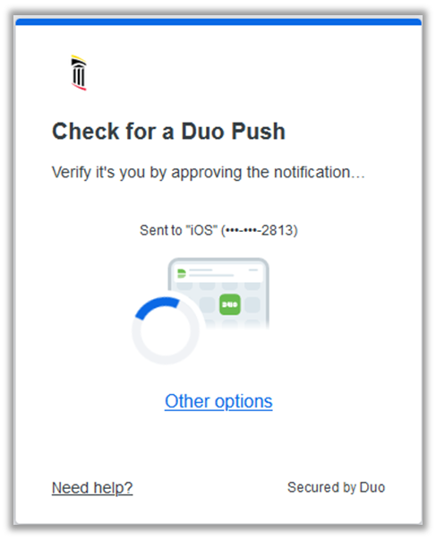
DUO Multi-Factor Authentication
DUO is the application used by UMB for Multi-Factor Authentication, which provides a 2nd level of identity checking.
Utilizing a Multi-factor Authentication like DUO allows us to keep our files and data secure
When you access various web applications with your UMB email and password, you will be required to authenticate who you are using DUO on a different device
You can download the DUO Mobile app on your smartphone or tablet
Enroll in Duo at: https://www.umaryland.edu/cits/services/duo/enrollment
General Information: https://www.umaryland.edu/duo
Notes:
Another important tool that you will absolutely see on a regular basis is multi-factor authentication. IT Security is a very important topic at UMB, and MFA, as it’s often referred to, is what allows us to have an extra level of security when signing into various applications.
Specifially, DUO is the application that we use and can be downloaded onto your smartphone or tablet to provide the 2nd level of identity checking.
Instructions and additional information on the Duo app can be found on the websites listed here.

Slide 7
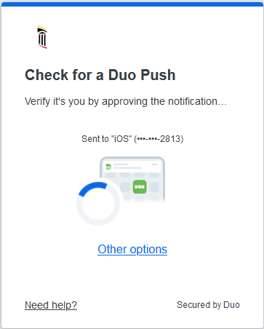
DUO Multi-Factor Authentication
Duo Prompt
From the UMB Account Management Site you can:
Choose your Authentication Method if you have registered a device (Download the DUO Mobile App and use the PUSH Function!)
Add a new device or edit your settings for DUO
You can download the DUO Mobile app on your smartphone or tablet
Notes:
When you sign into any application that requires MFA, this window will appear.
You have 3 options – Push, call or passcode.
We recommend using the Push method, which will send a notice to your smartphone or tablet and you simply need to select “Approve” and it will sign you in.
We also recommend selecting “Remember me for 7 days”. This will by pass needing to send a push every time you sign in.
To the left are links that allow you to add a new device and also review and update your personal settings.

Slide 8


UMB Alerts
UMB Alerts is the system used by the Emergency Management Team at the University of Maryland, Baltimore to notify the campus community about emergencies and weather-related closings.
You are automatically signed up for UMB Alerts via email but can register to get SMS texts as well!
You will be prompted to set up SMS Text Notifications for UMB Alerts as you are setting up your UMID on the Account Management Site.
To learn more visit: https://www.umaryland.edu/emergency/alerts
Notes:
Review slide.

Slide 9
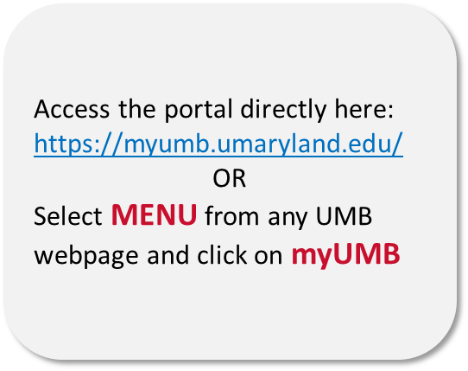
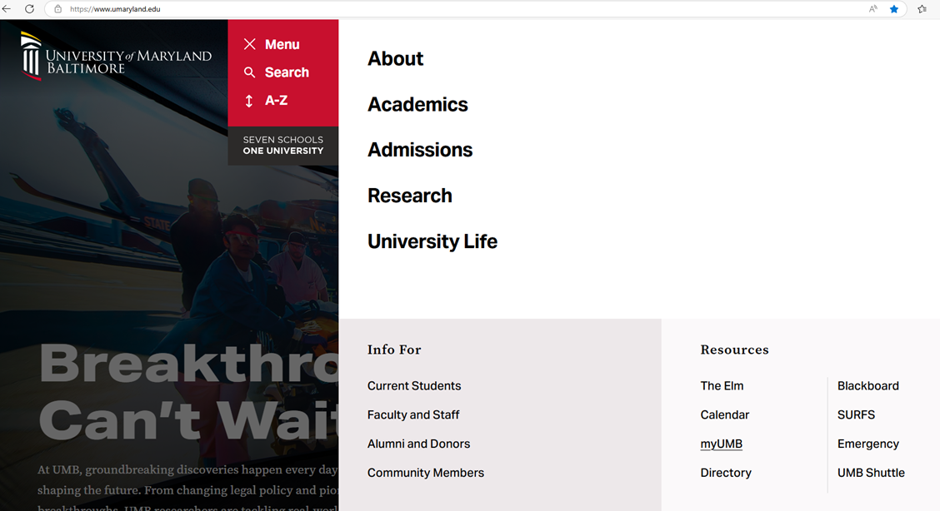

What is the myUMB Portal?
The myUMB Portal provides access to many applications, tools, and news pertinent to the UMB community. It is a customizable space

Slide 10
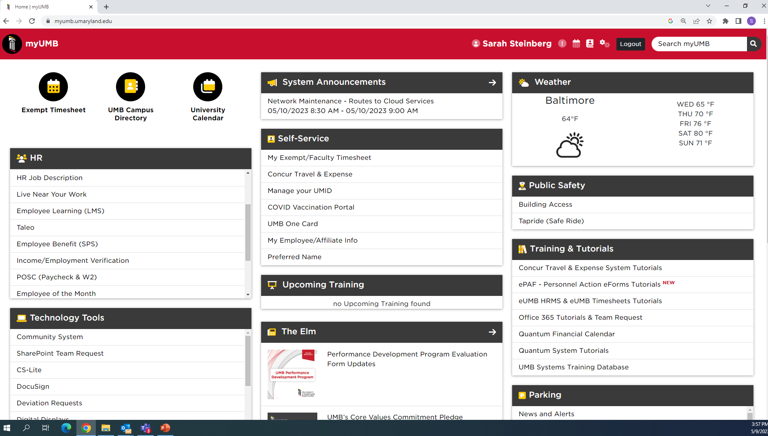
Notes:
This is a screenshot of the portal. Keep in mind – what YOU will see will be based on YOUR security role in our system, which includes if your exempt or non-exempt, what department or school you work for, and even your specific job. When you first access the portal, it will look different than what you see here.
But what is the same across the board:
In the upper left-hand corner are UMB Icons. Certain icons will default, including access to your timesheet.
Then, the rest of the screen is comprised of Widgets. Each box we see is a Widget. Certain Widgets will default into view, and what is great about this portal – it’s customizable! As you start to settle in here at UMB, you can remove widgets you know you won’t need, add widgets you would like easy access to, and move the order of the widgets! I’ll get to that shortly.
Some other items to point out:
Everyone will have the Self-Service widget – you can access your timesheet from here too, if you want to make changes to your UMID account – you can access it from here, and preferred name too!
The HR widget will also appear for everyone, and it provides access to your paycheck information and W2’s. What we don’t see in the screen shot – you can also access your leave inquiry and our university Learning Management System (LMS).
Another widget that may be helpful is the Training & Tutorials widget. This will NOT appear by default! If you want to access it, you will need to add it. What it provides is easy access to various training tools. If you’ll be working with our financial system – Quantum – the tutorials can be found here. Same with the eUMB systems – timesheet training can be found here, along with other Payroll related training. And the UMB Systems Training will access our training database that allows you to access and enroll in live training – both virtual and in person. I’ll come back to that later!
Then there is the Settings icon. The Gear icon will take you to your settings AND, more specifically, to Help.

Slide 11
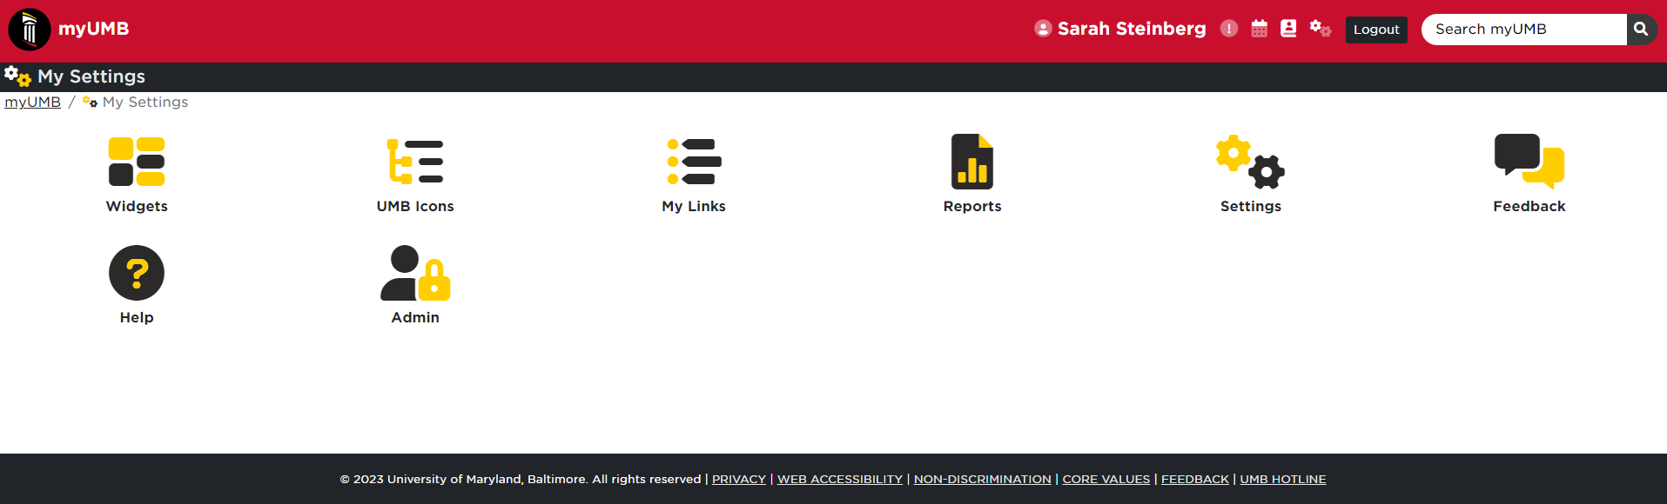
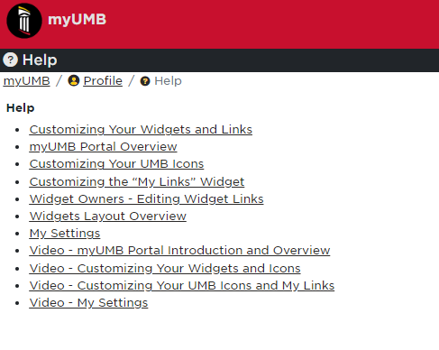
Locate the “Settings” icon in the top right and select the “Help” icon to access videos and information on how to customize your myUMB portal experience.

Slide 12

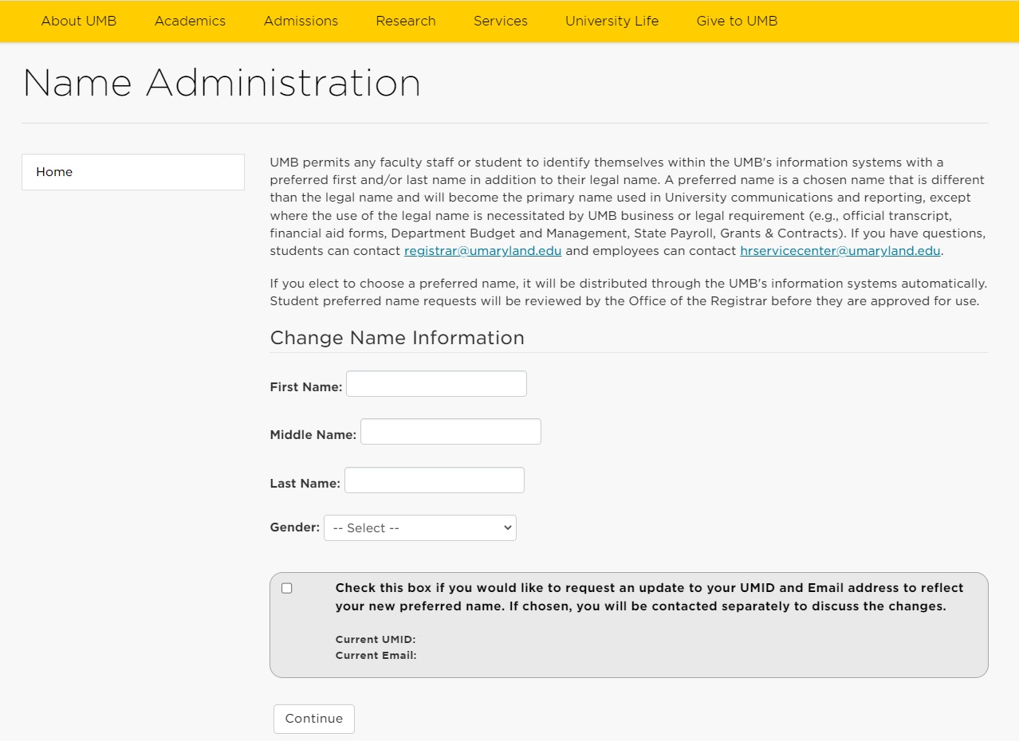
Preferred Name
Preferred Name allows any faculty, staff or student to identify themselves within UMB’s information systems with a preferred first and/or last name in addition to their legal name.
Update through:
https://cf.umaryland.edu/preferred_name/main.cfm
OR
myUMB Portal – “Preferred Name” under Self-Service

Slide 13

Electronic Timesheets
Most employees are required to submit Electronic Timesheets (ETS)
Electronic Timesheets (ETS) – Document hours or days worked and leave taken (if eligible)
Exempt faculty and staff record duty days (“D” rather than work hours)
Non-Exempt employees record in and out hours worked
For training, visit:
eUMB Systems Tutorial Browser in the myUMB Portal
Percipio
Direct tutorial Link: http://cf.umaryland.edu/ondemandtraining/enterprise/PlayerPackage/
For more information, visit:
https://www.umaryland.edu/policies-and-procedures/library/financial-affairs/procedures/
Notes:
All employees will fill out a timesheet every other week. Exempt employees will just record Duty days, non-exempt will need to enter their hours worked. To learn more about your timesheet and how to complete it, please view our training tutorials. They can be directly accessed at the link listed here, or through the portal and the Training & Tutorials widget that we saw a few moments ago.

Slide 14

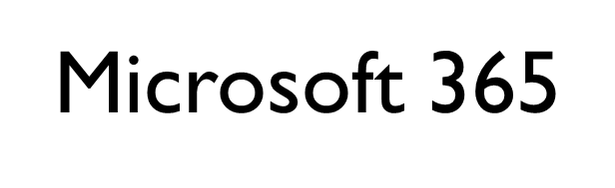
Access files, emails and M365 apps – anywhere and anytime with an internet connection and a smart device!
All UMB employees have access to the full suite of Microsoft 365’s productivity applications like Word, PPT, Excel, and Copilot Chat AI.
Outlook email is UMB’S primary method of communication and information sharing with the community.
2 Ways To Access Microsoft 365 Apps:
Desktop/Client
    Installed on all UMB issued devices
    Full functionality
    Needs to be installed on personal devices
Online/Portal
    Access through internet browser with https://portal.office.com
    Limited functionality
    Download Client version here (on up to 5 personal devices!)

Slide 15
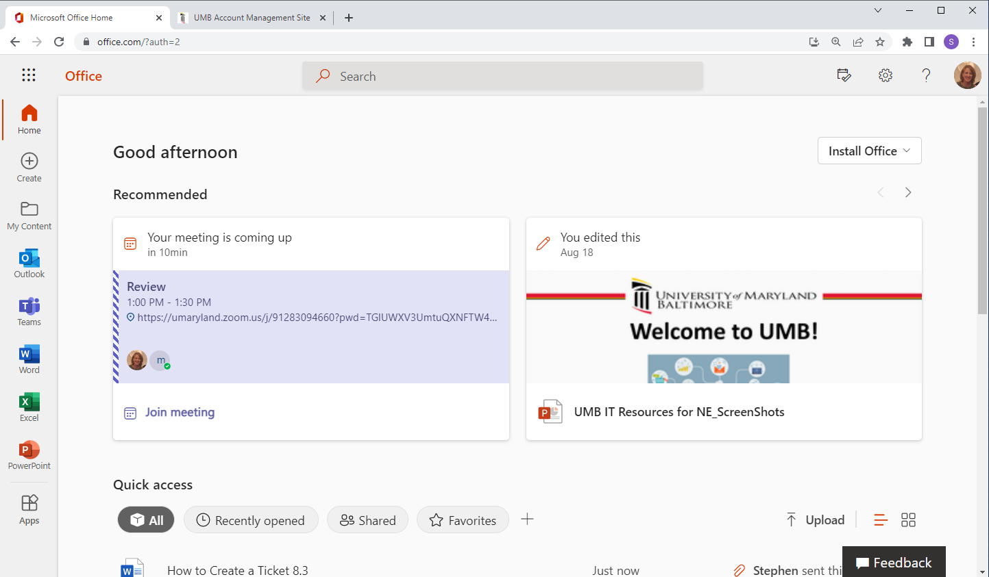

Slide 16
Microsoft 365 File Storage Best Practices
OneDrive
Used for personal work files that only the employee needs to access
File Sharing from OneDrive is NOT recommended and should only be used on a limited / short term basis if necessary.
For additional information visit: https://www.umaryland.edu/office365/onedrive-for-business/
SharePoint
Used for any work file that requires interaction (access, viewing, editing, sharing)
File collaboration is encouraged and supported through Teams. Each Team has its own SharePoint Site which serves as a document library for everyone on that Team.
For additional information visit: https://www.umaryland.edu/office365/sharepoint/

Slide 17
AI at UMB - Copilot Chat
Microsoft Copilot Chat is a generative AI chat search tool accessible through any web browser. It provides enhanced security and privacy features and is available to all UMB students and employees.
Copilot Chat allows users to search for information, generate text such as emails, outlines, summaries, and create images based on text/voice prompts.
You must be signed-in to Copilot Chat. By using your UMB credentials to access Copilot Chat you are ensuring that your data and UMB's data is protected in a secure search environment.
For more information visit CITS Training Resources:
https://www.umaryland.edu/cits/training/microsoft-365/copilot/

Slide 18

Eduroam Wireless Access
Eduroam (or Education Roaming) was developed for International Research and the Education Community and has allowed the University to enhance its wireless network.
Eduroam allows students, faculty, and staff from participating institutions to obtain internet connectivity across campus and when visiting other participating institutions by utilizing their UMaryland Email login on their laptop or smartphone.
Eduroam Wireless is the preferred connection on campus as it is part of the University’s Network and will grant you faster access to multiple websites and applications
Once connected you are registered and connected to Eduroam, you can actually connect to Eduroam at any UM Institution that offers it as well!
For more information visit: https://www.umaryland.edu/cits/services/eduroam/

Slide 19

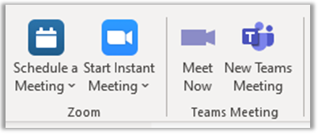

Conferencing Software
Look for the Zoom or Teams Icon to schedule meetings in your Outlook calendar!
Zoom
Support Site – umaryland.edu/zoom
Web Interface – umaryland.zoom.us
Microsoft Teams
Support Site – umaryland.edu/office365
Web Interface – portal.office.com

Slide 20
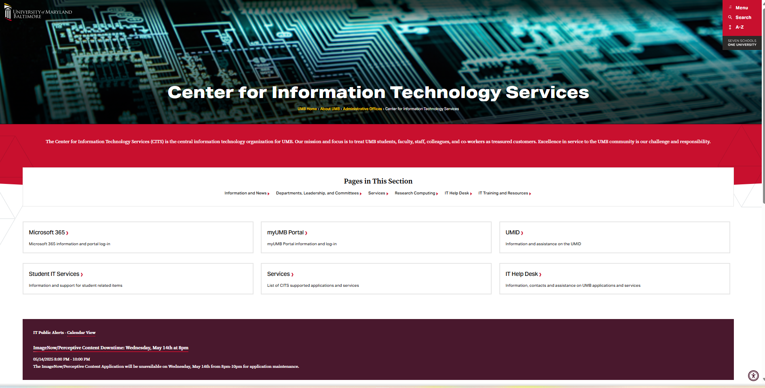
CITS Website: HTTPS://WWW.UMARYLAND.EDU/CITS
Access to:
IT Help Desk
IT Training Resources
myUMB Portal
UMID
IT Services
…and more!

Slide 21

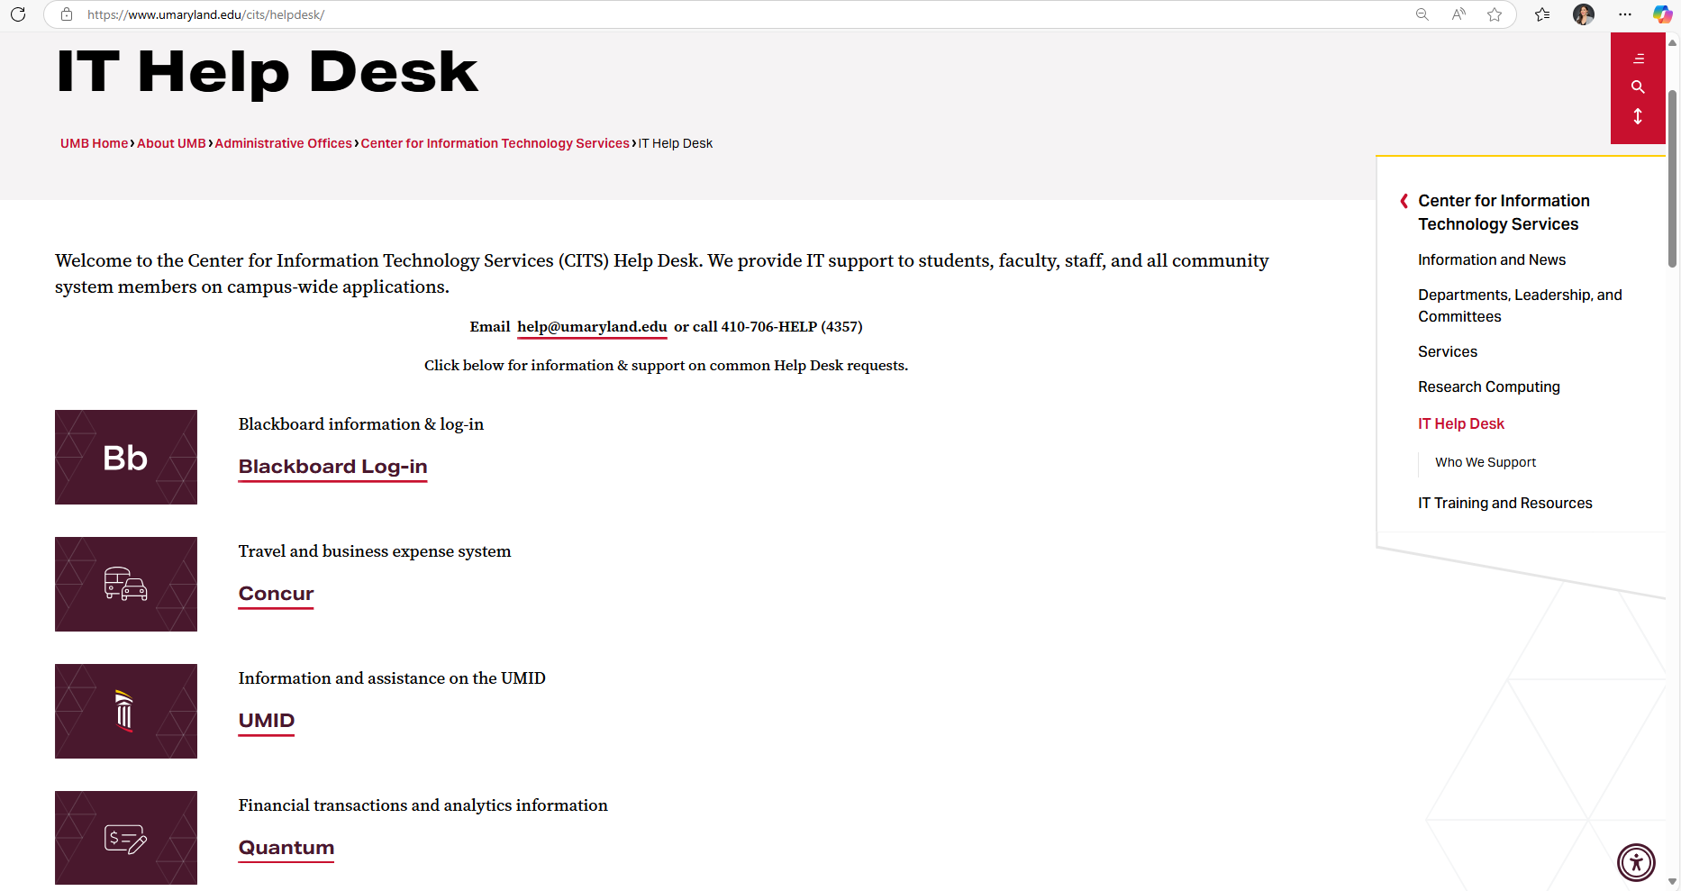
IT Help Desk: https://umaryland.edu/helpdesk
The IT Help Desk provides IT support to students, faculty, staff, and all community system members on campus-wide applications.
To reach the central IT help Desk:
Email: help@umaryland.edu
Call: 410-706-HELP (4357)
To reach School specific Help Desks:
  School of Dentistry – 410-706-2084
  School of Law – 410-706-5771
  School of Medicine – 410-706-3998
  School of Nursing – 410-706-4357
  School of Pharmacy – 410-706-4488
  School of Social Work – 410-706-3619
Notes:
The central IT help desk, that is available to everyone on campus for help with campus wide applications, can be contacted via email at help@umaryland.edu or by phone at the number listed here. Additionally, each school has their own help desk, and depending on what system you need help with, you may need to go to your school specific help desk.
Additionally, there is a website for the Help Desk and it offers a lot of important information.

Slide 22



IT Help Desk Tips
Web Browser – for any web-based application/system that is causing an issue:
  Try another browser
  Clear the browser cache/history
  Reboot your computers
  Try again!
When E-mailing the Help Desk, include:
  A useful subject line
  Any error message
  The URL or system name
  A screen shot of the problem
  Your name
  Affiliation
Review the Top Ten Calls to the Help Desk for a possible quick solution to your issue!
Notes:
Some basic tips when experiencing problems or sending an email to the Help Desk.

Slide 23

IT Security Best Practices
In this day and age of technology, IT Security is more important than ever. Please review and follow the following best practices to help ensure the safety of your data.
Use Multi-factor authentication (MFA) for all personal accounts or services that support this technology.
2. Only accept DUO requests when you are actively trying to login to a system or application.
3. Ensure that your personal computer has the latest version of the operating system and keep your software up to date by turning on automatic updates.
4. Ensure that you are using antivirus protection, with regular updates.
5. Beware of suspicious emails and phone calls because they could be phishing scams and/or contain malware.
To view a full list of monthly security articles that have appeared in the Elm, go to https://www.umaryland.edu/cits/it-security-and-compliance/security-awareness/.
Notes:
IT Security is a part of the CITS family and as security is such an important topic - review slide.

Slide 24

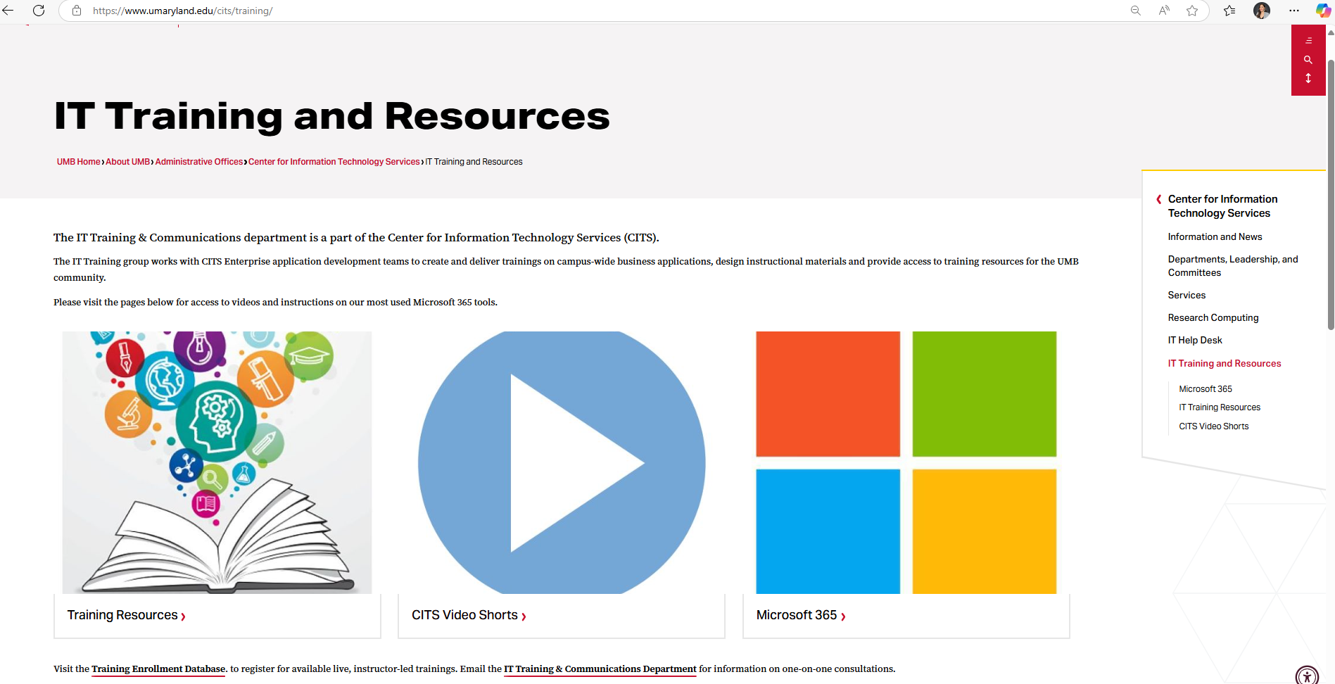
IT Training: HTTPS://WWW.UMARYLAND.EDU/CITS/TRAINING
The IT Training & Communications Department designs and delivers trainings on campuswide business applications on important and timely topics including the Microsoft 365 suite of products.
Training Resources Page:​
Applying sensitivity labels​
Sending secure emails – [secure]
Video Shorts
Microsoft 365 tutorials
IT Resources for New Employees PPT
Notes:
We’ve already mentioned a number of training resources available to you, we want to point out the CITS IT Training department. We offer training on campuswide applications, which primarily includes the Microsoft 365 suite of products – including OneDrive, SharePoint, Teams and more.
The office support site can be accessed from umaryland.edu/office365
Additionally, found under Training is the Training Resources page, which offers information on timely and topical issues, including applying sensitivity labels to office files and how to send secure emails.

Slide 25

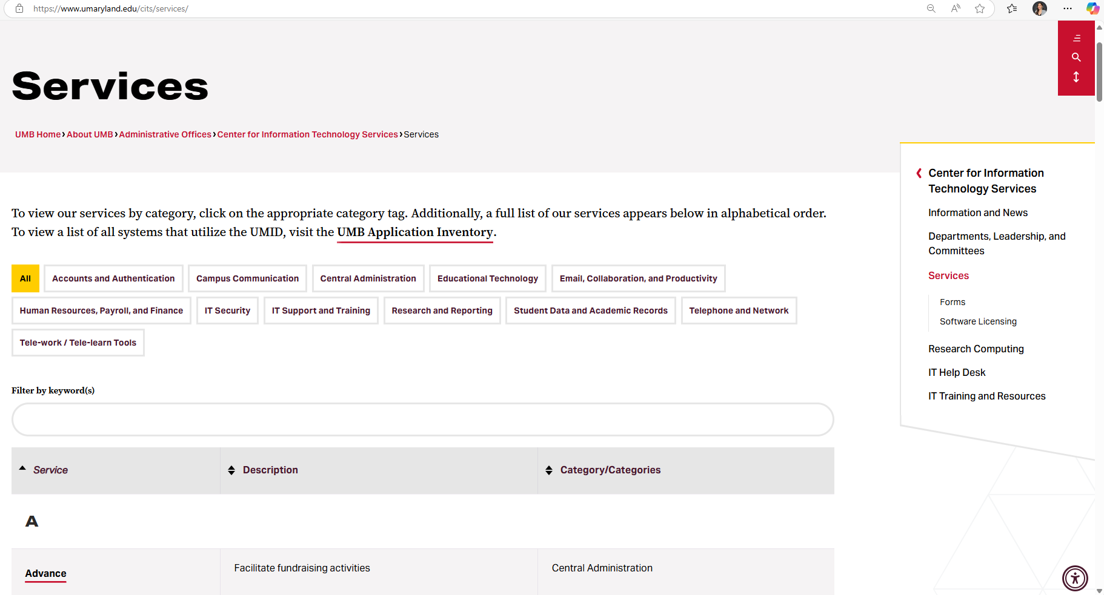
CITS Services: https://www.umaryland.edu/cits/services/
The CITS Services page allows users to search for information on various applications and services available at UMB.
Notes:
The CITS Services page allows users to search for support pages related to various applications and services available at UMB.

Slide 26
Helpful Tips:
Activate your UMID asap.
It will take 24 hours for your UMID and password to sync with all other UMB applications.
If you did not receive your workstation/email ID, contact your school’s IT Help Desk.
If you are having issues activating your UMID, contact the CITS Help Desk.
Thank you and
good luck!

