Slide 1
ICTR Drug Discovery and Development Core and Applications to Research
Paul Shapiro, PhD (pshapiro@rx.umaryland.edu; 410-706-8522)
James Polli, PhD (jpolli@rx.umaryland.edu; 410-706-8292)
ICTR Enrichment Seminar
October 13, 2020
www.umaryland.edu/ICTR

Slide 2
Agenda:
• Overview of Drug Discovery and Development (D3) Core Services
• D3 Core Services Offered at UMB and Project Examples
• Initiating a Project with UMB D3 Core Services
• Examples of Projects at General Clinical Research Center (GCRC)

Slide 3
Drug Discovery & Development (D3) Program a collaboration between University of Maryland and Johns Hopkins University
• Provide state-of-the-art support –
conceptual, consultative, and technical
• For translational scientists within UMB and JHU
• Provide infrastructure & expertise to navigate the complex drug discovery and development process.

Slide 4
UMB D3 Core Services
• Computer Aided Drug Design
• Mass Spectrometry Center
• Drug Formulation Laboratory
• Clinical Pharmacology and Pharmacometrics
Each offers 25 hours of free research-related consultation and more to UMB Faculty

Slide 5
D3 Cores at UMB and JHU that cover the entire Drug Discovery and Development Process

Slide 6
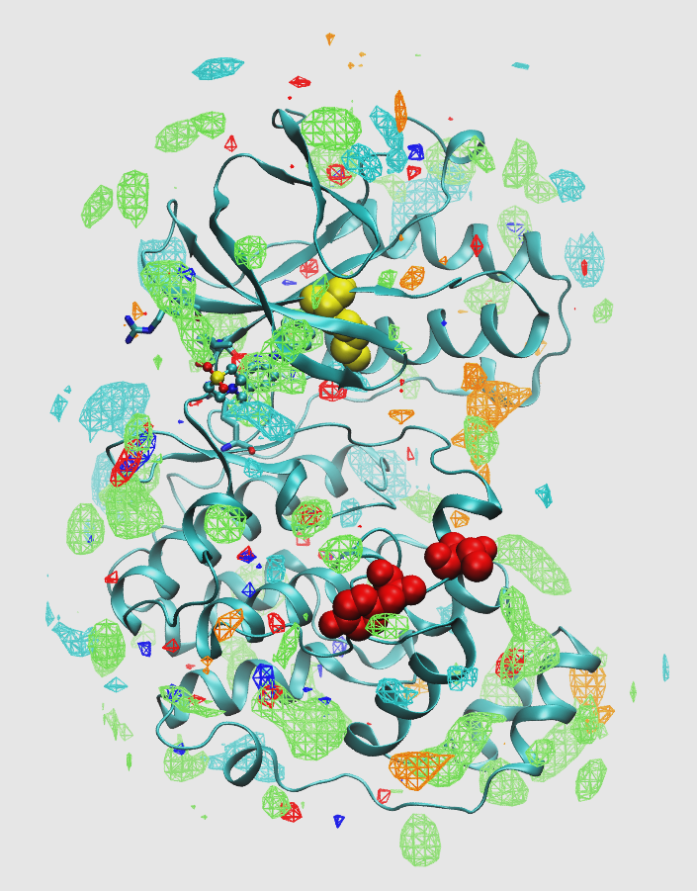
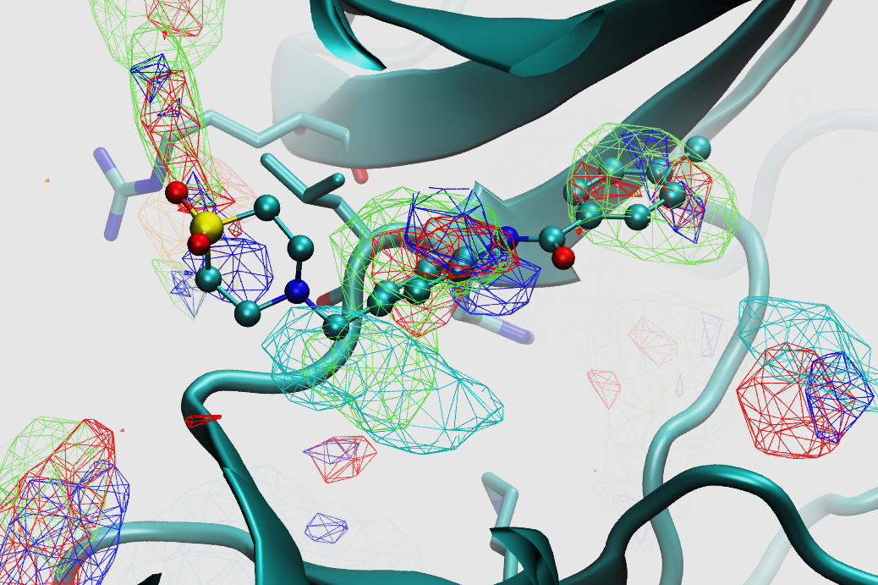
Computer-Aided Drug Design (CADD)
Alex MacKerell, PhD (amackerell@rx.umaryland.edu; 410-706-7442)
Services include access to CADD computational software and in silico databases.
…to discover novel chemical entities with the potential to be developed into novel therapeutic agents.

Slide 7
Computer Aided Drug Design: Example Projects
1. Anti-viral agents: inhibitors of the RNA polymerase complex (Matt Frieman, SOM).
2. Anti-inflammatory agents: Function-selective kinase inhibitors targeting acute lung injury– first in human trials scheduled for Dec. 2020 (Jeff Hasday and Paul Shapiro, SOM/SOP).
3. Anti-cancer agents: Thiourea-Based Inhibitors of the B‑Cell Lymphoma-6 (BCL6) oncoprotein (Fengtian Xue, SOP).

Slide 8
Mass Spectrometry Center
Maureen Kane, PhD (mkane@rx.umaryland.edu; 410-706-5097)
Free consultation plus subsidized rates for sample analysis and instrument time.
*Subsidy depends on types of samples / scope of analysis
Differential proteomic expression profiling
Post-translational modification analysis
Bioinformatics / pathway analysis

Slide 9
Mass Spectrometry Center: Example Projects
1. Heart transplant proteomics: Muhamed Mohiuddin (SOM)
-Generated preliminary data for a U19 application that was funded.
2. Lysosomal and mitochondrial proteomics: Marta Lipinski (SOM)
-Generated preliminary data for an AIM-HI UMB-UMCP Challenge Award application, which was funded, and an R01 application.
3. Pseudomonas aeruginosa metal proteomics: Amanda Oglesby (SOP)
-Manuscript in preparation for submission, data for R01 competing renewal to be submitted in November

Slide 10
Drug Formulation Laboratory Steve Hoag, PhD (shoag@rx.umaryland.edu; 410-706-6865)
Prepare and develop formulations of GMP products and matching placebos for preclinical and clinical studies.
• Adherence to FDA standards when preparing samples to give to humans.
• All steps in product development:
Formulation, manufacturing, packaging, and shipping

Slide 11
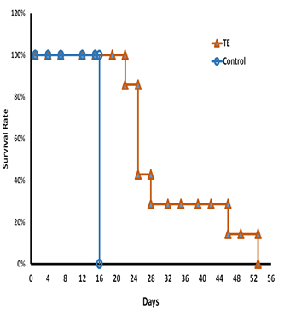
Drug Formulation Laboratory: Example Projects
TE Over 30 KD
1. Anti-cancer agents: Taro extract formulations for treating breast cancer (Namita Kundu and Amy Fulton, SOM).
2. Alcoholism therapy: Prepared low dose ondansetron with added riboflavin capsules with matching placebo for double blinded clinical study to monitor patient compliance (David Gorelick, SOM).
Standard
Raw TE
TE 10 to 30 kD

Slide 12
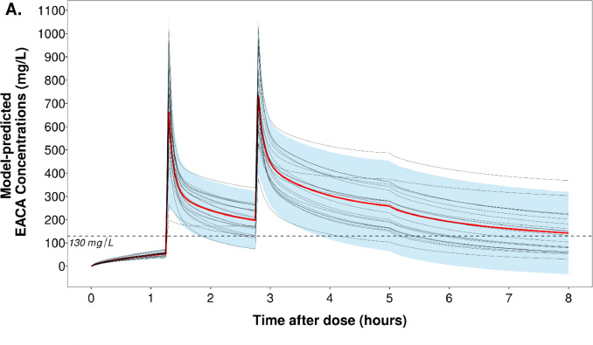
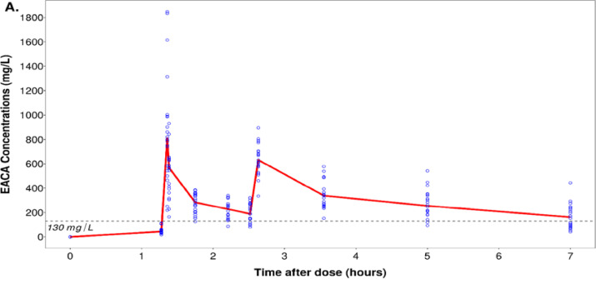
Clinical Pharmacology and Pharmacometrics
Joga Gobburu, PhD (jgobburu@rx.umaryland.edu; 410-706-5907)
Pharmacokinetic and pharmacodynamic modeling for experimental and clinical trial design and drug development.
Figs. from: J. Cardiothorac Vasc Anesth (2020), PMID 32811752

Slide 13
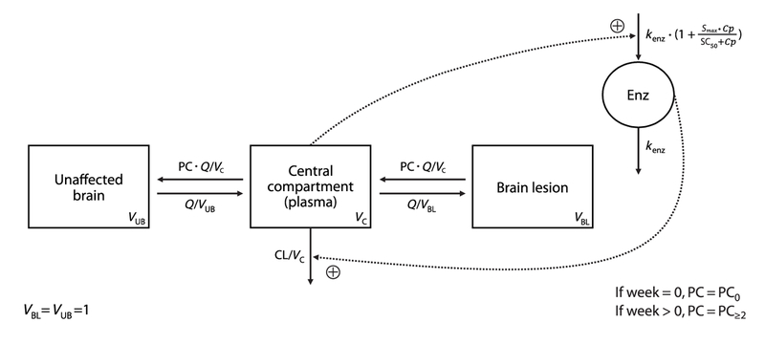
Clinical Pharmacology and Pharmacometrics: Example Projects
1. Pharmacokinetic and Pharmacodynamic Investigation of an ε-Aminocaproic Acid Regimen Designed for Cardiac Surgery With Cardiopulmonary Bypass (Erik Strauss, SOM).
2. A pharmacokinetic investigation of Rifampin distribution into infected bone, as guide to dose optimization (JHU).
Fig. from: Noninvasive ¹¹C-rifampin positron emission tomography reveals drug biodistribution in tuberculous meningitis
Sci Transl Med. 2018 Dec 5; 10(470)

Slide 14
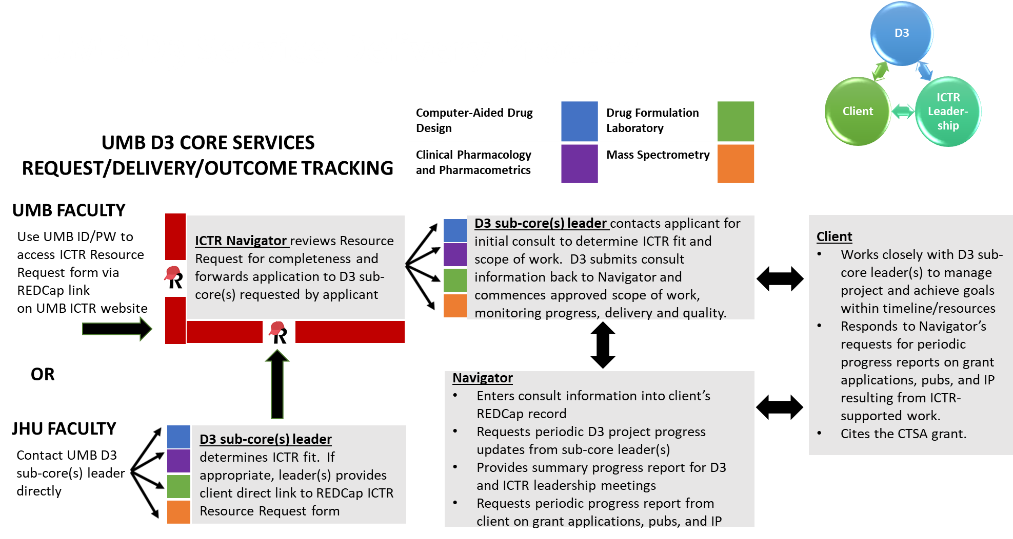

Slide 15
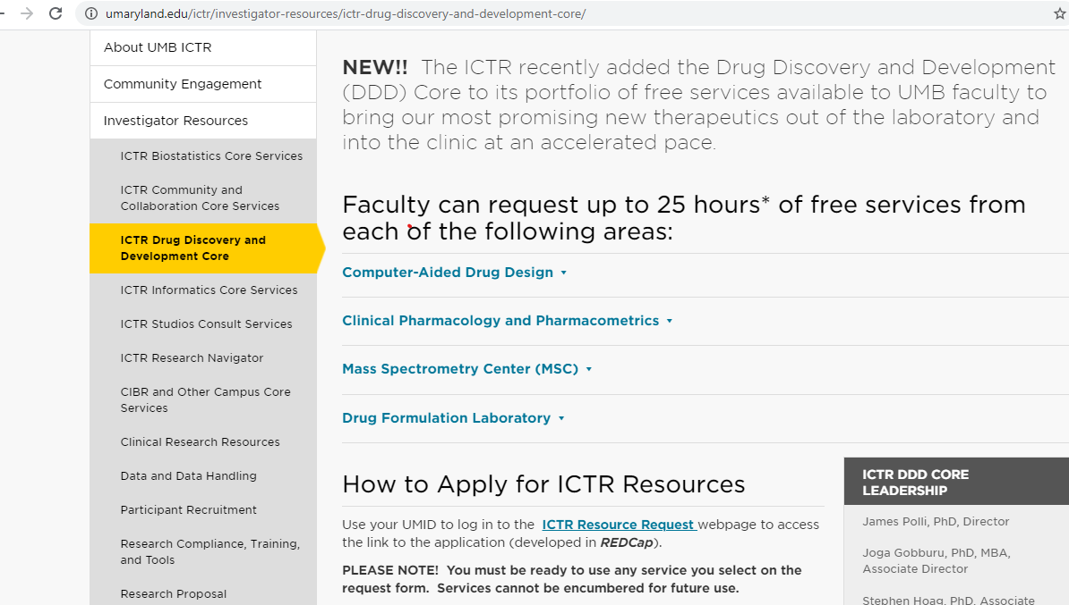

Slide 16
Examples of Projects at General Clinical Research Center (GCRC)
James Polli, PhD
Audra Stinchcomb, PhD

Slide 17
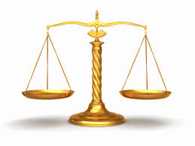
Bioequivalence Standard To pass, must fall within the goalposts of 80-125%
Cmax
AUC
Test
Cmax
AUC
Ref

Slide 18
Dermal and Transdermal Clinical Studies Conducted at GCRC
Absolute Bioavailability/Pharmacokinetic and Residual Drug Analysis of Duragesic® Transdermal System and Generic Fentanyl Transdermal System in Healthy Adults
Determination of Serum Oxybutynin Levels after Using Oxybutynin Transdermal Delivery System and Transdermal Gel with and without Standardized Heat Application in Healthy Human Volunteers
Environmental Harmonization in Multi-Application Sunscreen Use: In Vitro Permeation Testing to Healthy Volunteers
All projects approved by the UMB Institutional Review Board for human subject research

Slide 19
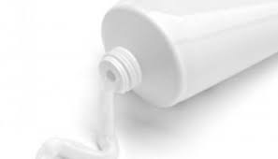
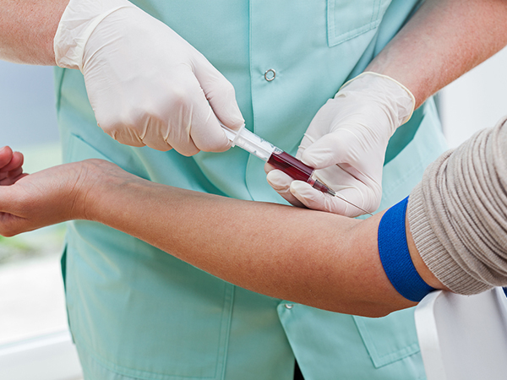
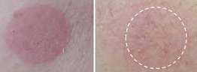
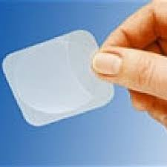
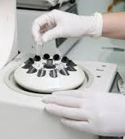
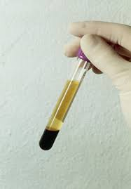
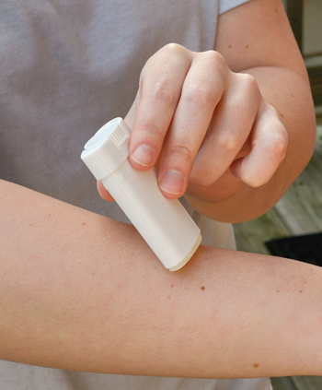
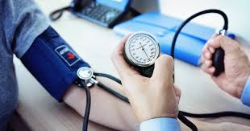
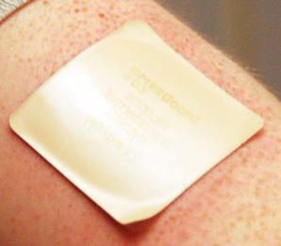
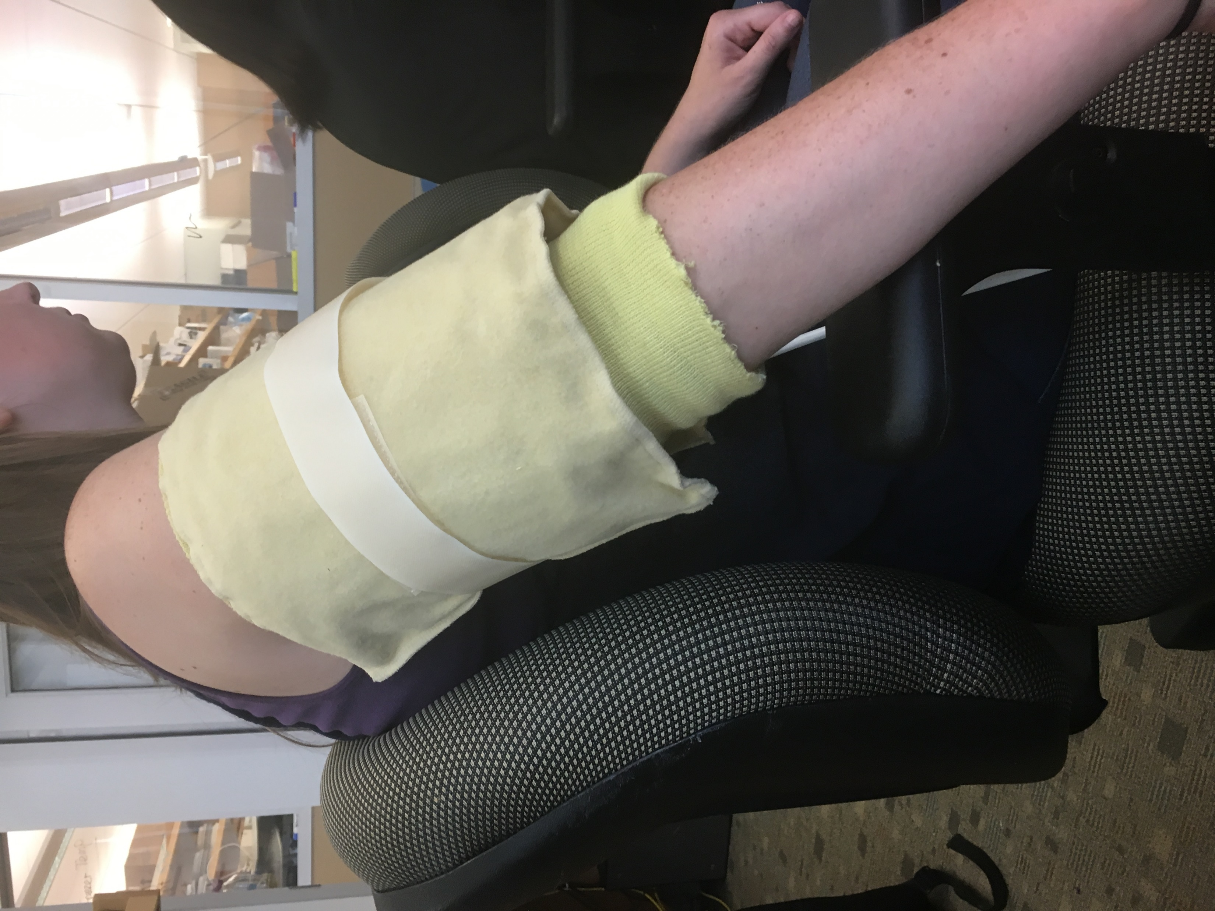
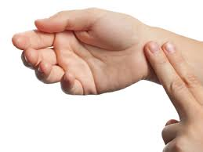
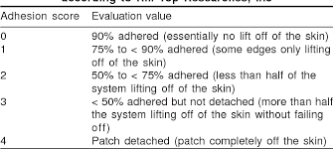
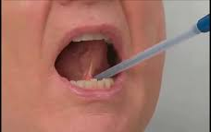
GCRC services
Formulation administration
Blood sampling & processing
Skin irritation assessment
Vital signs
Patch adhesion scoring
Heat application

Slide 20
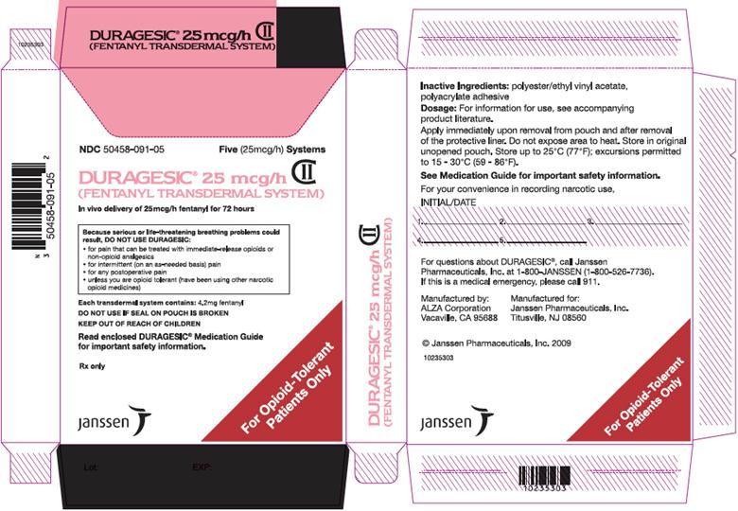
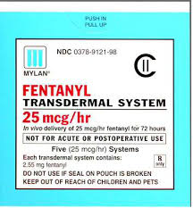
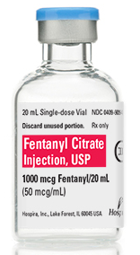
Fentanyl
Twenty-four volunteers (Sixty-five volunteers screened)
Transdermal patches applied and intravenous injection administered
Three study sessions (twenty-five days total, some overnights)
Opioid dependence challenge test (naloxone HCl injection)
Serial blood sampling (intravenous catheter or venipuncture); sample processing for serum
Vital signs (blood pressure, pulse, temperature, respiration rate)
Patch adhesion scoring
Skin irritation assessment

Slide 21
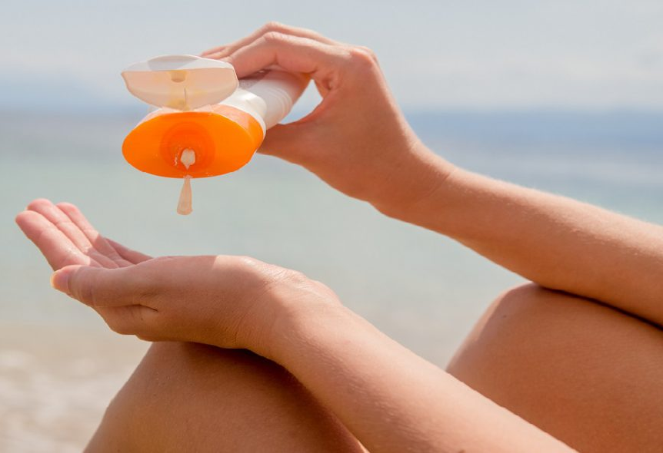
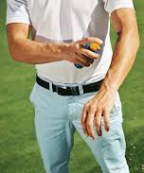
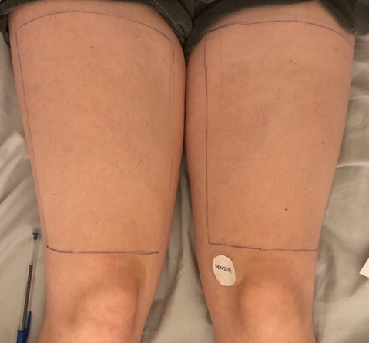
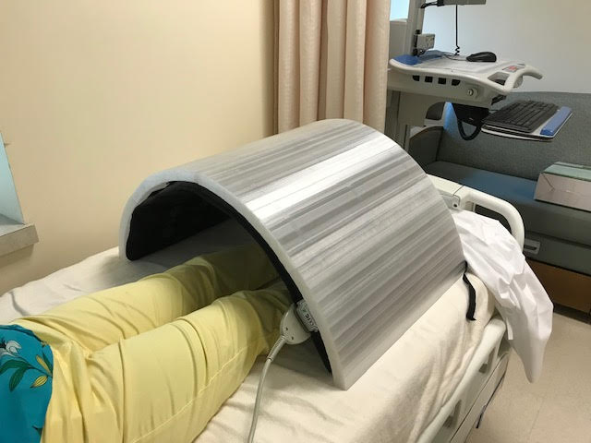
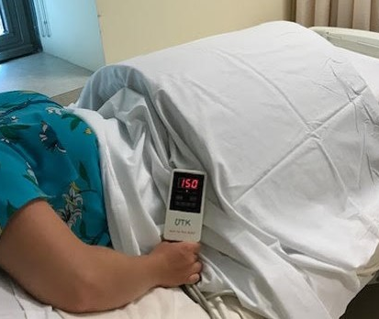
Oxybenzone
Twelve volunteers (Eight volunteers screened; two completed)
ongoing study
Topical sunscreens applied (multi-applications, 3x)
Study days (13 h each day)
Four study sessions (four days total, no overnights)
Heat and humidity application during all study sessions
Serial blood sampling (intravenous catheter or venipuncture); sample processing for serum
Vital signs (blood pressure, heart rate, temperature, respiration rate)
Skin irritation assessment
Skin surface temperatures
Humidity readings

Slide 22
Serum PK profiles
Mean ± SD; n=10 volunteers
Nicotine
Mean ± SD; n=10 volunteers
Fentanyl
Mean ± SD; n=24 volunteers

Slide 23
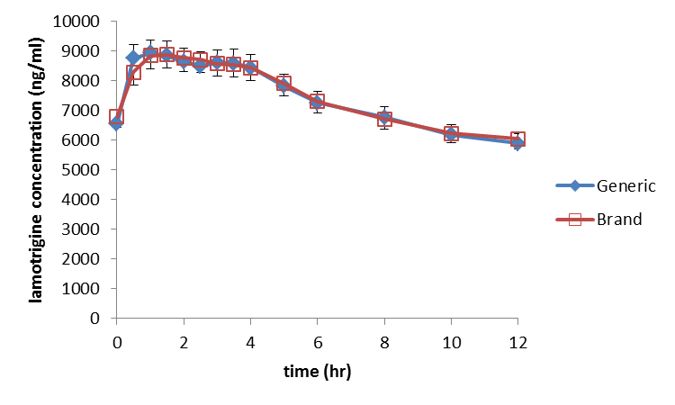
BioEquivalence in Epilepsy Patients (BEEP) study (i.e. “BEEP1”)
Cmax 90% CI: (98.8%, 104.5%) with ratio = 101.6%
AUC 90% CI: (97.2%, 101.6%) with ratio = 99.4%
Ting, T.Y., Jiang, W., Lionberger, R., Wong, J., Jones, J.W., Kane, M.A., Krumholz, A., Temple, R., and Polli, J.E. (2015): Generic lamotrigine versus brand-name LAMICTAL bioequivalence in epilepsy patients: a field test of the FDA bioequivalence standard. Epilepsia 56:1415-24.

Slide 24
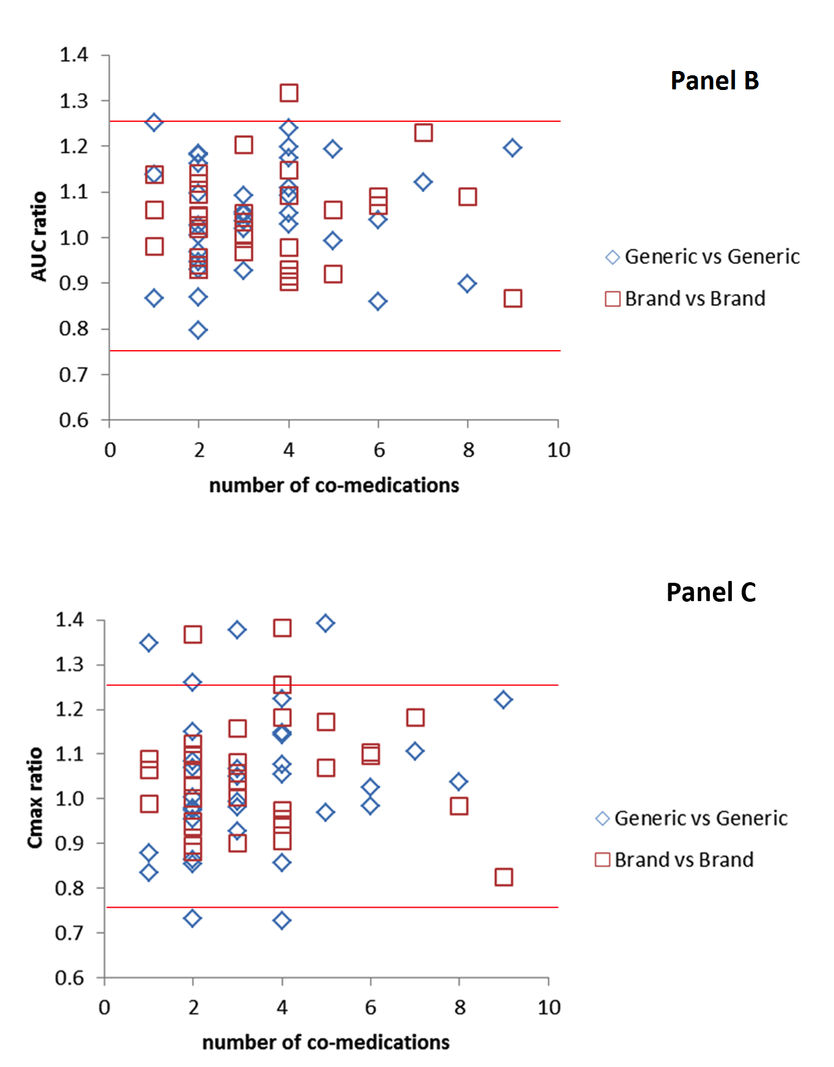

Slide 25
BEEP2b Methods
Randomized, investigator-blinded, multiple-dose, four-way fully-replicated crossover study
Epilepsy patients who competed BEEP2a and were “generic brittle”
Exploratory pharmacokinetic study involving several AEDs
Study drug in each patient was from the patient’s own AED regimen
- five different AED drug substances and seven different drug products
topiramate, lamotrigine ER, levetiracetam IR and ER, carbamazepine ER tab and ER cap, and zonisamide

Slide 26
Completed BEEP2b patients
13 of 16 had a prior switch problem
7 with study drug
6 with drug that was not study drug
Of the 3 with no switch problem, one only took brand
In study, 13 of 16 were brand-generic switch
In study, 3 of 16 were generic-generic switch
All 3 take generic of study drug

Slide 27
Completed BEEP2b patients
All current AEDs were viewed as problem AEDs by patients (versus 84% of current AEDs in BEEP2a)
range 1-4; average 2.4
Study drug was most problematic AED in all but one subject
Average total number of current medications was 9.3 (range 5-16)

Slide 28
Pharmacokinetic similarity assessment
AED product | Subject | Pharmacokinetic assessment
Topiramate tablet | 001 | Similar
 | 005 | Similar
 | 013 | Similar
 | 015 | Similar
 | 018 | Similar
Lamotrigine ER tablet | 002 | Similar
 | 006 | Similar (ratio of Cmin = 140.9%)
 | 020 | Similar
Levetiracetam IR tablet | 004 | Similar
 | 012 | Similar
 | 014 | Similar
Levetiracetam ER tablet | 008 | Similar
 | 010 | Similar (ratio of Cmin = 70.6%)
Carbamazepine ER tablet | 007 | Similar
Carbamazepine ER capsule | 021 | Similar
Zonisamide capsule | 019 | Similar

Slide 29
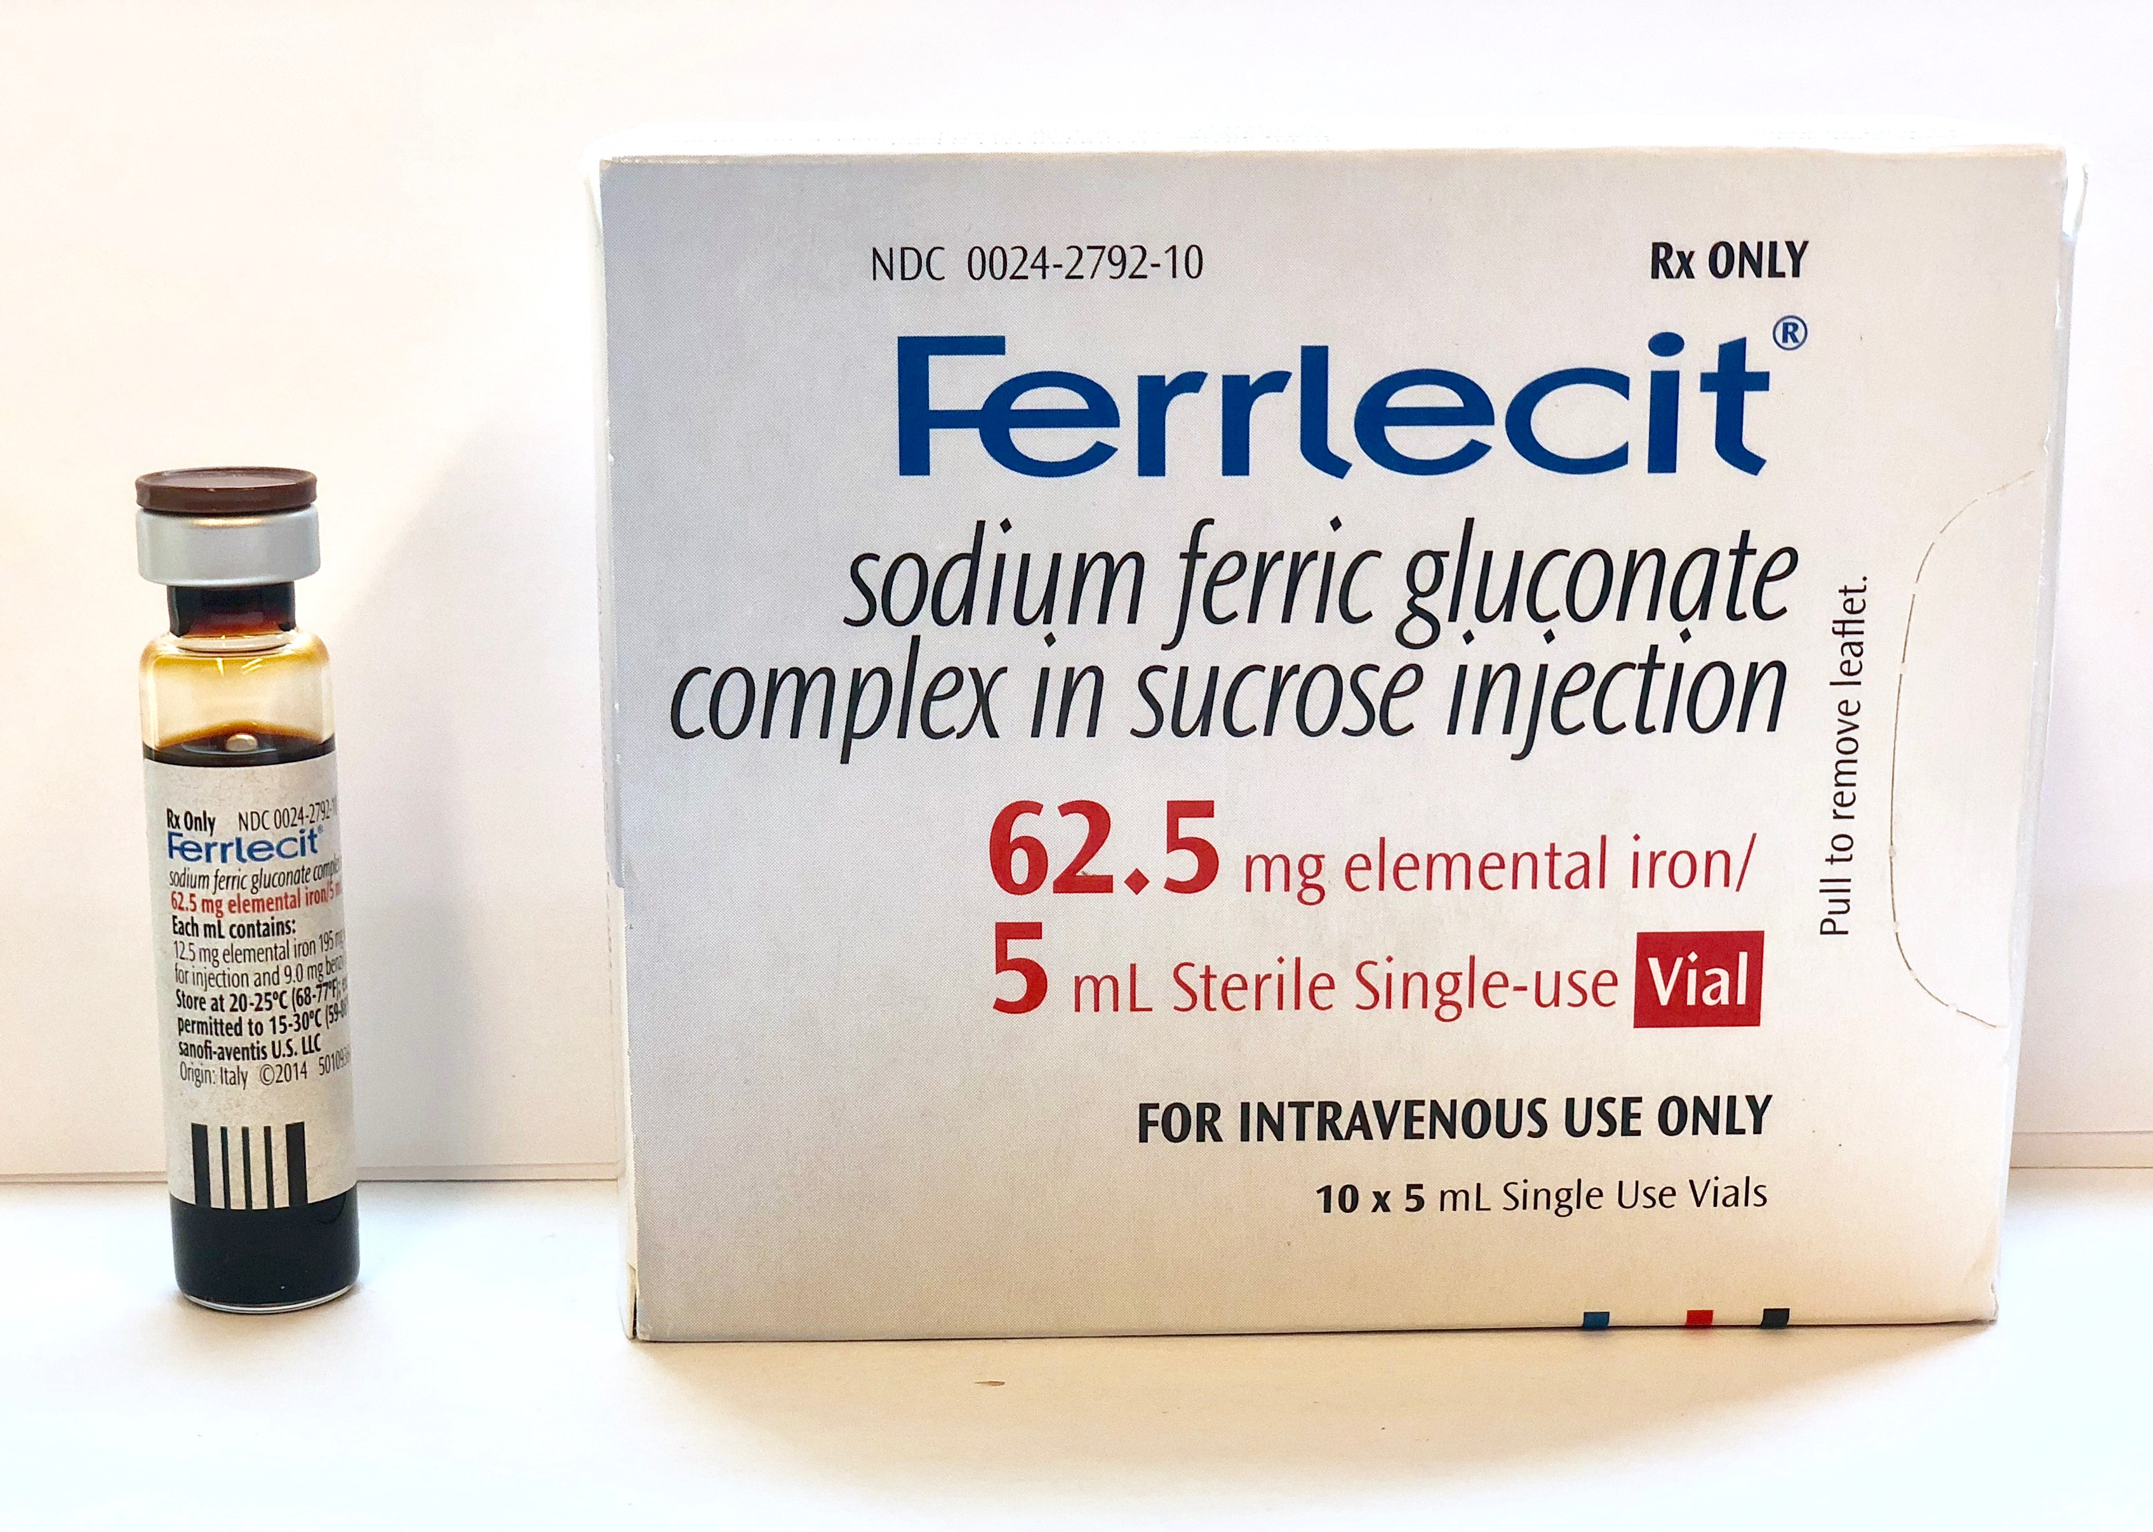
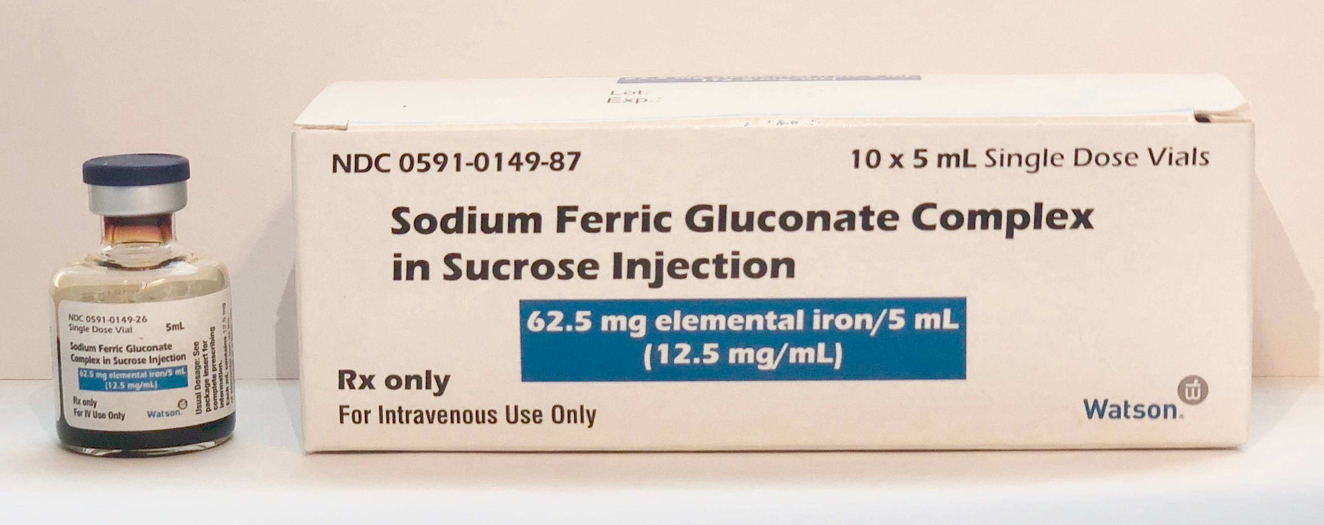
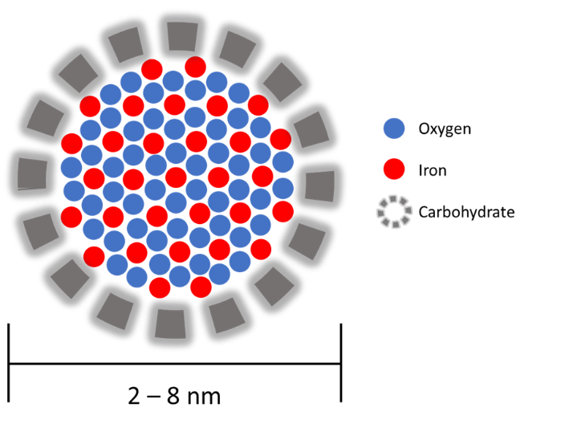
TOXICITY?
FDA approved: 1999
FDA approved: 2011
IV iron: iron (III)-oxyhydroxide form stabilized by a carbohydrate complex which leads to nano-sized colloidal structures.
B Michael et al. (2006) Drug Insight: safety of intravenous iron supplementation with sodium ferric gluconate complex. Nat Clin Pract Neprol 2: 92–100 doi:10.1038/ncpneph0068

Slide 30
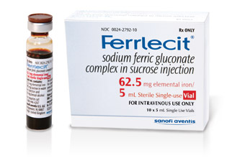
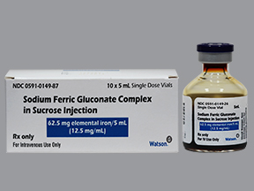
In vitro testing
Physicochemical properties | Comparative results
Optical spectra | Same
Total iron content | Same
Iron oxide crystalline order and structure | Same
Iron oxidation state | Same
Iron electronic and ligand metric parameters | Same
Acid stability/ iron lability | Different
Particle size | Different
Sedimentation coefficient | Different
Molecular weight distribution | Different
Non-identical in particle size, molecular weight distribution, and acid stability
Brand SFG has a larger particle size, MW, but releases is more acid soluble which may mean it releases Fe faster in the body

Slide 31
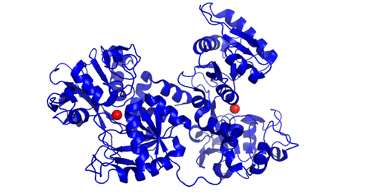
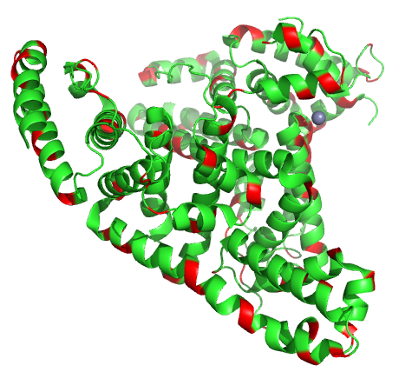
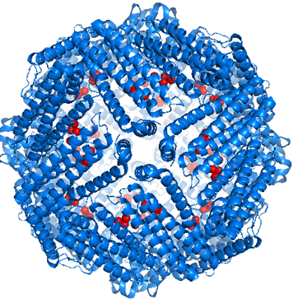
Iron Species in Plasma
DBI
TI = TBI + NTBI
TBI
TI = TBI + PBI + LI +DBI
NTBI
Transferrin
(3QYT)
PBI
LI
Iron(III) Citrate
[Fe(Cit)₂]^{5–}
Albumin (5IJF)
Ferritin
(5LG8)

Slide 32
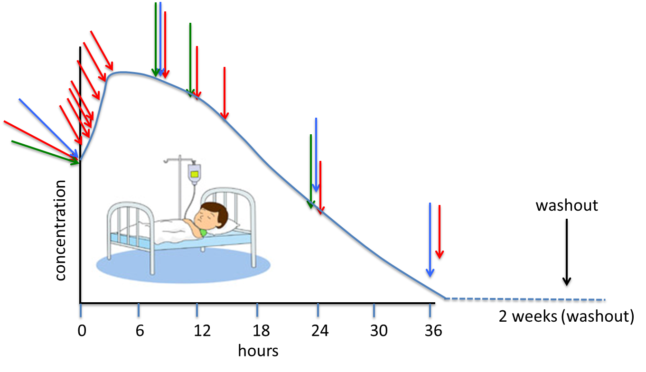
Clinical Trial
Primary Assay: TI, TBI, DBI, PBI, LI:
0, 10, 20, 40 min; 1, 2, 3, 4, 8, 12, 16, 24, 36 hr
Secondary Assays:
oxidative Stress: 0, 2, 8, 24, 36 hr
cytokines: 0, 2, 8, 24, 36 hr
safety: 0, 36 hr
washout: 4 weeks
Crossover Study- Each person own control
Non-inferiority Study
Safety Study
Power Analysis: sample size 44

Slide 33
Confidence intervals and within subject variabilities
PK metric | Mean ratio (90% CI) | CV%
DBI AUC | 1.083 (1.042-1.126) | 9.6
DBI Cmax | 0.956 (0.920-0.992) | 9.3
NTBI AUC,c | 1.101 (1.055-1.149) | 10.6
NTBI Cmax,c | 1.035 (0.989-1.083) | 11.3
LI AUC,u | 1.032 (0.861-1.237) | 47.3
LI Cmax,u | 1.096 (1.011-1.189) | 20.3
LI AUC,c | 0.735 (0.435-1.243) | 209.7
LI Cmax,c | 1.040 (0.898-1.203) | 37.3
u = uncorrected (i.e. not baseline-corrected)
c = corrected (i.e. baseline-corrected)

Slide 34
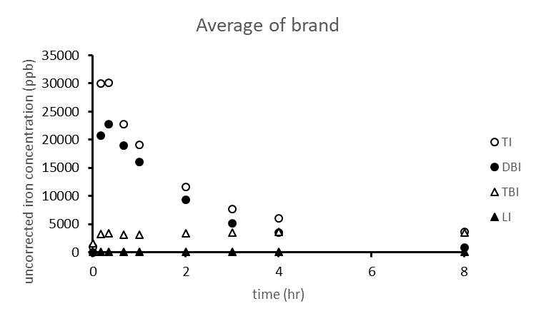
Average PK profiles

Slide 35
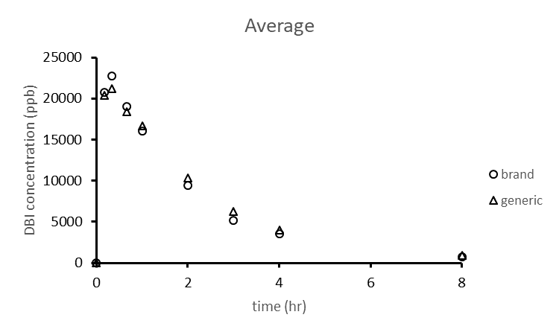
Average PK profiles

Slide 36
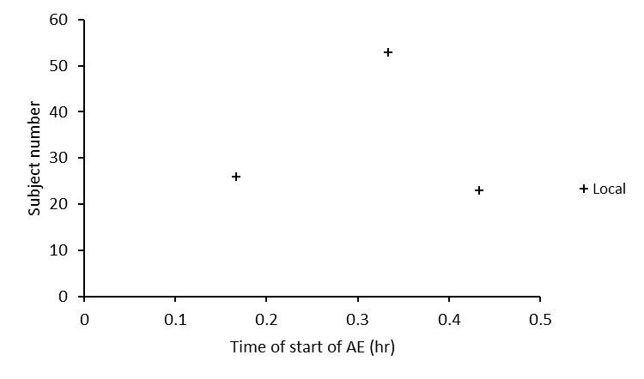
Notable adverse events
generic

Slide 37
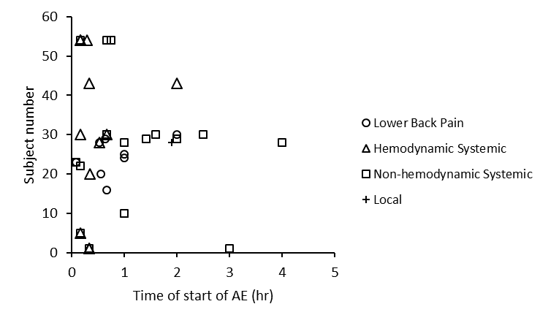
Notable adverse events
brand

Slide 38
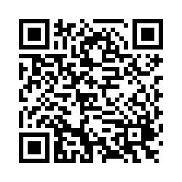
Thank you for attending today’s event!
QR code- Open your camera on your smartphone and aim it at the QR code above. It should direct you to the Survey link on your phone.

