Slide 1

SHOULD there be an app for that? Tips for success in funding and developing digital technology-based interventions
Cindy M. Schaeffer, Ph.D.
Associate Professor
National Center for School Mental Health
Division of Child and Adolescent Psychiatry
ICTR Enrichment Series, April 14, 2020
Notes:
Honor to be here, thank you for that kind introduction

Slide 2


Acknowledgments and Disclosures
R43/R44 MH097349-02A1 (MPIs: Dimeff & Schaeffer)
I share intellectual property rights for iKinnect with the Evidence Based Practice Institute (EBPI). Upon the eventual commercialization of iKinnect, I will have a profit-sharing agreement with EBPI for any iKinnect sales.
Notes:
Before I begin…

Slide 3
Defining Digital Health Technology
Components:
“Smart” = computer-based technologies
Designed to change a patient’s or provider’s behavior or improve the provision of care
Platforms:
Software programs, apps, games, interactive websites, wearable devices

Slide 4
Learning Objectives
Participants will be able to:
List available component technologies that can be incorporated into digital health interventions
Evaluate their own digital health intervention ideas against some key acceptability and feasibility considerations likely to be important to funders
Understand how they might find technology partners, funding sources, and other critical partners for digital health technology projects
Notes:
Self-introduction: I’m a child-clinical psychologist, trained primarily in family therapy and now a full time researcher. I don’t particularly love technology; I’ll tell you the story of how I find myself in this world a little later, when I tell the story about my particular project for conduct problems…
…but first, I’d like to orient you to this field a bit more broadly
And after you hear my story hopefully you’ll have a few take-aways for some key considerations if you’re doing this work to make sure you get it right

Slide 5
“In the space of 50 years, the digital world has grown to become crucial to the functioning of society.”
Hodson, R. (2018). The Digital Revolution. Nature, 563, S131

Slide 6
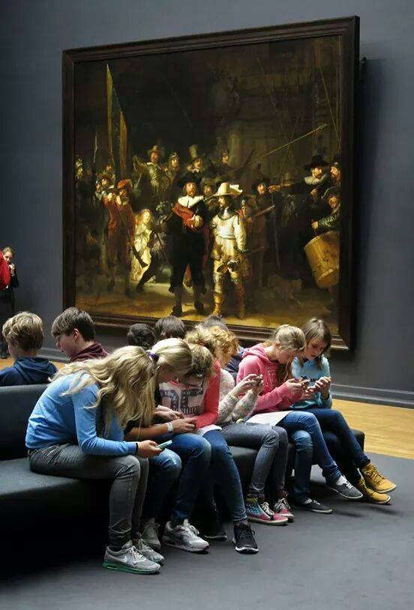

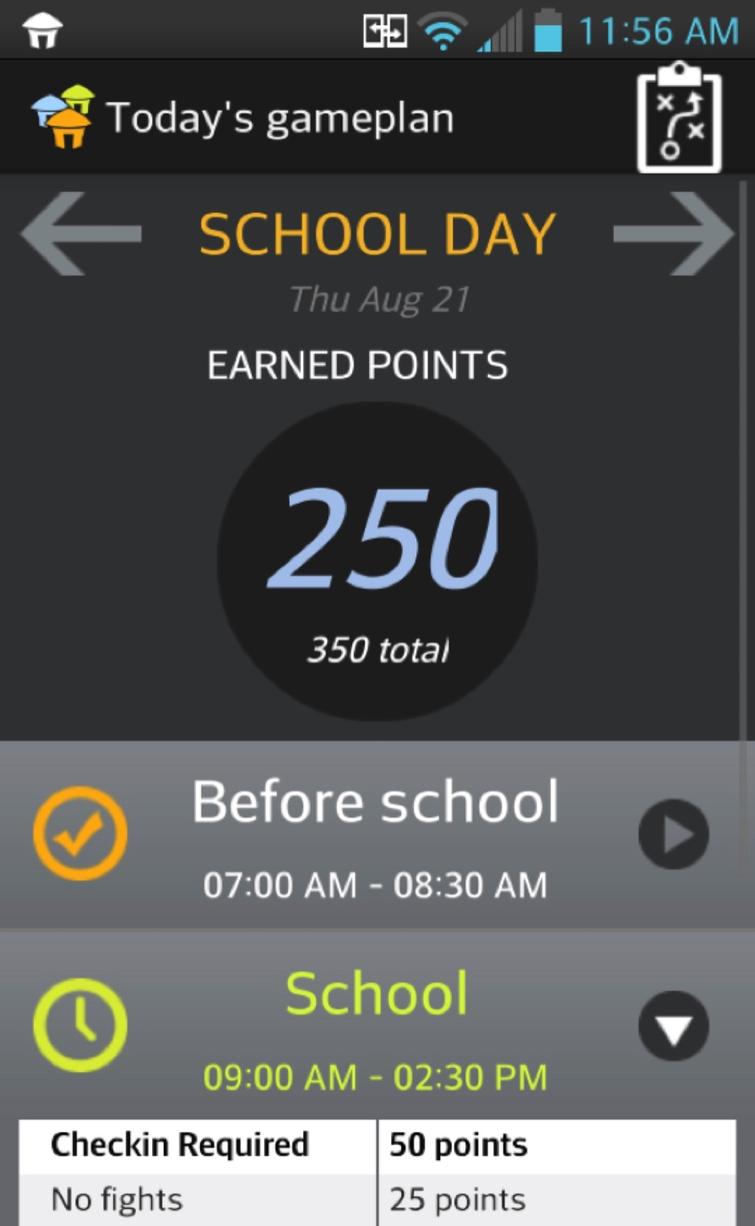
Smartphone use, 2018
Teens
95% of U.S. teens have a smartphone
95% of Hispanic youth
94% of African-American youth
An equal opportunity device - in households earning less than $30,000/year:
93% of teens own smartphones
Only 75% of teens have access to a computer
45% of teens report using their phones “almost constantly”
Adults
81% own a smartphone:
71% of rural Americans
71% of adults in households earning less than $30,000
25% on their phones “almost constantly”
Sources: Pew Research Center: Teens & Technology, 2019; Internet, Broadband, and Social Media, 2019
Notes:
Obviously, this has become the new normal – here to stay
Teen phones: Up from 73% in 2015
Pew: “Now ubiquitous”
Today’s teens are tomorrow’s adults
A full generation who has never NOT had technology / smartphones

Slide 7
The Digital Revolution The Information Era
A Public Health Opportunity
Notes:
So, I always saw the potential for digital tech to help behavioral health outcomes…
Low cost
Scalable
Wider reach
… but the more I do this work and reflect on it, its potentially even more critical than that: it may very well be what the next generation of mental health care consumers EXPECT and DEMAND, such that if we DON’T have at least some tools for incorporating this stuff into our clinical work we may become obsolete.

Slide 8
Wide Range of Possibilities
To facilitate a treatment – e.g., real-time support to a therapist during a session
To augment a treatment – e.g., online psychoeducational homework assignments
To fully deliver (replace) a treatment – e.g., a computer-delivered version of CBT
To disrupt and reimagine conventional treatment paradigms altogether – e.g., on demand crowdsource support
Notes:
So how might digital tech be incorporated? High level:
Facilitate: e.g., EMR provides reminders and warnings when a psychiatrist writes a particular prescription – contraindications, drug combos, etc.
Augment: e.g., before our next session, watch this video about eating disorders and we’ll discuss
Fully deliver: e.g., take this self-directed online training on the self-management of depression; if you’re still depressed, I’ll make a referral to a MH therapist for you
Disrupt/reimagine: e.g., a thriving and organized peer support community moderates its own forums and provides group-sourced care in the total absence of mental health professionals.

Slide 9
These Possibilities Can Be:
Entirely provider-facing
Entirely patient-facing
Hybrid – interactions between provider and patient / client

Slide 10
Review of the Reviews – Last 3 Years:
By clinical diagnosis – e.g., depression
By degree of mental health provider involvement: unsupported self-help to technology used within a treatment context
By type of treatment – e.g., mindfulness or CBT
By type of technology – e.g., immersive games, mobile apps

Slide 11
A Functions-Based Review (Tuerk, Schaeffer, et al., 2019, Current Psychiatry Reports)
8 Broad Categories:
Self-tracking of subjective data
Objective data collection
Digital phenotyping and ecological momentary interventions
Automated conversations
Immersive Experiences / Stimuli Presentation
Peer-to-peer sharing/crowdsourcing
Synchronous and asynchronous communication
Increase treatment engagement/acceptance
Automatically deliver treatments
Notes:
Many tech tools combine / bundle functions in the service of client outcomes, so these are in no way mutually-exclusive. But, at the most basic levels, we’re seeing technology being used in behavioral health for the following:
Self-tracking of subjective data
CBT approaches commonly use self-monitoring; e.g., in CBT for Panic Disorder, document each panic attack you had this week, and we’ll discuss triggers, etc. at our session
Used to promote self-awareness/track treatment progress
Objective data collection
Even better than subjective: Objective! Wearables! We can look at your physiology data in our next session and talk about the times you were anxious. We can relate your fitbit activity data to your self-report of depressed mood. Biofeedback within sessions.
Even more passive: “digital phenotyping” – analyze your existing phone call / texting activity; enhanced pattern recognition and prediction; and provide “ecological momentary interventions” just when you need them the most.
Automated conversations – conversational artificial intelligence with animated agents – potentially useful for screening (some evidence that can lead to greater initial emotional self-disclosure)
4. Immersive Experiences / Stimuli Presentation – virtual or augmented realities; e.g., to enhance emotional processing within imaginal exposure for trauma; autistic child to practice social skills
Peer-to-peer sharing/crowdsourcing – receive real-time feedback on a cognitive distortion; have 2+ clients with the same clinical condition can work together on interactive exercises. Forums can be moderated or unmoderated
Synchronous and asynchronous communication
Synchronous: teleconference/telemental health; could also be text though
Asynchronous: who says me and my therapist need to be in a session together at the same time?
Can be used to increase or decrease client contact – synchronous (reduce barriers to attendance) asynchronous (leave me a VM and I’ll respond later)
7. Increase treatment engagement/acceptance
Serious games
Gamification = “gamey” features
8. Automatically deliver treatments – totally self-directed, do this instead of in-person therapy. But, can also be used to standardize treatment delivery – the robots are coming!

Slide 12
We CAN do these things…
Should we?

Slide 13
We CAN do these things; should we?
Consideration 1: The sniff test
What real-world practice problem does the proposed technology aim to solve?
Is this problem large enough to justify tech development cost? Epidemiology, cost of care, etc.
Is there compelling “value added” over current practices?
Does something similar already exist?
Notes:
Answers that aren’t compelling:
We could just text our patients appointment information, but it would be fun to build an app since we work with so many teenagers
Well-managed rare diseases – standard practice pretty good and not enough cases to produce cost savings

Slide 14
One interventionist’s story…
How might digital technology be used to address adolescent conduct problems?

Slide 15
Our Funding
NIMH Small Business Innovation Research (SBIR) program
Goal: to provide economic and social benefits to the nation by
Increasing the commercial application of federally-supported research results
Improving return on investment from federally-funded research
Two federally-funded phases (Linda Dimeff & Cindy Schaeffer, MPIs)
Phase I: Preliminary scientific merit and feasibility of project (2R43MH-097349)
Phase II: Further research/development; more rigorous test of scientific merit (2R44MH-097349)

Slide 16
Conduct Disorder and other Conduct Problems
Conduct Disorder:
9.5% lifetime prevalence of CD in the U.S. (Ghandour te al., 2012)
Ranked 15th most burdensome global disability among 5-19 year olds (DALYs) (Erksine et al., 2014)
A risk factor for most adult psychiatric disorders, especially substance-use disorders (Morcillo et al., 2012)
Spectrum:
By age 18, U.S. adolescents:
7% will have dropped out of high school
16% will have an arrest
38% will have used marijuana
48% will be drinking
Externalizing behavior is the most common presenting problem in child/adolescent outpatient mental health clinics
Notes:
“Early recognition and treatment of CD may help prevent the development of adult-onset disorders.” Morcillo et al.

Slide 17

Our interventionist’s score…
Consideration 1: The sniff test
What real-world practice problem does the proposed technology aim to solve?
Is this problem large enough to justify tech development cost? Epidemiology, cost of care, etc.
Is there compelling “value added” over current practices?
Does something similar already exist?
Notes:
Answers that aren’t compelling:
We could just text our patients appointment information, but it would be fun to build an app since we work with so many teenagers
Well-managed rare diseases – standard practice pretty good and not enough cases to produce cost savings

Slide 18
We CAN do these things; should we?
Consideration 2: The science
Does the proposed digital technology make sense in light of the research literature about this problem?
Notes:
Example: Proposing an online portal that will allow teachers to talk asynchronously to pediatricians about asthmatic children; is there any evidence that increased pediatrician-teacher communication enhances outcomes for children with asthma?

Slide 19
Conduct Problem Etiology – Risk Factors Across Systems
Individual
Difficult temperament
Low IQ
Family
Inconsistent parenting
Harsh discipline
Neglect
Parent-child conflict and communication problems
Low parental monitoring / supervision
Peer
Association with delinquent peer group
Peer rejection
School / Community
High school mobility
Disorganized, impoverished, and/or violent neighborhoods

Slide 20
Effective Treatments for Conduct Problems
All empirically-supported treatments for this population are family-based:
Multisystemic Therapy (MST)
Treatment Foster Care – Oregon (TFC-O)
Functional Family Therapy (FFT)
Parent Management Training (PMT)
These treatments:
Outperform cognitively-oriented individual treatments
25-60% reductions in criminal recidivism
50-65% reductions in incarcerations
Effects persist well into adulthood

Slide 21
Treatment Mechanisms: Reversal of Key Risk Factors
Improved Parental Monitoring
MST
Decreased Delinquent Peer Affiliations
Decreased Delinquent Behavior
Improved
Parent-Teen Warm Communication
Improved Parental Monitoring
Decreased Antisocial Behavior
TFC-O
Improved Discipline Practices
Decreased Substance Abuse
(Huey et al., 2000; Schaeffer et al., 2010; Chamberlain, 2003)

Slide 22
Our Goals
To develop a mobile phone app that:
Is consistent with EBTs treatment principles for conduct problems
Helps families meet treatment goals that ultimately lead to reduced youth involvement in criminal activity and drug use
Increase parental monitoring
Increase parental consistency (rewards and punishments)
Improve parent-youth communication
Is feasible and acceptable to families
Can be made widely available and is affordable
Can be adopted by any treatment provider working with youth involved in criminal behavior, drug use, or at high risk for such

Slide 23
Our interventionist’s score…
Consideration 2: The science
Does the proposed digital technology make sense in light of the research literature about this problem?
Notes:
Example: Proposing an online portal that will allow teachers to talk asynchronously to pediatricians about asthmatic children; is there any evidence that increased pediatrician-teacher communication enhances outcomes for children with asthma?

Slide 24
We CAN do these things; should we?
Consideration 3: The user
What is the likelihood that users will want to use / actually use this technology?
Who is the best user to build for?
How do you imaging the user interacting with it? Settings, frequency, duration
What is the user’s motivation to use this technology?
Notes:
Amazing how many people skip this step
How many apps do you have on your phone right now? Would you download one for your dentist? What about for your gastroenterologist, so you can remember your once every 10 years colorectal cancer screening?
Hard to compete with the Amazon marketplaces of the world
Sometimes someone at a different point in the chain is actually a BETTER target user (sometimes NOT the patient)

Slide 25
Acknowledgments
Dr. Linda Dimeff, Chief Scientific Officer, EBPI, Co-PI
Dr. David Carroll, Mobile App Design, New School of Design
Margaret Wallace, Gamification Expert, Playmatics
Dr. Edward Deci, U of Rochester, Self-Determination Theory
Dr. Robert Volpe, Northeastern U, Point-Reward Systems / Monetization Expert
DSMB
Dedicated programmers, project managers, and research staff
Youth with conduct problems, their parents, their therapists, and their probation officers

Slide 26
History and Development of iKinnect
Late 2013: NIMH Small Business Innovation Grant (R43) awarded; user-centered design based prototype testing by intended users and stakeholders (N = 75)
MST experts, supervisors, therapists, parents and youth receiving MST, clinic administrators; juvenile justice personnel
Late 2014 - 2015: App development
2015 - 2016: User field testing of beta version; N = 16 parent-youth dyads participating in MST
March 2017: NIMH R44 awarded for further app development and testing.
June 2019: RCT nearing completion (N = 106 enrolled)

Slide 27
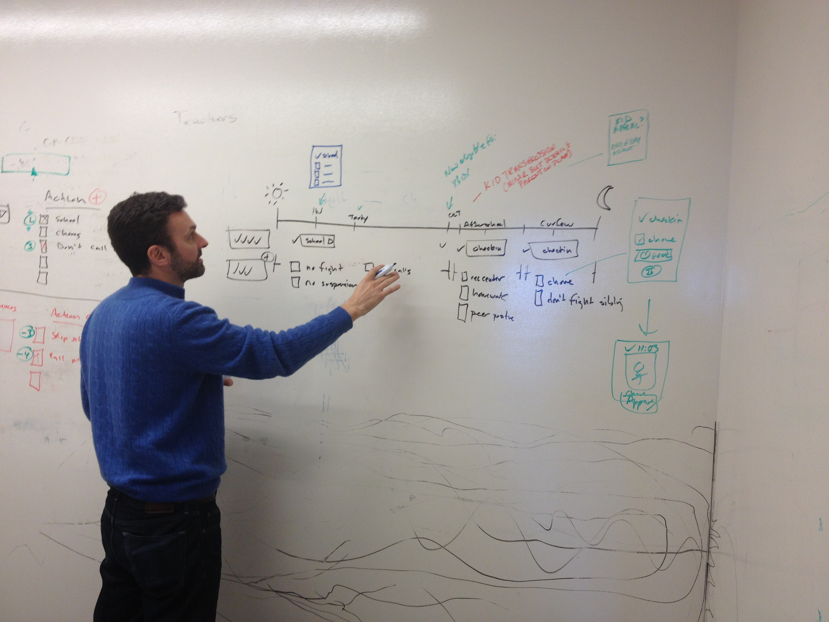
Phase 1 Launch: NYC, Jan 6-8, 2014

Slide 28
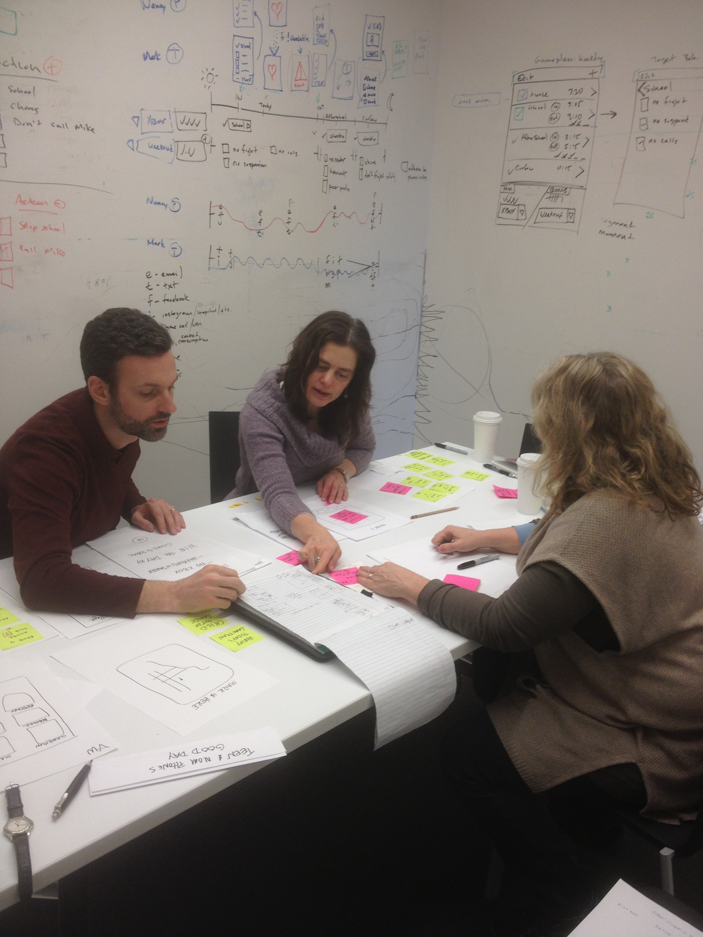
Paper Prototyping Process

Slide 29
Our interventionist’s score…
Consideration 3: The user
What is the likelihood that users will want to use / actually use this technology?
How do you imaging the user interacting with it? Settings, frequency, duration
What is the user’s motivation to use this technology?
Notes:
Amazing how many people skip this step
How many apps do you have on your phone right now? Would you download one for your dentist? What about for your gastroenterologist, so you can remember your once every 10 years colorectal cancer screening?

Slide 30

Mysterious programming steps…

Slide 31
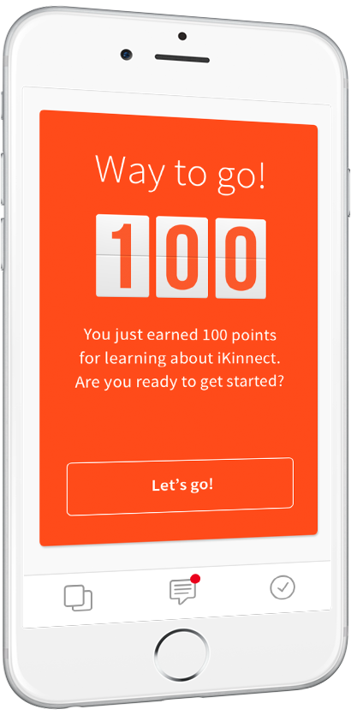
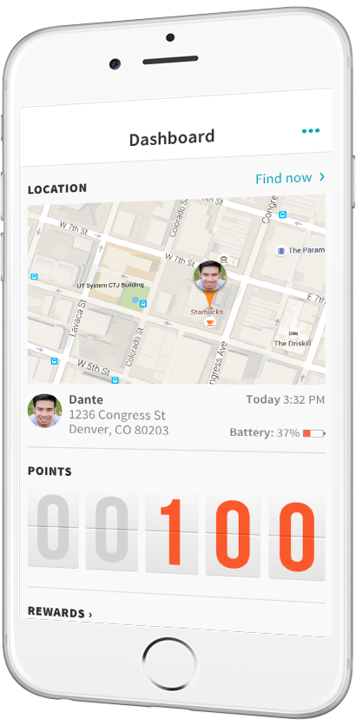

A product of the
For more information, go to https://ikinnectapp.com

Slide 32
KinBot “chatbot” –the personality of the app

Slide 33
iKinnect App Features
GPS location on demand – where’s my teen right now (one click)
Geofencing – parents can set geographic boundaries around teen’s required (e.g., school) or off-limits (e.g., city park) locations

Slide 34
iKinnect App Features
Game Plan – outlines parents’ behavioral expectations for teen throughout the day and the rewards associated with each
Configured modularly using Challenge Cards

Slide 35
Challenge Cards: Required Activities

Slide 36
Challenge Cards: Off-Limits Locations

Slide 37
Parent Alerts
Parent Notifications / Alerts
When teens enter or leave geofenced locations (e.g., Your teen is no longer at the required location, “school”)
When teens self report on expected behaviors (e.g., “Completed after school chores”)

Slide 38
Teen alerts – prompts and reward notices

Slide 39
Rewards and Gamification Features

Slide 40
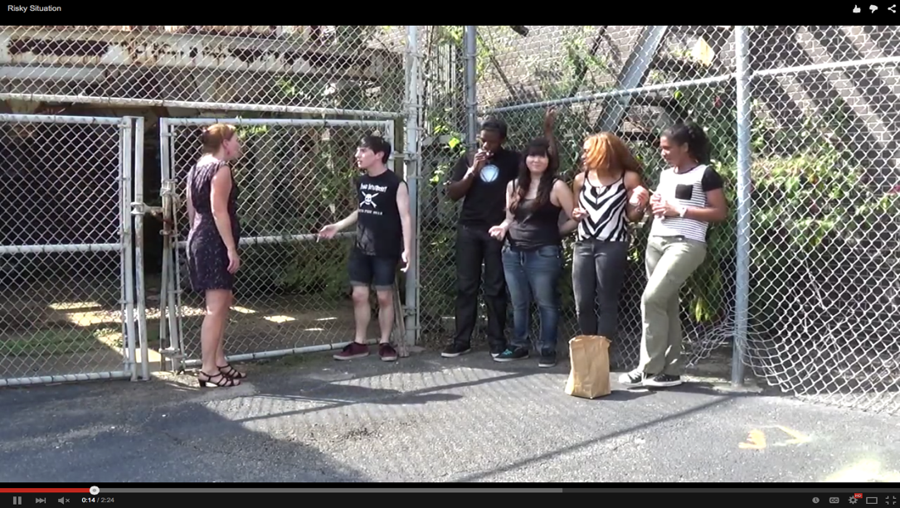
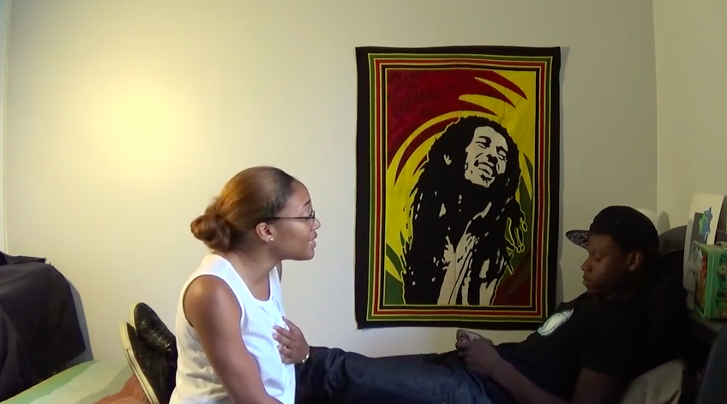
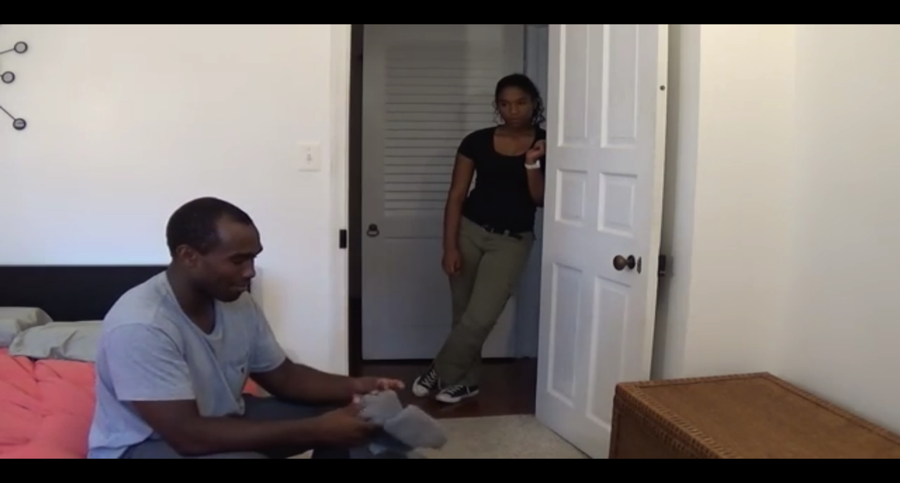
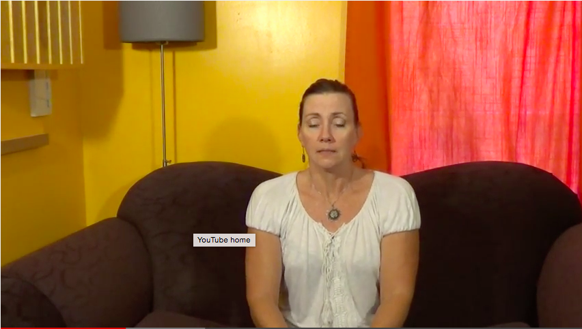
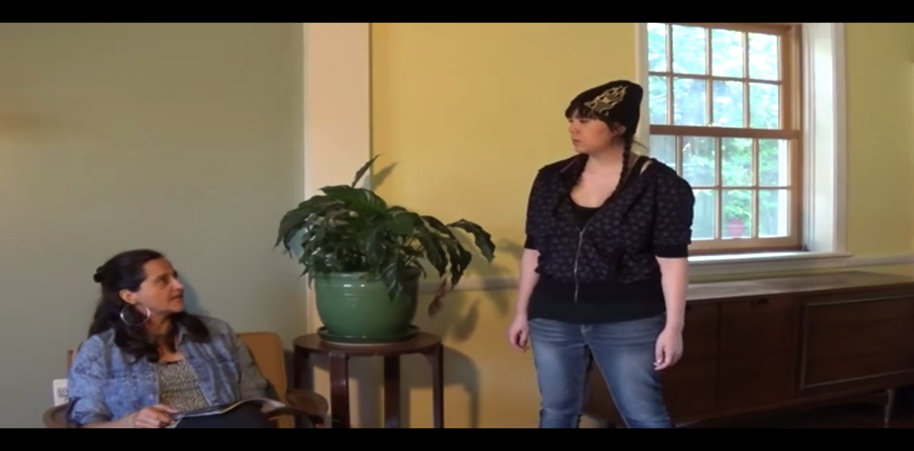
In-Your-Pocket Parental Coach
Extracting a Teen from a Risky Peer Situation
Showing Affection to a Teenager
Asking Questions & Verifying Information
Calming Down after Difficulty Interaction
Staying Firm and Calm when Teen Protests

Slide 41
Phase 1 Pilot Study Design
N = 16 parent-youth dyads receiving MST for a serious youth conduct problem and their therapist
Baseline assessment
Battery of instruments
Use app as you wish for 4 weeks
Phone prompts for satisfaction ratings 3xs/week
App usage data – what features used
Post-usage assessment
Battery of instruments
Qualitative interview by phone

Slide 42
Phase 1 Sample Characteristics
Parents
88% female
Average age: 41.7 years
58% less than high school education
44% unemployed
Youth
Average age = 14.6 years, SD = 1.6 years
52% male
56% African American, 40% Caucasian, 4% Native American
20% of youths also identified as Hispanic/Latino
63% previously arrested
32% previously detained
Average CBCL externalizing score in 95th percentile (T > 70)
Notes:
Hartford, Seattle, Washington DC, New York City

Slide 43
Pilot Study Outcomes
Families used it: Across 4 weeks, youth 4xs/day, parents 2.5xs/day
Families liked it: Avg. satisfaction ratings, parents = 6.0, youth = 6.2 on 7pt scale
Evidence for small pre- to post-usage change on key clinical indicators: average effect sizes parents d = .35, youth d = .29
Qualitative feedback positive
Led to a Phase II SBIR award, RCT completed in late 2019

Slide 44
Our interventionist’s score…
Consideration 3: The user
What is the likelihood that users will want to use / actually use this technology?
How do you imaging the user interacting with it? Settings, frequency, duration
What is the user’s motivation to use this technology?

Slide 45
We CAN do these things; should we?
Consideration 4: The marketplace
What is the realistic marketability / dissemination potential of this technology? (commercialization planning)?
What are the markets / who are the purchasers?
How broad or narrow (specialized) are these?
How will dissemination be monetized? Enough for maintenance/upkeep?
How does this product interface with other products?
What is the likelihood for product obsolescence?
Notes:
Relates back to user desire; health care technologies are much less slick that products we are used to
My thing may be too big or too small – advantage of iKinnect is that its “model-agnostic”

Slide 46
iKinnect Dissemination Potential
“Any provider working with youth involved in criminal behavior, drug use, or at high risk for such”
Large juvenile justice organizations – alternatives to MST or incarceration
Large treatment provider organizations – treatment supplement, aftercare
Hook up with some other product / commercial interest? E.g., providers of other juvenile justice technologies such as ankle bracelets, home drug test kits (channel company)
Direct to consumer? - App Store or Play Store
→ Need additional features for wide-scale implementation?

Slide 47
Future Development of iKinnect
Expand gamification features
Use objective data to do full digital phenotyping with ecological momentary interventions
Use as a platform for fully automated treatment – expand KinBot setup function
Dashboard interface for large organizational management

Slide 48
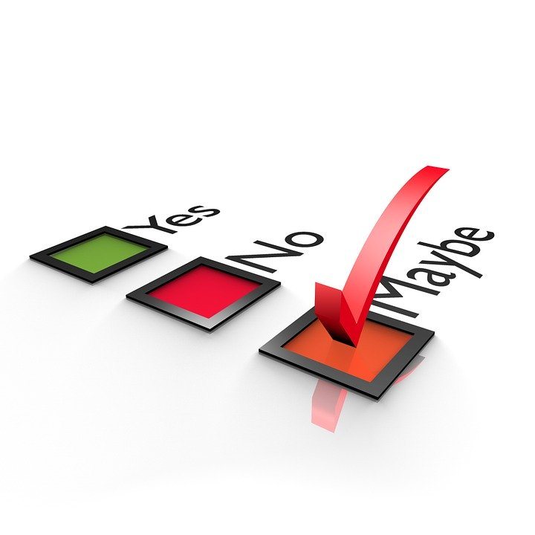
Our interventionist’s score…
Consideration 4: What is the realistic marketability / dissemination potential of this technology?
What are the markets / who are the purchasers?
How will dissemination be monetized?
How does this product interface with other products?
What is the likelihood for obsolescence?

Slide 49
One Model for Successful (?) Development and Implementation
Empirically sound conceptual basis (clear mechanisms of change identified)
Fills a space not already filled by a competitor product
Rigorous user-centered design process (N = 73 people in Phase I; N 200+ in Phase II)
Youth with clinically-significant conduct problems and their parents
From paper prototyping through field testing
Rigorous evaluation (RCT)
Untethered to a specific EBT or treatment setting
Multiple potential applications

Slide 50
HOW do we do these things?
Finding funding sources
SBIR
STTR
RO1s and other standard mechanisms
Foundation grants
Finding technology company partners
https://www.sbir.gov/
Analogous products / developers

Slide 51
Campus Resources
https://www.umaryland.edu/ictr/investigator-resources/ictr-informatics-core-services/
https://www.umaryland.edu/research/offices-and-contacts/contact-us/technology-transfer-um-ventures-contacts/

