Slide 1
Opportunities for Healthcare Research Using Administrative Data: An Introduction to IQVIATM Health Plan Claims Data
Susan dosReis, PhD
Eberechukwu Onukwugha, PhD Department of Pharmaceutical Health Services Research University of Maryland Baltimore School of Pharmacy
August 13, 2019 12:00pm – 1:00pm
ICTR Enrichment Series

Slide 2
Objectives
Overview of the IQVIATM Health Plan Claims Data
ICTR support for projects using IQVIATM data
Steps to obtain ICTR support
Example project
Q&A

Slide 3
Overview of the IQVIATM Health Plan Claims Data

Slide 4
IQVIATM Health Plan Claims Data
Fully adjudicated medical and pharmacy claims
Inclusive of 2006 through 2015
Health plans and self-insured employer groups
Mix of mainly commercial PPO, commercial Medicare and commercial Medicaid
Individuals represented from nearly all US States
Not nationally representative of privately insured individuals

Slide 5
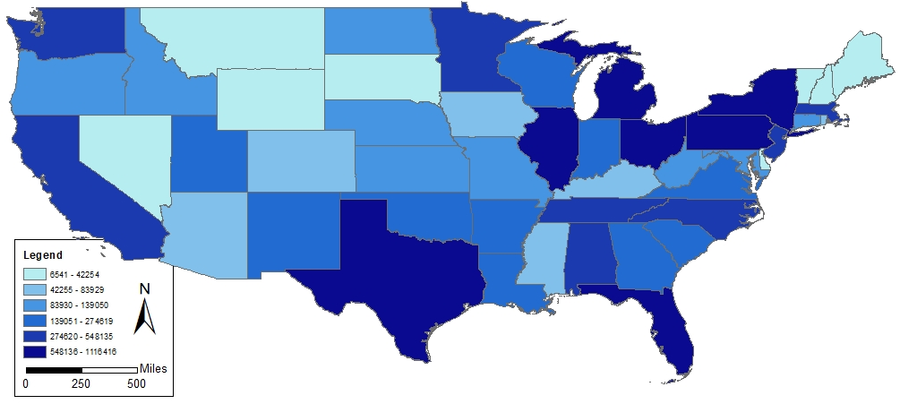
Population File: Patient Information
Variable | N (%)
Patient ID | 12,416,600
Sex (Male) | 6,113,869 (49.2)
Age 25-50 | 5,109,079 (41.1)
Total Number of Months Enrolled
Max | 183
Min | 1
Median | 27
Courtesy of the Pharmaceutical Research Computing Center

Slide 6
Population File: Patient Information
Courtesy of the Pharmaceutical Research Computing Center

Slide 7
Population File: Geographic Region
Courtesy of the Pharmaceutical Research Computing Center

Slide 8
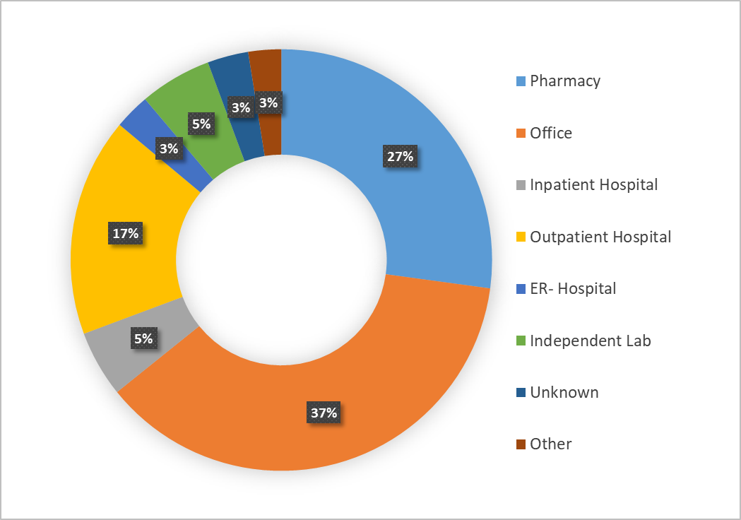
Claims File: Service Settings
(n=349,870,000)
(n=477,690,000)
(n=65,583,807)
(n=215,990,000)
(n=35,260,065)
(n=71,121,512)
(n=40,495,334)
(n=32,512,471)
Courtesy of the Pharmaceutical Research Computing Center

Slide 9
ICTR Support of Projects Using the IQVIATM Health Plan Claims Data

Slide 10
Collaborative Opportunities – IQVIATM Health Plan Claims Data
Conduct exploratory, hypothesis-generating studies
Develop preliminary data for a grant application
Conduct an analysis for a manuscript

Slide 11
Support for ICTR Investigators
Initial Consultation
a) determine project scope & support needs b) assess the appropriateness of the data for the research question c) explain the data use terms & conditions d) determine if the analysis plan is well-defined | 1 hour

Slide 12
Consultation to Determine Feasibility
Review file layout descriptions to understand:
Years covered by the data
Measures available in the data
Measures that are not available in the data
Is the dataset appropriate for your research question?
Does the timeline for access work with your overall timeline?

Slide 13
Support for ICTR Investigators
Tier 1: Descriptive Population Statistics
a) descriptive analysis (means & frequencies) b) cross-sectional analysis (annual trends) c) define key variables | 3 months of limited support

Slide 14
Tier 1 Support Project – Descriptive Population Statistics
Example: Distribution of the Population by Year
 | Year
Variables | 2007 |  | 2008 |  | 2009 |  | 2010 |  | 2011 |  | 2012 |  | 2013 |  | 2014 |  | 2015
 | N | % | N | % | N | % | N | % | N | % | N | % | N | % | N | % | N | %
Gender
Male
Female
Age
Year or Group
Region
East
Midwest
South
West

Slide 15
Tier 1 Support Project – Descriptive Population Statistics
Example: Prevalence of Diagnoses and Medication Use by Year
 | Year
Variables | 2007 |  | 2008 |  | 2009 |  | 2010 |  | 2011 |  | 2012 |  | 2013 |  | 2014 |  | 2015
 | N | % | N | % | N | % | N | % | N | % | N | % | N | % | N | % | N | %
Diagnoses
Diagnosis 1
Diagnosis 2
Diagnosis 3
Medication
Agent 1
Agent 2

Slide 16
Tier 1 Support Project – Descriptive Population Statistics
Stratify the analysis by descriptive characteristics
Example: Graphical Display of Prevalence by Gender and Year

Slide 17
Support for ICTR Investigators
Tier 2: Population Outcomes Analysis
a) provide input on study design & cohort selection b) create variable definitions c) operationalize study outcomes d) conduct simple cross-sectional regression analysis and provide output | 6 months of limited support

Slide 18
Example: Tier 2 Support Project
Example: Logistic Regression Model Output
Logistic Regression w/ GEE Results
Variable | Odds Ratio | Standard Error | Confidence Limits |  | Pr > ChiSq
Year | 1.03 | 0.001 | 1.03 | 1.03 | <.01
Age | 1.05 | 0.002 | 1.05 | 1.06 | <.01
Sex | 0.54 | 0.004 | 0.53 | 0.55 | <.01
Primary Dx | 31.53 | 0.32 | 30.91 | 32.16 | <.01
Other Medications | 3.46 | 0.036 | 3.39 | 3.53 | <.01
Comorbid Dx1 | 0.88 | 0.01 | 0.86 | 0.92 | <.01
Comorbid Dx2 | 1.22 | 0.017 | 1.19 | 1.26 | <.01
Comorbid Dx3 | 0.82 | 0.013 | 0.79 | 0.84 | <.01
Comorbid Dx4 | 1.10 | 0.013 | 1.08 | 1.13 | <.01

Slide 19
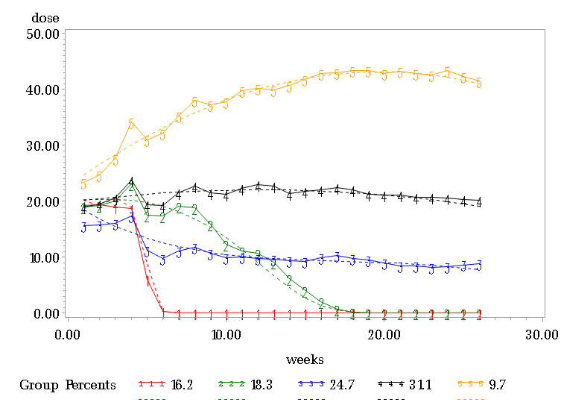
Analysis Beyond Tier 1 or 2 Support
Latent Class Trajectory Analysis

Slide 20
Obtaining ICTR Support for Tier 1 and Tier 2 Projects with IQVIATM Health Plan Claims Data

Slide 21
Procedural Steps to Access IQVIATM
Complete the ICTR REDCap Request
Consultation with the UM IQVIATM Access Support Faculty (ICTR Bioinformatics Core)
Select ‘Non-EHR Data’ under the Informatics Core
Determination of Tier 1 or Tier 2
Work with PHSR Vice Chair for Research to Complete the Project

Slide 22
Connection to PHSR Database Access
Submit application for access
Review user support documents from UMB
Secure IRB approval as appropriate
Create a workspace for output files
Work with the PHSR Community Database Team

Slide 23
Data Use Agreement
Must provide documentation of institutional review board approval
All members of the research team must complete the data access agreement

Slide 24
Application
Rates of Discharges Against Medical Advice and the Medicare Hospital Readmissions Reduction Program:
An Analysis in a Commercially Insured Population

Slide 25
Acknowledgements
Co-authors: David Alfandre MD MSPH, Aakash Bipin Gandhi B.Pharm
University of Maryland, Baltimore, Institute for Clinical & Translational Research (ICTR)
IQVIATM Health Plan Claims Data January 2006 – December 2015, IQVIATM

Slide 26
Discharges against medical advice (DAMA)
Definition: patient leaves the hospital prior to a physician-recommended endpoint
Excluded from the Medicare Hospital Readmissions Reduction Program calculations
May lead to increased DAMA over time

Slide 27
Study overview
Objective: We evaluated if changes in DAMA were related to the HRRP.
Design: Interrupted time series analysis of monthly DAMA rates (per 1,000 discharges)
Participants: Individuals aged 18-64 years old at admission; admission during 1/1/2006 to 12/31/2015

Slide 28
Statistical analysis and sample size
Segmented linear regression with two interruptions
Sample size:
1,087,812 discharges
668,823 individuals
120 months

Slide 29
Results
IQVIATM Health Plan Claims data provide a large sample size for conducting pilot and exploratory research studies

Slide 30
Questions & Discussion
IQVIATM training session on campus (see handout)
Pharmacy Hall Room N106
2:10pm – Spotlight Research Using IQVIATM
2:30pm – Data Overview
4:30pm – General Discussion
For more information about all of the community databases available within PHSR, please contact: Susan dosReis (sdosreis@rx.umaryland.edu)

Slide 31
Population File: States
Patient State Frequencies
Patient State Percentages

Slide 32
Supplemental Slides

Slide 33
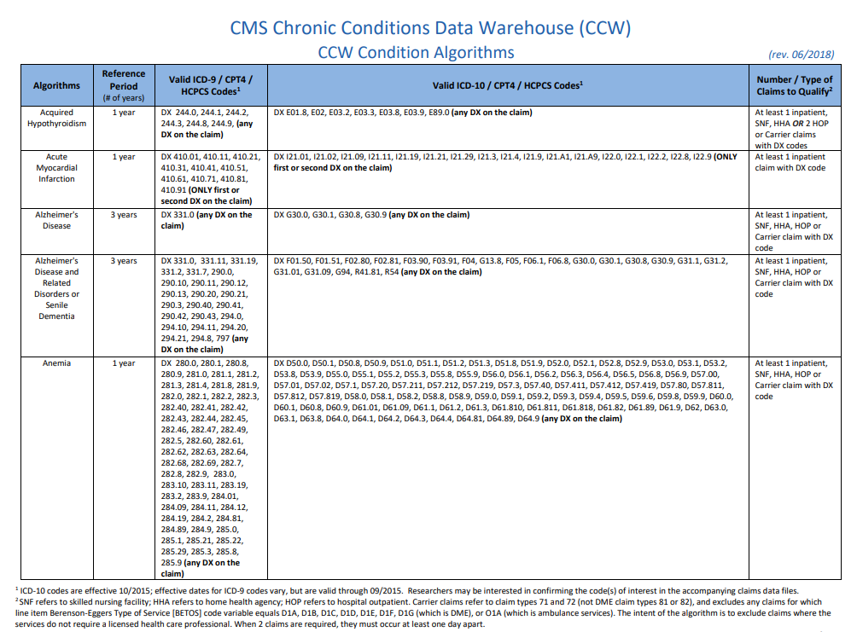

Slide 34
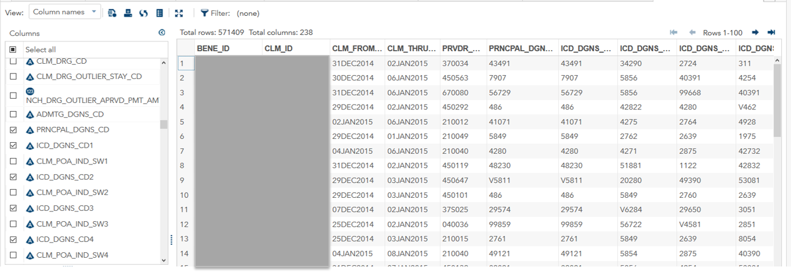
Inpatient File Example
Variable Highlights
Admission, discharge dates, Diagnosis (ICD diagnosis), Procedure (ICD procedure code), FFS reimbursement amount, Hospital provider number

Slide 35
Where to Begin and How to Finish
Secure Funding
Develop a Comprehensive Analysis Plan
Apply for a Data Use Agreement
Acquire Data Access
Investigate the Data
Create Analytic Files
Analyze the Data
Abstract/Manuscript Completion

Slide 36
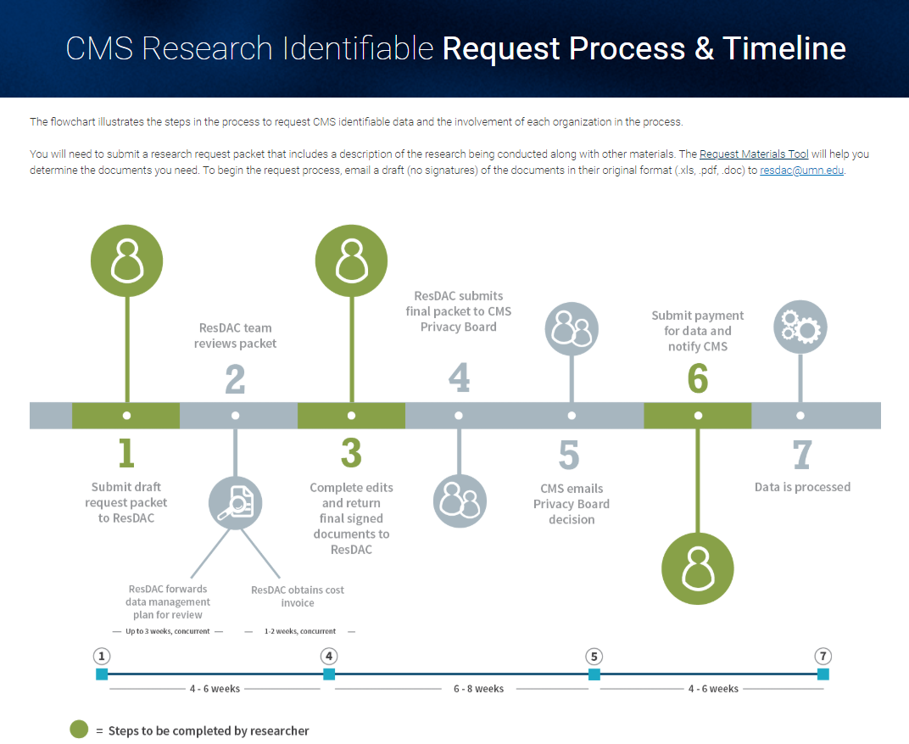

Slide 37
Data Request – Reuse Data
DUA Application
Must be requested by the original requesting organization (UMB) when reusing data (CDP data)
DUA application is extensive and can take upwards of a week to complete
DUA process may take upwards of 3 months to fully execute
Custodians listed on the DUA are able to access the raw data files, approved for use, through the secure server
Data Access
Training required (HIPAA, CITI, Security Training meeting NIST compliance standards)
Approval from the CBP Chair
Active IRB & DUA
UMB, SOP Affiliate Status
VPN & Internet Capabilities

