Slide 1
Publishing and Beyond: How the HSHSL Can Help You Maximize Your Research Output
HSHSL Scholarly Communications Committee:
Amy Yarnell, MLS, Head of Data and Bioinformation Services
Emily Gorman, MLIS, Research and Education Librarian, SOP
Nicole Shelawala, MLIS, Research and Education Librarian, SOM
Christine Nieman Hislop, MSLIS, Data Services Librarian
Notes:
Did you know the HSHSL can cover open access publishing fees in Wiley and Elsevier hybrid journals? Join this session to learn more about these publishing opportunities and explore additional HSHSL services that can help you maximize your research, such as choosing the right journal, tracking research impact, conducting evidence syntheses, managing research data, and navigating NIH public access and data sharing policies.

Slide 2
Overview
Open Access and HSHSL's "Read & Publish" agreements
Other publishing resources at HSHSL
Research and education services
Data services and resources

Slide 3

What is Open Access Publishing?
"Open Access (OA) is the free, immediate, online availability of research articles coupled with the rights to use these articles fully in the digital environment." – SPARC
Notes:
First, some definitions to make sure we're all on the same page

Slide 4
Open Access Models
Gold – The journal is available to read to all without subscription, authors usually pay an Article Processing Charge (APC) to publish
Hybrid – The journal requires a subscription to read, but authors can pay an APC to make their own article open.
Green – Authors may "self-archive" publication on their own website or in a repository. May be permitted only after an embargo period and/or with the author's accepted manuscript, not the published final version.
Notes:
There are a few different models of open access publishing. Gold open access, or fully open access means that the journal is available to anyone to read without a subscription, authors usually have to pay an article processing charge to publish in these journals. Examples of these include PLoS one and BMC
Hybrid journals require a subscription to read, but authors can choose to pay a fee to make their own articles open – this can be helpful for disseminating your research farther, because it won't be behind a paywall, it can also help you comply with public access policies. These are the types of journals covered by our agreements which we will talk about next.
Typically OA fees are around $3000-4000, but
Green open access refers to the process of self-archiving your article – in a place like PubMed Central, or an institutional repository. Publishers may put limitations on this, like requiring an embargo period of 6 months to a year, and allowing only the author accepted manuscript

Slide 5
What is Read and Publish?
Subscription model for journals that provides:
Access to content in those journals
Credits for publishing an Open Access (OA) article in some of those journals without paying the article processing charge (APC)
HSHSL has two Read and Publish agreements:
Wiley Hybrid Journals – 95 credits a year
Elsevier Hybrid Journals – 100 credits a year
Notes:
The HSHSL has recently entered into two read and publish agreements – here we pay for the subscription to a set of journals so the campus community can read them, and we also have purchased a number of credits so our authors can publish in them and make their own articles open without paying the usual fee that you have to pay for hybrid journals. Our agreements are with Wiley and Elsevier – two of the largest academic publishers. We have 95 credits for Wiley and 100 for Elsevier – each credit is one publication.

Slide 6
How the Agreements Work:
Article must have a UMB-affiliated corresponding author
When your article in an eligible journal is accepted, you will have the option in the publishing portal to select OA as the publishing format
Credits are allocated on a first-come, first served basis.
Currently 34 Wiley and 11 Elsevier credits remain for 2025.
Already saved over $225,000 in APCs from Wiley alone
Notes:
To have an article fee covered under this agreement you just need to make sure that you choose an eligible journal and that the corresponding author is UMB-affiliated. There is no special application – when your article is accepted by the journal you will see the option to make it open on the publisher's site – you may be asked to confirm your affiliation. Credits are allocated on a first come, first serve basis. We currently have 34 left for Wiley and 11 left for Elsevier as of this week. If you think you submitted to an eligible journal in this last year and didn't see that option, please reach out and let us know! We received a report from Wiley on all the articles that were published under this agreement at UMB and without the agreement the APC costs would have been over $225000, and that was as of October – so we can see what a good value this is.

Slide 7
Selected Eligible Journals
Elsevier
Wiley
Advanced Drug Delivery Reviews
American Journal of Emergency Medicine
American Journal of Transplantation
Biological Psychiatry
Dental Materials
Disability and Health Journal
Genetics in Medicine
Journal of Professional Nursing
Vaccine
Advanced Materials
Addiction
Arthritis and Rheumatology
Clinical Pharmacology and Therapeutics
Journal of Medical Virology
Journal of Nursing Scholarship
Journal of Prosthodontics
Medicinal Research Reviews
Ultrasound in Obstetrics and Gynecology
Notes:
On this slide are just a handful of the journals covered by these agreements – just to give you a sense of the variety of subjects covered. These are all journals that UMB authors have published in before and are highly regarded in their respective fields. As we said the agreements are with two of the largest publishers in the world and cover about 3000 journals overall. Now, not all of those are in the health sciences, but we did take a look and UMB authors published in about 900 of these journals over the last five years, representing about a quarter of all UMB publications.

Slide 8
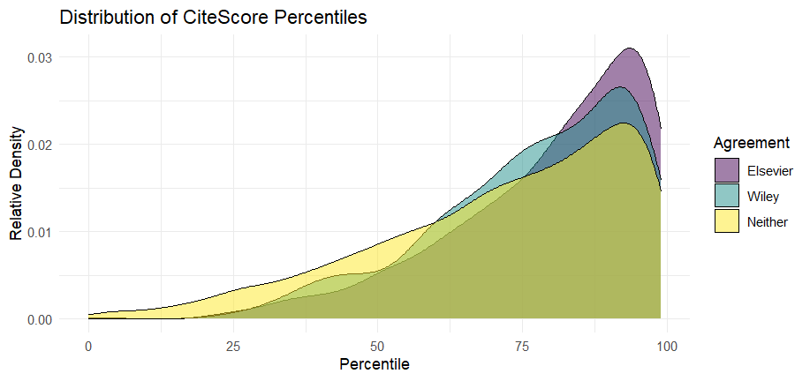
Quality of Eligible Journals
Notes:
This graph speaks to the quality of the journals covered by the agreements. It's based on the distribution of CiteScore Percentiles – this is a metric from Scopus that indicates the relative standing of a journal in its field, and this graph shows that the articles in our agreements tend to be a little more clustered in those higher percentiles than those not in the agreements.

Slide 9
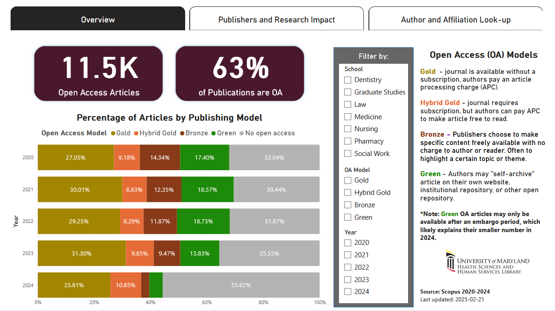
More about OA at UMB
Open Access Dashboard
Notes:
If you want to explore the overall picture of OA publishing at UMB you can take a look at our dashboard

Slide 10
Publishing Resources at HSHSL
Publication Planning Guide
Where to publish, author IDs, predatory publishing, preprints and repositories, and more
NIH Public Access Policy Guide
Information to help ensure compliance
Research Impact Guide
How to measure the impact of your research, request an impact report from the HSHSL
HSHSL Poster Printing Service
Notes:
In addition to information about our Read and Publish agreements, the Publication Planning guide also contains resources to help you with tasks such as identifying journals that match your manuscripts, maintaining your scholarly profiles via author IDs, avoiding predatory publishers, and sharing your work in open repositories. The NIH Public Access Policy guide provides guidance on how to be compliant with this policy, as well as how to check your compliance status. If you are unfamiliar with the public access policy, it was recently updated in July 2025 to mandate that all NIH-funded research be made open immediately upon its publication, with no embargo period or delay. Using the Read and Publish agreements could help you comply with this policy, as well as pursuing Green OA options (i.e. self-archiving). If you have questions about the policy or would like assistance exploring your options for compliance, we are happy to help.
The research impact guide provides information on different measures of impact at the article, journal, and author level, and describes our research impact report service. The HSHSL also has a poster printing service that is very reasonably priced!

Slide 11
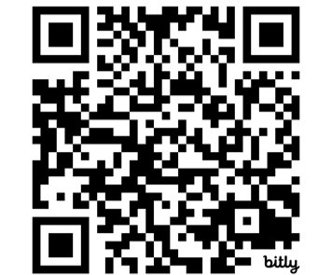
Research and Education Services
Expert literature searches
Evidence synthesis projects (e.g., systematic and scoping reviews)
Instruction (guest lectures, custom workshops for faculty or student groups)
Subject guides, e.g.:
Finding Drug and Clinical Information
AI and Information Literacy
Citation Managers
Coming in 2026: Consensus premium trial
https://bit.ly/HSL-RES

Slide 12
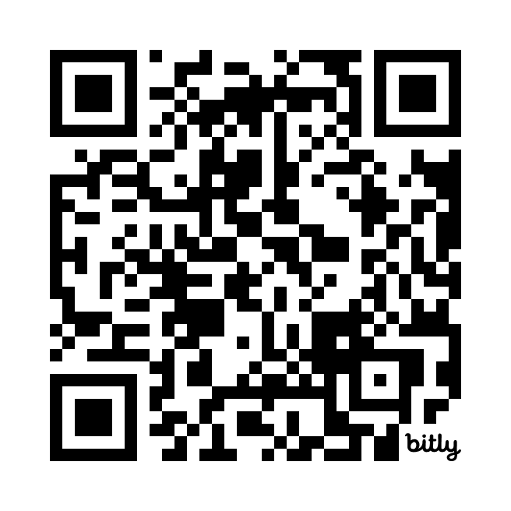
Data and Bioinformatics Services
Research data sharing consultations
Data visualizations for publications
ICTR Voucher Program
Instruction
Workshops & tutorials (materials on OSF)
Guest lectures
1-on-1 tech help in consultations
https://bit.ly/HSHSL-DABS
Notes:
The Data and Bioinformatics Services Team offers research data management and sharing consultations. We can answer questions on data throughout the research data lifecycle, including helping you select a repository for publishing your data or fulfilling grant data sharing requirements.
The library has a professional designer on the team who can also help you with producing publication-ready data visualizations. This service is eligible for the ICTR Voucher Program. If you're interested, you can schedule a consultation to learn more about this service or get help with creating your own data vizzes.
And then we offer instruction on data-related topics. We've done workshops and guest lectures on data management and sharing planning, as well as offering 1-on-1 assistance on using specific software applications in consults.

Slide 13
UMB & HSHSL Data Resources
Make your data more visible and findable by submitting your dataset to the UMB Data Catalog
Publish data in membership repositories
Qualitative Data Repository (QDR) – specializes in qualitative data (5 free deposits a year)
ICPSR – allows for controlled access (paid); free to deposit in openICPSR
OSF – accepts both data and pre-prints (free)
Explore more UMB- and HSHSL-Supported Data Resources
Notes:
UMB and HSHSL have several data resources that can also support your publishing. If you have shared or published data – especially if your data is not openly shareable or requires controlled access – you can make your data more visible and findable by submitting your dataset to the UMB Data Catalog. The UMB Data Catalog is a collection of metadata records that describe datasets and how to access them. You can submit your dataset with or without, before or after a publication.
Or if you need help with determining where to share your data, while the UMB Digital Archive does not accept data in its repository, there are 3 repositories that HSHSL is a member of.
QDR or the Qualitative Data Repository is a specialized data repository for qualitative data. Through our membership, UMB researchers can deposit up to 5 datasets a year for free.
ICPSR is one of the world's largest archives of social, behavioral, and political science data. Through UMB's institutional membership, researchers have full access to ICPSR data to download and to deposit. There is a fee for curation services when depositing data in the main ICPSR, however openICPSR is free for self-depositing. However, openICPSR is open which means it may not be appropriate for data that contains sensitive information.
You can self-deposit your data for free in openICSPR. OpenICPSR is particularly well-suited for the deposit of replication data sets if you need to publish the raw data associated with a journal article so that other researchers can replicate their findings. However, there are some limitations and researchers are responsible for documenting sensitivity and ensuring access is restricted if necessary.
And OSF, formerly the Open Science Framework is a platform for collaborative project management where you can organize and share projects, pre-register your research protocol, and search for pre-prints or data. There are several community-run pre-print servers that are part of OSF, including PsyArXiv and SocArXiv.
This is just a brief overview of some of the data resources at UMB and HSHSL, you can check out more at the link on this slide.

Slide 14
Key Takeaways
Before publishing, check if your journal is covered in one of our "Read and Publish" agreements
Reach out for help selecting the right journal or data repository
Submit your dataset to the data catalog
Include a librarian on your evidence synthesis project
Notes:
Some key takeaways from today's presentation are:
Before publishing your research, check if the journal you are publishing in is covered in one of our "Read and Publish" agreements – you can also reach out to the HSHSL if you'd like us to check or advise on which journals are covered. We can also help with selecting the right repository for your data.
At the time of publishing, you can also submit you data to the UMB Data Catalog which can make your data more findable and reusable.
And lastly, the library can help you with evidence synthesis projects and in general assist you throughout the research lifecycle/process.

Slide 15
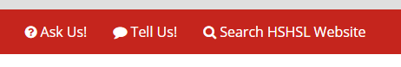
Questions?
hshsl.umaryland.edu
Information Services Desk:
410-706-7996
hshsl@umaryland.edu
Data and Bioinformatics Services:
data@hshsl.umaryland.edu
Publishing / Public Access Policy:
publishing@hshsl.umaryland.edu

