Slide 1
ICTR Enrichment Series October 14, 2025 UMB Secure Research Environment (SRE)
Peter J. Murray, Senior VP for IT and CIO
Brian Coats, Sr. Associate VP and Deputy CIO
Braden Bierman, Sr. IT Cloud Infrastructure Architect

Slide 2

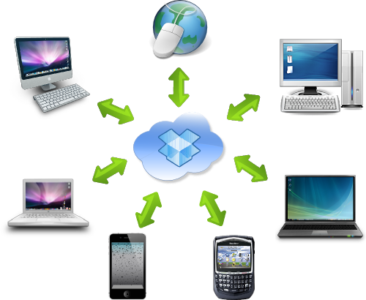

Cybersecurity Challenges:
End-point security; Data security;
Expanded Attack Surface

Slide 3

IT Security is Critical Technical safeguards must be applied because…
Cyber Attacks are the #1-way sensitive data are breached
UMB receives between 250-300 million
attempts daily to get access to systems
and data;
Between 60-70 million of these
attempts are blocked immediately
because they are security threats;
UMB receives approx. 1.2 million
emails daily
Between 150-200 thousand emails are blocked because they are either spam/junk, phishing attempts or contain malware.

Slide 4
Federal and State Privacy and Security Rules Why Would I Need to Know About Them?
There are significant penalties for not complying federal and state
rules and regulations.
Each of us has a responsibility to respect and protect the privacy and security of all personally identifiable information (PII).
UMB professionals need to know and understand institution policies and procedures for protecting sensitive data; and take note of best practices for protecting personally identifiable information, including protected health information.
Cyber criminals do nefarious activities and cause great harm when
they obtain PII.

Slide 5
Sensitive Data Definition Personally Identifiable Information (PII)
Definition provided by the State of Maryland Attorney General’s Office:
An individual’s first and last name in combination with any one or more of the following data elements:
Social Security number, an Individual Taxpayer Identification Number, a passport number, or other identification number issued by the federal government;
A driver’s license number or state identification card number;
An account number, a credit card number, or a debit card number, in combination with any required security code, access code, or password, which permits access to an individual’s financial account;
Health information, including information about an individual’s mental health;
A health insurance policy or certificate number or health insurance subscriber identification number in combination with a unique identifier that permits access to an individual’s health info.;
Biometric data of an individual such as fingerprint, voice print, genetic print, retina or iris image, or other unique biological characteristic, that can be used to uniquely authenticate the individual’s identity when the individual accesses a system or account.
A username or email address in combination with a password or security question and answer that permits access to an individual’s email account.
Please note that this definition could be different for other states.

Slide 6
Risk Management is Critically Important
Information Technology Security Risk Management of Sensitive Data Used for Research
Securing access to systems and data used for research
Achieving compliance with Federal and State Security and Privacy Rules and Requirements
Protecting from misuse
Personally Identifiable Information (PII), including
Protected Health Information (PHI)

Slide 7
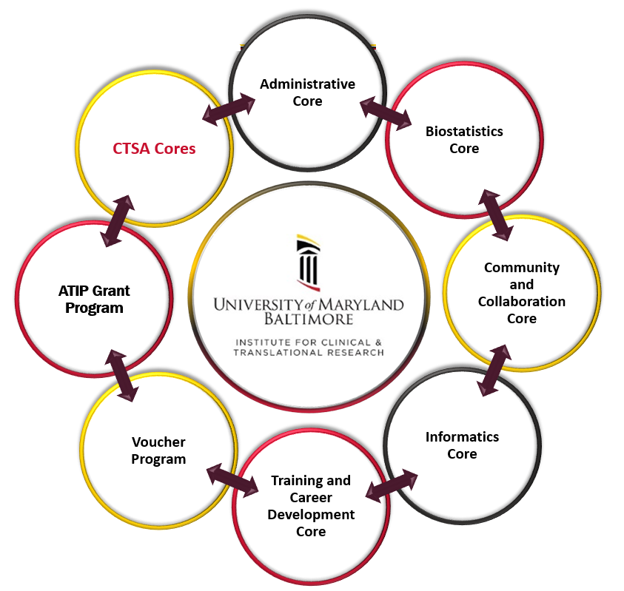

UMB Research and UMMS Data Use Agreement
In 2022, UMMS and UMB created a Data Use Agreement.
It streamlines the provision of clinical data to researchers.
It specifies the use of a secure research environment.
It requires oversight and UMMS/UMB expertise in the management of clinical data used by UMB researchers.
UMB
UMMS
UMB-UMMS Clinical Research Informatics
Clinical Data for UMB Researchers

Slide 8
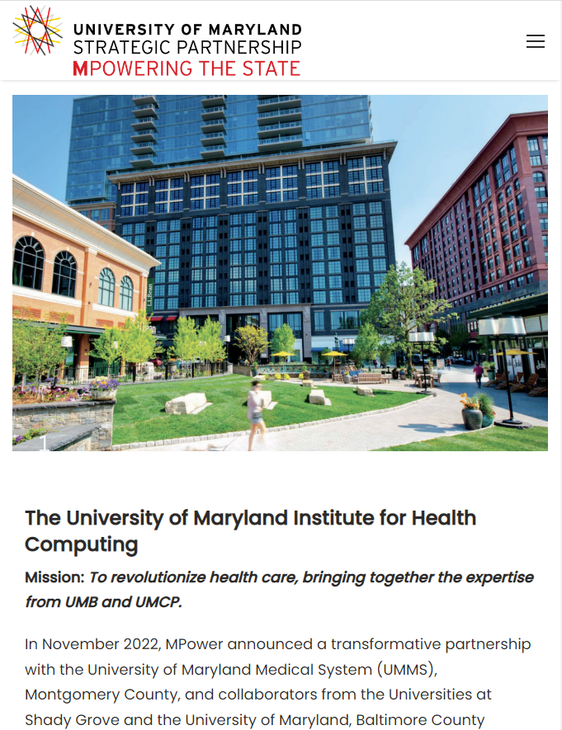
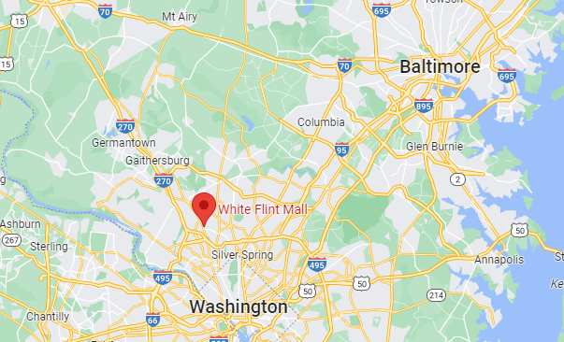

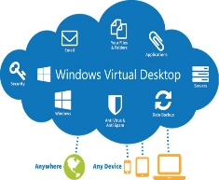
Institute for Health Computing (IHC)

Slide 9
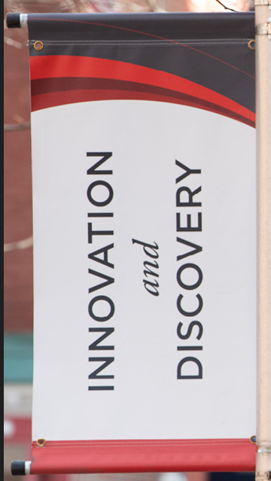


Innovative Technology Solutions, Cloud-First
Achieving Goals that Align with UMB Strategic Plan
Innovation and Discovery
Cloud Infrastructures Offer:
Improved sustainability
Greater capacity and faster scalability
The ability to be agile and rapidly deploy state-of-the-art technology and implement new services
Increase redundancy and disaster recovery capability
“Pay as you go” subscription model where UMB is only be obligated to pay for those services that are consumed and
Enhanced security of sensitive data
Cloud First
Approach
The Cloud-first approach has resulted in the use and benefits of technology that is modern and based on industry best practices. It has allowed the institution to be current and innovative with a computing infrastructure that leveraged new features and functionality and continuous improvements.

Slide 10
Innovative Technology Solutions
Secure Research Environment (SRE)
The UMB Secure Research Environment (SRE) has been created to protect sensitive data used by faculty for research purposes as well as for protecting the intellectual property that develops from research studies.
It is designed to protect sensitive and restricted research data from misuse and unauthorized access.
It minimizes risk to the institution and to the principal investigator of an unlawful exposure of sensitive data.
The SRE is different from the current UMB research computing environment in that the computing resources, data storage and software are not located on a local server, desktop or laptop computer but are available in a secure Cloud infrastructure.

Slide 11

Innovative Technology Solutions, Securing Research Data
Achieving Goals that Align with UMB Strategic Plan
Innovation and Discovery
Secure Research Environment (SRE) | Task
Environment Developed and Available to Faculty Researchers | A Secure Research Environment (SRE) was developed using the Microsoft Azure infrastructure; data are accessed via the use of Azure Virtual Desktop (AVD).
Computing Power, Data Storage | Appropriate computing power and data storage are configured for a PI(s) based on the needs of the research project.
Production Ready | 279 researchers are currently using the SRE for performing their research studies.
Guidebook | A Guidebook has been created for faculty that provides information about the SRE and how to get started using the environment for their research. https://www.umaryland.edu/cits/research-computing/
Support for Faculty | Principal Investigators receive assistance from an IT Team. The IT team consults with the researcher, loads the data into the SRE; and provides on-going technical support.
An Environment Created for Researchers | The SRE has been created with high security so that faculty researchers can focus on performing their research and not on how to protect the sensitive data used for their research project.

Slide 12
Secure Research Environment (SRE)

Slide 13
REDCap (Research Electronic Data Capture)
New expanded and enhanced REDCap program
Supports all UMB and UMCP faculty
Replaced UMCP environment
Replacing IGS/CTRIC environment
Universally available at no cost, including training and support
2 new REDCap environments - latest version of REDCap
SRE REDCap
Sensitive data including UMMS Epic & non-UMMS medical record
Directly accessible from SRE
Standard REDCap
Non-sensitive data
Directly accessible from anywhere without VPN
Module expansion
APIs, Mosio SMS service, MyCap, and MobileApp already available
AI integration and Flight Tracker coming soon

Slide 14
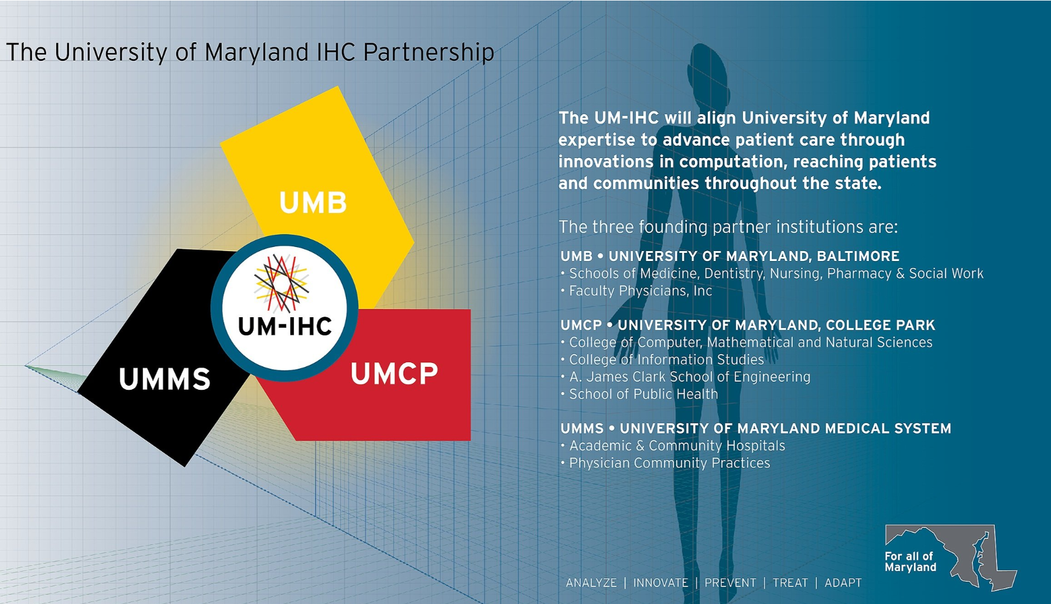
The University of Maryland IHC Partnership
Merging the computational expertise, clinical expertise, biomedical innovation, health data and academic resources of the University of Maryland, Baltimore; the University of Maryland, College Park; and the University of Maryland Medical System the IHC’s mission is to innovate health care delivery and support the Montgomery County life science community.
Partnering with the nearby critical mass of federal agencies and biotech industries, UM-IHC uses advanced computing to improve well-being and quality of life, fight disease and enhance outcomes for all people across Maryland and beyond.
Key Research Areas:
Applied AI
Bioinformatics
Immersive Visualization
Real-World Evidence and Adaptive Clinical Trials
Population Health
Therapeutic Drug Discovery
UMB provides the IHC with secure cloud computing (the SRE) to perform their research.

Slide 15


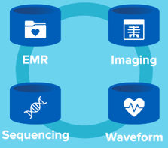
Secure Microsoft Azure Infrastructure, Processes for Using the SRE for
Performing Research
IRB, ORD,
Honest Broker,
IT Consult
Cloud-based access via AVD
Data in
the SRE
Application Review
Approval Processes
Provisioning Data
IT Consult
Loading Data in the Azure Infrastructure
Authorization
Authentication
Availability
Security
Analysis
SAS, Stata, R, etc.

Slide 16

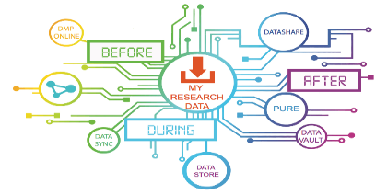
SRE Statistics
 | Task
Active Researchers | 279
Active Projects | 138
Research Spotlight |  | Task
HP-00110331 | Dr. Katherine Goodman | Evaluating the potential of natural language processing algorithms and large language models (AI) to accurately parse various unstructured clinical data to extract meaningful insights.
HP-001103027 | Dr. Bradley Maron | Investigating the various demographic and clinical characteristics of patients with Pulmonary Hypertension within the state of MD to better inform the nuances of the disease's classification.
HP-00108302 | Dr. Jay Unick | Examining and documenting the effectiveness of peer recovery coaches (PRC) treatment services in an emergency department setting.

Slide 17

SRE Demo

Slide 18


Secure Research Environment
Added Features/Accomplishments
Since Inception
 | Task
Artificial Intelligence (AI) | The SRE has added AI capabilities to allow for Azure OpenAI and Large Language Models (LLMs).
Standard and Custom Compute, and Data Storage | Standard configured host pools as well as high performance computing services and data storage are available based on the needs of the PI and research project.
Managed Open Access | Managed connectivity to external sites/data sources needed for projects.
REDCap Access | Secure connection to REDCap. Sensitive data collected via REDCap is stored and analyzed in the SRE.
Continuous Engagement with Faculty Researchers | Surveys; Feedback sessions; Direct conversations; Intake mechanism for new requests.
Governance Council | A Governance Council meets every two weeks to review status of the SRE: projects completed; workstreams underway; future enhancements.

Slide 19


Secure Research Environment
Projects in Flight
 | Task
DataMover – Self Service Data Ingress/Egress | The application enables researchers to securely move data in and out of the SRE autonomously after being scanned for sensitive data (PHI/PII). Scheduled to complete by end of October.
HPC Bursting | Integration with on-premise HPC cluster to land 30% of HPC workloads in SRE to leverage cloud capabilities and accelerate research. Scheduled to complete by end of April.
Shock Trauma Platform | Ingest and analyze large amounts of trauma data for improved care. Working with other partner research universities to share data and results securely and compliantly. Scheduled to completed in the next month.
Clinical Imaging | Manage & Optimize large file access and combine stored and real-time patient information (including imaging) for Genomics Department and for the Medical Center to allow clinicians to make faster and more accurate diagnoses and treatment recommendations. Finalizing requirements.

Slide 20
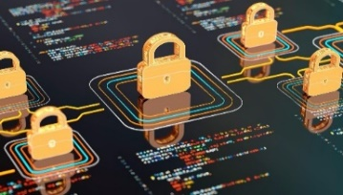
Secure Research Environment
What’s Next
 | Task
Purview to Help Classify Data | Purview will act as an additional control and layer of security for sensitive data (PII/PHI) use.
Geocoding APIs | Geocoding tools, Maplibre and Geocodio, are hosted by UMMS. APIs will be integrated into the SRE via API Manager.
Custom Compute - Linux | SRE compute offerings will include Linux systems.
Radiology Image Analysis | The SRE Azure infrastructure will be used for analyzing radiology image data. To perform the analysis, dedicated graphical hardware (GPU) will be made available.
Connection to Google Cloud | Google Cloud data will be available within the SRE.

Slide 21
Secure Research Environment
Next Phase for the SRE
 | Task
Full On Promotion and Adoption | Requiring the SRE for research using sensitive data, unless there is a compelling reason why the SRE cannot be used for a research project.
Expanding SRE Support | As more faculty from schools and departments use the SRE, IT support staff in those areas are joining the SRE IT Support Team.
Additional AI Tools, Software and Features | The SRE will continue to adopt and add new, contemporary technology, software, and feature-rich offerings to meet the demands of researchers.
Balance of Flexibility and Security | The SRE will maintain its core mission of being a secure environment while selectively offering flexibility and self-service capabilities for researchers.
A Research Computing Environment Used University-Wide | The SRE will be a University sponsored program that is used in all schools and departments of the University. It is THE platform for supporting the research enterprise at UMB as well as supporting faculty elsewhere where UMB research collaborations occur.
An Environment Promoted and Embraced by Researchers | The SRE has been created for faculty researchers; to give researchers a readily available environment with the power and capability to perform research; without having to worry about protecting sensitive data used for research projects.

Slide 22
Evolution of the SRE
Summer 2022
Conception
Summer - Winter 2022
Design and Development
Jan - Aug 2023
Pilot program
Sept 2023
First production deployment for UMB & IHC
Expanding and improving the SRE
Met with U-Pitt, Microsoft and other universities
Today and Beyond
Participation from volunteer researchers
Creation
Go-live
Enhancements

Slide 23

Getting Started
sre-support@umaryland.edu
eda-research@umm.edu

Slide 24

Thank You!
Questions?

