Slide 1
Nov. 1, 2023
Town Hall: Standards VI and VII

Slide 2
Nov. 1, 2023, Town Hall: Standards VI and VII
Call to Conversation
Bruce E. Jarrell, MD, FACS
President
William T. Wood, JD
Assistant Treasurer, University System of Maryland Board of Regents
Mark A. Reynolds, DDS, PhD, MA
Dean, School of Dentistry, and Co-Chair, Middle States Steering Committee
Gregory C. Spengler, MPA
Associate Vice President for Institutional Effectiveness
and Middle States Accreditation Liaison Officer

Slide 3
Nov. 1, 2023, Town Hall: Standards VI and VII
UMB Is Accredited as an Institution by MSCHE
MSCHE stands for the Middle States Commission on Higher Education.
MSCHE is recognized by the U.S. Department of Education as an institutional accreditor and has accredited over 600 institutions.
Institutional accreditors do not accredit individual programs, units, or locations, they accredit institutions in their entirety. That’s why schools and programs have their own separate system of accreditation.
Notes:
*Originally, there were “REGIONAL” accreditors and “NATIONAL” accreditors. As a regional, MSCHE covered only a specific geographic portion of the US; a handful of contiguous states (MD, DE, NY, NY, PA); plus DC, Puerto Rico and the US Virgin Islands.
In 2020, the Department of Education eliminated both titles and the combined accreditors are called institutional accreditors. MSCHE’s footprint now extends to 48 states (the exceptions being North Dakota and Montana); two U.S. Territories (Puerto Rico and the U.S. Virgin Islands); and the District of Columbia. Its footprint extends to 94 countries.

Slide 4
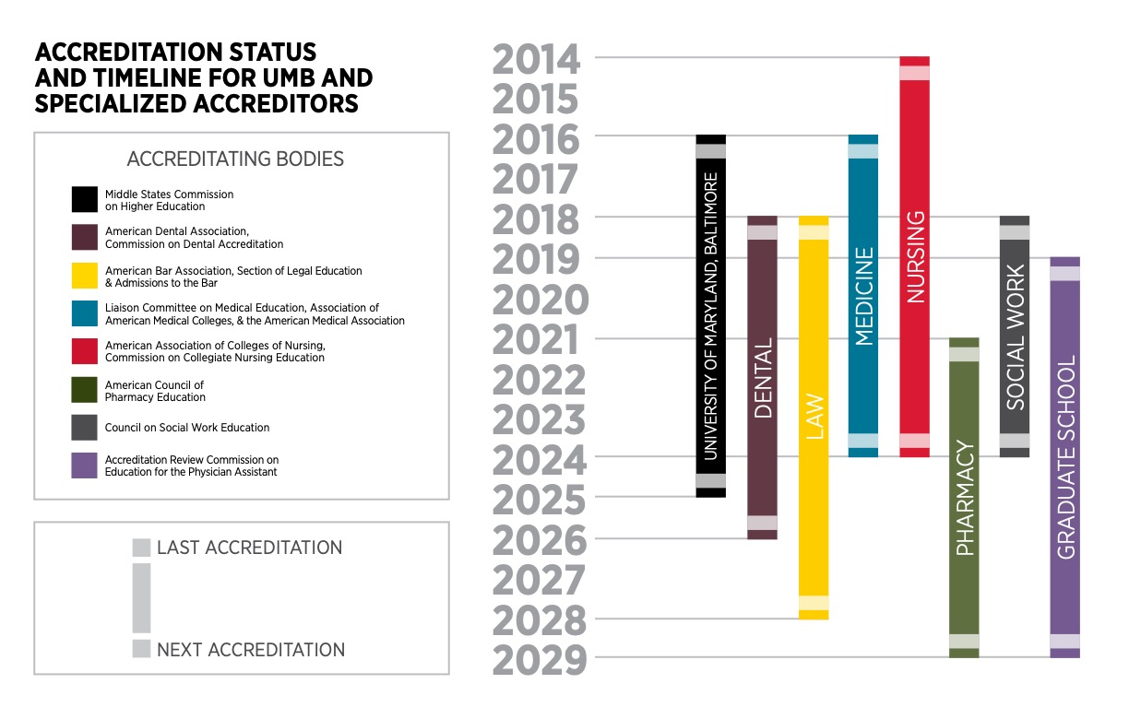
Nov. 1, 2023, Town Hall: Standards VI and VII

Slide 5
Nov. 1, 2023, Town Hall: Standards VI and VII
Why Does Middle States Matter?
Institutional accreditation provides a “seal of approval” that is a prerequisite for receiving federal financial aid funds!
MSCHE mandates that its member institutions meet rigorous and comprehensive standards, which are addressed in the context of the mission of each institution and within the culture of ethical practices and institutional integrity.
If UMB were to lose its accreditation, EVERY school and program would be at risk.
Notes:
Select the Self-Study design most appropriate for UMB. The themes in the design should align with our core values and the priorities in our Strategic Plan. This task should be completed no later than April 25, 2023.
Design an inclusive and transparent self-study process that actively and deliberately seeks to engage members of the University community from every corner of campus.
Produce a Self-Study report that demonstrates our compliance with the Middle States Commission on Higher Education accreditation standards and provides forward-looking recommendations to move the institution further along its quest for excellence in graduate and professional education, research, clinical activities, and service for the public good.

Slide 6
Nov. 1, 2023, Town Hall: Standards VI and VII
Middle States Standards and Requirements
Accredited institutions are expected to demonstrate compliance with MSCHE’s seven standards (and related requirements), to conduct their activities in a manner consistent with the standards and requirements, and to engage in ongoing processes of self-review and improvement.
Standard I – Mission and Goals
Standard II – Ethics and Integrity
Standard III – Design and Delivery of the Student Learning Experience
Standard IV – Support of the Student Experience
Standard V – Educational Effectiveness Assessment
Standard VI – Planning, Resources, and Institutional Improvement
Standard VII – Governance, Leadership, and Administration

Slide 7
Nov. 1, 2023, Town Hall: Standards VI and VII
UMB’s Accreditation Components and History
The accreditation process has two main parts:
  The creation and submission of a Self-Study report to MSCHE.
  A multiday site visit and review in spring 2025 by a team composed of peer evaluators from other accredited institutions organized by MSCHE.
UMB’s MSCHE accreditation was reaffirmed in June 2016.
UMB’s accreditation status will be acted on again by MSCHE in 2025.

Slide 8
Nov. 1, 2023, Town Hall: Standards VI and VII
Intended Outcomes of the Self-Study
To engage in an inclusive and transparent self-appraisal process.
To produce a Self-Study report that demonstrates compliance with the seven standards and related requirements.
To develop forward-looking recommendations to inform UMB’s next Strategic Plan to move the institution further along in its quest for excellence in graduate and professional education, research, clinical activities, and service for the public.
Notes:
Self Study Approach
The Standards Based self-study design was chosen as the one in which the University could focus most intensely on its strategic priorities. UMB has a robust culture of planning and accreditation. Part of the reason for our unique culture is that each of UMB’s professional schools is accredited by their own unique accrediting organizations and as such UMB is continually examining its practices and making improvements. UMB is fortunate that the Middle States Self-Study affords the University yet another opportunity to integrate existing planning and accrediting processes.

Slide 9
Nov. 1, 2023, Town Hall: Standards VI and VII
What Are Today’s Objectives?
  Divide into small groups to assist the Working Groups in their assessment of UMB’s satisfaction of the relevant standard and related requirements.
  Small groups also will consider questions seeking to identify opportunities for improvement.
  This town hall is an important part of UMB’s self-review process. Thank you for taking the time to be engaged!
Notes:
Drs. Ward, Reynolds, and Greg Spengler to introduce Co-chairs

Slide 10
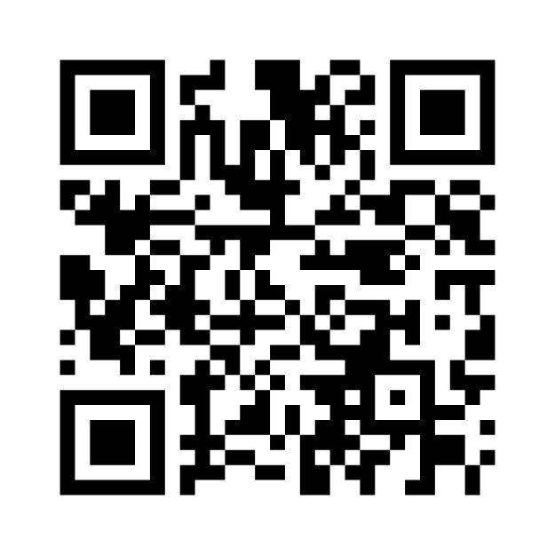
Nov. 1, 2023, Town Hall: Standards VI and VII
Scan the QR code for a UMB and Middle States Check-In

Slide 11
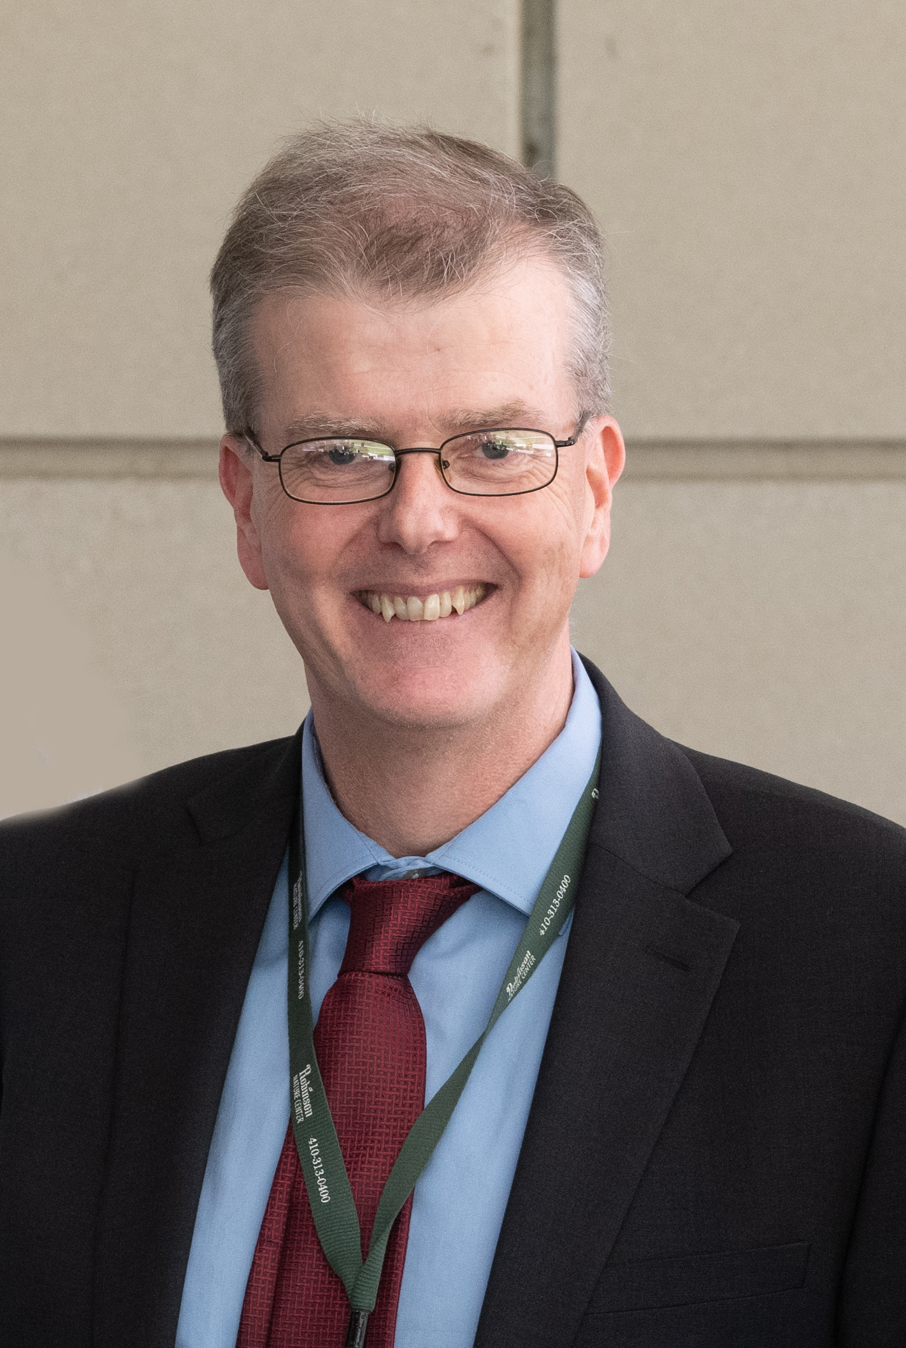
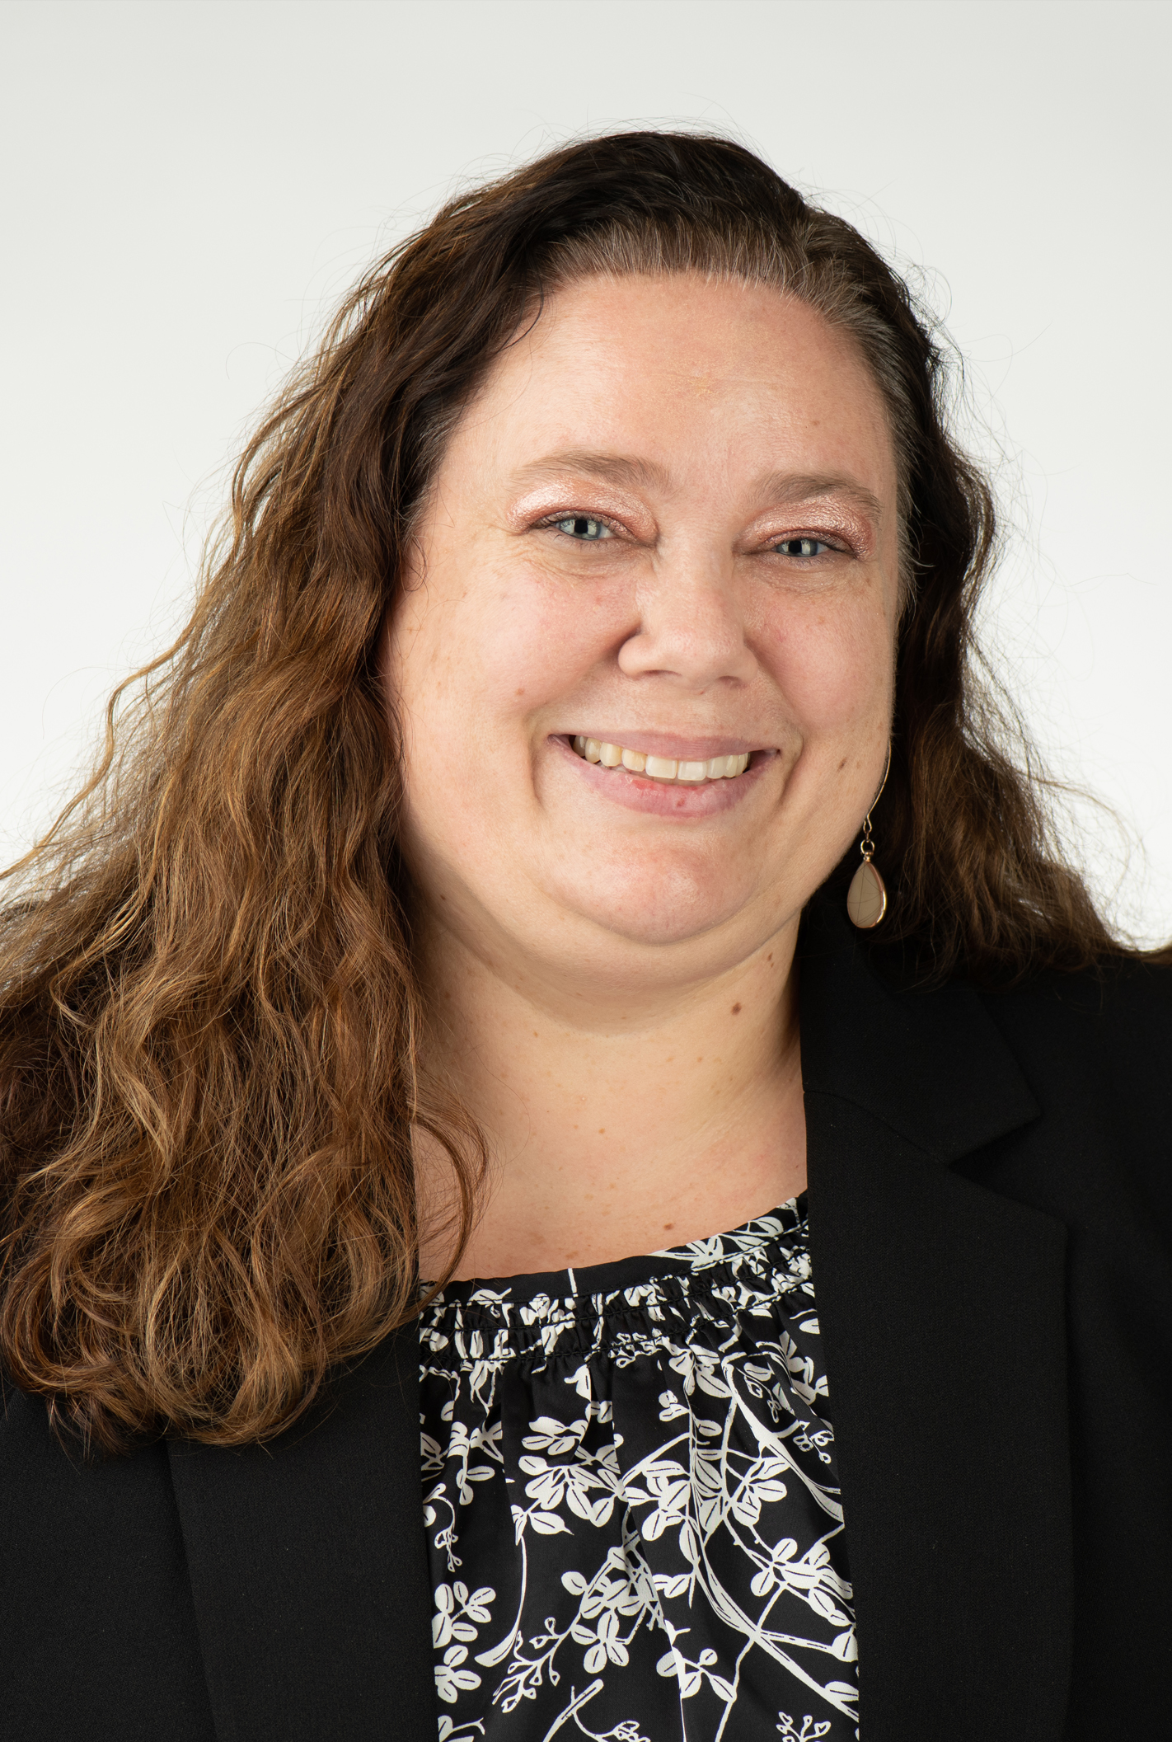
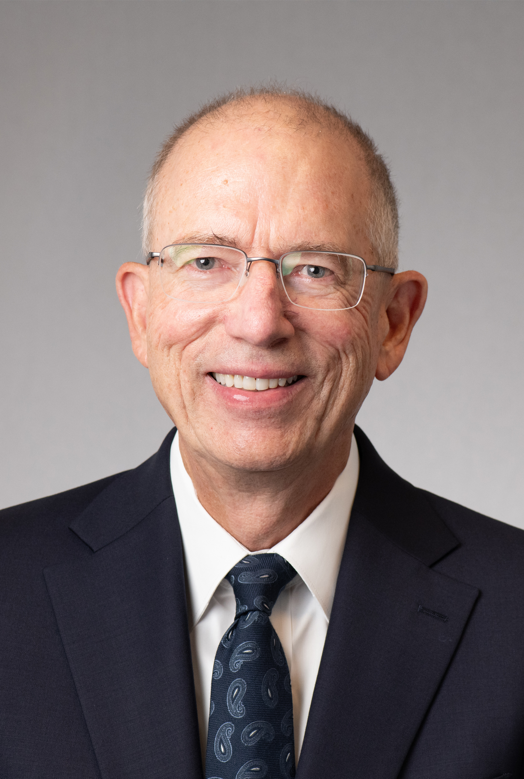
Standard VI – Planning, Resources, and Institutional Improvement
  Kevin Donegan, MBA, FCCA
  Jill Frankenfield, MSL, MS
  Peter Murray, PhD, CAS, MS
  Logistics Committee Liaison: Tricia O’Neill

Slide 12
Standard VI – Planning, Resources,
and Institutional Improvement
The institution’s planning processes, resources, and structures are aligned with each other and are sufficient to fulfill its mission and goals, to continuously assess and improve its programs and services, and to respond effectively to opportunities and challenges.
Notes:
From : https://www.msche.org/standards/thirteenth-edition/#standard1 and
https://www.umaryland.edu/middlestates/design/organizational-structure-of-groups-and-committees-/

Slide 13
Standard VI – Planning, Resources,
and Institutional Improvement
To what extent do UMB policies and procedures for planning, budgeting resources, and institutional improvement support institutional priorities?
a. How are resources allocated in alignment with our mission, goals, and strategic institutional priorities?
b. How does planning and resource allocation reflect the goals and long-range plans at the school/unit level?
c. What data is used to guide the planning process? To what extent do all constituencies participate in the planning, resource allocation, and improvement process?
Notes:
From : https://www.msche.org/standards/thirteenth-edition/#standard1 and
https://www.umaryland.edu/middlestates/design/organizational-structure-of-groups-and-committees-/

Slide 14
Standard VI – Planning, Resources,
and Institutional Improvement (continued)
To what extent is UMB measuring and assessing the effectiveness of planning, resource allocation, and budgeting processes to ensure efficient utilization and financial sustainability?
a. How does the allocation process ensure that there is sufficient human, fiscal, and infrastructure resources to support our mission and goals?
b. How does UMB measure and ensure its strategic goals are implemented at all levels across the campus?
c. How are the planning and decision-making processes communicated across campus? Are planning and improvement processes clearly documented and communicated?
Notes:
From : https://www.msche.org/standards/thirteenth-edition/#standard1 and
https://www.umaryland.edu/middlestates/design/organizational-structure-of-groups-and-committees-/

Slide 15
Standard VI – Planning, Resources,
and Institutional Improvement (continued)
How does UMB assess the performance and effectiveness of the administrative programs, services, and offices that support the operational and academic functions of the institution?
a. What process is used to periodically assess our planning, resource allocation, and institutional renewal processes?
b. How do we use a systematic approach to improve efficiency, contain costs, and develop revenue streams to support our mission and goals?
c. After reviewing the above questions, how can UMB improve in any of these areas?
Notes:
From : https://www.msche.org/standards/thirteenth-edition/#standard1 and
https://www.umaryland.edu/middlestates/design/organizational-structure-of-groups-and-committees-/

Slide 16
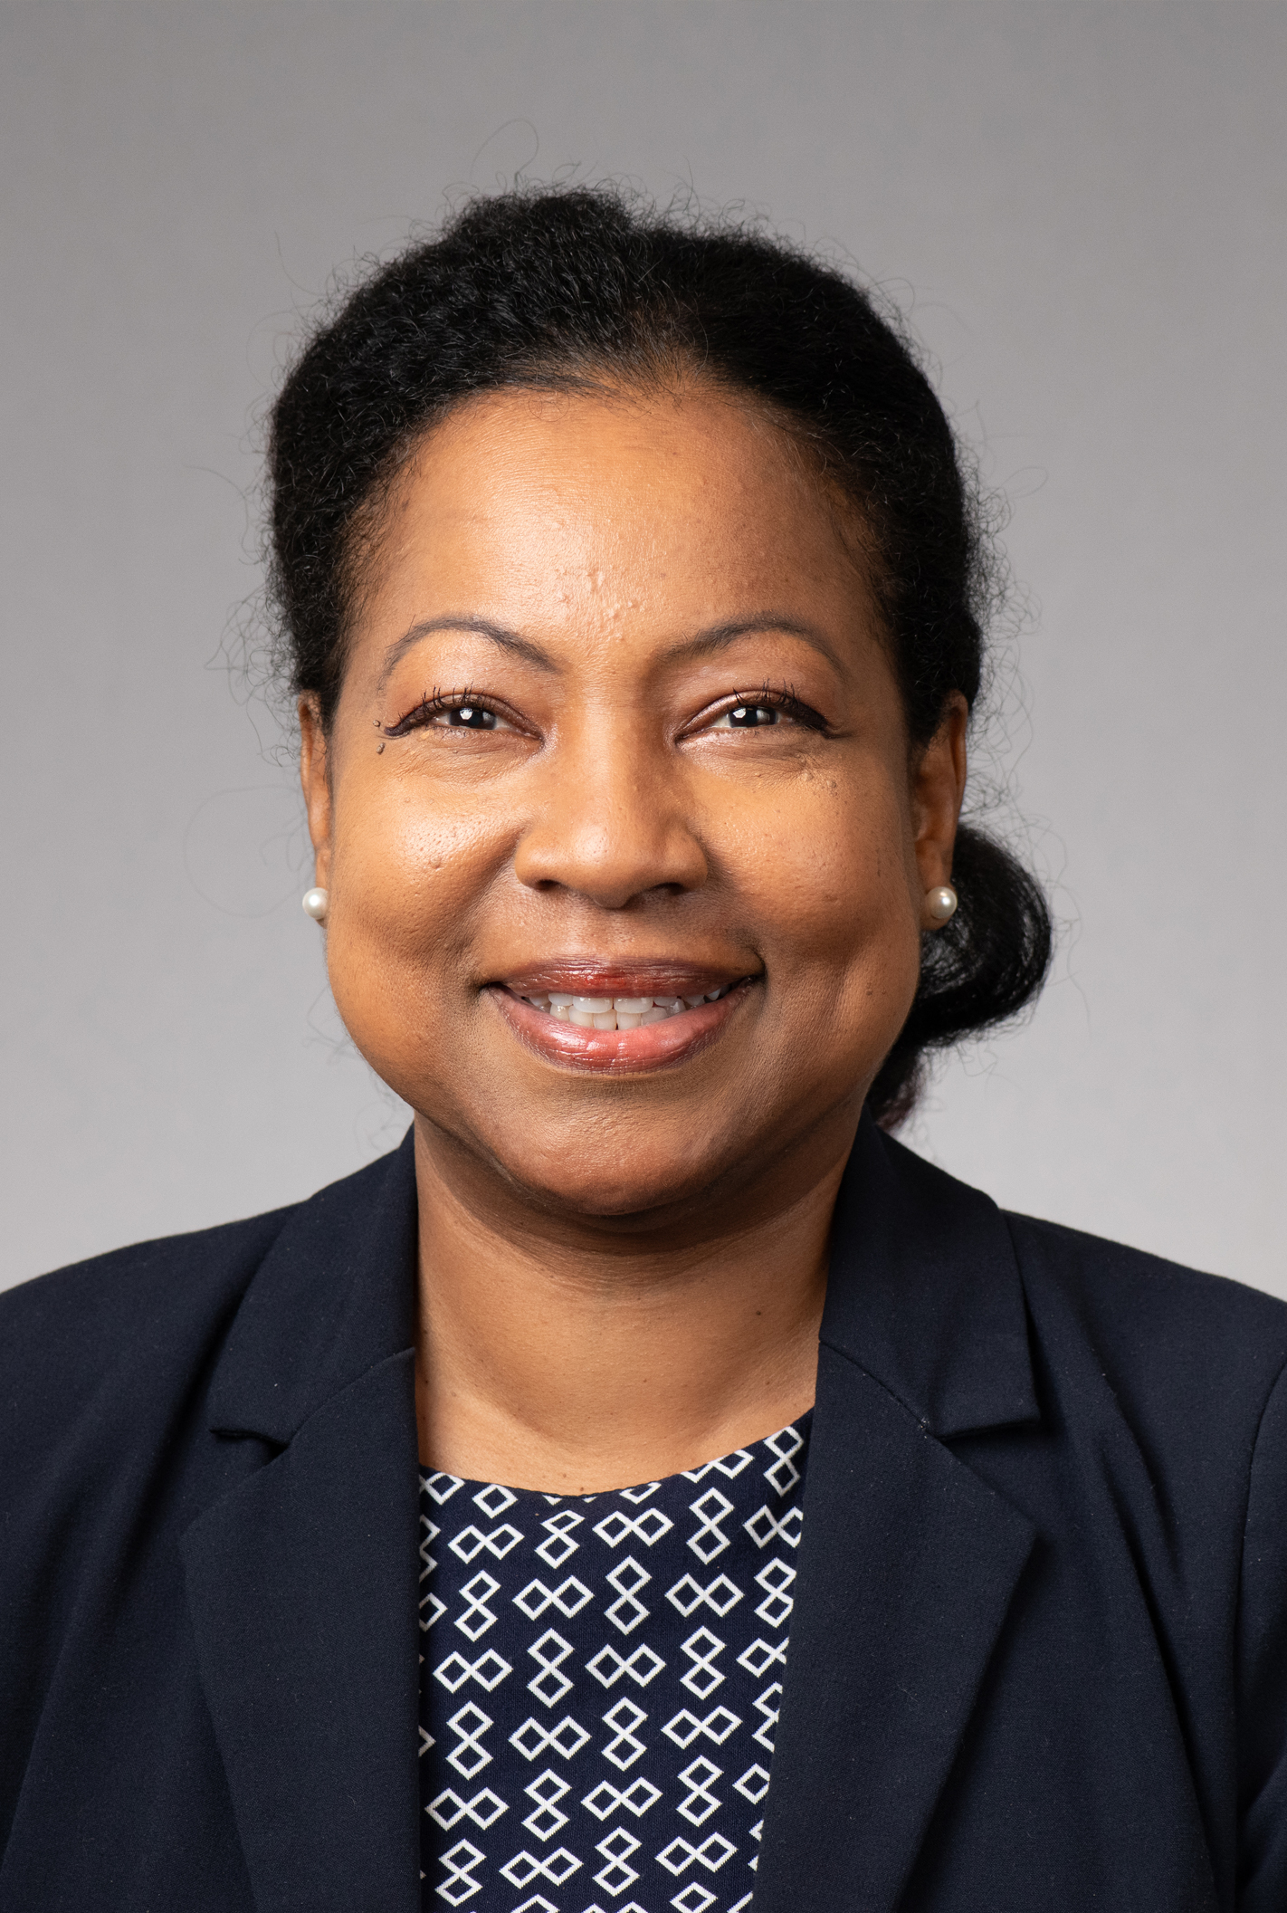
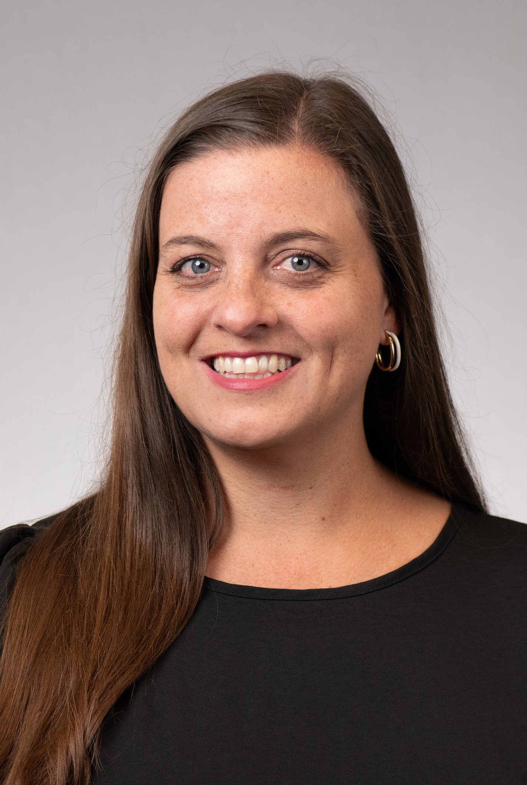
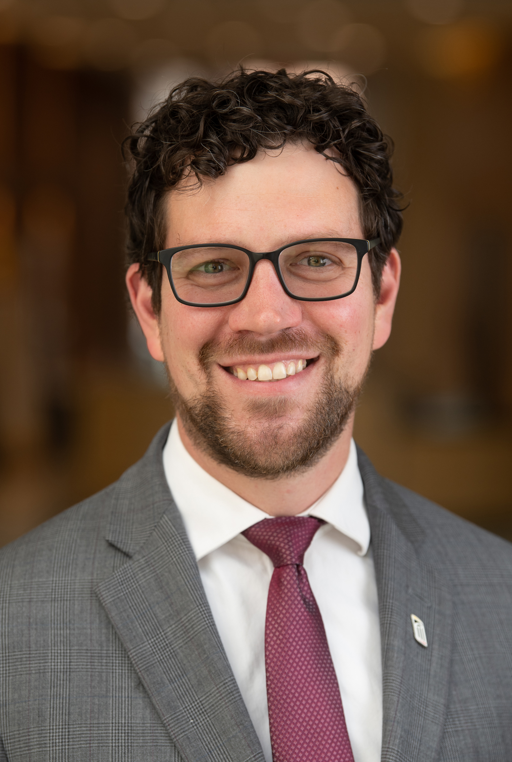
Standard VII – Governance, Leadership,
and Administration
  Diane Forbes Berthoud, PhD, MA
  Monica Maggiano
  Jon Kucskar, JD
  Logistics Committee Liaison: Michael Brown

Slide 17
Standard VII – Governance, Leadership,
and Administration
  The institution is governed and administered in a manner that allows it to realize its stated mission and goals in a way that effectively benefits the institution, its students, and the other constituencies it serves. Even when supported by or affiliated with governmental, corporate, religious, educational system, or other unaccredited organizations, the institution has education as its primary purpose, and it operates as an academic institution with appropriate autonomy.

Slide 18
Standard VII – Governance, Leadership,
and Administration
How do we show that there's a well-defined system of shared governance with written rules that explain what different people involved are responsible for?? How are these policies shared with the campus community? What evidence exists that the written policies are adhered to?
What structures are in place to avoid conflicts of interest and to make sure that the board and its relevant communities play an appropriate role in the oversight of the institution’s policies and financial affairs? What processes are in place to identify any need for changes to the structure and membership?
What policies and procedures are there to ensure that the top
executive and other leaders have the right qualifications,
experience, resources, and support?
Notes:
Ethical conduct across the mission areas
Does the UMB infrastructure – polices, procedures, etc. - promote ethical behavior across the University?

Slide 19
Standard VII – Governance, Leadership,
and Administration (continued)
4. How do we show a clear organizational structure that explains who reports to whom and who makes decisions in different areas?
5. Do we regularly assess how effective our governance, leadership, and administration are?
6. To what extent does UMB’s administration possess skills, time, assistance, technology, and expertise required to perform their duties? How does UMB use systematic procedures for evaluating administrative units and for using assessment data to enhance operations?
7. What is the role of the UMB Foundation?
Notes:
Ethical conduct across the mission areas
Does the UMB infrastructure – polices, procedures, etc. - promote ethical behavior across the University?

Slide 20
Nov. 1, 2023, Town Hall: Standards VI and VII
Small Group Discussions
1. Questions to be answered
2. Potential evidence
3. Potential recommendations and opportunities
Notes:
Logistics
Group identifies a notetaker and presenter
Report out to the Standard group and opportunity to share key takeaways, comments with the larger group
Ask co-chairs to capture notes and write them up post-town hall with the logistics liaison

Slide 21
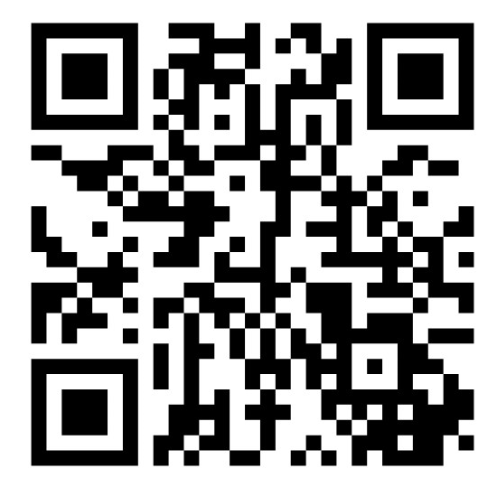
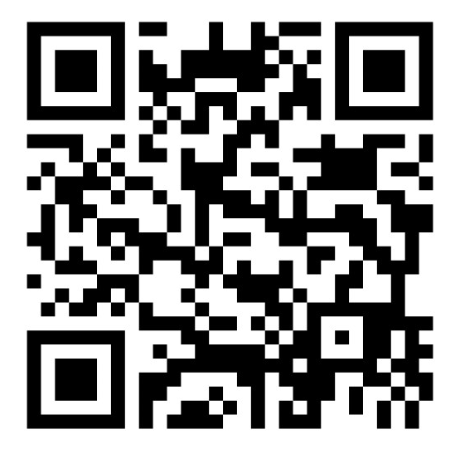
Input and Considerations from Your Groups
Nov. 1, 2023, Town Hall: Standards VI and VII
Standard VI
Standard VII
Code: 44819727
Code: 16489602
Notes:
Logistics
Group identifies a notetaker and presenter
Report out to the Standard group and opportunity to share key takeaways, comments with the larger group
Ask co-chairs to capture notes and write them up post-town hall with the logistics liaison

Slide 22
Nov. 1, 2023, Town Hall: VI and VII
Upcoming Town Halls – Join the Conversation
DESIGN AND DELIVERY OF THE STUDENT LEARNING EXPERIENCE / SUPPORT OF THE STUDENT EXPERIENCE
Nov. 8, 2023
Noon | SMC Campus Center | Elm Ballroom
EDUCATIONAL EFFECTIVENESS ASSESSMENT
Nov. 13, 2023
2:30 p.m. | SMC Campus Center | Elm Ballroom
ADDRESSING ALL SEVEN STANDARDS
Nov. 16, 2023
11 a.m. | Virtual via Zoom
umaryland.edu/middlestates/register/
Notes:
Dr. Ward and Dr. Reynolds
Brief reflection on what they heard from the discussions; key takeaways, etc.
The self-study enables UMB to look at ourselves; identify ways to self-assess and improve
This is an organic process for UMB
Community discussions will serve as the launching point for our next strategic plan
Invite groups to briefly share a takeaway, comment, question, etc.
Next steps
Upcoming town halls and how to register AND QR code to provide feedback on Town Hall (CLICK TO PROGRESS SLIDE)
One (1) suggestion, idea, question that came up for you.
What improvement(s) should be made to the Middle States Accreditation Town Halls?
Thank you!

Slide 23
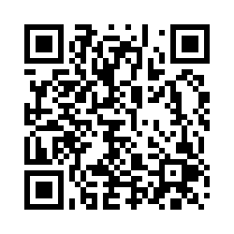
Nov. 1, 2023, Town Hall: Standards VI and VII
Scan the QR code to provide feedback about today’s meeting.

