Slide 1
October 3, 2023
Town Hall - Standards I and II

Slide 2
October 3, 2023 Town Hall - Standards I and II
Call to Conversation
Bruce E. Jarrell, MD, FACS
President
Roger J. Ward, EdD, JD, MSL, MPH, Provost and Executive Vice President
Mark A. Reynolds, DDS, PhD, MA, Dean, School of Dentistry
Co-Chairs, Middle States Steering Committee
Gregory C. Spengler, MPA
Associate Vice President for Institutional Effectiveness
Middle States Accreditation Liaison Officer

Slide 3
October 3, 2023 Town Hall - Standards I and II
UMB Has a Very Active Cycle and Culture of Accreditation
Each professional school has an independent accreditor.
The timeline for renewal of accreditation is unique for each school. For example, the School of Nursing’s accreditation cycle is 10 years, while the School of Medicine’s cycle is 8 years.
In some schools, separate accreditors govern at the program level. For example, the Nurse Anesthesia Program is part of the Graduate School and is accredited by a specialized accreditor different from that of the School of Nursing.
Notes:
^ SON is generally ten years; SOM is generally eight years.
*Example – Council on Accreditation of Nurse Anesthesia Educational Programs (COA) does the accrediting for the GRADUATE school Nurse Anesthesia Program housed in the Nursing School. The Nursing School is accredited by the Commission on Collegiate Nursing Education.(CCNE).

Slide 4
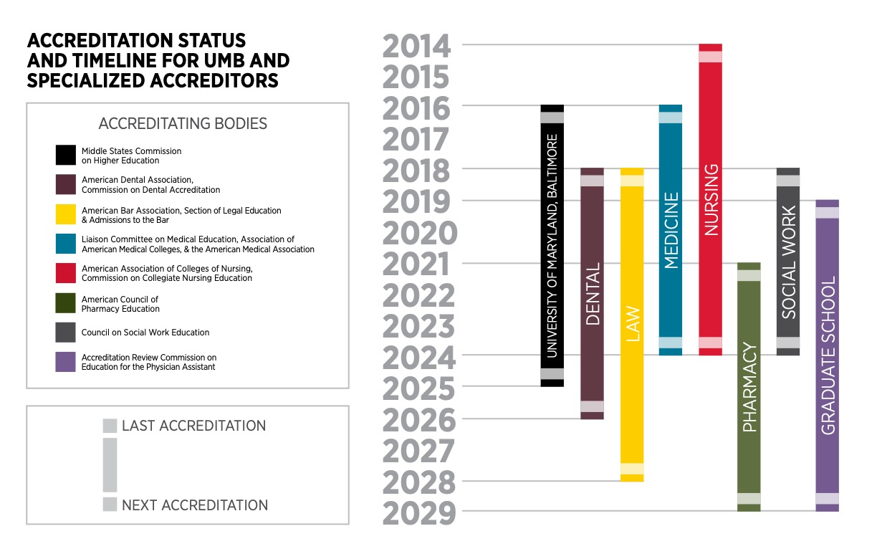
October 3, 2023 Town Hall - Standards I and II

Slide 5
October 3, 2023 Town Hall - Standards I and II
UMB Is Accredited as an ‘Aggregate’ by MSCHE
MSCHE stands for the Middle States Commission on Higher Education.
MSCHE is recognized by the U.S. Department of Education as an institutional accreditor and has accredited over 600 institutions.
Institutional accreditors do not accredit individual programs, units, or locations, they accredit institutions in their entirety. That’s why schools and programs have their own separate system of accreditation.
Notes:
*Originally, there were “REGIONAL” accreditors and “NATIONAL” accreditors. As a regional, MSCHE covered only a specific geographic portion of the US; a handful of contiguous states (MD, DE, NY, NY, PA); plus DC, Puerto Rico and the US Virgin Islands.
In 2020, the Department of Education eliminated both titles and the combined accreditors are called institutional accreditors. MSCHE’s footprint now extends to 48 states (the exceptions being North Dakota and Montana); two U.S. Territories (Puerto Rico and the U.S. Virgin Islands); and the District of Columbia. Its footprint extends to 94 countries.

Slide 6
October 3, 2023 Town Hall - Standards I and II
Why Does Middle States Matter?
Institutional accreditors provide a so-called “seal of approval” that is a prerequisite to receipt of federal financial aid funds!
MSCHE mandates that its member institutions meet rigorous and comprehensive standards, which are addressed in the context of the mission of each institution and within the culture of ethical practices and institutional integrity.
An institution seeking accreditation demonstrates that its goals are achieved through self-regulation and peer review.
If UMB were to lose its accreditation, EVERY school and program would be at risk.
Notes:
Select the Self-Study design most appropriate for UMB. The themes in the design should align with our core values and the priorities in our Strategic Plan. This task should be completed no later than April 25, 2023.
Design an inclusive and transparent self-study process that actively and deliberately seeks to engage members of the University community from every corner of campus.
Produce a Self-Study report that demonstrates our compliance with the Middle States Commission on Higher Education accreditation standards and provides forward-looking recommendations to move the institution further along its quest for excellence in graduate and professional education, research, clinical activities, and service for the public good.

Slide 7
October 3, 2023 Town Hall - Standards I and II
Middle States Standards and Requirements
Accredited institutions are expected to demonstrate compliance with MSCHE’s seven standards (and related requirements), to conduct their activities in a manner consistent with the standards and requirements, and to engage in ongoing processes of self-review and improvement.
Standard I – Mission and Goals
Standard II – Ethics and Integrity
Standard III – Design and Delivery of the Student Learning Experience
Standard IV – Support of the Student Experience
Standard V – Educational Effectiveness Assessment
Standard VI – Planning, Resources, and Institutional Improvement
Standard VII – Governance, Leadership, and Administration

Slide 8
October 3, 2023 Town Hall - Standards I and II
UMB’s Accreditation Components and History
The accreditation process has two main parts:
  The creation and submission of a Self-Study report to MSCHE.
  A multi-day site visit and review in spring 2025 by a team composed of peer evaluators from other accredited institutions organized by MSCHE.
UMB’s MSCHE accreditation was reaffirmed in June 2016.
UMB’s accreditation status will be acted on again by MSCHE in 2025.

Slide 9
October 3, 2023 Town Hall - Standards I and II
Intended Outcomes of the Self-Study
To engage in an inclusive and transparent self-appraisal process.
To produce a Self-Study report that demonstrates compliance with the seven standards and related requirements.
To develop forward-looking recommendations to inform UMB’s next Strategic Plan to move the institution further along its quest for excellence in graduate and professional education, research, clinical activities, and service for the public.
Notes:
Self Study Approach
The Standards Based self-study design was chosen as the one in which the University could focus most intensely on its strategic priorities. UMB has a robust culture of planning and accreditation. Part of the reason for our unique culture is that each of UMB’s professional schools is accredited by their own unique accrediting organizations and as such UMB is continually examining its practices and making improvements. UMB is fortunate that the Middle States Self-Study affords the University yet another opportunity to integrate existing planning and accrediting processes.

Slide 10
October 3, 2023 Town Hall - Standards I and II
Self-Study Structure - Steering Committee
Broad representation (24 staff, faculty, students) from across the University.
Seven working groups, each with three co-chairs charged with producing a draft chapter for each standard:
  Showing evidence of compliance with their assigned standard and the related requirements
  Showing areas of possible noncompliance
  Identifying opportunities for improvement
Notes:
Self Study Approach
The Standards Based self-study design was chosen as the one in which the University could focus most intensely on its strategic priorities. UMB has a robust culture of planning and accreditation. Part of the reason for our unique culture is that each of UMB’s professional schools is accredited by their own unique accrediting organizations and as such UMB is continually examining its practices and making improvements. UMB is fortunate that the Middle States Self-Study affords the University yet another opportunity to integrate existing planning and accrediting processes.

Slide 11
October 3, 2023 Town Hall - Standards I and II
Self-Study Structure - Logistics Committee
Ten core staff supporting the co-chairs and Steering Committee.
  Prepares agendas for Steering Committee meetings
  Organizes town halls
  Serves as a liaison in support of assigned working group
  Plans the arrangements for the visiting team of peer evaluators
Notes:
Self Study Approach
The Standards Based self-study design was chosen as the one in which the University could focus most intensely on its strategic priorities. UMB has a robust culture of planning and accreditation. Part of the reason for our unique culture is that each of UMB’s professional schools is accredited by their own unique accrediting organizations and as such UMB is continually examining its practices and making improvements. UMB is fortunate that the Middle States Self-Study affords the University yet another opportunity to integrate existing planning and accrediting processes.

Slide 12
October 3, 2023 Town Hall - Standards I and II
What Is Today’s Objective?
  Divide into small groups to assist the Working Groups in their assessment of UMB’s satisfaction of the relevant standard and related requirements.
  This town hall is an important part of UMB’s self-review process. Thank you for taking the time to be engaged!
Notes:
Drs. Ward, Reynolds, and Greg Spengler to introduce Co-chairs

Slide 13

UMB and Middle States Check-In
Notes:
Logistics liaison to lead activity
What does MSCHE stand for?
Middle States Commission on Higher Education
When was UMB last accredited?
2016
2. Who accredits the Graduate School?
Accreditation Review Commission on Education for the Physician Assistant, Inc. (ARC-PA)
3. What is the period of time between accreditation cycles?
Ten years
4. Name the accreditors for two of our schools
5. University of Maryland, Baltimore was founded in what year?
1807, 1906,1709, 1608
6. How many graduate and professional schools operate at the UMB?
7
7. In what Baltimore neighborhood was the famous baseball player Babe Ruth born?
Ridgley’s delight, Pigtown, Federal Hill, Fells Point
8. Which of the following birds are mascots for a Baltimore sports teams?
Eagle, Oriole, Penguin, Swan
9. What crustacean is popular to eat in Baltimore?
Shrimps, Lobsters, Crayfish, Crabs

Slide 14
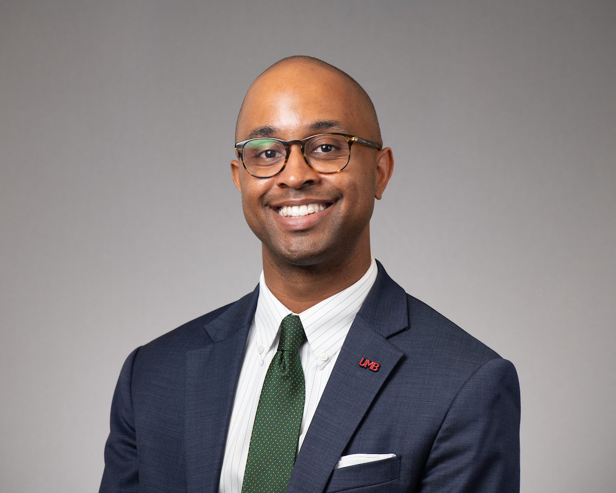
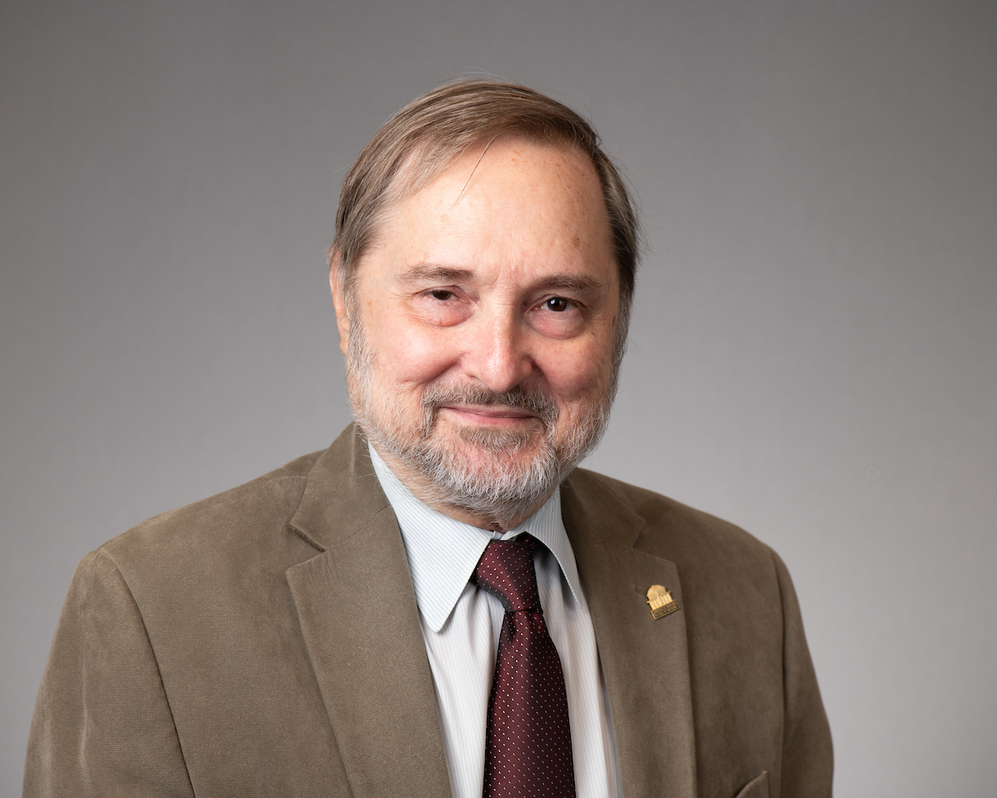
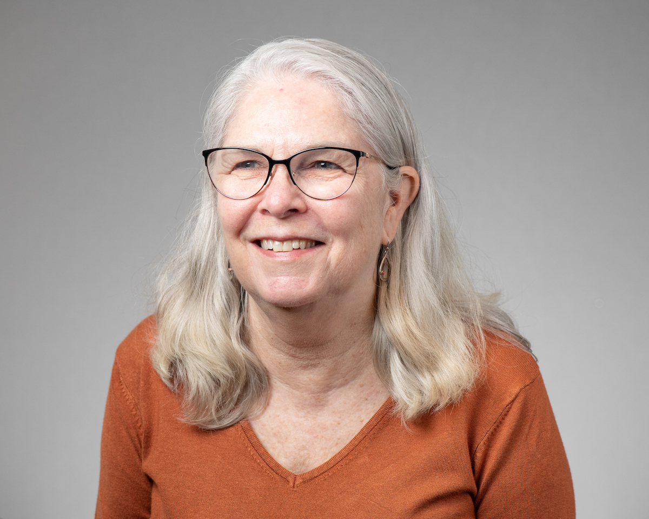
October 3, 2023 Town Hall - Standards I and II
Standard I – Mission and Goals
  Bill Joyner, JD, MSW
  James B. Kaper, PhD
  Alexa A. Mayo, MLS, AHIP
  Logistics Committee Liaison: Victoria Meadows, MS

Slide 15
October 3, 2023 Town Hall - Standards I and II
Standard I – Mission and Goals
UMB’s Mission Statement: To improve the human condition and serve the public good of Maryland and society at-large through education, research, clinical care, and service.
Standard 1 focuses on the appropriateness, effectiveness, and alignment of the mission and goals of UMB and its constituent organizations such as schools and administrative units.
This standard also focuses on how well the institutional mission and goals are integrated into organizational processes and activities such as budgeting and teaching.
Notes:
From : https://www.msche.org/standards/thirteenth-edition/#standard1 and
https://www.umaryland.edu/middlestates/design/organizational-structure-of-groups-and-committees-/

Slide 16
October 3, 2023 Town Hall - Standards I and II
Standard I – Mission and Goals
How does UMB’s mission statement shape its current strategic plan?
To what extent should UMB’s mission statement be reviewed and revised to reflect post-pandemic shifts, especially as they relate to:
  a. How we teach our students
  b. How we conduct research; and
  c. How we strengthen equity, diversity, and inclusion
What can UMB do to demonstrate the economic and social impact of its community engagement initiatives in Baltimore?
Notes:
From : https://www.msche.org/standards/thirteenth-edition/#standard1 and
https://www.umaryland.edu/middlestates/design/organizational-structure-of-groups-and-committees-/

Slide 17
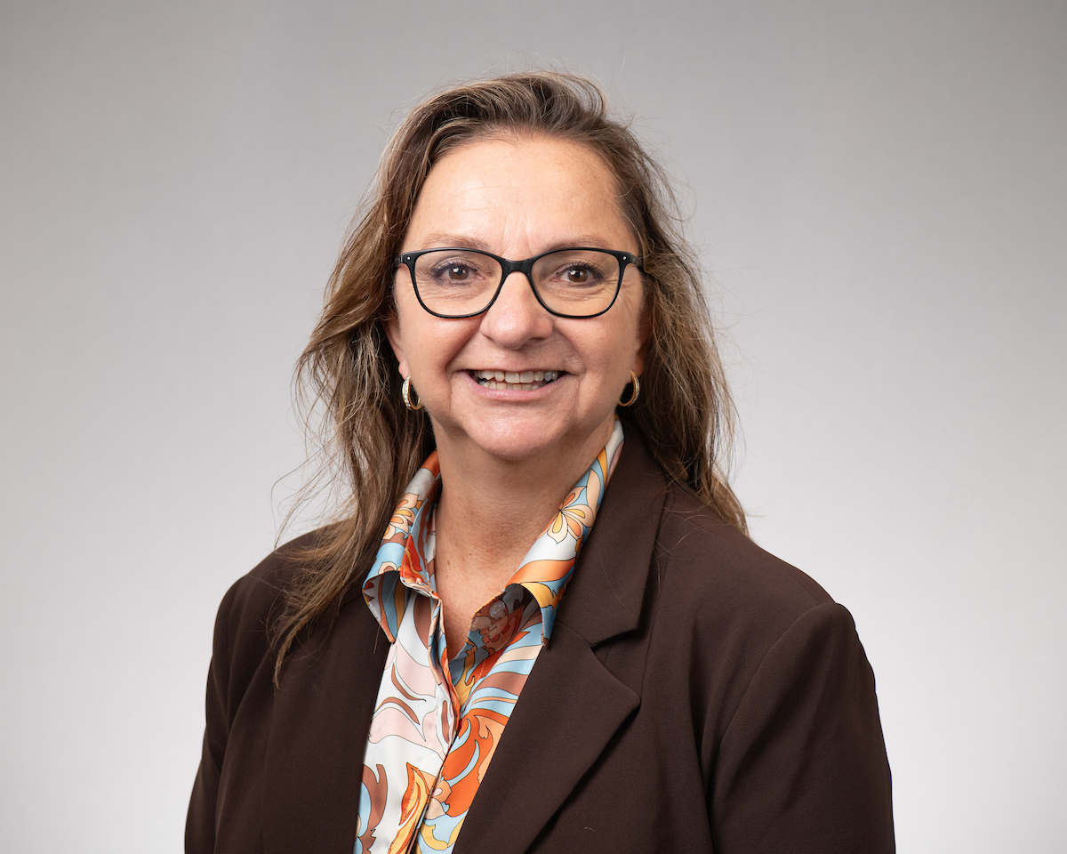
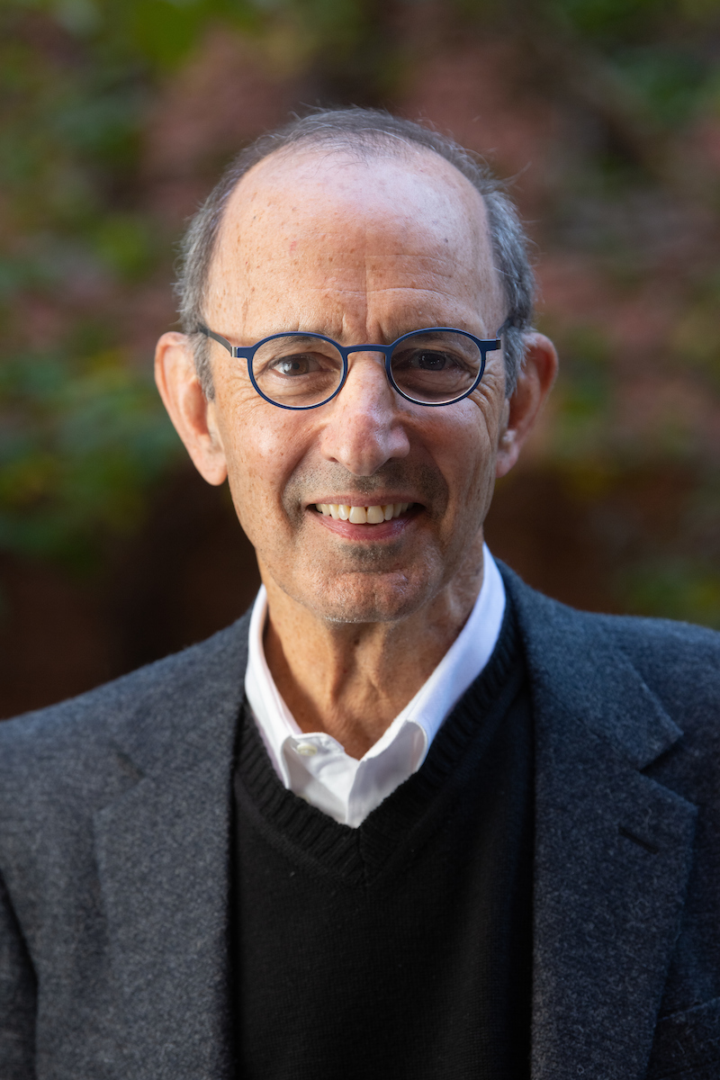
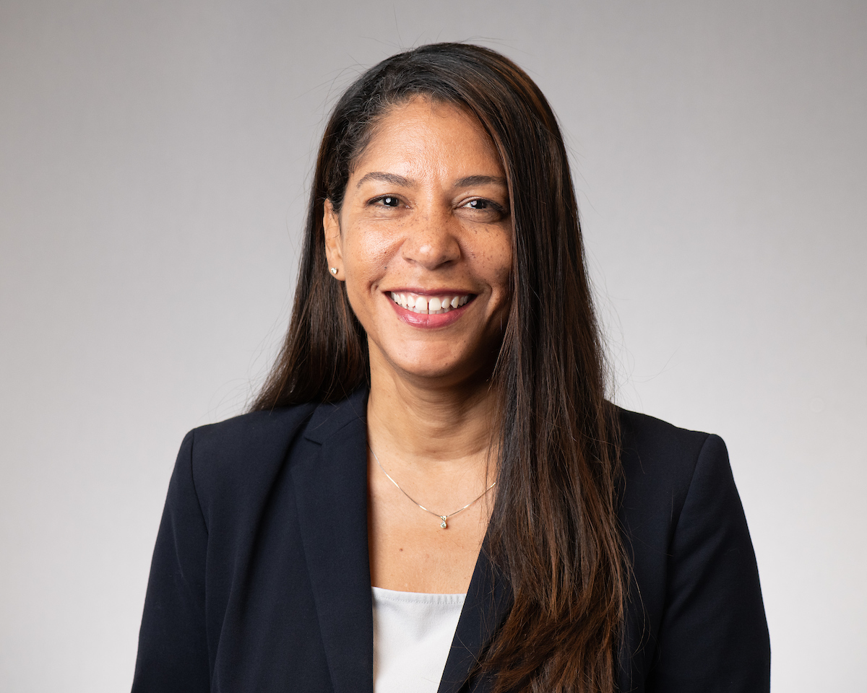
October 3, 2023 Town Hall - Standards I and II
Standard II – Ethics and Integrity
  Susan Buskirk, DM, MS
  Geoffrey Greif,
  PhD, MSW,
  LCSW-C
  Vanessa Harrington, MS, SHRM-CP
  Logistics Committee Liaison: Courtney Resnick, EdD, MA

Slide 18
October 3, 2023 Town Hall - Standards I and II
Standard II – Ethics and Integrity
  Ethics and integrity are central, indispensable, and defining hallmarks of effective higher education institutions. In all activities, whether internal or external, an institution must be faithful to its mission, honor its contracts and commitments, adhere to its policies, and represent itself truthfully.

Slide 19
October 3, 2023 Town Hall - Standards I and II
Standard II – Ethics and Integrity
Where are UMB’s policies relating to ethical expectations?
What UMB programs promote ethical conduct?
How do we know that our policies/procedures are working?
What does it look like. What does it feel like?
Are these policies applied equitably across groups?
How can UMB’s ethical practices and reporting mechanisms
be improved?
Why is it important for members of the UMB community to
act ethically?
Notes:
Ethical conduct across the mission areas
Does the UMB infrastructure – polices, procedures, etc. - promote ethical behavior across the University?

Slide 20
October 3, 2023 Town Hall - Standards I and II
Small Group Discussions
1. Questions to be answered
2. Potential evidence
3. Potential recommendations and opportunities
Notes:
Logistics
Group identifies a notetaker and presenter
Report out to the Standard group and opportunity to share key takeaways, comments with the larger group
Ask co-chairs to capture notes and write them up post-town hall with the logistics liaison

Slide 21
Input and Considerations from Your Groups
October 3, 2023 Town Hall - Standards I and II
Notes:
Logistics
Group identifies a notetaker and presenter
Report out to the Standard group and opportunity to share key takeaways, comments with the larger group
Ask co-chairs to capture notes and write them up post-town hall with the logistics liaison

Slide 22
Upcoming Town Halls – Join the Conversation
PLANNING, RESOURCES, AND INSTITUTIONAL IMPROVEMENT / GOVERNANCE, LEADERSHIP, AND ADMINISTRATION
Nov. 1, 2023
1 p.m. | SMC Campus Center | Elm Ballroom
DESIGN AND DELIVERY OF THE STUDENT LEARNING EXPERIENCE / SUPPORT OF THE STUDENT EXPERIENCE
Nov. 8, 2023
Noon | SMC Campus Center | Elm Ballroom
EDUCATIONAL EFFECTIVENESS ASSESSMENT
Nov. 13, 2023
2:30 p.m. | SMC Campus Center | Elm Ballroom
ADDRESSING ALL SEVEN STANDARDS
Nov. 16, 2023
11 a.m. | Virtual via Zoom
umaryland.edu/middlestates/register/
Notes:
Dr. Ward and Dr. Reynolds
Brief reflection on what they heard from the discussions; key takeaways, etc.
The self-study enables UMB to look at ourselves; identify ways to self-assess and improve
This is an organic process for UMB
Community discussions will serve as the launching point for our next strategic plan
Invite groups to briefly share a takeaway, comment, question, etc.
Next steps
Upcoming town halls and how to register AND QR code to provide feedback on Town Hall (CLICK TO PROGRESS SLIDE)
One (1) suggestion, idea, question that came up for you.
What improvement(s) should be made to the Middle States Accreditation Town Halls?
Thank you!

Slide 23
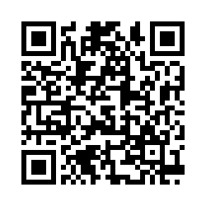
October 3, 2023 Town Hall - Standards I and II
Provide Feedback About Today’s Meeting

