Slide 1

Submitting Federal Common Forms Through SciENcv
How to Submit Biosketch and Current and Pending (Other) Support

Slide 2

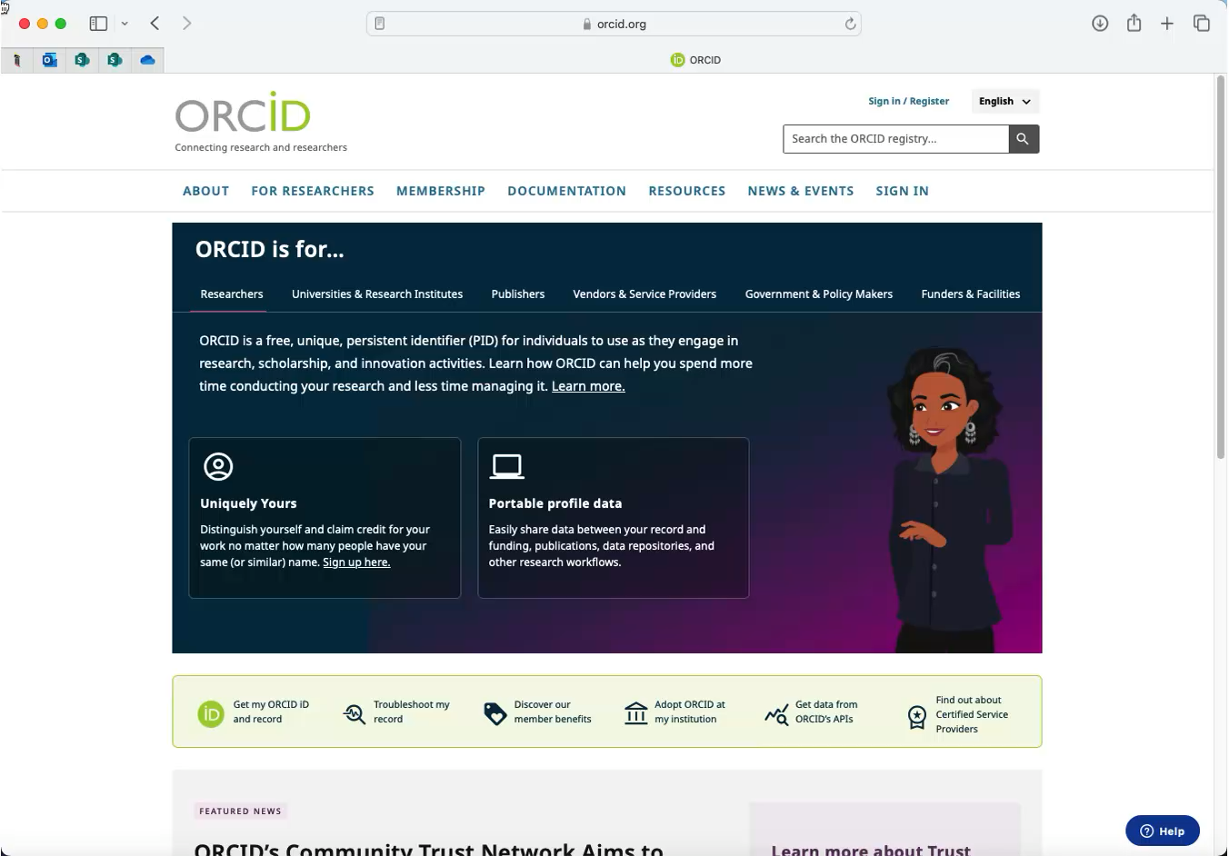
Demonstration – creating an ORCiD ID
You can create and submit documentation like Current and Pending (Other) Support or Biographical Sketches through SciENcv.
UMB recommends using an ORCiD ID to log in. If you do not have an ORCiD ID, you can create one. Watch the video on the right for a demonstration.
Link to ORCiD: https://ORCiD.org

Slide 3
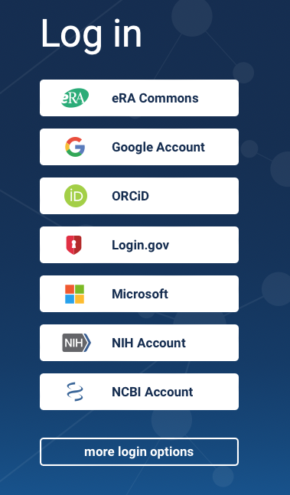
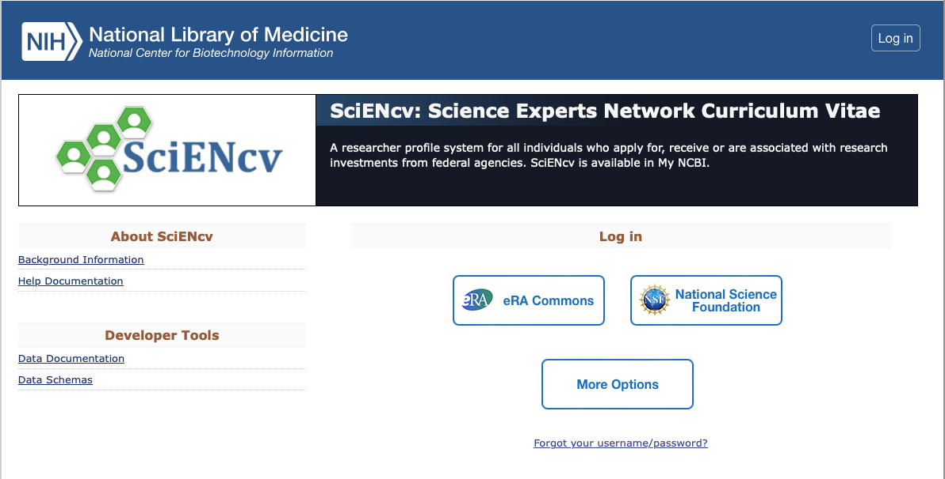
Logging into SciENcv
Once you have an ORCiD ID, navigate to SciENcv, click More Options, and then select ORCiD.
Link to SciENcv: https://www.ncbi.nlm.nih.gov/sciencv

Slide 4
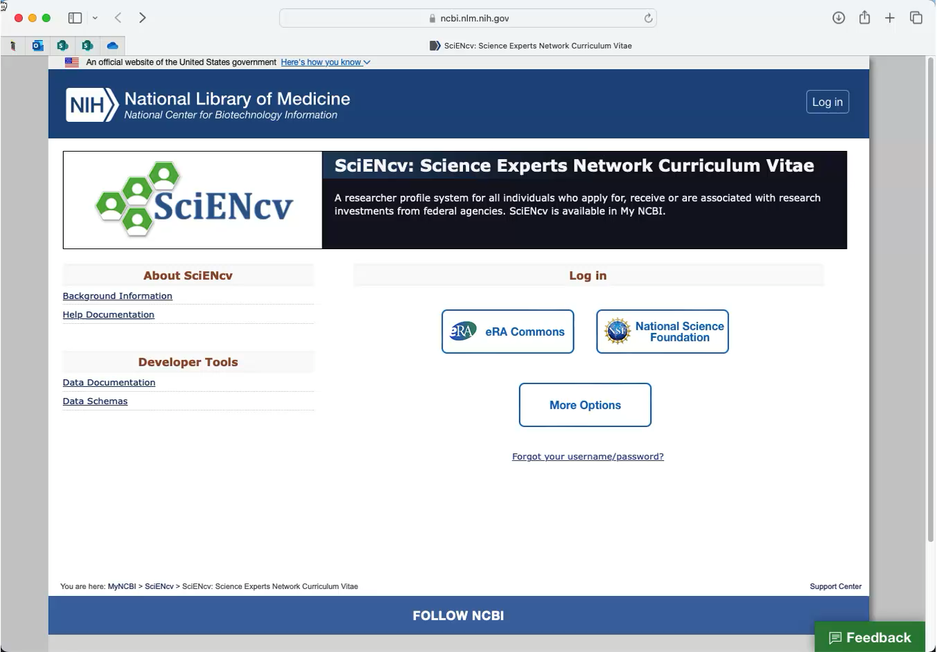
Demonstration – logging into SciENcv
Watch the video on the right for a demonstration on signing into SciENcv.
After you are signed in, please ensure your ORCiD ID appears in your SciENcv profile as shown at the end of the video.
Link to SciENcv: http://www.ncbi.nlm.nih.gov/sciencv

Slide 5
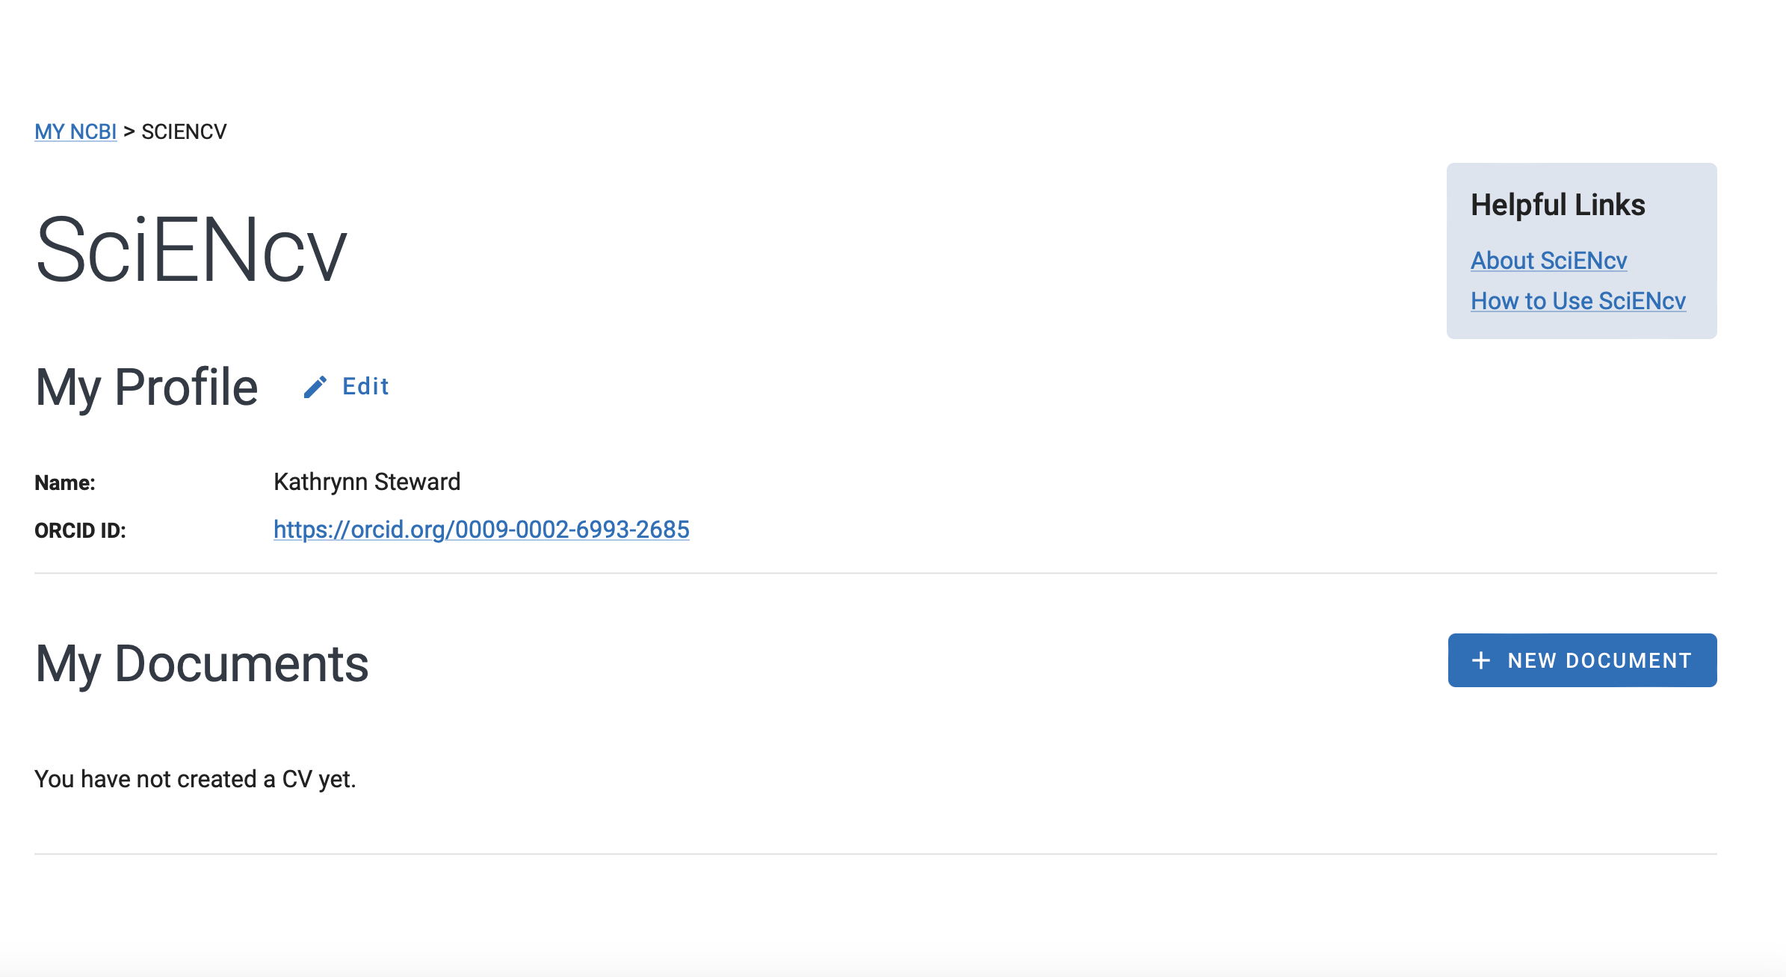
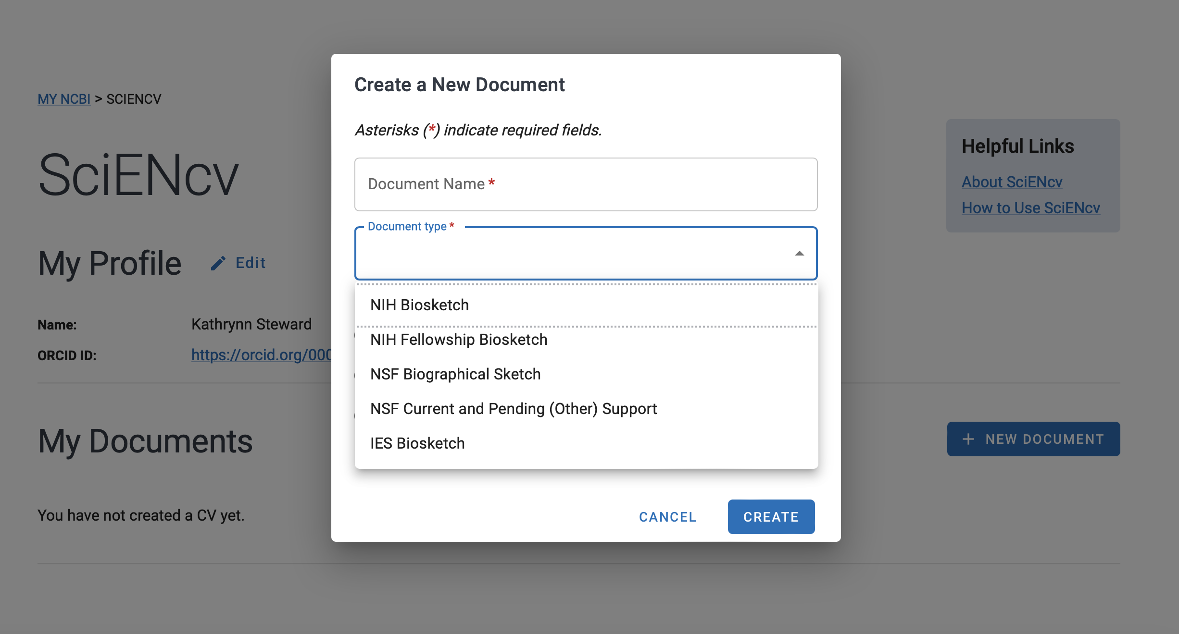
Generating and submitting documents
After signing into SciENcv, you can submit your documents.
Click New Document, name the document, and then select a Document type from the drop-down. You will be able to either upload an existing document or generate a blank one. Ensure you review the document for missing information, errors, and compliance prior to submitting.

Slide 6
Disclosure requirements
NSPM-33 states that “research funding agencies shall require the disclosure of information related to potential conflicts of interest and commitment from participants in the Federally funded R&D enterprise… The appropriate disclosure requirement varies depending on the individual’s role in the United States R&D enterprise.”
Since requirements vary, you must be sure you are disclosing everything needed. Link to guidance: https://nsf-gov-resources.nsf.gov/files/may2024-r.pdf
The tables in the linked document will help you determine:
  The types of activities to be reported
  Where such activities must be reported in the application
  When updates are required in the application and award lifecycle
  Activities that are not required to be reported
For more detailed information, see the implementation guide, linked here: https://bidenwhitehouse
.archives.gov/wp-content/uploads/2022/01/010422-NSPM-33-Implementation-Guidance.pdf

Slide 7
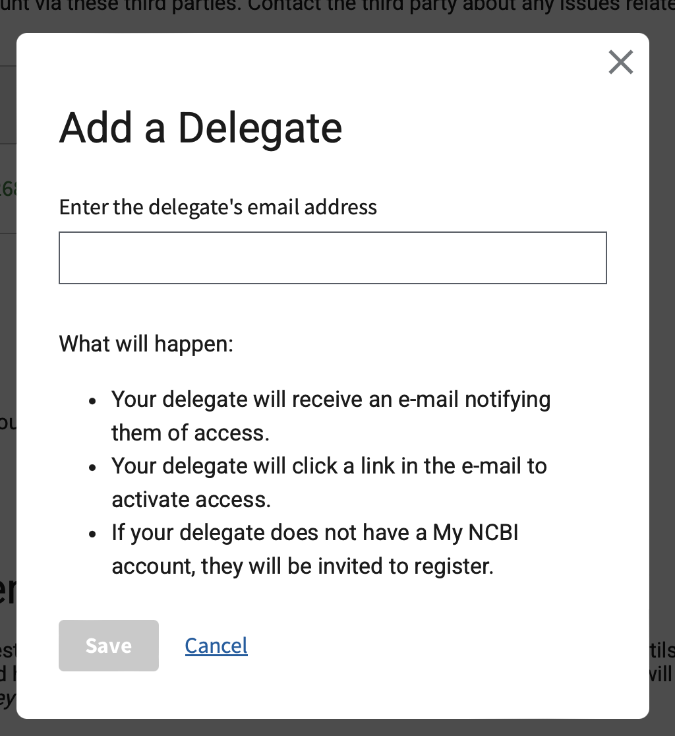

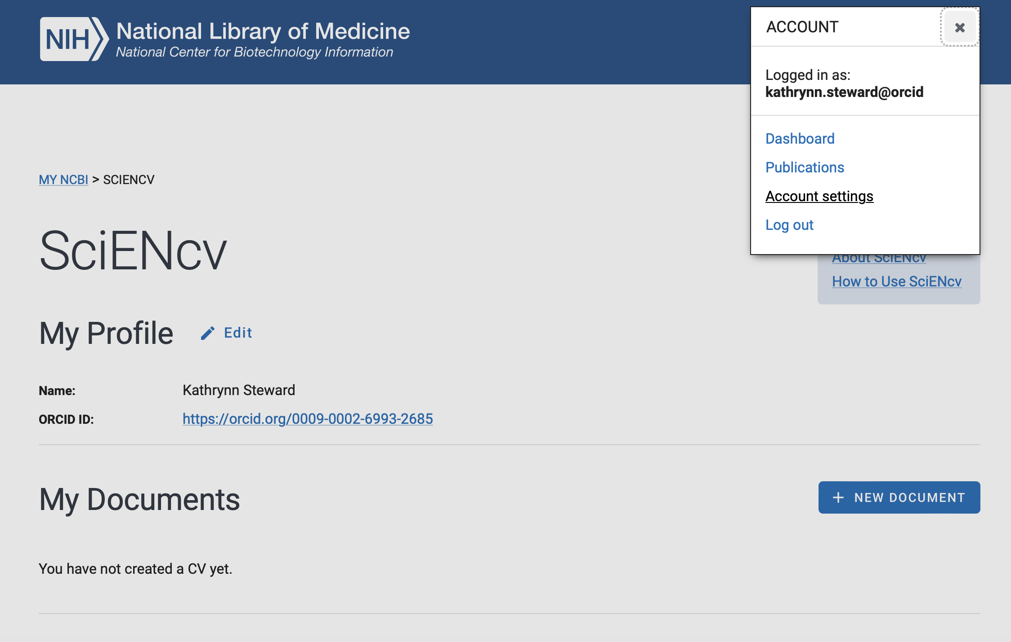


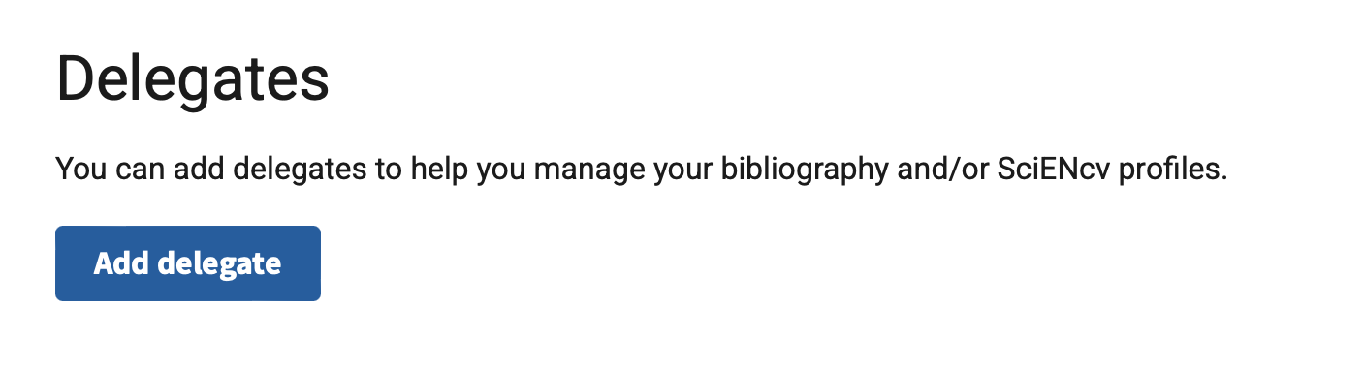

Delegating access to an administrator
The PI can delegate access to an administrator by following these steps after logging into SciENcv:
Click username in the upper right corner
Select Account settings
Scroll down to Delegates and click Add delegate
Enter the delegate’s email address

Slide 8
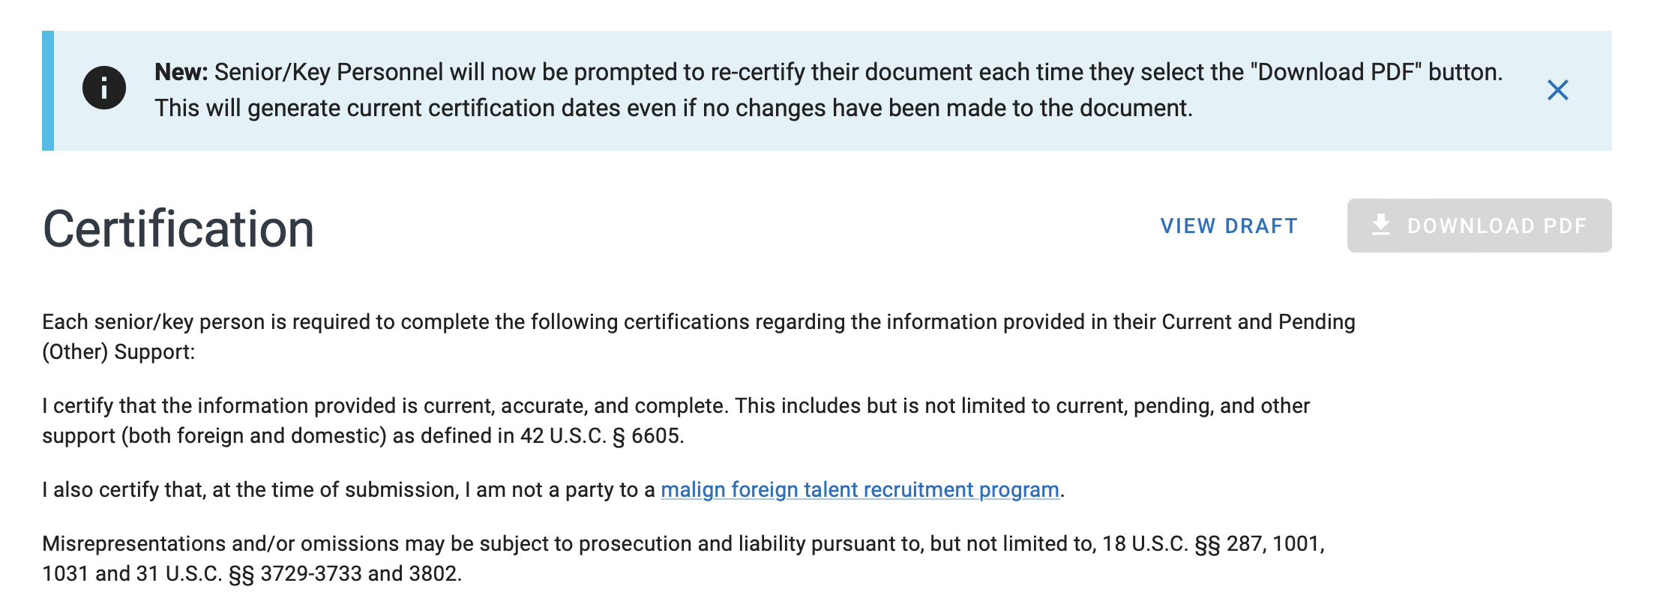
Certifying documents
Each senior/key person must certify documents before submission. They will also need to recertify each time they select the Download PDF button.

