Slide 1
Kuali Research and the Kuali Build apps:
a post-award guide to what to route where

Slide 2
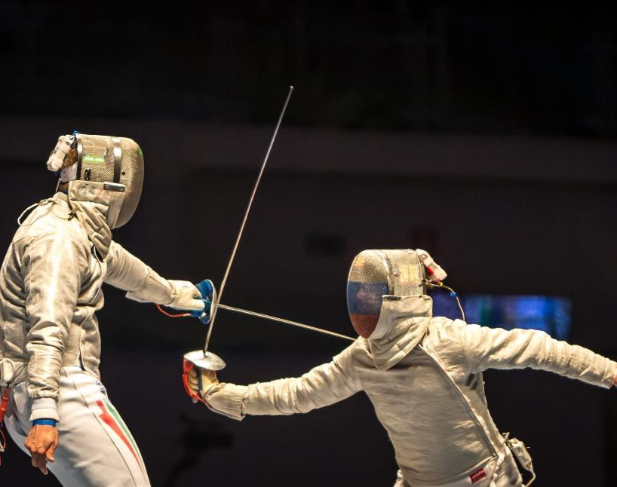
Or…
KR vs KB

Slide 3
Kuali Research
Use for:
New proposals
  Funded or unfunded
New $$: Any funds not included in the original proposal. EXAMPLES:
  Continuation year
  Supplement
  Additional funds awarded by sponsor
Change of PI
Change of department

Slide 4
Kuali Build
KR Award ID is required for KB forms (apps) in current use
Increase in $$ must be covered by a KR proposal
Use for:
Post-award changes to existing awards such as:
  Continuation funding
  No-cost extension requests
  Requests and modifications approved by sponsor
  Amendment to an unfunded agreement
  Modifications signed by CCT
SPA signatures on documents for existing awards

Slide 5
Kuali Build apps for post-award actions
Award Modification
No-cost Extension Request
Departing Investigator
Subaward Request (for Outgoing Subawards – new and modifications)

Slide 6
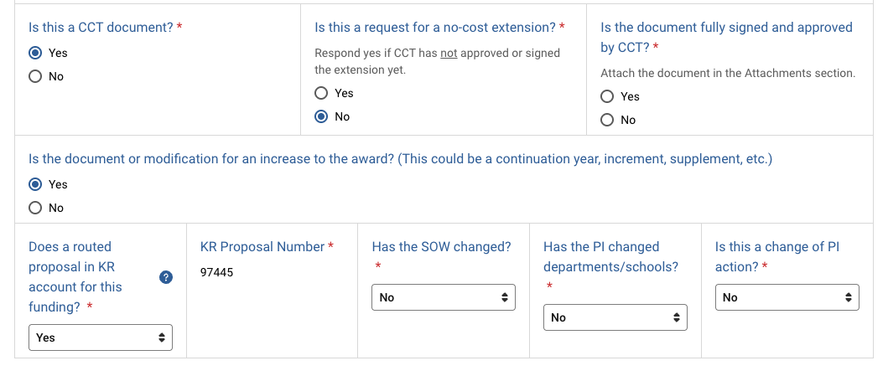
Award Modifications

Slide 7
No-cost Extension (NCE) Request
Is Sponsor approval needed?
If no - the request must be submitted for internal approval.
  Currently, both CCT and SPA use this form for internal NCE approvals

Slide 8
NCE Request for Sponsor Approval
When UMB must submit a request to the sponsor for an NCE
Is there a requirement the request come from an AO/AOR? If so, the dept should use this app for SPA to submit the request to the sponsor
If no firm requirement the request come from an AO/AOR, the dept or PI may ask the sponsor for the NCE
  In this case, once approved by the sponsor, the dept submits the approval (or formal mod) in via the KB Award Mod app

Slide 9
Departing Investigator
Applies to departure for any reason
Addresses all active sponsored awards – funded and unfunded
For a specific investigator, enter info for all awards on one form, OR submit forms as you obtain sufficient information for each award.

Slide 10
Subaward Request for Outgoing Subawards
Request to issue a new subaward or modify an existing subaward
Sponsor approvals
Federal Contract question

Slide 11
Send to SPA via e-mail
Pre-award/post submission requests such as:
  Just-in-time responses
  Representations & certifications for SPA signature
Federal progress and final report actions (RPPRs)
Temporary account requests
Carryover requests
Budget modification requests

Slide 12

More tips
The KR Award that you enter must be in Approved status.
The PI of the KR Award that you enter must be an active UMB employee/affiliate. (Does not apply to Departing PI form)
The KR Award ID or Subaward ID data that autofills is the current data in the KR record.
When you enter the Award or Subaward ID, make sure there is no blank space before the number.

Slide 13
A few final words
Kuali is our UMB auditable system of record – routing is important.
Requests may be lost if sent in via email only.
Helps SPA monitor and manage workload – many eyes
If you aren't sure, please ask
Questions?

Slide 14
Resources
Award modifications:
  https://www.umaryland.edu/spa/award-management/award-modification/
  Decision tool (PPT opens in play mode) https://www.umaryland.edu/media/umb/ord/documents/spa/Award-Modifications-Clickable-PowerPoint-.ppsx
Outgoing subaward requests
  https://www.umaryland.edu/spa/collaborations-and-subrecipients/subrecipient-agreements/subaward-request-instructions/
No-cost extensions
  https://www.umaryland.edu/spa/award-management/changes-to-project-or-budget/no-cost-extensions/
Departing investigators
  https://www.umaryland.edu/spa/award-management/faculty-transfers---outgoing/
  https://www.umaryland.edu/spa/award-management/award-reports-and-close-out/final-reports-and-close-out/

