Slide 1
Kuali Build at UMB
Overview and Tips

Slide 2
Who has access?
Anyone with UMB credentials can start and submit a form
Currently, approvers and investigators need to be active “Kuali Users”. Kuali Users are:
  Active employees (on payroll)
  Active affiliates and students who have requested “app access” for Kuali https://cfapps.umaryland.edu/apprequest
    The person who creates the Community System record for an affiliate can include the request for Kuali access in the Community System record.
    The affiliate or student can log into the app request link above and request Kuali access.

Slide 3
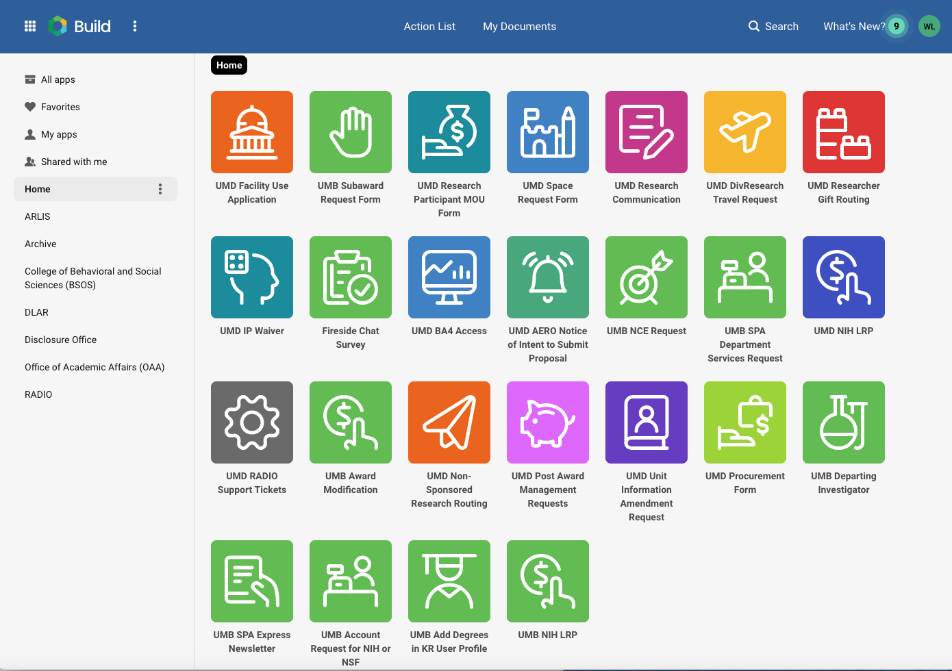
Action List and My Documents

Slide 4
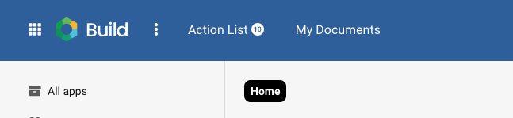
If I have access, what can I see?
Forms that you created (My Documents)
Action List of forms ready for approval or “sent back” for action

Slide 5
My Documents - Submitted
Forms you create are either Submitted or Drafts
  Document type = form name
  Title = form number
  Status = Complete, In Progress, Denied, Withdrawn, Error
  Action = Duplicate (available for all forms) or Withdraw (for In Progress forms)
There are Sort and/or Filter options for most of the column headings

Slide 6
My Documents - Drafts
Draft documents can be edited, completed and submitted
  Click on the line to view/edit
If no longer needed, a form can be Deleted using the trash can icon at the far right of the line

Slide 7
The Kuali Build Home Page

Slide 8
What apps exist? What actions can I take in KB?
App = Form
UMB apps are labeled as such (e.g. “UMB Subaward Request”) and are green
Active apps are:
UMB Subaward request
UMB Award Modification
UMB NCE request
UMB SPA Department Services Request (must have SPA permission)
UMB Departing investigator
UMB Account Request for NIH or NSF (request eCommons or Research.gov account)
UMB Add degrees in KR user profile
UMB NIH LRP (NIH Loan Repayment Program)
UMB SPA Express Newsletter (email sign-up)

Slide 9
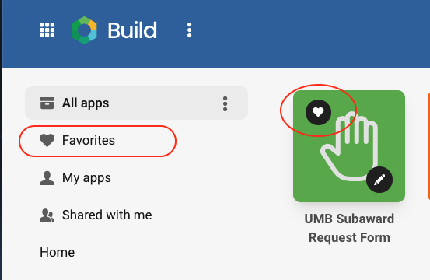
Favorites
Favorites
The best way to “sort” the apps on the home page is to identify the apps you use as “favorites” – and then bookmark that link.
On the home page, hover your cursor over an app and then click on the heart. You have just “favorited” the app.
In the left navigation menu, select Favorites
Bookmark the link: https://usmd.kualibuild.com/build/space/favorites

Slide 10

Coming soon!
Temporary account request
Prior approval request (will incorporate the current NCE Request)
The Publication Waiver Request form is currently in use, initiated by SPA when required.

Slide 11
General tips for data entry

Slide 12
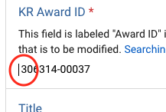
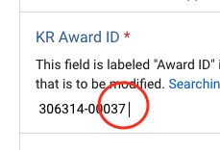
Adding the KR Award ID
Awards must be active (“Approved” status) in KR
  If you add the award ID and nothing appears, the award status needs to be updated. Email Kate and Janet with your request to update. (link for email is in the form)
Make sure there is no blank space either before or after the Award ID (or Subaward ID)

Slide 13
Adding the KR Award ID 2
For a Subaward Request for a New subaward, the Award must include the Approved Subaward(s)
  If you add the Award ID and in the Subrecipient Information section there is no dropdown with the subrecipient organization(s), Approved Subawards must be confirmed and added. Email SPA-Subcompliance@umaryland.edu with your request (including Award ID and organization(s) missing)

Slide 14
Award ID – PI “issues”
The PI is often included in the workflow.
Check that the correct PI appears from the linked award. If not, did you select the correct award record? Or, has the change of PI been routed in KR and processed?
Check that the “User Type Ahead (Office Use Only)” field is filled. If it is blank, the PI is not active in KR.

Slide 15
After submission

Slide 16
Workflow
Workflow is customized for each app, including Approvals and Tasks
To check workflow status,
  Go the Home page, My Documents > Submitted.
  Click on the line to open the form.
  In the top right corner, click the Workflow Status button
  Click the arrow on a workflow stop to see details. OR, click the View button to “Expand All” to see detailed for all stops

Slide 17

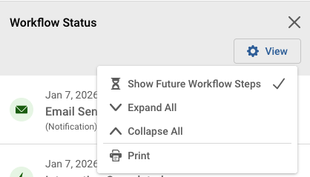
Workflow status

Slide 18
My form seems “stuck” in workflow
To have a KB email notification re-sent to your PI or Department Approver, contact Janet (jsimons@umaryland.edu)
If you have a deadline for the requested action – contact the appropriate Team email early in the process.
  https://www.umaryland.edu/spa/spa-contact-us/
All workflow stops show who can approve or complete the task. However, please use the SPA Team emails (not individual SPA staff emails) to raise a concern.

Slide 19
Submitter Acknowledge/Approve
To date, three forms (Subaward Request, Award Modification, NCE Request) include an “Acknowledge/Approve” stop for the submitter.
This “extra” stop allows SPA to return a form to the Submitter without requiring the PI to re-approve.
You will receive an Approval notice, and the action will appear in your Action List to approve.

Slide 20
Sent Back notifications
When a form is Sent Back, it will appear in your Action List.
The email notification and the form will contain a note describing why the form was returned and what action is required.
Make the required update and Approve back into workflow (or Withdraw if requested/appropriate).

Slide 21
Why are submissions Sent Back?
Wrong response to questions
Missing or incomplete attachments
”Is this a CCT agreement” answered wrong (this affects the workflow for Award Modifications and NCE Requests)
  CCT agreements are signed by Mike Rollor

Slide 22

Questions?

