Slide 1
IPAs and JPAs
Richard Ingrao, Contracts Manager

Slide 2

I. -Indian
P. -Pale
A. -Ale

Slide 3
IPA- Intergovernmental Personnel Act
Agreements for the assignment of personnel and the reimbursement of salary and fringe benefits
Between:
The Federal government and ………
State and local governments, Colleges and Universities, Indian Tribal Governments, Federally funded research and development centers, and other eligible organizations.
In other words, it is a temporary exchange of an employee.
Notes:
may not be placed on another assignment without at least a 12 month return-to-duty with his/her regular employer.

Slide 4
JPA. (Not a type of beer)
Joint Personnel Assignment (JPA) Agreements
Agreements for the assignment of personnel and reimbursement of salary and fringe benefits between……..
UMB and the Baltimore Research and Education Foundation (BREF), which is the VA's Foundation.
UMB enters into JPA agreements when an individual is hired by UMB employee is temporarily assigned to work on a BREF-funded project.
In other words, a JPA is a type of IPA. But the employee is specifically working for the Baltimore Research and Education Foundation (BREF)

Slide 5
IPA and JPA Fun Facts and things to know!
Most UMB IPA’s are with the Baltimore VA
  But could be with almost any Fed agency
IPA’s can be reversible ( ie A Federal employee can be assigned to a UMB project)
IPA’s, like standard agreements can be modified . ( Continuations, supplements , terminations etc.)
An employee can work on multiple projects under the same IPA
But, an employee can not work on Multiple IPA’s at the same time
There are no limits to how many IPA’s agreement a non-federal person can enter into. Provided they are not simultaneous
There is NO F&A with the VA IPA’s. ( IPA’s with other agencies may allow F&A and should be verified)

Slide 6
Fun Facts (Part two)
All IPA assignments are considered temporary.
  After the project is over, the employee is expected to return to his original employer. IPA’s are initially limited to a two year term. At its conclusion it can be extended to an additional two-year extension.*
If employee has worked four continuous years on a project, then they may not be placed on another IPA assignment without at least a 12- month return-to-duty with his/her regular employer.
There should be a 60 Calander day limit between different IPA assignments
  Note: This is not a mandatory requirement. However, entering into a new IPA prior to a 60 day break will be regarded as continuous service that is added to the four year continuous limit.
Usually assignments are set up into year long periods
Ipa’s are considered by the Federal government to be payment mechanisms .
An IPA assignment can have a number of PO’s during its life
A partially executed IPA must be delivered to the VAMHCS (Veteran Affairs Health Care System) for review at least 60 days in advance of the proposed IPA start date.

Slide 7
Fun Facts (Part Three)
There can be an incredible amount of IPA variation between Fed agencies and even between VA agencies.
For example:
*The Four year continuous IPA cap.
  VA exception: The Cleland-Dole Act included legislation that allows the VA to waive the four-year continuous cap. However, this exception is handled by separate VA agencies on a case-to-case basis.
  The Baltimore VA allows for more than four years. (2+2+2…)
  Subsequently, it negates the need for a 60- day break between IPA assignments. Because there is no cap to add to.
Notes:
break It negayes

Slide 8
Fun(?) Facts ( Part Four)
VA IPA’s must be set up for two year intervals.
  Even if project is less than a year
  IPA’s should never be used to hire clinical or administrative staff for VA.
  The Goal is to support research projects and that both the VA and the University can benefit from the project. Not to provide employees for empty VA positions

Slide 9
Some IPA BACKGROUND
To qualify for an IPA, the the nonfederal employee must meet two sets of requirements
  1- IPA eligible 2 Meet the qualifications/ Duties for that particular Federal position
IPA eligible means:
  The employee must be employed by an eligible non-federal organization ie accredited university
  Must be employed by that agency for at least 90 days in a career position
  The assignment must be temporary, voluntary and of mutual benefit to the federal agency and the nonfederal agency
  Job Qualification means:
  In practical terms, the person must satisfy the applicable education, specialized experience, license, certification, medical, security and other requirements for the position or duty
  Qualifications degree varies depending on if the IPA is an appointment or a detail
  A Detail is a temporary assignment and not a federal hire means employee individual returns to their original job, is paid by the permanent employer and doesn’t qualify for federal benefits
  An appointment is a temporary Federal hiring. Paid by the feds and qualifies for federal benefits
  Most UMB IPA’s are Detail type

Slide 10
Some Baltimore VA Background
ON July 29, 2024, the VA changed slightly their method of processing IPA’s. The applications must go through VA human resources before they can be awarded.
The July change created two HR departments
The first department handles hospital-based funding. Amanda Federer and Nathaniel Wright
The second department handles research-based funding. Tim Foley
The groups are distinguished by funding source
These groups require the inclusion of different forms
Personal observation-At times VA seems very arbitrary and non-specific. In part because of Processing changes and federal financing cuts. Feel free to call me

Slide 11
IPA Set up and routing
Confirm employee has Veterans Sector Check (VSC) background check. Some agencies require checks to be in place at the time of the application submission. Others will hold off until the application is reviewed and approved.
Verify and Complete the required VA forms
  Required forms can vary from agency to agency- confirm with agency
  Forms can be found with agency, SPA web site, or Google
  Helpful Hint : When looking for forms on Google. Check bottom of page. It should say if form is for VA or CDC or NIH etc.
Complete your KR submission, add attachments and submit to routing

Slide 12
VA Forms
Most commonly required attachments
1) Employment Verification. * #
2) OIG exclusion check. #
3)Resume/cv. * #
4)OF-178. *
5) IPA Worksheet. #
6)Educational Transcripts #
7) Cover Letter.
8) OF-69 * #
When in doubt….send them *Research. #Hospital

Slide 13
Employment Verification
Employment verification is a letter attesting that the employee is in a non-temporary position for at least 90 days from the applicant's supervisor/dept head, etc. (pdf format)
The letter language should state, at a minimum:
  “(Name of applicant) has been employed since (Month, Day, Year) a non-temporary position for at least 90 days with University of Maryland, School of (Insert School)”

Slide 14
Office of The Inspector General (OIG) Exclusionary List-
Purpose: This is a list of individuals and entities that are excluded from Federally funded health care programs. They can not receive payment from Federal health care programs for any items or services they furnish, order, or prescribe.
You will be required to go to OIG Exclusion Data base to determine if the IPA employee is on the list
Proceedure:
1)Go to the Data Base. https://exclusions.oig.hhs.gov/?AspxAutoDetectCookieSupport=1
2)Enter the individuals first and last name- Hit search
3)Make a copy of the results- (Screen Shot)

Slide 15
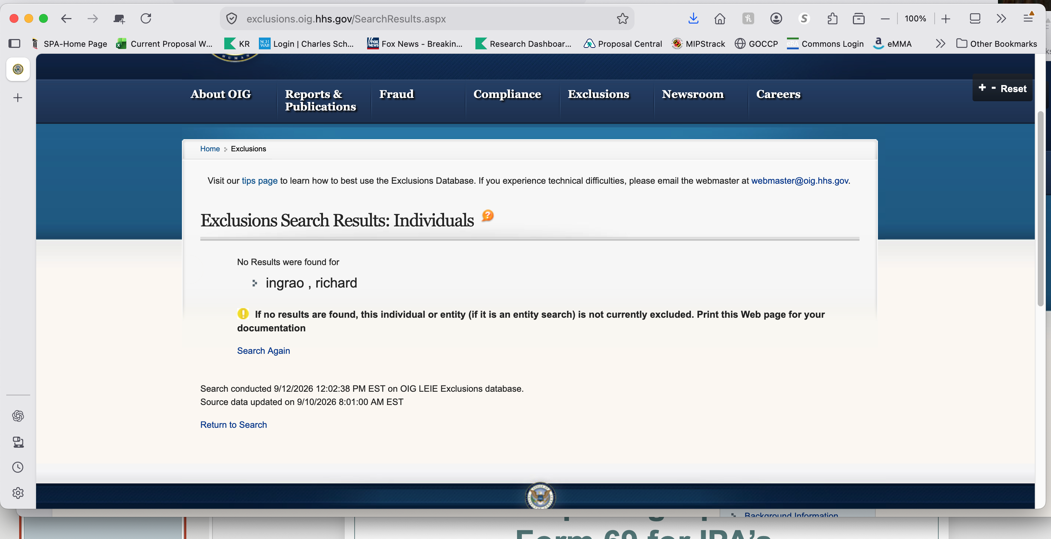
OIG Exclusion

Slide 16
Resume/CV
Used during review of application to verify credentials and ensure the applicant's expertise aligns with the project.
Resume should be tailored to show employment history supports the projects description of duties

Slide 17
OF 178 form- Certificate of Medical Examination
is a U.S. government document used to evaluate whether an individual meets the physical and medical standards required for a specific federal position or assignment
Typically, an optional form. Rarely used with Baltimore VA IPA’s
Fill out only Part B box #3 (see page 2 of form/pdf)

Slide 18
Worksheet
The work sheet is a check list of questions that addresses important requirements for IPA qualification. Among the covered issues are
1) Employee qualifications
2) COI knowledge and status
3)Work Duration limits and restrictions
The variation of the worksheet may vary in form from Fed agency to agency, VA departments to departments and even within a VA department.

Slide 19
Education Transcripts
This is a relatively new request for the Baltimore VA.
It is used as a verification that employee is qualified for the assignment position. Show that past education can support the project duties and expected qualifications.
Generally Post- Grad education transcript is used.
But you can use Grad education transcript if it can show education supports employee’s qualifications and project duties
An Unofficial transcript version is acceptable.
Biggest Problem- Foreign Transcripts
  Reviewers request Foreign Equivalency Reports from
    Association of International Credential Educators (AICE) or
    National Association of Credential Educational Services (NACES)

Slide 20
Cover Letter
The Baltimore VA does not specifically require a cover letter, but the practice might vary from VA to VA and other Fed agencies
However, it is advisable with Baltimore VA, especially when submitting modifications, that a cover letter be included to clearly explain the intended modification.
The VA’s OF-69 form can sometimes be misleading and there isn’t much room to lay out the modifications.
Cover letters should be submitted in KR attachments for SPA signature

Slide 21
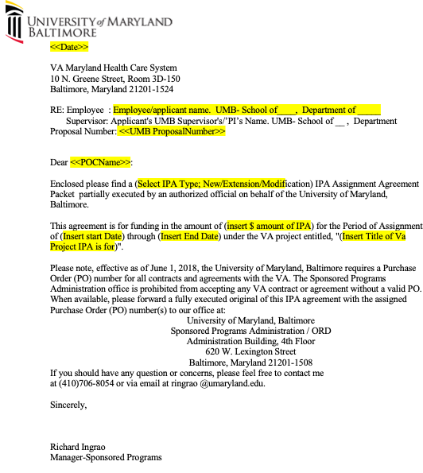
Cover letter Example
Include applicant's name
Applicant’s Supervisor/PI’s name
Name of the IPA project
Type of application -New/Mod/extension
Dates of project
Brief explanation of requested Mod
changes or reason for extension
Prepared cover letters can be submitted in
  KR attachments for SPA signature

Slide 22
OF-69. The main application
This is the main application document.
It serves as the contract with the VA.
The same document also is used for modifications. (Yikes)
IT should be set up for a two year period
( Even if project is less time)

Slide 23
OF-69
SPA link to of-69 training slides
https://www.umaryland.edu/spa/developing-proposals/ipas-and-jpas/

Slide 24
How to Modify
Process a kr submission like any other modification.
Complete a OF-69 with modification or extension box checked
Change the OF-69 to reflect modifications
Attach original OF-69 in internal attachments
Prepare cover letter highlighting required changes

Slide 25
Resources
1- VA Handbook 5005/32 (IPAs) docx
2-SPA Information on IPA/JPA-Link to Filling out OF-69 https://www.umaryland.edu/spa/developing-proposals/ipas-and-jpas/
3-OIG- Exclusions https://exclusions.oig.hhs.gov/?AspxAutoDetectCookieSupport=1
4- 5C.R.F. 334.106
Notes:
---%CRF-334.106

Slide 26

Questions

