Slide 1
SPA Updates
SPA/SPAC Meeting
Wednesday, September 2, 2026
2:00PM

Slide 2
SPA Agenda
Personnel Updates
SPA Contact Us
General SPA Updates
  KR Updates
Team Updates
  Research Security Updates
  Proposal Team
  Grants Team
  Incoming Contracts Team
  Outgoing Subaward Team

Slide 3

SPA Personnel Updates
Retirement – Jean retired as of 8/31, Still use Team Aqua
No new team updates
Open Position – Manager, Sponsored Data and Information Systems
Please utilize the Team Email Addresses.
https://www.umaryland.edu/spa/spa-contact-us/

Slide 4
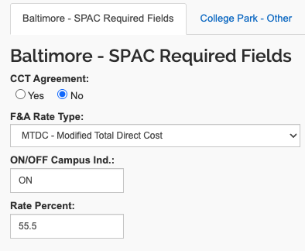
KR – new supplemental field
Under SPAC Required Fields
CCT Agreement? Yes/No
  No validation error, but please complete anyway
  How do you know? Look for Mike Rollor's name as the signatory on the agreement. He is in CCT.

Slide 5
Kuali Build UMB "Space"
Apps (forms) are now sorted into UMB's space
Just click on University of Maryland Baltimore in the left navigation
You can still use Favorites for the apps you use most

Slide 6
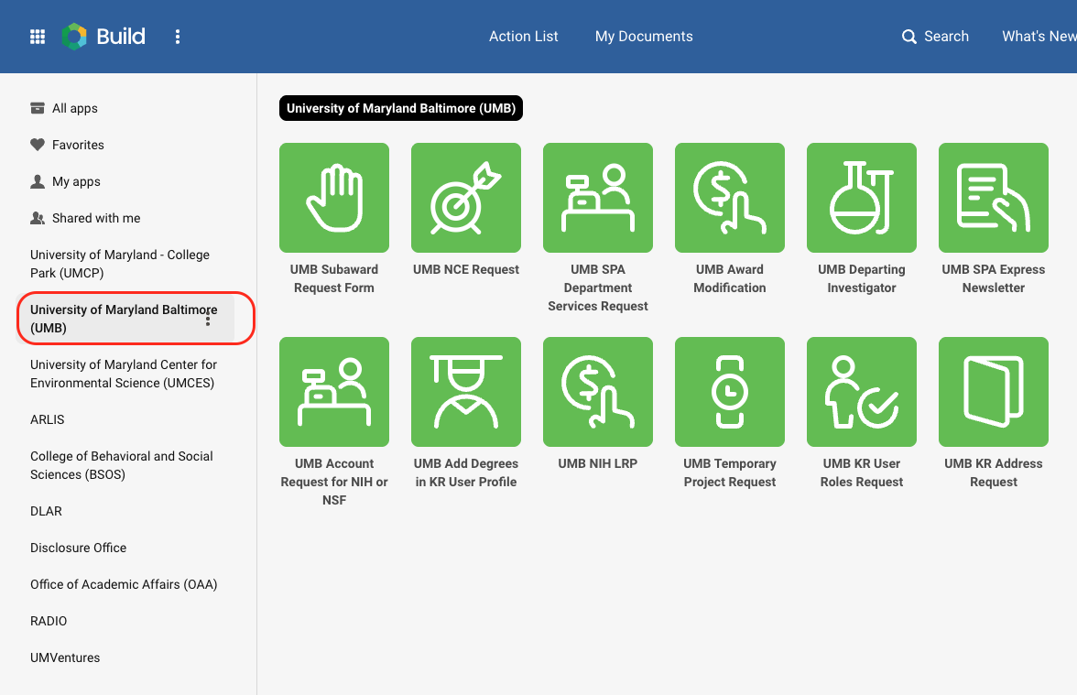
Kuali Build UMB Space

Slide 7
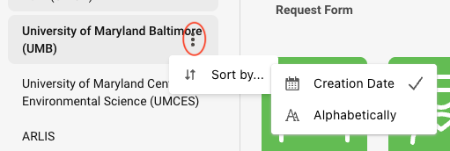
KB UMB Space

Slide 8

KR: Canceling or Deleting a Proposal
Did your PI abandon a proposal? Feel free to Cancel it
If you can edit the proposal, you should have the Cancel button
Cancel means the proposal is removed from the Dashboard, but you can view or copy it
Delete means it's gone. Only "In Progress" proposals can be deleted. Only SPA can Delete (contact Janet or Greg).

Slide 9
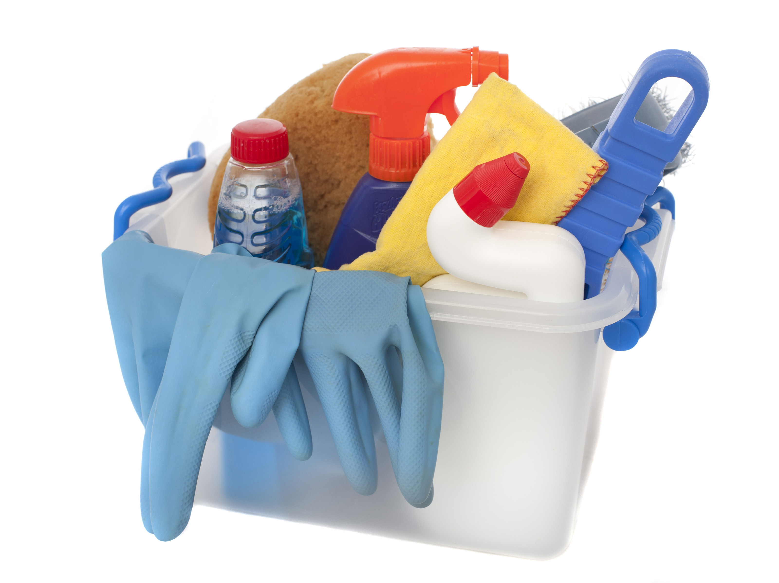
KR Proposal Clean Up
PLEASE DO NOT COPY OR REVIVE PROPOSALS THAT ARE MORE THAN 6 MONTHS OLD!!
We have been canceling old proposals.
This will help avoid issues with rates, questionnaires, etc.

Slide 10
Federal Updates
IMPORTANT!
If you or a PI are contacted by anyone from outside of UMB requesting changes related to a federal award, immediately share the request with Jill and Laura, copying the department chair and dean. Do not respond to requests independently.

Slide 11
SPA Training Updates
SPARKS – Sponsored Programs Administration Research and Knowledge Sessions
  One-hour presentation + Q&A on a variety of topics
  Open to all via Zoom on the 3rd Tuesday of each month at 9:00 am
  September 2026: IPAs/JPAs
  Slides & recordings available on the website
  https://www.umaryland.edu/spa/research-administration-training/sparks/
COMING SOON! ESP – Essentials of Sponsored Projects - New curriculum focused on the sponsored project lifecycle

Slide 12
Reminder: RAC Listserv
SPA and SPAC use the RAC Listserv for important communications.
Email CGEPPI@som.umaryland.edu to be added to the listserv
Important SPA communications are archived here: https://www.umaryland.edu/spa/spa-notices-archive/ - use the navigation menu to find the topic and date

Slide 13

Team Updates

Slide 14

Research Security Team
ThePhoto by PhotoAuthor is licensed under CCYYSA.

Slide 15
Research Security
Completion of research security training required within 12 months prior to ALL sponsored proposals submitted through SPA.
NSF RST Consolidated Training Module 2026-2027
  Training is required when:
    No date entered for "Date Submitted" or
    If the respective due date for the proposal reviewed exceeds 12 months after the "Date Submitted" date.
  Check research security training completion in Kuali Research
RS Website
  Research Security Training Frequently Asked Questions (FAQs)
  Federal Agency Risk Assessment/Risk Mitigation Matrices
  Posted: NIH Other Support Disclosures Supplement
New RST Refresher – COMING SOON!
  RS Team Office Hours
  1st and 3rd Wednesday 2:00pm – 3:30pm
  SPA-Research_Security@umaryland.edu

Slide 16

Proposal Team
ThePhoto by PhotoAuthor is licensed under CCYYSA.

Slide 17
Proposal Team Members
Proposal Team Members:
Greg J. Sorensen – Assistant Director SPA
Christine To'alepia – Senior Administrator
Michael Starace – Senior Administrator
Urmil Dhru – Level 3 Administrator
Zineb Kirchner – Level 3 Administrator
Andra Davis – Level 3 Administrator

Slide 18
DOD Refresher
Attachments need to go in the reverse order when uploading them into KR, and when you go into the Attachments form everything should be in order. An easy way to check if they have been put in correctly is when you go to the S2S Tab and Create a PDF for the Attachment Section, that will show you the order that they will appear in and it should match what is in the announcement, not all announcements are the same.
If all the attachments are not being used remember to put a place holder in with the correct naming for the attachment not being used, if you don't the attachments will not appear in the correct order, and your proposal could be rejected by DOD.

Slide 19
DOD Refresher 2
Naming for the Biosketches and the Current and Pending attachments must follow the announcements instructions For naming, ex: Biosketch_Sorensen and Support_Sorensen.
The Biosketches type of attachment will be Biosketch and the current and pending will be CurrentPending. Do NOT USE Other.

Slide 20
DOD Refresher 3
Follow the announcement guide for pages allow for each type of PDF, not all the announcements are the same.
Sponsor Proposal ID should be the ID assigned during the Pre-Application process. And if we are a partnering PI the number will end as P1.
Remember that the RequiredReps attachment needs to be flattened or it will not appear in the proposal after submission. After you flatten it, It will not allow you to edit the form

Slide 21
Proposal Reminders
Upload the Announcement/Notice/Instructions in to the internal section on the attachment tab.
Proposals should be routed to SPA 5 business days before the deadline, with all the attachments being marked as final.
JIT materials should be uploaded into eCommons by the PI or their designee, if an emergency happens we can help with the upload.

Slide 22
Proposal Reminders 2
Use the correct date that the proposal is due to the sponsor. If items are needed earlier still leave the real Due Date and then work with the person who is assigned to the proposal to get the proposal completed earlier and the needed forms signed.
The National Institutes of Health (NIH) has officially ended its Continuous Submission policy as of August 10, 2026, shifting reviewer flexibility into an updated late-submission framework. Please see the next page:

Slide 23
Reference: Late Applications and Continuous Submission
You may submit during the late application period if all the following are true:
One or more of the PD/PIs listed on the application encountered extenuating circumstances that led to the missed deadline
  We don't accept late applications due to situations involving individuals other than a PD/PI (e.g., authorized organization representatives (AORs)/signing officials (SOs), senior/key personnel, other significant contributors, mentors/sponsors, co-investigators, collaborators, consultants, project or core leaders in a multi-component application)
The PD/PI's extenuating circumstances are documented in the cover letter submitted with the late application
Your application is in response to a program that allows late submission
  We will not accept late submission for
    Fellowship (e.g., F30, F31, F32, F33, F99/K00) and
    Small Business (e.g., R41, R42, R43, R44, SB1, UT1, U44) applications which have the shortest processing time prior to review
    Collaborative International Research applications (e.g., PF5, UF5)
    Any funding opportunity that states in the Key Dates section that late applications will not be accepted

Slide 24

Grants Team
ThePhoto by PhotoAuthor is licensed under CCYYSA.

Slide 25
Grants Team - DMS Plans
DMS Plans_Post Award
Recipients will no longer be required to obtain prior approval to modify an approved DMS Plan. As such, NIH plans to retire the DMS Prior Approval Request type in the eRA Commons Prior Approval Module.
Effective October 1, 2026, recipients must use the RPPR (Section C.5.c.) to report progress on data sharing activities and notify NIH of changes to an approved DMS Plan, such as changes in scientific direction, data repositories, or sharing timelines.
The new DMSP form should be uploaded in Section C.5.c.
NOT-OD-26-100

Slide 26
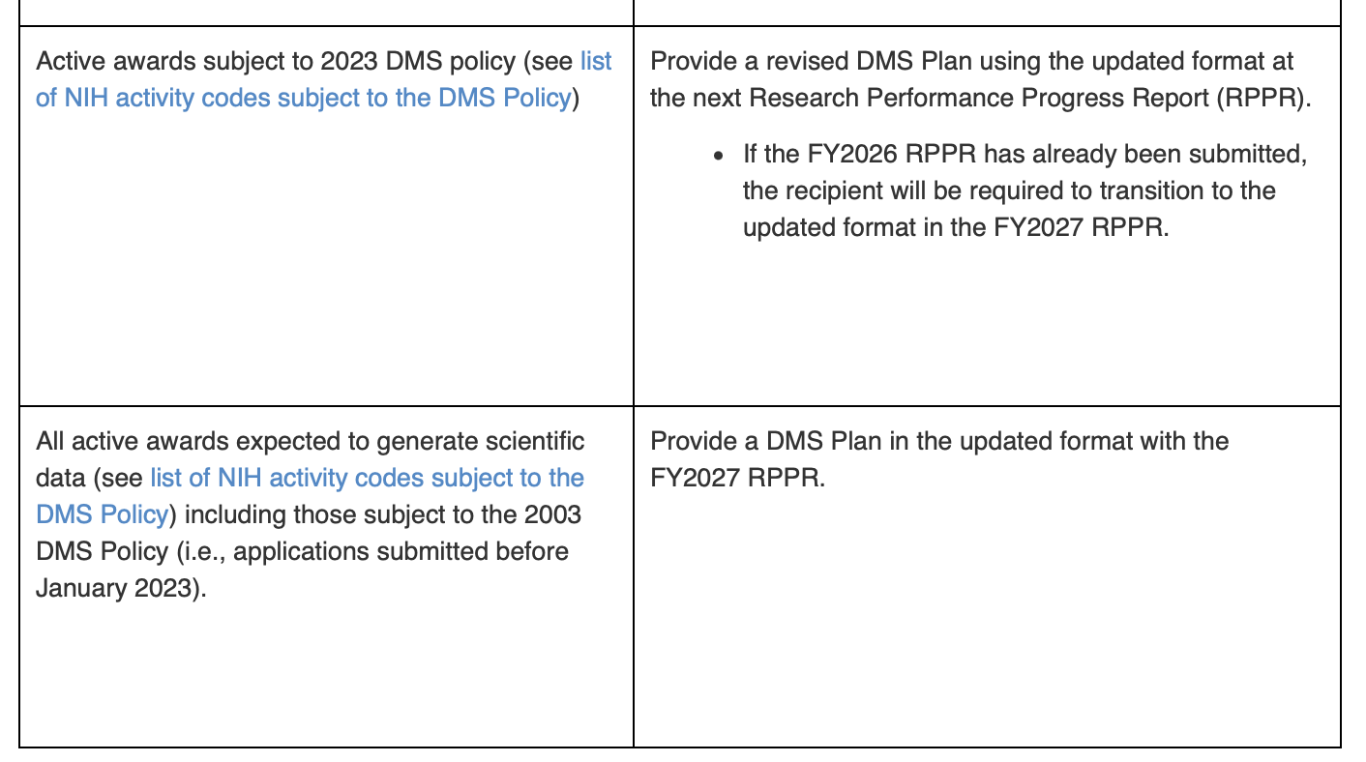
Grants Team – DMS Transition
  Begin transitioning to the Updated DMS Plan Format
  Beginning in FY 2027, NIH will require all existing awards and applications subject to the NIH DMS Policy to transition and align with the updated DMS Plan Comprehensive listing of all activity codes that generally require applications to submit a Data Management and Sharing Plan.
  Expected Transition and Reporting Requirements for Adoption of the updated DMS Plan Format

Slide 27
Grants Team – RPPR Reminders
RPPR Reminders
Section D. Participants-Remind participants to complete their eRA Commons Profiles with demographic and degree information. This includes individuals with postdoctoral, graduate or undergraduate roles.
Section D. Participants-Review Other Support to ensure Active effort does not exceed 12 Calendar Months.
Section G.1 Special Reporting Requirements-Ensure that MFTRP Certifications are uploaded under G.1 if the Key Person's 2026 OS or Biosketch were not uploaded under D.1.
UMB Federal RPPR Resources Page Link

Slide 28
Grants Team - NoAs
Federal Notice of Awards are processed by the SPA Grants Team.
The award notification is emailed to SPAC, the PI, and Grants Department email address via an Action Form.
Please review the NoA in full and ensure that the highlighted terms and restrictions are particularly noted.
Contact SPA Grants if you are unsure how to respond to or address a restriction. SPA-Grants@umaryland.edu.

Slide 29

Incoming Contracts Team
ThePhoto by PhotoAuthor is licensed under CCYYSA.

Slide 30
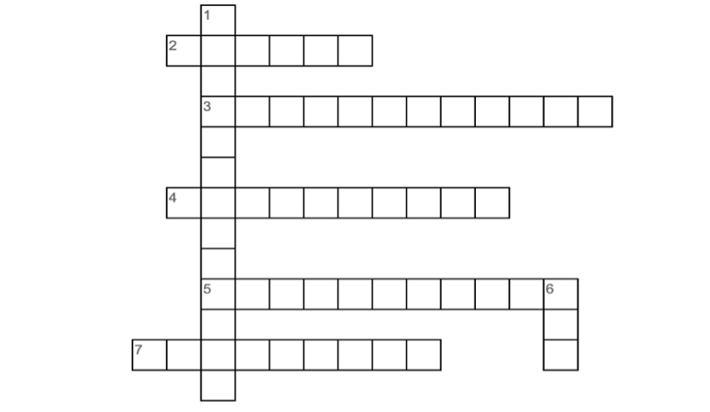
ANSWERS TO OUR CROSSWORD PUZZLE FROM Q3 SPA EXPRESS NEWSLETTER
How did you do?
These are items that you would include in your agreement request/routing
Across
2 - This is the breakdown of the funding to be received (Budget)
3 - This includes verifications, waivers and any information from sponsor or about the project (Supplemental)
4 - This should always be up-to-date information on regulatory matters (Compliance)
5 - These are referenced in the award mechanism (Attachments)
7 - This is the award mechanism and contains terms and conditions (Agreement)
Down
1 - This is a form or list that requires responses from PI (Questionnaire)
6 - This is what the PI and study team proposes or promises to do (SOW)

Slide 31
SPA Contracts
Action Status of Contracts Team:
Total # of actions requested for FY26 = 1331
Current # of actions requested by FY27 = 306
(July – August)
FY27 actions still active/in queue = 124
(completed 182)
FY26 actions still active/in queue = 113
(completed 1218)

Slide 32
SPA Contracts - Reminders
Don't forget . . .
To contact and communicate with the central SPA contracts team use the ONLY email the team will receive and reply to email messages:
SPA-Contracts@umaryland.edu
DO NOT USE:
SPA-Contracts-Shared-Services@umaryland.edu

Slide 33
SPA Contracts – Reminders 2
Do you know . . .
What happens with Actions in progress or not at SPA level:
What does in progress or not at SPA level mean?
These are actions being submitting through a SPA submission system that has not reached SPA level for triage and assignment
What happens when submission is in progress?
If it has enough information to identify which team it is to be triaged to, it will be triaged to that team. A triage email will be received by team, and the team will send a notification that they have been triaged the submission; but it will not be assigned to a team member until it reaches SPA level. NOTE: If a submission is in progress when it is triaged to the contracts team this is the ONLY notification the team will receive regarding status of submission
What to do to make sure it gets assigned?
NOTIFY THE SPA TEAM THE SUBMISSION IS AT SPA LEVEL via email to
SPA-Contracts@umaryland.edu
When does the clock start?
Date triaged to SPA contracts if submission is at SPA level at time of triage; or
Date department notifies contracts team via email to
SPA-Contracts@umaryland.edu the routing has reached SPA level
(NOTE: This ONLY needs to be done if the submission was not at SPA level when it was triaged to team)

Slide 34
SPA Contracts – Reminders 3
We want you to avoid delays or kickbacks . . . so remember . . .
Data Integrity!
Here are some friendly KR reminders:
Include the prime agency of NIH
Ensure your sponsor’s name is accurate & correct (should match the agreement)
Project title should be full & accurate (any other reference e.g., “DUA”, should be in parenthesis before the full and accurate project title
Provide up-to-date compliance information
Proposal type is correct for agreements & contracts (NOT SAME AS GRANTS/S2S)
Here are some friendly KB reminders:
Use the correct proposal development# that covers funding
The proposal development being used for a TEMP is approved & submitted
Have you answered YES to:
Change in SOW
Change in PII
DO NOT CONTINUE SUBMISSION IN KB; Route in KR

Slide 35
YOU ARE ON OUR INVITATION LIST!!
Data Use Agreements – stay tuned for an upcoming SPARKS session!
But here’s one QUICK RUNDOWN:
Will your PI externally send Data owned by UMMS?
Here’s few things we will share with UMMS before we can approve –
Will any of the following UMMS resources be used?
UMMS facility (e.g., if UMMS will be providing the location for the research)
UMMS medical / electronic health records
Existing data from UMMS medical records
Research Informatics Core (RIC) team (e.g., if RIC or other UMMS resource will de-identify data, check this box)
Will any funds from project go to UMMS for work performed?
UMMS employees involved (NOTE: This must be determined by UMB Dept and if individuals involved in project are UMB or UMMS/UMMC employees)
  in collection of Data
  in maintaining Data
  in research activities
  in clinical activities
  Other
  None of the above
Patient or study subjects billing involved?
To study subject’s insurance
  Participant compensation? If yes; explain:
  Other:
  If yes to any of the above; source or origination of funding (if none, enter “none”)?

Slide 36
SPA-Contracts
UMMS Resources Q&A cont'd
List all UMMS owned facilities involved where work will be performed and role of facility; or,
Indicate NOT APPLICABLE
We will request name(s) of UMMS facility(ies) and the role / action facility will play
We will also request answers to the following:
What type of UMMS data will be accessed for this project (i.e., please provide the specific data elements)?
Are both UMMS and UMB each providing data to collaborator?
Who will access the UMMS data (e.g., review of medical charts by provider? Or large data pull by data team)?
Will the data be de-identified by UMB? If yes, how, using what method? Or will another entity (the data services team) de-identify for the UMB team?
What is the method of data transfer to collaborator?
Is UMB participating in the project, other than UMB extracting data from the UMMS medical record and sharing it with collaborator?
Does UMB expect to have access to resulting research developed using this data?
If UMMS will be providing “facility for the research”, please provide additional details and/or if study team will be “maintaining Data in UMMS facility repository; biobank, etc.” what exactly is UMMS doing in those roles?

Slide 37
Need to request a DUA?
REMINDERS:
New request? Submit in Kuali Research
Modification to an existing DUA? Submit via KB Award Modification system using KR Award ID# assigned to original agreement
Have a funded agreement that has a DUA associated? Each agreement must be submitted via applicable submission system separately
Are there DUA terms and conditions incorporated in agreement or referenced as an attachment? This only requires one submission to SPA
Multi-sites? Each must be submitted to SPA
Is a DUA needed if data is de-identified and publicly available? This will be answered in SPA's next issue of the SPA Express

Slide 38

Outgoing Subaward Team
Obligated and Anticipated
ThePhoto by PhotoAuthor is licensed under CCYYSA.

Slide 39
Obligated Amount
What it means:
This is the amount of funding that has been officially approved and awarded to the Subawardee. The subaward agreement must be fully executed by UMB and the Subawardee.
Why it matters:
This is the money that can be spent right now because it has been formally authorized by the Sponsor and UMB. It shows how much money is currently available to the Subawardee for work on the project.
Review Check for modifications:
Make sure the new request fits within the approved funding after considering money that has already been promised or spent.

Slide 40
Anticipated Amount
Definition:
Funding that is expected to be received in the future but has not yet been officially awarded or committed to the Subawardee.
Purpose:
Helps institutions plan ahead for future subaward amendments, funding actions, and project activities that may depend on receiving additional funds.
Key Review Questions:
  Is UMB expected to provide more funding?
  When is the additional funding anticipated?
  How certain is it that the funding will be received?
  Should future subaward actions be planned based on that expectation?

Slide 41
Current Available Amount
Current Available Amount = Obligated Funding – Amount Already Committed or Expended
Review considerations:
Verify sufficient balance exists before approving a request.
Compare requested subaward amount to available funding.
Consider anticipated funding separately from currently available funds.
Decision Focus:
Ensure requested subaward funding is supported by available resources and aligns with project funding status.

Slide 42
Example: NIH Award – 5 years for $500,000 Total
Only Year 1 funding is being obligated at the time of the new subaward. Years 2-5 are considered Anticipated
Total Anticipated Amount: $500,000
Funding Obligated Under This Action: $100,000 for the Year 1 budget period.
The Subrecipient is authorized to incur costs up to $100,000 for the Year 1 budget period. The sub is not authorized to incur costs in excess of the obligated amount and beyond the budget period end date. When the Year 2 NOA is received, a KB Subaward Modification Request is submitted to add year 2 funds ($100,000) and extend the budget period dates. The modification Obligated amount will then be $200,000.
Anticipated future funding is as follows:
Year 1: $100,000 (Obligated)
Year 2: $100,000 (Anticipated)
Year 3: $100,000 (Anticipated)
Year 4: $100,000 (Anticipated)
Year 5: $100,000 (Anticipated)
Total Anticipated Subaward Amount: $500,000

Slide 43
Budget Rounding
When preparing a subcontract budget, rounding to the nearest whole dollar is important for several reasons:
Consistency with Sponsor Requirements
  Many federal agencies and institutions require budgets to be submitted in whole dollars. Using cents can create discrepancies when the proposal is entered into electronic systems.
Avoids Calculation and Reconciliation Issues
  Subcontract budgets often flow through several systems (subrecipient, prime recipient, and sponsor systems). Rounding eliminates small differences caused by cents that can lead to budget mismatches.
Simplifies Budget Review
  Reviewers focus on the reasonableness of costs, not minor cent-level variations. Whole-dollar amounts make budgets easier to read and verify.
Ensures Budget Totals Match
  If individual line items contain cents, totals can differ slightly depending on how each institution rounds calculations. Rounding each line item to the nearest dollar helps prevent differences between detailed budgets and budget summaries.
Facilitates Award Setup and Financial Reporting
  Awards are typically established and tracked in whole dollars. Starting with rounded figures reduces administrative adjustments later

Slide 44
Reminders
NIH Foreign Type 3 Supplements Must Be Processed as “New”
Use Unique File Names for All Documents Uploaded to Kuali Research Subaward KB Request
Each file must have a unique name. Documents with duplicate file names can cause system upload errors, prevent successful attachment processing,
Example: Uploading the file named "budget justification". It should be given another name so it doesn't cause an error.
Following these practices will help ensure smoother processing, reduce administrative delays.

Slide 45

Questions
ThePhoto by PhotoAuthor is licensed under CCYYSA.

