Slide 1
SPA/SPAC Updates
March 31, 2021
2:30 – 4:00 pm
Event address for attendees:
https://umaryland.webex.com/umaryland/onstage/g.php?MTID=e33c98a295311d67a5d260c4cc29be58e

Slide 2
SPA Agenda
General Announcements & Personnel
Kuali Build
Grants & Contract Updates
Training
Reminders

Slide 3
SPA General Announcements
Central Offices & Department Research Administrators Standing Committee
KR Training Schedule*
  April 20, 2021 (Tuesday) 10:00 AM – noon
  May 11, 2021 (Tuesday) 1:00-3:00 PM
  June 16, 2021 (Wednesday) 10:00 AM - noon
  July 15, 2021 (Thursday) 1:00-3:00 PM

Slide 4
SPA Personnel Changes
Kim Moore Team Red
  Administrator, SPA
Special assignments internal to SPA
  Ken Fahnestock (Grants)
  Jeanne Galvin (Contracts)
C2 positions posted/open ranked
  (closes in 2 weeks!)

Slide 5
Kuali Build
Working with Kuali Co and UMCP to implement the Kuali Build system since October 20.
First form to be implemented is the Subaward Request Form
  Should go live April 19, 2021
  Training Video will be on SPA website beginning April 14, 2021
  FAQ will be created on SPA website
  Advantages: PI will need to approve the routing, errors may be corrected on the same form, automatic uploading of data from KB to KR Subaward module
Next forms to be considered:
  Award Set up form to SPAC/PI/Departments, NCE, Temporary Requests, Clinical Trial Routing and Award setup, Unfunded agreements

Slide 6
SPA Grant Team
Greg Sorensen – Assistant Director, SPA
Team Red
Suzanne Hollis – Senior Administrator, SPA
Shelley Tiemann – Administrator, SPA
Kimberly Moore – Administrator, SPA
Team White
Christine To’alepai – Senior Administrator, SPA
Towanda Gilliam – Administrator, SPA
Michael Starace – Administrator, SPA
Odessa Neale – Administrator, SPA

Slide 7
UP COMING FORM CHANGES
May 17 – Grants.gov will deploy all new UEI form versions to the Production environment. Applicant Impact: S2S Applicants must be ready to support Application Packages containing the new UEI form versions Kuali Research are working on this right now.
May 25 – Changes to the Biographic Sketch and Other Support Forms
NOT-OD-21-073 – These changes will effect both applications and RPPRs.
During the transition to the new Biosketch format, NIH will not withdraw applications that include the previous Biosketch format. Beginning with applications submitted on or after January 25, 2022, failure to follow the appropriate Biosketch format may cause NIH to withdraw your application from consideration.

Slide 8
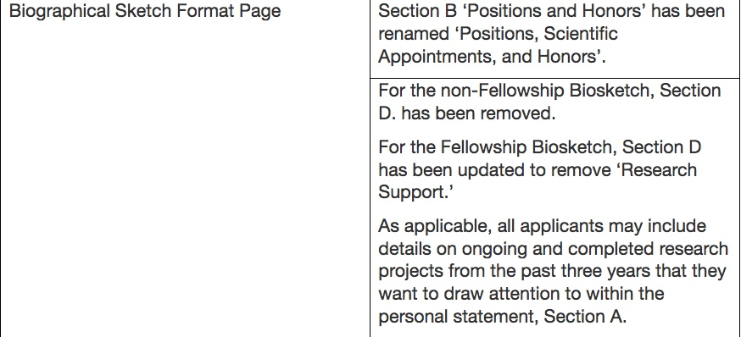
May 25 – Changes to the Biographic Sketch and Other Support Forms
NOT-OD-21-073 – These changes will effect both applications and RPPRs
  Biographic Sketch:

Slide 9
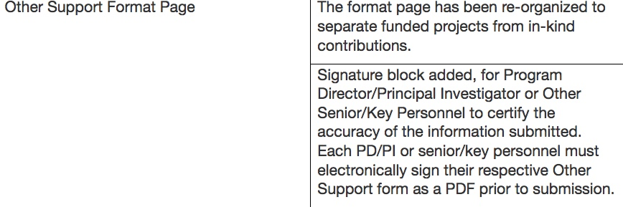
Other Support page:
Supporting Documentation: For Other Support submissions that include foreign activities and resources, recipients are required to submit copies of contracts, grants or any other agreement specific to senior/key personnel foreign appointments and/or employment with a foreign institution as supporting documentation. If they are not in English, recipients must provide translated copies. This supporting documentation must be provided as part of the Other Support PDF following the Other Support Format page.

Slide 10
Other Support Cont.
Consulting agreements, when the PD/PI or other senior/key personnel will be conducting research as part of the consulting activities. Non-research consulting activities are not Other Support.
In-kind contributions, e.g. office/laboratory space, equipment, supplies, or employees or students supported by an outside source. If the time commitment or dollar value of the in-kind contribution is not readily ascertainable, the recipient must provide reasonable estimates.
Other Support does not include training awards, prizes, or gifts. Gifts are resources provided where there is no expectation of anything (e.g. time, services, specific research activities, money, etc.) in return. An item or service given with the expectation of an associated time commitment is not a gift and is instead an in-kind contribution and must be reported as Other Support.

Slide 11
General Updates
The Departments must go through Greg Sorensen to get permission to use Workspace and ASSIST. The request must list the Announcement Number and the KR Proposal Number.
Remember SPA Proposal Team will respond to Team Emails within 1 to 2 working days.
If an Item is needed that day then put URGENT in the title of the email. These items must truly be urgent.
When you put the due day into KR it should reflect the date you need the items or submission to the sponsor. When the proposal team looks at their work flow it is scheduled by when the is due. If the due date changes, please notified the triaged team member immediately. If that person is out then send a message to the team email.

Slide 12
General Updates Cont.
If a department plans of a proposal or triaged item being submitted by the proposal team after 5:00 pm, a request must be sent to SPA a couple days in advance so accommodations can be made.
Proposals are to be routed before they are submitted to the sponsor. This gives the buyoff from the Department, Deans Office and SPA, and provides a review of the terms and conditions before the submission of the proposal to the sponsor.
Also a reminder that proposals need to be routed at least 24 hours before they due. It take approximately 24 hours after the proposal is created to pull all the information into our database for triage.

Slide 13
SPA Contracts Updates
For unfunded agreements – do not forget to include a SOW and a fully completed Unfunded Agreement Form when submitting your KR request. SPA contracts team will not review your agreement until both information is received.
  Title
  External entity contact information
New Process
  Contracts Shared Service (CSS) – modified internal process for managing greater workload - contracts team central service to help facilitate the flow of work.
For Subcontracts – Use the updated Sub-commitment form dated 9/1/2020. Sub team will not process your sub request unless the updated version is used.
  We’ve caught up on any subs that were 15 days out of compliance*
Feel free to contact the contracts team before routing if you have a peculiar information
Notes:
-Title: You can include the title of the project where the data or CI was created/obtained or the RFP
-External entity contact information – ensure to include the administrative person’s NAME and EMAIL
-CSS – Although Stacey is the main person managing CSS continue to send emails to the correct team mailboxes unless it has already been triaged to a contracts team member. – we’ve ironed out some issues and still addressing other issues as they arise – e.g. SPA not receiving some emails – two emails 1. when it was routed – CSS is only reviewing the proposals; 2. whom the agreement is triaged at which point, you can contact that team member directly
*For those sub requests where you’ve not received any correspondence from a sub team member. – if you have a sub request that is out of compliance and have not received any correspondence from the subs team, please send us an email

Slide 14

S
P
A
R
K
S
Sponsored
Programs
Administration
Research &
Knowledge
Seminars

Slide 15
What’s in SPARKS?
(GASP 2.0)
Curriculum/certificate training
Kuali Research training*
Brownbag/Discussion Sessions
*KR training will be provided via Zoom. SPARKS KR training will be available once SPARKS is online.

Slide 16
SPARK Curriculum
(GASP 2.0)
Core courses
Pre- and Post-award track options
On-line – asynchronous and Zoom meeting components
Knowledge testing

Slide 17
Reminders…
Info & Guides on SPA website
  http://www.umaryland.edu/kualicoeus/user-resources-and-help/
  Navigating and searching in KR
  PI certification and approval
Ask your general questions at Research Matters http://researchmatters.umaryland.edu
New email for KR “Report a Problem”
  DLKualiResearchHelp@umaryland.edu

Slide 18


Slide 19

SPAC AGENDA
Policy Updates – Laura Scarantino
Procedure Updates – Laura Scarantino
Cost Updates – Beryl Gwan
Central Team Update – Michelle Ward
SPAC Teams Update – Kevin Cooke

Slide 20

New Policies
UMB Policy on Unallowable Costs for Federal Awards
Salary Cap

Slide 21
UMB Policy on Unallowable Costs for Federal Awards
Completed and posted
https://www.umaryland.edu/policies-and-procedures/library/financial-affairs/policies/viii-9907a.php
The purpose of this policy is to provide guidance to the University of Maryland, Baltimore (UMB) community on defining and identifying costs that are unallowable for reimbursement by the federal government on Sponsored Projects.
A full list of types of unallowable costs can be found in 2 C.F.R §§ 200.400 – 200.475 (Subpart E – Cost Principles)
The policy summarizes that list

Slide 22
Salary Cap For FY22
Salary Cap
  Grants and Cooperative Agreements: Department Administrators and Principal Investigators (PI) must re-budget funds to accommodate the change in the salary cap. Upon issuance of the new salary cap by HHS, the University requires that the new cap be adopted by the departments in their budgets in the next calendar month or 30 days, whichever comes first. Exceptions to the application of the new cap must be approved by the Assistant Vice President (AVP) of Sponsored Projects Accounting and Compliance (SPAC) .
  Contracts: Department Administrators must contact the contracting officer for approval to use the new salary cap. This approval or denial needs to be forwarded to the SPAC Contracting Team. If approved, the OTC must be adjusted in the next calendar month or 30 days from the time of the approval, whichever comes first.
  Federal Pass-throughs: Department Administrators must contact their Grant Sponsor to provide notice of who will be affected by this change and when the change will be implemented . If the pass-through is under a grant or cooperative agreement, Department Administrators and PIs must re-budget funds according to the requirements listed under Grants and Cooperative Agreements. If the pass-through is under a contract, Department Administrators must receive approval from the Grant Sponsor in order to use the new salary cap and must adjust the OTC in the next calendar month or 30 days from the time of the approval, whichever comes first.

Slide 23
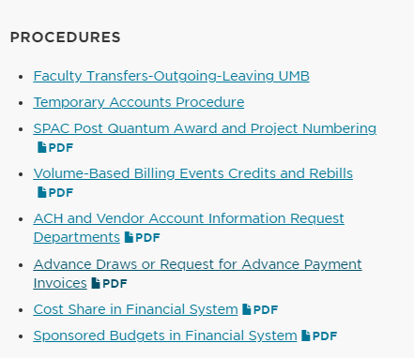
SPAC Procedures
Can be found here https://www.umaryland.edu/spac/sponsored-projects-accounting-and-compliance-spac/policies-and-procedures/
Highlight
Project Numbering
Volume Based Billing Events Credits and Rebills
Advance Draws
The others that will be covered in the presentation
ACH Vendor Account Information Request
Cost Share in Financial System
Sponsored Budgets in the Financial System

Slide 24
SPAC Procedures
Project Numbering
https://www.umaryland.edu/media/umb/af/spac/AWARD-AND-PROJECT-NUMBERING_121119_FINAL.pdf
Quantum is now based on Award (not projects)
With Quantum, we only change the award Number for 4 reasons
  Change in a Purchase Order (PO) Number Single - (VA) Multiple PO’s on one award (BCPS)
  Change in Sponsor Contract Number (not adding the year at the end, the core # must change)
  Change in Letter of Credit (LOC) ID
  Change in Sponsor funding source (like LOC ID change – but this is a new funding window

Slide 25
SPAC Procedures
Volume Based Billing Events ‐ Credits and Rebills https://www.umaryland.edu/media/umb/af/spac/Volume-Based-Billing-Credit-and-Rebills_101620.pdf
It is the responsibility of the departments to create the credit in billing events

Slide 26
Advance Draws or Request for Advance Payment
https://www.umaryland.edu/media/umb/af/spac/procedures/Advance-Draws-or-Request-for-Advance-Payment-Invoices.pdf
Very few instances where UMB is a “payment in advance”
Needs to identified in the award – if not and no modification
Backup documentation to support the expenses that are to be drawn that are included on an invoice and not included in the financial system.
This may include but is not limited to vendor invoices, Direct Retro calculations for salary cost transfers and/or debit memos.

Slide 27
Advance Draws or Request for Advance Payment Continued
If backup documentation is not available, there must be a cash forecast showing how funds will be spent within the next 30 days from the date of the request. This request must be approved and signed off by the Principle Investigator responsible for the award funding

Slide 28
Advance Draws or Request for Advance Payment Continued
If a cash forecast is provided to request the advance draw, the following are additional requirements
  The department must include correspondence from the sponsor agreeing to the advance draw.
  The department must provide a departmental OSOAPF for SPAC to charge the interest calculated on the advance
  When the interest is charged to the OSOAPF, SPAC will advise the department.

Slide 29
Advance Draws or Request for Advance Payment Continued
  All advance draws or final invoices that are not supported by backup documentation equal to the reportable costs must be reviewed and approved by a Director of AVP of SPAC.
  All requests supported by a cash forecast must be reviewed and approved by a Director or AVP of SPAC

Slide 30

Cost Agenda
  FY22 Fringe Rate Update
  Direct Retros – Reminders and Training
  Effort Reporting System Upgrade and Training
  FA rate preparation: Space Survey
  Faculty Training - Resources

Slide 31
FY22 Fringe Rate Update
While the rates on the next slide were proposed (submitted to the government)
The rates have NOT BEEN NEGOTIATED YET
These rates can be used for planning purposes
The proposed rates have been included in Kuali Coeus
The memo and planning rates have been uploaded to our website
https://www.umaryland.edu/media/umb/af/cost/FY2022-Planning-Rates-Announcement.pdf

Slide 32
Fringe Benefit Rates-PROPOSED NOT YET NEGOTIATED!!
 | Apply to Accounts | FY22 | Costs Recorded in Account
Faculty | 1011 – Faculty 9/10 mo. 1012 – Faculty 12 mo. | 26.2% | 2790 – Fringe rate Faculty
Staff | 1013 – Exempt staff 1014 – Non-exempt staff | 34.6% | 2791 – Fringe rate Staff
Legislated Benefit | 2071 – Faculty 2072 – Exempt staff (C1) 2073 – Non-exempt staff (C1) 2080 – Summer salaries 2085 – Supplemental Pay 2110 – Overtime 2120 – Shift differential 2130 – On call pay 2140 – Bonus Payments 2074 – College Work study (summer) 2075 – Students (other than CWS) (summer) 2090 – Contractual employee (C2) (Until FY16) | 8.3% | 2793 – Fringe rate Legislated Benefit
Limited Benefit | 1021 – Post Docs/Fellows 2090 – Contractual Employee (C2) (FY16+) | 20.9% | 2792 – Fringe rate Limited Benefit
Students | 1020 – Graduate Assistants 2074 – College Work Study (CWS) 2075 – Students (Other than CWS) | 0% | N/A
Other | 2196 – Accrued Leave Payout | 0% | N/A

Slide 33
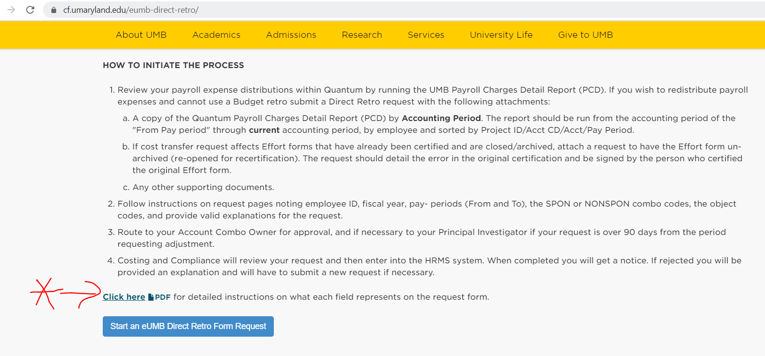
Direct Retro Reminders and Training
Please review effort instructions in detail. Help new employees go through it

Slide 34
Direct Retro Reminders and Training
Please review effort instructions in detail. Have new employees go through it.
  https://cf.umaryland.edu/eumb-direct-retro/Instructions%20for%20Direct%20Retro%20Form.pdf
Training will be offered for new employees, as needed. If you need it, email effort@umaryland.edu
  Dates will be scheduled based on the need
  Correspondence will be sent and posted on our website when scheduled
Special approvals: Attach all relevant documentation, not just the PCD
  Approval from sponsor
  Correspondence from SPAC
All rejected DRs MUST be resubmitted with documentation attached
  Accounting period PCD within 2 weeks of submission

Slide 35
DHHS Salary Cap_Cost Sharing for Payroll Expenses
DHHS Salary Cap for 01/03/2021 to 09/30/21 is $199,300
  Reflected in March 2021 effort forms
Check employees who may go over the cap
    Amount is based on annualized salary- Ex. FTE=.20 and amount paid at UMB= $40K → Annualized= $200K
This only applies to DHHS agencies and pass-through funds*. See link below for all DHHS and NIH sponsors and awarding agencies:
  https://www.hhs.gov/grants/grants-business-contacts/grant-officials/index.html
  https://www.nih.gov/institutes-nih/list-nih-institutes-centers-offices
Position owner creates EFP but may be unaware that a project from another department requires Over The Cap - communicate!
*Please ensure that you are familiar with other sponsors salary caps and apply methodology accordingly.

Slide 36
DHHS Salary Cap_Cost Sharing for Payroll Expenses Continued
Notice posted to link below
  https://grants.nih.gov/grants/policy/salcap_summary.htm
• New Proposals
– Use new salary cap for budgeting
• Active awards – Rebudget if funds are available no additional budget will be provided

Slide 37
Upcoming – ERS Upgrade
New Effort Reporting System will be in the cloud
Currently testing with Maximus
Go-Live Expected by the end of April 2021
  Will communicate Go-Live date
Not significantly different but many new enhancements
Training classes will be scheduled and correspondence sent out

Slide 38
Upcoming – ERS Upgrade
We need your help to prepare
March 2021 Effort Reporting Period (ERS) was initiated in current ERS
  Please ensure certifiers complete effort forms in current ERS environment
All outstanding forms will be moved to ERS Cloud
First ERS period to be initiated in ERS-Cloud will be 063021

Slide 39

FA Proposal: Space Survey Project
Costing and Compliance is working with Huron Consultant
  Base Year is FY2021
Survey will be entirely conducted online in the new cost model
  No more manual process with excel spreadsheets
  The system is called eFACs
    Cost Recovery Project
    Space Survey Project

Slide 40
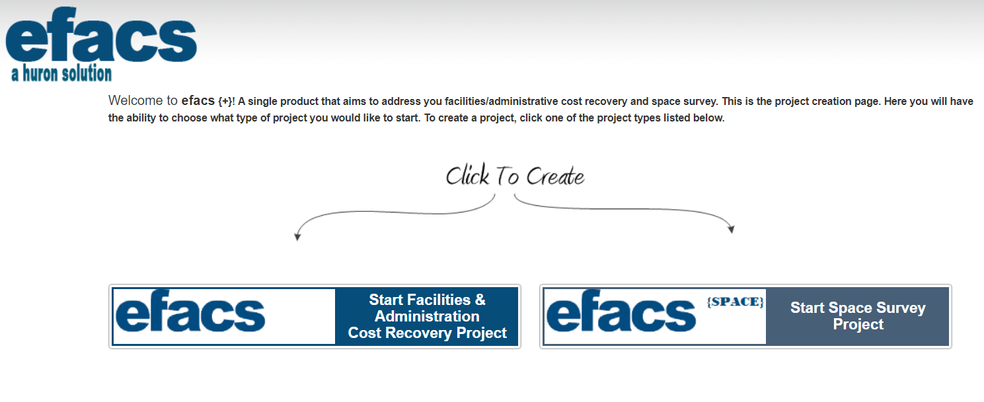
Space Survey Project

Slide 41
Space Survey Project
Departments to be surveyed were selected based on:
  Research labs
  Clinical areas
  Animal space
Affected Schools:
  SON – 1 department
  SOD – 3 departments
  SOP – 1 Department
  SOM – 24 Departments

Slide 42
Space Survey Project
Correspondence sent to Deans on 03/29/21
Point of Contact - Department Coordinators (DCs) in ERS
  Other contacts as requested by the Deans/chairs
Training will offered to DCs
  2 to 3 days training
  Projected Start: Mid April 2021
  Survey Launched: Beginning May 2021
  Completion date: 60 calendar days

Slide 43
Faculty Training: Online Resources
After space survey is submitted (Due 12/31/21), this will be Cost Department’s next priority
Effort Reporting Policy
  https://www.umaryland.edu/media/umb/af/cost/Effort-Reporting-Policy.pdf
Certifiers Quick Guide
  https://www.umaryland.edu/media/umb/af/cost/effort-help/certificationquickreference.pdf
Individuals with VA appointments and K-awards
  https://www.umaryland.edu/media/umb/af/cost/effort-help/VAFAQ.htm
  https://www.umaryland.edu/media/umb/af/cost/effort-help/Kawardguidelines.pdf

Slide 44

Questions

Slide 45
SPAC Central Team Agenda
  ACH Vendor Registration Forms
  Accounts Receivable Current Status
  Accounts Receivable Invoice and Payments
  Update on Collections
  Financial Reporting and Invoices

Slide 46
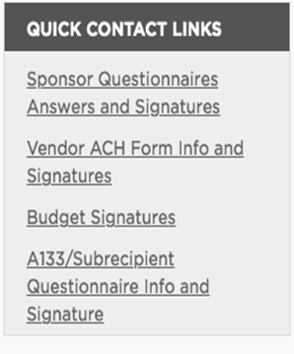
SPAC Central Team
ACH Vendor Registration forms:
  We are unable to post UMB’s banking information online.
  Provide basics- DUNS #, Tax ID, CAGE #, Lockbox Addresses.
    https://www.umaryland.edu/spac/sponsored-projects-accounting-and-compliance-spac/about-the-office/spac-banking-information/
  Request completion of forms via Quick Contact Links
  Turnaround time 24 – 48 hours
  Link: https://www.umaryland.edu/spac/external-communication-plan-for-spac/

Slide 47
Accounts Receivable:
  Working to streamline our AR process within Quantum.
  Working on additional help so that we can identify and apply payments faster.
  Working on streamlining our communication with departments. Please use Sponsored Accounts Receivable email Spacsponsored_ar@umaryland.edu.
    This will help reduce the email traffic back and forth with Mary only.
  Vendor payment remittance notices should also go to the Sponsored Accounts Receivable email. - ***this is a change
  COMING SOON- Monthly list of SPAC’s unidentified payments.

Slide 48
Accounts Receivable Payments
If a sponsor asks for a copy of the invoice, they are available n Quantum Financial under Contracts – documents. This will be discussed later
With Quantum, we no longer track awards by projects – so all of your searches are by Award number
Viewing physical check or payments copies
  Requires UMB Grants Viewer security role
  Breadcrumbs:
    Quantum Financials > Contract Management > Contracts.
    Search for Award and click “Number” hyperlink.
    Documents tab > Supporting Documents section

Slide 49
Collections:
  New Sr. Collections Specialist – Jocelyn Klucar
  Outstanding invoices 60days plus – will send out Dunning letters.
  Departments will be notified and cc’d on correspondence going out to sponsors.
  Any information/ correspondence about collections via spaccollections@umaryland.edu.

Slide 50
Financial Reporting/ Invoicing
  SPAC Central Team is not responsible for submitting invoices to sponsors.
  SPAC Central Team is ONLY responsible for submitting Federal financial reports to sponsors.

Slide 51
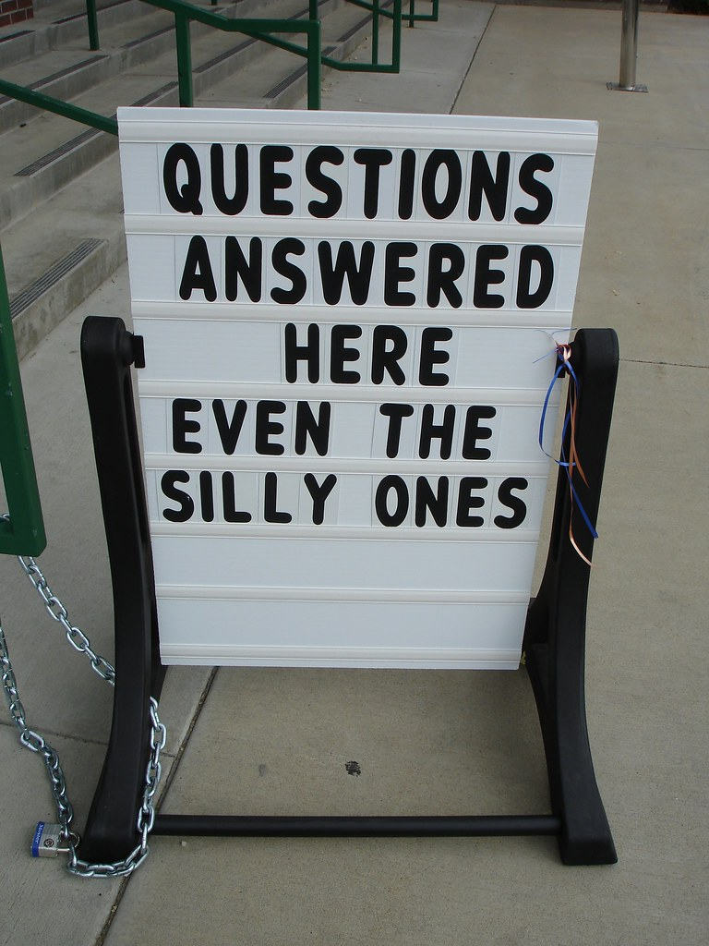

Slide 52
SPAC TEAMS AGENDA
Staffing Updates
Efficiencies
Budgets
Cost Sharing
Billing
ROEs
Helpful Links

Slide 53
SPAC Staffing Updates
OPEN POSITIONS
Manager, Team Red
Accounting Analyst, Team White
ADDITIONAL CHALLENGES
SPAC cannot process account maintenance during payroll

Slide 54
Efficiencies
Reduce email traffic and internal email routing
  Use SPAC Communication Plan to get directly to the team that can help
  Use Team Email addresses to ensure it gets into Image workflow
  Don’t “Reply All” if additional action isn’t needed
Common Questions
  Budgets
  Cost Share
  Billing
ROE’s

Slide 55
Budgets
  Viewing Budgets in QA
  Budgets in the financial system

Slide 56
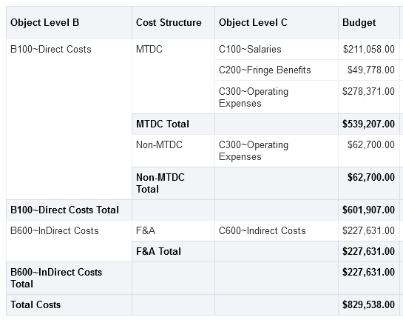
Budgets
QA Award Detail

Slide 57
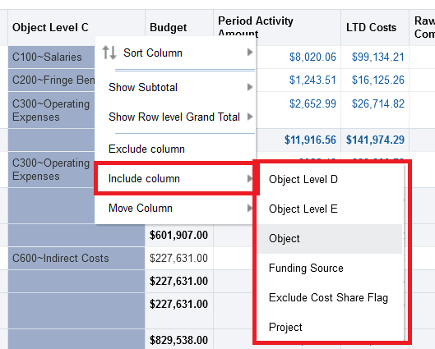
Budgets
To view additional budget detail, right click Object Level C column heading
Can see budgets Object Level D, Object Level E, and Object

Slide 58
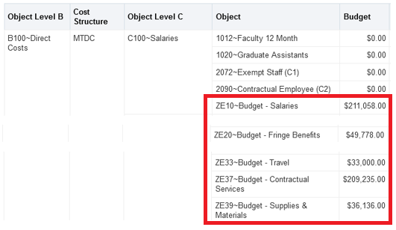
Budgets

Slide 59
Budgets
Budgets in the financial system
  SPAC will input the detailed budget in the award
  If the budget is not included in the award, SPAC will be required to check the budget in KR
  If the KR budget does not exist, or if the amount in KR does not match what is negotiated in the award, SPAC will only put in the Direct and Indirect budget
  It is up to the dept to review and send a budget modification to correct the budget

Slide 60
Cost Share
Over the Cap
  Does NOT require department to provide SOAPF for each project
  SPAC will automatically put in OTC for all DHHS federal awards
  Other than those awards, it is required by the departments to input the need for OTC in KR distribution tab/cost sharing
  If it does not appear there, the department will be required to contact their assigned team to have it set up

Slide 61
Cost Share
Committed Cost Share
  DOES require department to provide SOAPF for each project
  Other than those awards, it is required by the departments to input the need for CCS in KR distribution tab/cost sharing
  If it does not appear there, the department will be required to contact their assigned team to have it set up

Slide 62
Cost Share
Updating the SOAPF for OTC (set at Org level) or CCS (set at project level)
  Department will be required to contact their assigned team to update the SOAPF
    This will update accounting for all future cost share expenses
    To update cost share expenses that have already been incurred to the old SOAPF, department will need to process debit memo

Slide 63
Billing
  Viewing information in QA
  New campus report
  Viewing invoice copies

Slide 64
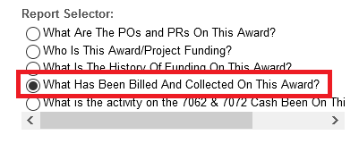
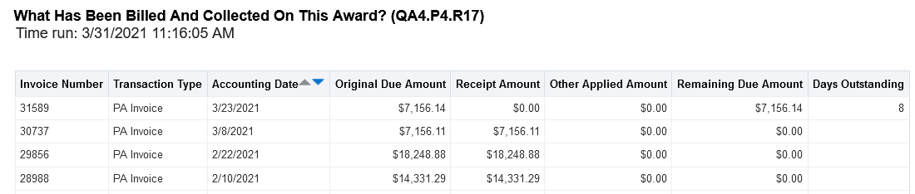
Billing
Viewing information in QA
  Use Report Selector on Award Detail

Slide 65
Billing
New Campus Report
  Assists with managing multiple Awards in one report for easier organization
  Can use report filters to display invoice information per Org, Award, or Sponsor via Excel format

Slide 66
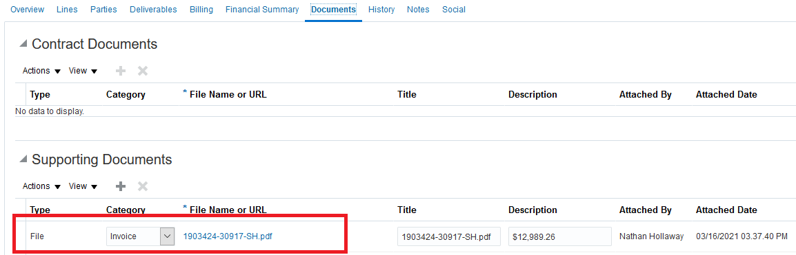
Billing
Viewing physical invoice copies
  Requires UMB Grants Viewer security role
  Breadcrumbs:
    Quantum Financials > Contract Management > Contracts.
    Search for Award and click “Number” hyperlink.
    Documents tab > Supporting Documents section

Slide 67
ROE’s / Closeout
ROE’s
  SPAC spends a lot of time sending ROE Drafts to departments for PI sign off
  Working on developing new QA Report and business process so that department can generate ROE report without SPAC having to run it for them
  Once sign off is obtained, still send to SPAC for final billing and closeout

Slide 68
ROE’s / Closeout
Before sending signed ROE to SPAC for closeout, make sure:
  Expenses per signed ROE match expenses per Quantum
    Any “trailing charges” should be included in the “Adjustments” column and will be invoiced as long as there is appropriate documentation provided
  Commitments (requisitions) and Obligations (PO’s) are closed
  7062 and 7072 expenses have been removed
  Provide a Non-Sponsored SOAPF is provided if expenses > contract limit

Slide 69

Helpful Links

Slide 70
Helpful Links
SPAC Communication Plan: https://www.umaryland.edu/spac/external-communication-plan-for-spac/
Budget Modification request form: https://www.umaryland.edu/media/umb/af/spac/forms/BudgetMod.pdf
Quantum Analytics Training Classes: https://www.umaryland.edu/quantum/training-and-support/
Quantum UPK’s: http://cf.umaryland.edu/upk/quantum/PlayerPackage/data/toc.html
    Campus Reports (AR Aging Report)
    Using Debit Memos for Accounting Transfers
    Creating and Approving Requisitions
Quantum Bytes Publications: https://www.umaryland.edu/quantum/quantum-bytes-publications/

Slide 71


