Slide 1
SPA/SPAC Updates
Quarter 2, 2020
January 23, 2020
2:30 – 4:00 pm

Slide 2
SPA Updates
Quarterly 2020
January 23, 2020
2:30 – 4:00 pm

Slide 3
GDRP
General Data Protection Regulation
https://www.umaryland.edu/oac/general-data-protection-regulation/
Within Kuali Research: New question in UMB Questionnaire

Slide 4
International Relationships & Activities
It is recommended by the National Institutes of Health and other federal sponsors that all Principal Investigators and personnel listed within a proposal must disclose the following within their submitted proposal:
  Researchers should ensure they disclose all applicable “Other Support” as required by federal sponsors.
  Significant financial interests received from any foreign entity, including governments and universities, must be disclosed
  Disclose all foreign consulting and other outside business activities
  All University Persons must request a pre-travel review of planned international travel activities undertaken for official University business purposes prior to departure. No export review is required for purely personal travel events or for travel by students for non-University business purposes.

Slide 5
Kuali Research Questions
SPA will be adding questions to all federal proposals within UMB Questionnaire to bring these new “rules” to the attention of the Principal Investigators and Department Administrators.
  Questions have not been completely developed but look for them to be included in all federal proposals.

Slide 6
Subrecipient Monitoring
All federal awards that were received by UMB and contain a fully executed subaward must be monitored
  SPA conducts a subrecipient risk assessment of all subrecipients on an annual basis
  SPA conducts a subrecipient risk assessment of all subrecipient projects at the time of creating the subrecipient agreement
  Department Administrators/PIs are required by Uniform Guidance to review all invoiced expenditures to determine if the amount of funds being paid are equivalent to the scope of work completed. This must be done for every paid invoice no matter the dollar amount

Slide 7

UMB Core Value Awards Nominations
Coming Soon: Nominations for Core Value Awards
UMB will soon be accepting nominations for awards tied to each of the University’s Core Values: accountability, civility, collaboration, diversity, excellence, knowledge, and leadership.

Slide 8
F&A Rates for State Sponsored Proposals
UMB should propose a minimum of 15% within your proposal budget to State Sponsored Agencies
Unless
1) Award guidelines or instructions expressly cap/limit/ or establish a lower rate
(Restrictions should be published so that they will be equally applicable to everyone applying for award)
2) If the proposal is a continuation of a prior award where the rate was agreed upon.
All “new” proposals should be seeking 15%.
If this is a new cycle and most-likely a new and separate sponsor contract award number will occur, then you should propose 15% even though the work was similar to work in the prior cycle.
Department of Budget & Management (DBM) advises State Agencies like MDH but does not limit indirect rates.
Each agency requires a justification as to why the rate should be over 15%.
UMB is discussing with the state agencies that accepting anything under UMB’s federally negotiated rate is tantamount to cost-sharing.
Accepting a rate that does not fall into one of these exceptions will require a waiver to be signed by your dean’s office and Jim Hughes

Slide 9
NIH F-Forms and Salary Caps
Application Guide for the F-Forms will be posted no later than March 25, 2020.
NIH Applications must use the F-Forms on or after May 25, 2020.
AHRQ SALARY CAP $197,300 NOT-HS-20-006
NIH has not changed their salary cap at time, once it changes SPA will notify campus

Slide 10
Kuali Research
Routing of Proposals in Kuali Research
  Combining with College Park resulted in all key persons named in the proposal to be included in the routing, which caused delay and confusion.
  The new routing agendas are all in place.
Notes:
Proposals created the same day will not show on SPA’s deadline report (internal)

Slide 11
Routing Process
Routing Process
  There will be no change if a department/division creates a proposal for their faculty.
  If a center/institute creates a proposal, it will automatically pull in the center/institute as the lead unit into the Person details within the Key Persons tab. (This controls the routing of the proposal)

Slide 12
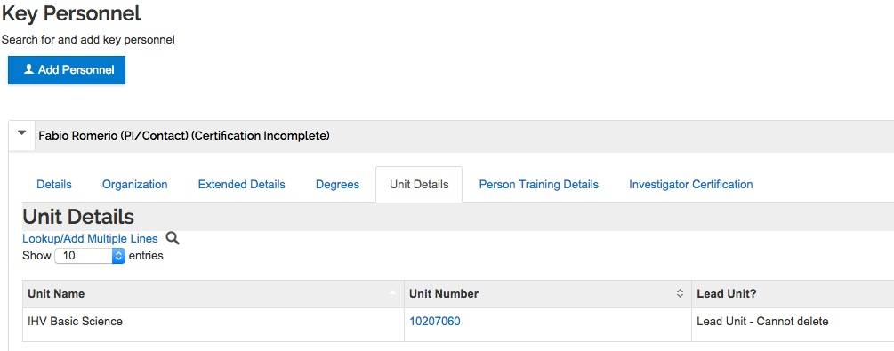
Routing Process
  Under Key Person tab – Under Personnel you will add your Principal Investigator and any other key person.
  Open Details – under Unit Details, add the academic unit
Click here to add academic unit

Slide 13
Routing Process
Add Academic Unit number (you must have this in the proposal, or it will be rejected back to you for correction)

Slide 14
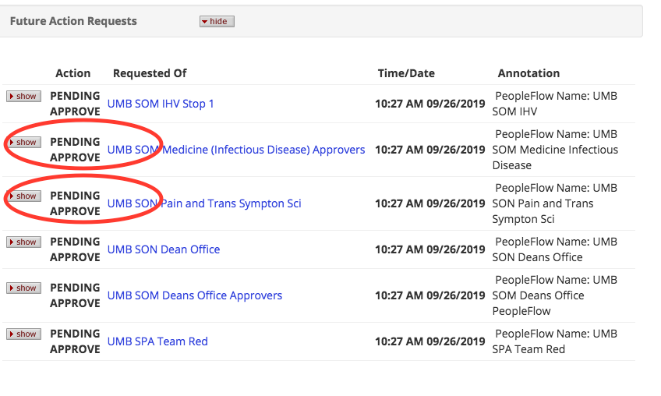
Old vs Current Routing
These will be listed as FYI instead of Pending Approval

Slide 15
KR Proposal Miscellaneous
Info & Guides on SPA website http://www.umaryland.edu/kualicoeus/user-resources-and-help/
  Navigating and searching in KR
  PI certification and approval
KR New User Training Dates (CITS enrollment database)
  2/20/2020 10:00AM-12:30PM
  3/17/2020 10:00AM-12:30PM
New email for KR “Report a Problem”
  DLKualiResearchHelp@umaryland.edu

Slide 16
KR Proposal Miscellaneous
Subrecipient Commitment Form is still a requirement at the time of proposal
PI’s must certify the proposal – This holds true for copied proposals as well
Do not use old proposals!
Proposals with human subjects
  Instructions for NIH proposals with human subjects http://www.umaryland.edu/kualicoeus/user-resources-and-help/nih-human-subjects-forms/

Slide 17
General Reminders
Please use the team emails when communicating with SPA, this allows us to triage the action. Then you will receive an email from the SPA person who is working on that action. This is true unless you are already working with a SPA individual then communicate directly with them. If the assigned person is not available then reach out to the Team Email Box and a team member will get back to you.
Remember SPA response time to e-mails generally takes 24 hours unless an email is marked as URGENT!!
Ask your general questions at Research Matters http://researchmatters.umaryland.edu
If you change the deadline date, please update your team or the person working on your proposal immediately!
Please give SPA adequate time to review your proposal.

Slide 18
General Reminders
To get permission to use Workspace or Assist the department must send a request to Greg Sorensen.
The request must list the proposal number and the announcement number. SPA will then verify if the proposal can be submitted via KR.

Slide 19

Questions

Slide 20

Cost Agenda
SPAC-Costing and Compliance
  Space Model
  Direct Retro (DR) Form Changes
  Negative lines on your effort forms
  Post Doc fringe adjustment entries
  Expenditure Item Date

Slide 21

Space Model
Thanks to all that participated
This information was very helpful for us to make some decisions
Impact of some of the big changes, Quantum and HSF III are delayed

Slide 22
Direct Retro Online
Still waiting for the final prototype
Quantum needed to be pushed to the forefront
Questions about Activity and Purpose on the form – your HRMS code identifies this

Slide 23
Negative Lines on Effort
If your effort form has negative lines don’t panic
Due to some changes in HRMS for Quantum we discovered most of them and corrected
We are aware of the issue
Please contact efforthelp@umaryland.edu

Slide 24
Post Doc Fringe Rates
Have not been able to do an adjustment since September
Working through and testing a solution now
Hope to have these input by February
Any training grants you have closing and reporting in Jan or Feb you my team will work with you to reflect the appropriate fringe cost

Slide 25

Expenditure Item Date
Experiencing some issues with Direct Retros
HRMS is based on the Expenditure item date
A direct retro goes to the paycheck and pulls amounts off
If the paycheck had any adjustments from previous pays – HRMS/Quantum does not know
Bombing payroll

Slide 26
Questions

Slide 27

SPAC AGENDA
Staffing Updates
VA – PO maxing
Communications
Challenges
  Timing
  Dunning
  F&A Issue
Changes
  Project Numbering
Helpful Hints
  Payroll Reports
  Volume/Sch Based Billing
  Where you will see documents
Presentation Questions
Some Tidbits
  NSF Survey
  NIH Regional Meeting
  Quantum Questions

Slide 28
SPAC Staffing Updates
Reorganization - will be coming to accommodate Quantum
Will be repurposing a position for a Sr. Collection Specialist
Welcome Back
Kevin Cooke
Was Sr. Manager now Director – Central Team/QQA

Slide 29
SPAC Staffing Updates
Danijela Macakanga – promoted from Accountant 1 to Financial Analyst on Team White
Permanent 3/1/20
Michelle Ward
Director Over Red/White Teams and Cost

Slide 30

VA PO Maximum
Currently no pretty way to ID which awards are overspent due to merit or COLA
VA issues PO for original award amount
We will bill up to the award amount
If you want SPAC to bill for amounts over PO, you will need to notify the VA that you are going over the PO amount
Request and Receive amendment documents increasing the value of the PO
SPAC will increase the award amount and bill the excess
Anything not covered by an increase or over the increase will be required to be funded by the department

Slide 31
Communication
Frustrated – aren’t we all!
We are a user just like you
We are not requiring OSN now
    Only for Schedule and Volume Base billing
  Continue using our team email addresses for correspondence and award setup/mods etc.
  For quicker responses please lead off with your Award Number (you can include the project number if necessary after award #)

Slide 32

Challenges
SPAC is slower than normal
We have one week in a month – mid month where we are challenged with Project setup
So we may take 5 days in to set up projects during that time
Refunds are far behind

Slide 33
Challenges
Dunning
All converted invoices used the Contract address rather than the invoice address
A lot of calls from sponsors
A lot of returned letters
Quantum help ticket in, but no resolve yet

Slide 34
F&A Issue
It was discovered after we returned from break that F&A did not calculate for Dec 2019
Kevin immediately tackled the 3 day analysis
An entry was processed on Wednesday 1/15/2020 to adjust burden through December 2020
Please let SPAC know if you realize a difference in F&A greater than 1 or less than -1.

Slide 35

Changes

Slide 36
Project Numbering
Automatic carryover 1 project for life of the award if
  A child project (which has a C at the end of the award #
  No change in LOC
  No change in PO
  No change in department or sponsor
https://www.umaryland.edu/spac/sponsored-projects-accounting-and-compliance-spac/policies-and-procedures/

Slide 37

Project Numbering
Non-Auto Carryover
  Project ID per year
  No new award unless change in
    LOC
    PO
    Source of Funding

Slide 38
Project Numbering
    Concerns
  Annual reporting – we get this from Terms and Conditions and Commons for NIH and some others
  Using funds for Non-Carryover – Immediate Closeout of projects
    If expense equals final report/invoice/bill
    Can not if you have trailing charges
    Since we no longer do multiple projects – watch your restricted funds

Slide 39

Helpful Hints

Slide 40
Payroll Reports
Breadcrumbs- QA Landing Page>Payroll Sponsored Details> (now Need Pay Period Report)
https://www.umaryland.edu/media/umb/af/fs/payroll/Pay-Date-Schedule.xlsx
Select> Pay period posted (for backing up invoices, we always want “posted”)
Put in your pay periods/award
  And any of the other fields if necessary
  Apply

Slide 41

Payroll Reports
When your report returns
  Middle of the page pick salary and fringe in the middle of page
Then you can export your report to excel
As long as you choose posted and choose posted from the dashboard, these number will equal
No need to do pivots like in PeopleSoft

Slide 42
Volume Based Billing
OSN
If the bill is to be prepared by us you need to put in each event
If the bill is prepared by you one event is fine for the entire bill
  Attach a copy of your bill to the request
  We will add the invoice number and send

Slide 43
Where are the Documents
We found that OSN was to time consuming for the average user
Also, it did not reach the wide audience like we are used to
Going forward, we are only using email except for Volume-based billing and project set up
Project set up is to get all of the documents in Quantum

Slide 44
Where are the Documents
All set ups, modifications, or anything to do with changing the award will be housed in OSN, under the contract
All checks, refunds, invoices, FFR’s will be housed under contracts “Documents”
Going forward, we are only using email except for Volume-based billing

Slide 45
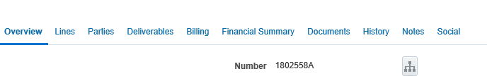


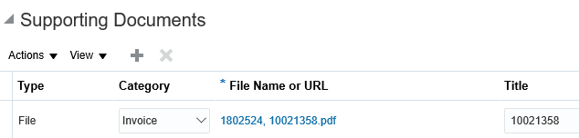
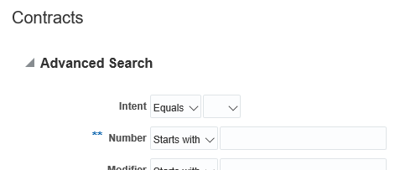
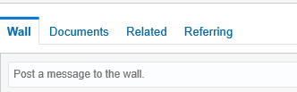
Where are the Documents?
1
5
2
6
Find Checks, FFR’s Invoices, relinquishing, refunds
3
7
4
This will be your award setup emails
Click on your returned Hyperlink

Slide 46
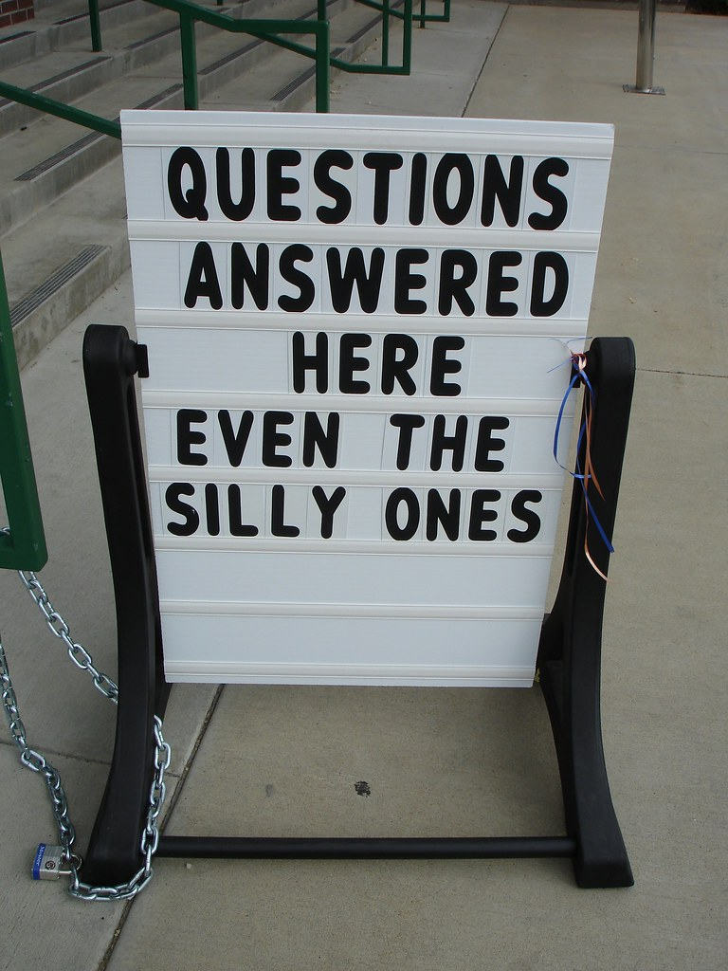

Slide 47
Some Tidbits
Combining the NSF Survey for 2019 with UMCP – why?
NIH Regional Meeting
  April 20-22, 2020
  Email forthcoming for volunteers
  research faculty, administrators, and students who volunteer on one day, can attend the 2cd day at a discounted rate of $100

Slide 48


QUANTUM QUESTIONS
https://www.umaryland.edu/quantum/quantum-bytes-publications/

Slide 49
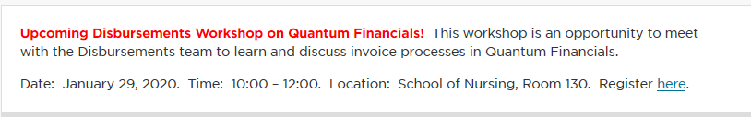
QUANTUM QUESTIONS
Disbursement Meetings Next Week
By Financial Services
Talk about
  Non PO Invoices
  Debit Memos
  Cost Transfers
https://www.umaryland.edu/financialservices/disbursements/

