Slide 1
Core Values Townhall
Dr. Judy L. Postmus
Dean & Professor, School of Social Work
Dr. Roger J. Ward
Provost & EVP (Interim)
Dean, Graduate School
Co-Chairs, Strategic Planning Steering Committee

Slide 2
Overview
Goal: Adopt UMB’s FY22 – FY26 Strategic Plan by June 30, 2021
23 Steering Committee (SC) Members – Meets every 3 weeks
11 Logistics Team (LT) Members – Meets weekly

Slide 3
Steering Committee
Roger Ward, Co-Chair Judy Postmus, Co-Chair
Joshua Abzug – Faculty Senate
Bimbola Akintade – Nursing
Peter Danchin – Carey Law
Christina Fenwick – Staff Senate
Nivedita Hegdekar – USGA
Laura Kozak – External Relations
Jon Kucskar – President’s Office
Lisa Lebovitz – Pharmacy
Flavius Lilly – Graduate School
Mark Macek – Dentistry
John McKee – Philanthropy
Peter Murray – CITS
Dennis Paffrath – ORD
Donna Parker – Medicine
Dawn Rhodes – A&F
Terry Rogers – Medicine
Wendy Shaia – Social Work
Emily Smith – GSA
Stephanie Suerth – Compliance
M.J. Tooey – HSHSL
Ashley Valis – Community Engagement

Slide 4
Logistics Committee
Roger Ward, Co-Chair Judy Postmus, Co-Chair
Cherita Adams
Danielle Brown
Michael Brown
Nazanin Fouladi
Laura Kozak
Jon Kucskar
Karen Matthews
Tricia O’Neill
Greg Spengler

Slide 5
Strategic Planning Timeline
January – March
Review Core Values
Develop strategic plan themes and high-level strategic outcomes informed by:
Mission, Vision, Core Values
President’s goals; USM goals; current strategic planning goals, MHEC, Other (?) …
Involves deans, VPs, shared governance councils, others (?)
April – May
University-wide feedback/input sessions on themes and outcomes
Revise and refine themes and outcomes
Draft plan
Mid-May – June
Finalize and adopt plan
Design implementation plan

Slide 6
What are Core Values?
Core values are our guiding principles and value statements.
Core values guide our strategic direction, mission, and self-conception.
Core values are our essential and enduring tenets that ought not be compromised, ever.
Core values are relatively durable over time and function as anchors in times of uncertainty.
Core values speak to who we are as a community and what we stand for.

Slide 7
Current Core Values
ACCOUNTABILITY
The University is committed to be responsible and transparent in all areas.
CIVILITY
Professional, ethical, respectful and courteous interactions are the expectation.
COLLABORATION
Teamwork fosters insightful and excellent solutions and advancement.
DIVERSITY
The University is committed to a culture that is enriched by diversity and inclusion, in the broadest sense, in its thoughts, actions and leadership.
EXCELLENCE
The University is guided by a constant pursuit of excellence.
KNOWLEDGE
The University’s industry is to create, disseminate and apply knowledge.
LEADERSHIP
The University continuously strives to be a leader and to develop leaders.

Slide 8
Core Values Evolution
Civility/Accountability Respect and Integrity
Leadership Well-Being and Sustainability
Diversity Equity and Justice
Excellence/Knowledge/Collaboration Innovation and Discovery

Slide 9
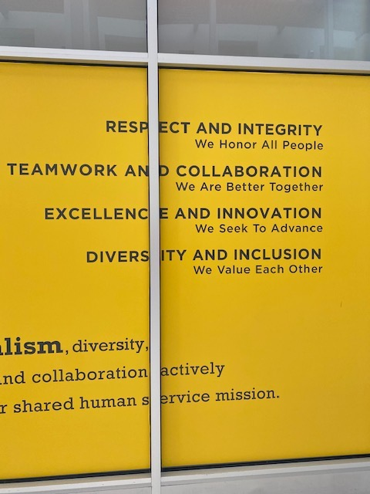
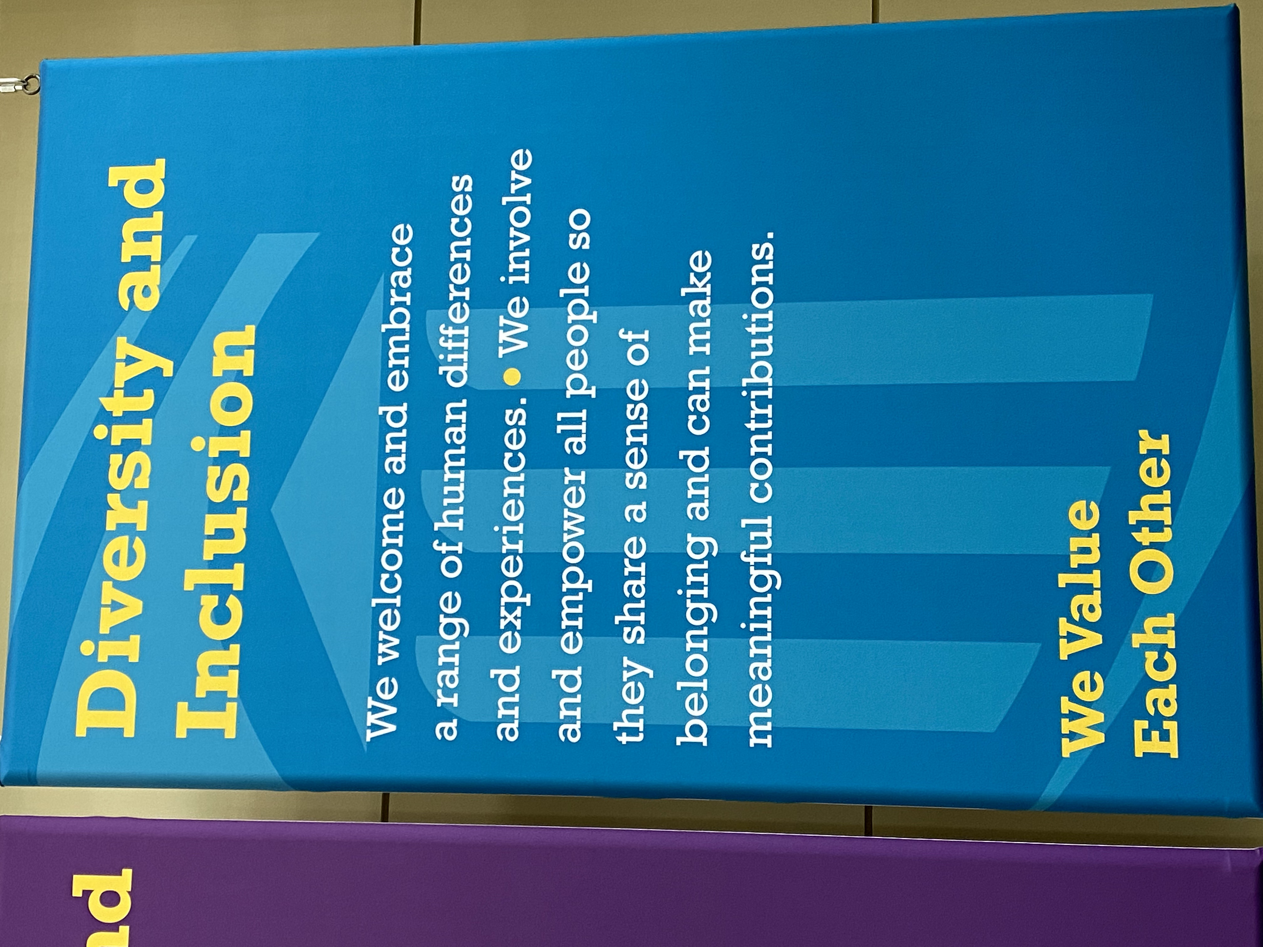
Proposed Values Format (UMMC Model)

Slide 10


RESPECT and INTEGRITY
Civility/Accountability
WHAT IT MEANS
We value each other and hold ourselves accountable
for acting ethically and transparently.
SYNONYMS/IDEAS TO CAPTURE IN THE FULLER NARRATIVE
Civility | Accountability | Transparency | Ethics

Slide 11

Leadership
WELL-BEING and SUSTAINABILITY
WHAT IT MEANS
We care about the welfare our people, planet,
communities, and university.
SYNONYMS/IDEAS TO CAPTURE IN THE FULLER NARRATIVE
Work & Academic Life Balance | Environmentally Friendly
Responsible Stewardship of Resources| Family Friendly| Mindfulness

Slide 12

Diversity
EQUITY and JUSTICE
WHAT IT MEANS
We embrace diversity and value inclusive and
just communities.
SYNONYMS/IDEAS TO CAPTURE IN THE FULLER NARRATIVE
Diversity | Inclusion | Social Justice

Slide 13

INNOVATION and DISCOVERY
Excellence/Knowledge/Collaboration
WHAT IT MEANS
We imagine new and improved ways to get things done.
SYNONYMS/IDEAS TO CAPTURE IN THE FULLER NARRATIVE
Creativity | Discovery | Agility | Novel Thinking | Teamwork | Partnership

Slide 14
Next Steps
  Community & Stakeholder feedback
  Leadership update and input
  Review/reconcile draft values
  Review/reconcile draft themes

Slide 15
The End
Go in Peace and Spread Love

